Slide 1
Data Models
A data model is the model through which we perceive and manipulate our data. For people using a database, the data model describes how we interact with the data in the database.

Slide 2
Relationships
Aggregates are useful in that they put together data that is commonly accessed together.
Consider the relationship between a customer and all of his orders.
single aggregate : Some applications will want to access the order history whenever they access the customer .
Link tables with IDs such as customer ID and Order ID.
Aggregate-oriented databases treat the aggregate as the unit of data-retrieval.
Atomicity is only supported within the contents of a single aggregate.
Multiple aggregates at once, leads to failure.

Slide 3
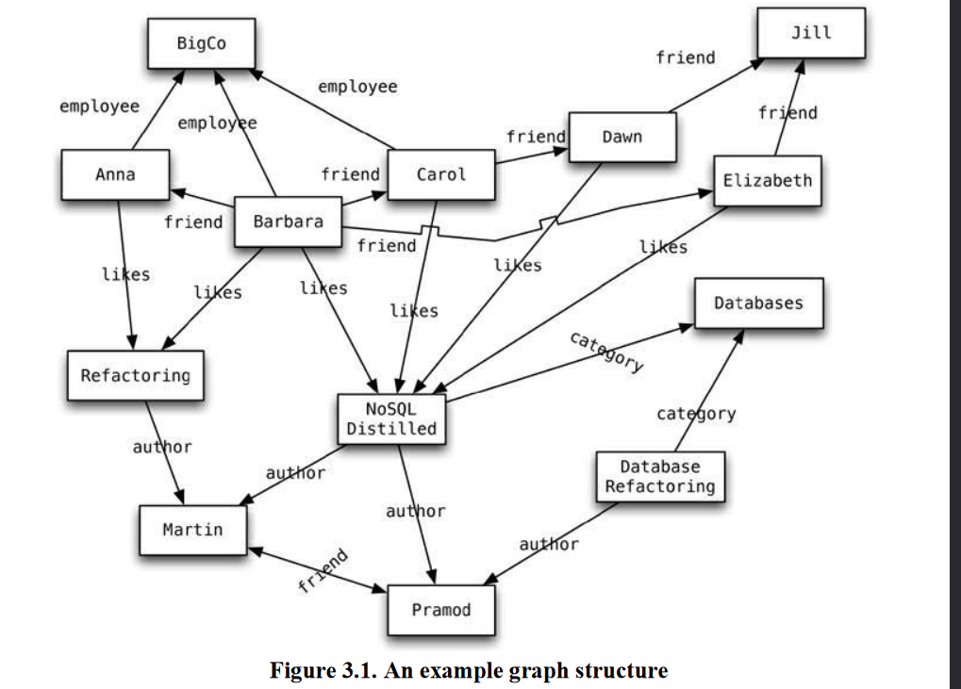
Graph Databases
Graph databases are an odd fish in the NoSQL pond.
Graph databases are motivated by a different frustration with relational databases and thus have an opposite model—small records with complex interconnections, something like

Slide 4
Graph Databases
It uses nodes, edges, and properties instead of tables or documents to represent and store data.
The edges represent relationships between the nodes.
This helps in retrieving data more easily and, in many cases, with one operation.
Relational databases can implement relationships using foreign keys, the joins required to navigate around can get quite expensive—which means performance is often poor for highly connected data models.
Graph databases make traversal along the relationships very cheap.

Slide 5
Schemaless Databases
A type of NoSQL database that do not require a predefined schema to store data
A key-value store allows you to store any data you like under a key.
A document database effectively does the same thing, since it makes no restrictions on the structure of the documents you store.
Column-family databases allow you to store any data under any column you like.
Graph databases allow you to freely add new edges and freely add properties to nodes and edges as you wish.
Freedom and flexibility.
This allows you to easily change your data storage as you learn more about your project.

Slide 6
Schemaless Databases
Nonuniform Data: data where each record has a different set of fields.
A schema puts all rows of a table into a straightjacket, which becomes awkward if you have different kinds of data in different rows.
Sometimes there are meaningless columns like custom columns.
Schemalessness is appealing, and it certainly avoids many problems that exist with fixed-schema databases, but it brings some problems of its own.
Added data like billingAddress and not addressForBilling or quantify not 5 or five. So it can not be readable by programs.
Programs are not humans; they cannot read “qty” and infer that that must be the same as “quantity”—at least not unless we specifically program them to do so.
Implicit schema is a set of assumptions about the data’s structure in the code that manipulates the data.

Slide 7
Materialized Views
Materialized Views are views that are computed in advance and cached on disk.
Materialized view is also a logical virtual table, but in this case the result of the query is stored in the table or the disk.
The performance of the materialized view is better than normal view since the data is stored in the disk.
Although NoSQL databases don’t have views, they may have precomputed and cached queries, and they reuse the term “materialized view” to describe them.
Materialized views can be used within the same aggregate

Slide 8
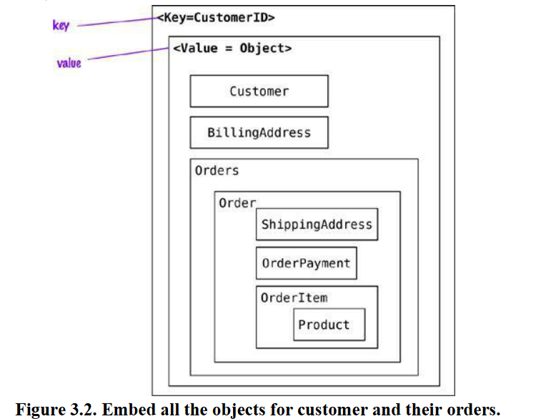
Modeling for Data Access

Slide 9
Modeling for Data Access
In this scenario, the application can read the customer’s information and all the related data by using the key.
If the requirements are to read the orders or the products sold in each order, the whole object has to be read and then parsed on the client side to build the results.

Slide 10
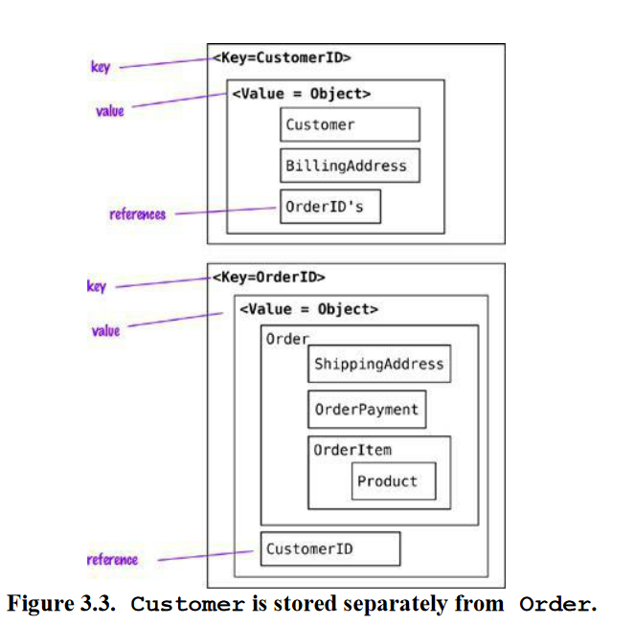
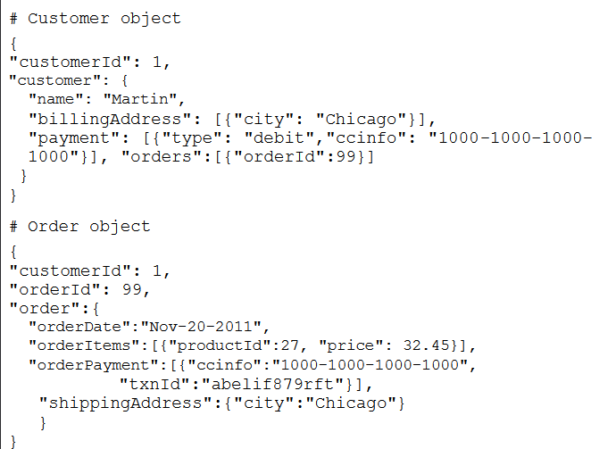

Slide 11
Modeling for Data Access
Aggregates can also be used to obtain analytic.
aggregate update may fill in information on which Orders have a given Product in them.
{ "itemid":27, "orders":{99,545,897,678} } { "itemid":29, "orders":{199,545,704,819} }
In document stores, since we can query inside documents, removing references to Orders from the Customer object is possible.
This change allows us to not update the Customer object when new orders are placed by the Customer.

Slide 12
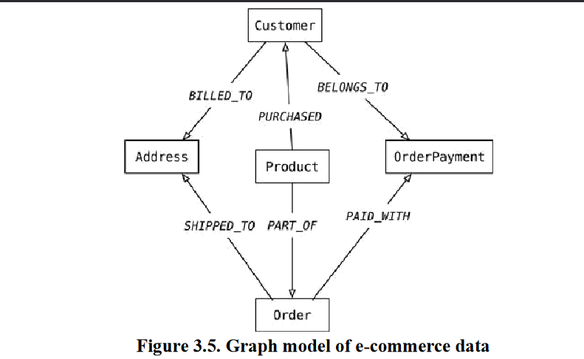
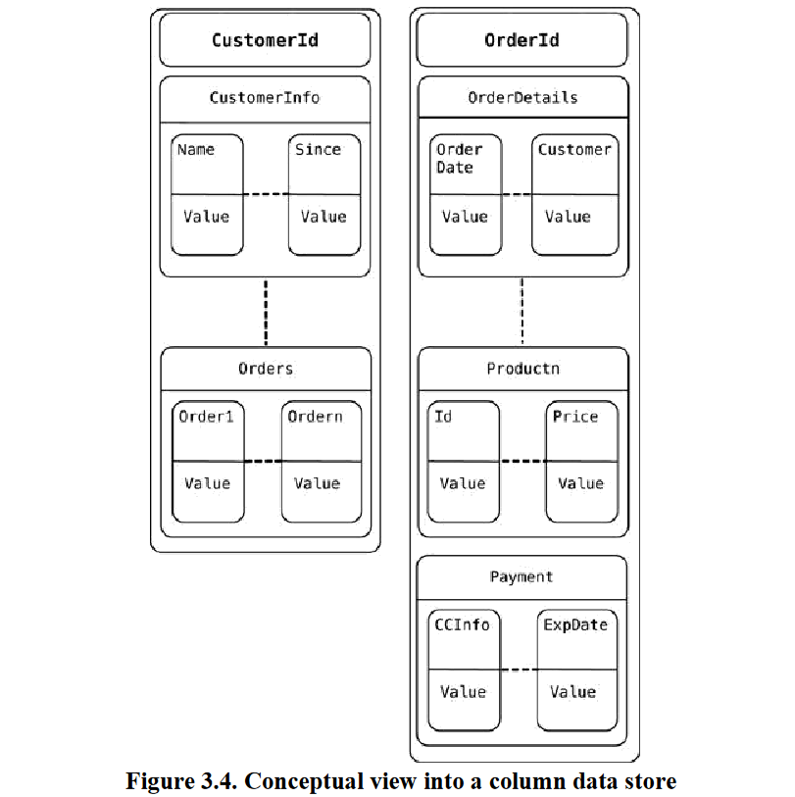
Column Family

