Slide 1
Distribution Models

Slide 2
Distribution Models
Single Server
Sharding
Master-Slave Replication
Peer-to-Peer Replication
Combining Sharding and Replication

Slide 3
Single Server
Run the database on a single machine that handles all the reads and writes to the data store.
It eliminates all the complexities.
It’s easy for operations people to manage and easy for application developers to reason about.
Graph databases best use in this.

Slide 4
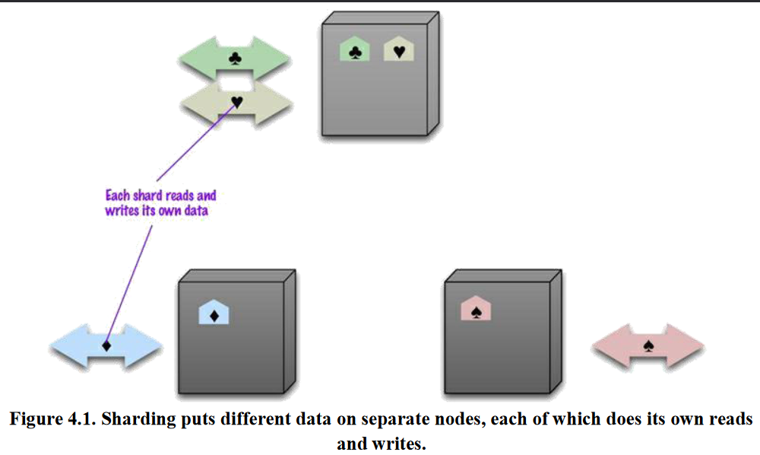
Sharding
A busy data store is busy because different people are accessing different parts of the dataset.
In these case we can support horizontal scalability by putting different parts of the data onto different servers—a technique that’s called sharding.

Slide 5
Sharding
Gets rapid responses from that server.
Vertical scaling
  By simply upgrading your machine, you can scale vertically without the complexity of sharding. Adding RAM, upgrading your computer (CPU), or increasing the storage available to your database are simple solutions that do not require you to change the design of either your database architecture or your application.
Specialized services or databases
  Depending on your use case, it may make more sense to simply shift a subset of the burden onto other providers or even a separate database. For example, file storage can be moved directly to a cloud provider such as Amazon S3. Analytics or full-text search can be handled by specialized services or a data warehouse.
Replication
  If your data workload is primarily read-focused, replication increases availability and read performance while avoiding some of the complexity of database sharding. By simply spinning up additional copies of the database, read performance can be increased either through load balancing or through geo-located query routing.

Slide 6
Advantages
Disadvantages
Increased read/write throughput
Increased storage capacity
High availability
Query overhead
Complexity of administration
Increased infrastructure costs
Auto-sharding, where the database takes on the responsibility of allocating data to shards and ensuring that data access goes to the right shard.

Slide 7
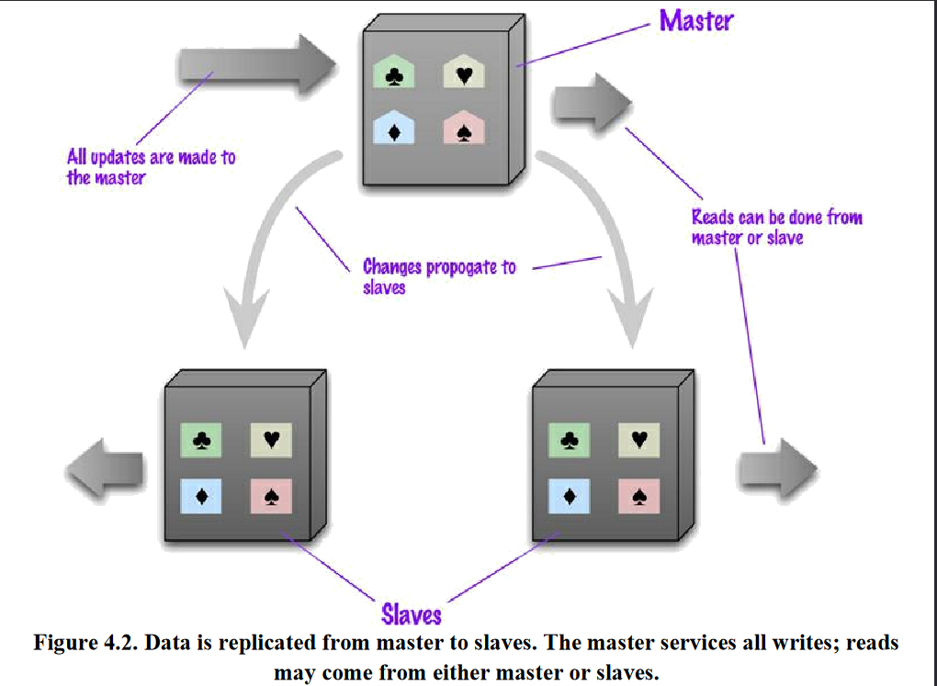
Master-Slave Replication
you replicate data across multiple nodes.
One node is designated as the master, or primary. This master is the authoritative source for the data and is usually responsible for processing any updates to that data.
The other nodes are slaves, or secondaries. A replication process synchronizes the slaves with the master

Slide 8
Master-Slave Replication
Master
  is the authoritative source for the data
  is responsible for processing any updates to that data
  can be appointed manually or automatically
Slaves
  A replication process synchronizes the slaves with the master
  After a failure of the master, a slave can be appointed as new master very quickly

Slide 9
Pros and cons of Master-Slave Replication
Pros
  More read requests:
    Add more slave nodes
    Ensure that all read requests are routed to the slaves
  Should the master fail, the slaves can still handle read requests
  Good for datasets with a read-intensive dataset
Cons
  The master is a bottleneck
  Limited by its ability to process updates and to pass those updates on
  Its failure does eliminate the ability to handle writes until:
    the master is restored or
    a new master is appointed
  Inconsistency due to slow propagation of changes to the slaves
  Bad for datasets with heavy write traffic

Slide 10
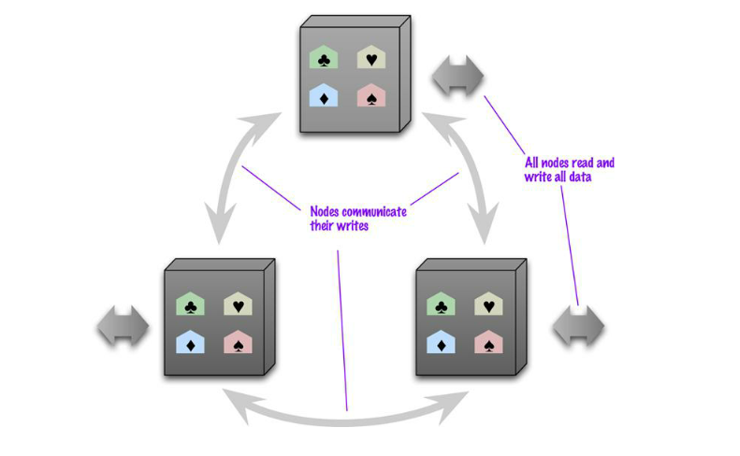
Peer-to-Peer Replication
All the replicas have equal weight, they can all accept writes
The loss of any of them doesn’t prevent access to the data store

Slide 11
Pros and cons of peer-to-peer replication
Pros:
  you can ride over node failures without losing access to data
  you can easily add nodes to improve your performance
Cons:
  Inconsistency!
    Slow propagation of changes to copies on different nodes
      Inconsistencies on read lead to problems but are relatively transient
    Two people can update different copies of the same record stored on different nodes at the same time - a write-write conflict.
      Inconsistent writes are forever

Slide 12
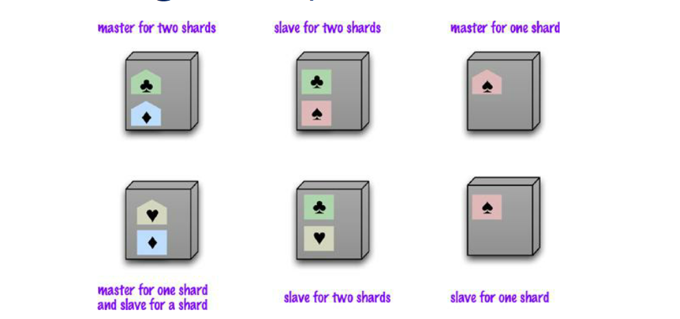
Combining Sharding and Replication
We have multiple masters, but each data only has a single master.
Two schemes:
  A node can be a master for some data and slaves for others
  Nodes are dedicated for master or slave duties

Slide 13
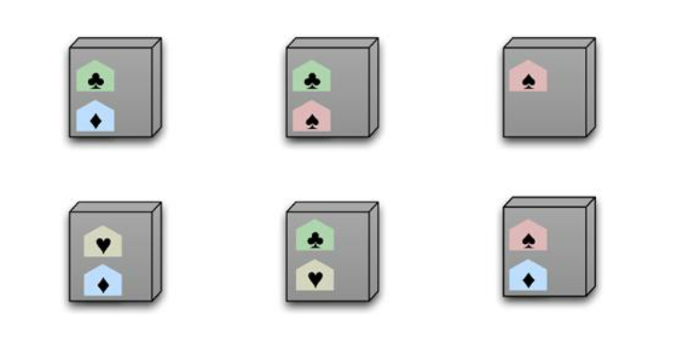
Sharding and Replication on P2P
Usually each shard is present on three nodes
A common strategy for column-family databases

