Slide 1
Consistency

Slide 2
Consistency
Biggest change from a centralized relational database to a cluster-oriented NoSQL
Relational databases: strong consistency
NoSQL systems: mostly eventual consistency

Slide 3
Consistency
Update Consistency
Read Consistency
Relaxing Consistency
The CAP Theorem
Relaxing Durability
Quorums

Slide 4
Update Consistency
Write-write conflict
Two people updating the same data item at the same time
If the server serialize them: one is applied and immediately overwritten by the other (lost update)
Pessimistic Approach:
It works by preventing conflicts from occurring;
Optimistic Approach:
lets conflicts occur, but detects them and takes action to sort them out.
Conditional update:
Any client that does an update tests the value just before updating it to see if it’s changed since his last read

Slide 5
Pessimistic Approach:
A pessimistic approach works by preventing conflicts from occurring; an optimistic approach lets conflicts occur, but detects them and takes action to sort them out.
For update conflicts, the most common pessimistic approach is to have write locks, so that in order to change a value you need to acquire a lock, and the system ensures that only one client can get a lock at a time.
So Martin and Pramod would both attempt to acquire the write lock, but only Martin (the first one) would succeed. Pramod would then see the result of Martin’s write before deciding whether to make his own update.

Slide 6
Conditional update:
A common optimistic approach is a conditional update where any client that does an update tests the value just before updating it to see if it’s changed since his last read.
In this case, Martin’s update would succeed but Pramod’s would fail.
The error would let Pramod know that he should look at the value again and decide whether to attempt a further update.

Slide 7
Optimistic Approach:
There is another optimistic way to handle a write-write conflict—save both updates and record that they are in conflict.
This approach is familiar to many programmers from version control systems, particularly distributed version control systems that by their nature will often have conflicting commits.
The next step again follows from version control: You have to merge the two updates somehow.
Maybe you show both values to the user and ask them to sort it out—this is what happens if you update the same contact on your phone and your computer
Alternatively, the computer may be able to perform the merge itself; if it was a phone formatting issue, it may be able to realize that and apply the new number with the standard format.

Slide 8
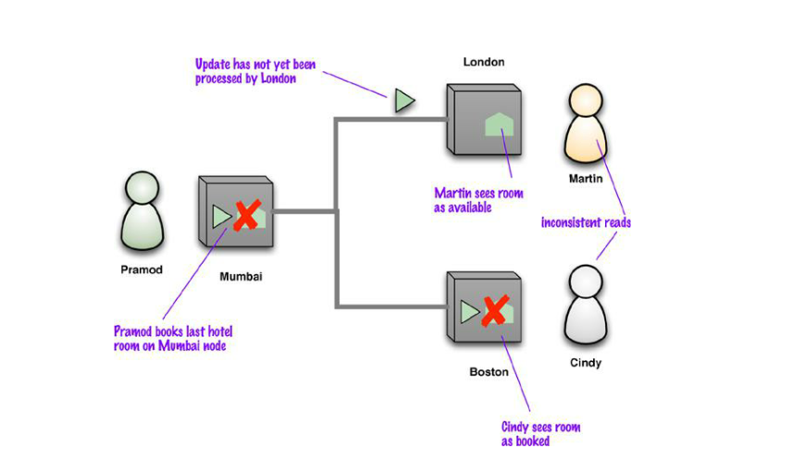
Read Consistency
Replication is a source of inconsistency

Slide 9
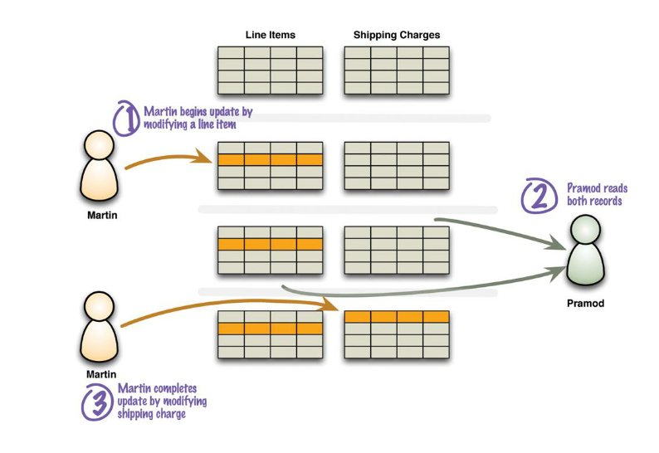
Read-write conflict
A read in the middle of two logically-related writes.
ensuring that different data items make sense together.
To avoid a logically inconsistent read-write conflict, relational databases support the notion of transactions.
Providing Martin wraps his two writes in a transaction, the system guarantees that Pramod will either read both data items before the update or both after the update.

Slide 10
Solutions
Pessimistic approach
Prevent conflicts from occurring
Usually implemented with write locks managed by the system
Optimistic approach
Lets conflicts occur, but detects them and takes action to sort them out
Approaches (for write-write conflicts):
conditional updates: test the value just before updating
save both updates: record that they are in conflict and then merge them

Slide 11
Pessimistic vs optimistic approach
Concurrency involves a fundamental tradeoff between:
consistency (avoiding errors such as update conflicts) and
availability (responding quickly to clients).
Pessimistic approaches often:
severely degrade the responsiveness of a system
leads to deadlocks, which are hard to prevent and debug

Slide 12
Forms of consistency
Strong (or immediate) consistency
ACID(atomicity, consistency, isolation, and durability) transaction
Logical consistency
No read-write conflicts (atomic transactions)
Sequential consistency
Updates are serialized
Session (or read-your-writes) consistency
Within a user’s session
Eventual consistency
You may have replication inconsistencies but eventually all nodes will be updated to the same value

Slide 13
Relaxing Consistency
Consistency is a Good Thing—but, sadly, sometimes we have to sacrifice it. It is always possible to design a system to avoid inconsistencies, but often impossible to do so without making unbearable sacrifices in other characteristics of the system.
As a result, we often have to tradeoff consistency for something else.
While some architects see this as a disaster, we see it as part of the inevitable tradeoffs involved in system design.
Furthermore, different domains have different tolerances for inconsistency, and we need to take this tolerance into account as we make our decisions.
Trading off consistency is a familiar concept even in single-server relational database systems.

Slide 14
The CAP Theorem
Why you may need to relax consistency
Proposed by Eric Brewer in 2000
Formal proof by Seth Gilbert and Nancy Lynch in 2002
“Given the properties of Consistency, Availability, and Partition tolerance, you can only get two”

Slide 15
The CAP Theorem
Consistency is pretty much as we’ve defined it so far.
Availability has a particular meaning in the context of CAP—it means that if you can talk to a node in the cluster, it can read and write data.
That’s subtly different from the usual meaning, which we’ll explore later.
Partition tolerance means that the cluster can survive communication breakages in the cluster that separate the cluster into multiple partitions unable to communicate with each other

Slide 16
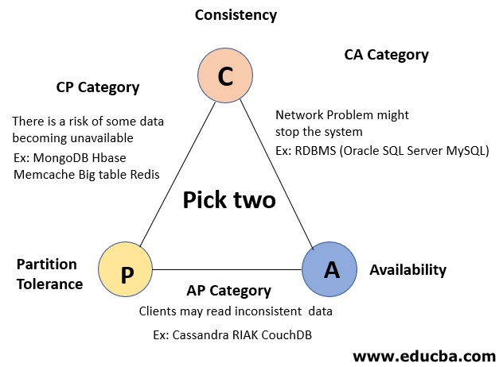
The CAP Theorem
Consistency: all people see the same data at the same time
Availability: Every request receives a response – without guarantee that it contains the most recent write
Partition tolerance: The system continues to operate despite communication breakages that separate the cluster into partitions unable to communicate with each other

Slide 18
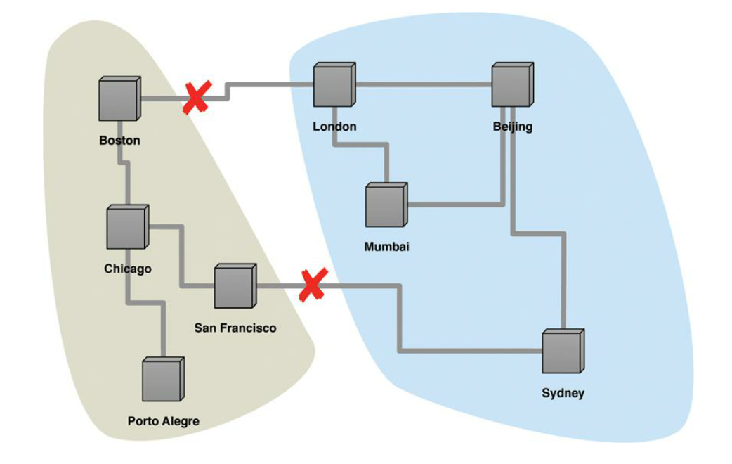
Network partition
With two breaks in the communication lines, the network partitions into two groups.

Slide 19
A single-server system is the obvious example of a CA system—a system that has Consistency and Availability but not Partition tolerance.
A single machine can’t partition, so it does not have to worry about partition tolerance.
There’s only one node—so if it’s up, it’s available.
Being up and keeping consistency is reasonable.
This is the world that most relational database systems live in

Slide 20

An example
Anna is trying to book a room of the Ace Hotel in New York on a node located in London of a booking system
Peter is trying to do the same on a node located in Mumbai
The booking system uses a peer-to-peer distribution
There is only a room available
The network link breaks.
then neither system can book any hotel room, sacrificing availability.

Slide 21
Possible solutions
CA: Neither user can book any hotel room
CP: Designate Mumbai node as the master for Ace hotel
Peter can make the reservation
Ann can see the inconsistent room information
Ann cannot book the room
AP: both nodes accept the hotel reservation
Overbooking!
These situations are closely tied to the domain
Financial exchanges? Blogs? Shopping charts?
Issues:
how tolerant you are of stale reads
how long the inconsistency window can be
Common approach:
BASE (Basically Available, Soft state, Eventual consistency)

Slide 22
Possible solutions
CA: Neither user can book any hotel room
CP: Designate Mumbai node as the master for Ace hotel
Peter can make the reservation
Ann can see the inconsistent room information
Ann cannot book the room
AP: both nodes accept the hotel reservation
Overbooking!

Slide 23
The classic example of allowing inconsistent writes is the shopping cart.
In this case you are always allowed to write to your shopping cart, even if network failures mean you end up with multiple shopping carts.
The checkout process can merge the two shopping carts of the items from the carts into a single cart and returning that.
Almost always that’s the correct answer—but if not, the user gets the opportunity to look at the cart before completing the order.

Slide 24
CA vs AP systems
A single-server system is the obvious example of a CA system
Traditional RDBMS
CA cluster: if a partition occurs, all the nodes would go down
Data center (rare and partial partitions)
Availability in CAP: every request received by a non-failing node in the system must result in a response (a failed, unresponsive node doesn’t infer a lack of availability)
A system that suffer partitions:
Distributed cluster
Tradeoff between consistency VS availability
Give up to some consistency to get some availability
AP is usually the preferred choice since AC is less responsive

Slide 25
Relaxing Durability
By relaxing consistency, distributed systems can be highly available and durable.
It’s possible for data to be inconsistent; a query might return old or stale data.
Over time, data that is spread across storage nodes will replicate and become consistent.
What makes this behavior acceptable is that developers can anticipate this eventual consistency and allow for it.
You may want to trade off durability for higher performance
Main memory database: if the server crashes, any updates since the last flush will be lost.
Another example of relaxing durability is capturing telemetric data from physical devices. (sensor data)
It may be that you’d rather capture data at a faster rate, at the cost of missing the last updates should the server go down.

Slide 26
Replication durability
Replication durability: occurs when a master processes an update but fails before that update is replicated to the other nodes.
A simple case of this may happen if you have a master-slave distribution model where the slaves appoint a new master automatically should the existing master fail.
If a master does fail, any writes not passed onto the replicas will effectively become lost.
Should the master come back online, those updates will conflict with updates that have happened since.
We think of this as a durability problem because you think your update has succeeded since the master acknowledged it, but a master node failure caused it to be lost.

Slide 27
Quorums
When you’re trading off consistency or durability, it’s not an all or nothing proposition. (distribution, transactions, latency, scale, flexibility)
Quorum consistency is consistency in Cassandra for high mechanism and to ensure that how many nodes will respond when we will define the read and write consistency in Cassandra.
The more nodes you involve in a request, the higher is the chance of avoiding an inconsistency.
This naturally leads to the question: How many nodes need to be involved to get strong consistency?

Slide 28
Practical approach: Quorums
Problem: how many nodes you need to contact to be sure you have the most up-to-date change?
N: replication factor, W: n. of confirmed writes, R: n. of reads that guarantees a correct answer
Read quorum: R + W > N
Write quorum: W > N/2
How many nodes need to be involved to get consistency?
Strong consistency: W = N
Eventual consistency: W < N
In a master-slave distribution one W and one R (to the master!) is enough
A replication factor of 3 is usually enough to have good resilience

