Slide 1
Chapter – 7 Map Reduce

Slide 2

Introduction
The rise of aggregate-oriented databases is in large part due to the growth of clusters. Running on a cluster means you have to make your trade-offs in data storage differently than when running on a single machine.
If you store lots of data on a cluster, processing that data efficiently means you have to think differently about how you organize your processing.
With a centralized database, there are generally two ways you can run the processing logic against it: either on the database server itself or on a client machine.
When you have a cluster, there is good news immediately—you have lots of machines to spread the computation over.

Slide 3
Introduction
The map-reduce pattern is a way to organize processing in such a way as to take advantage of multiple machines on a cluster while keeping as much processing and the data it needs together on the same machine.

Slide 4
Basic Map-Reduce
To explain the basic idea, we’ll start from an example—that of customers and orders. Let’s assume we have chosen orders as our aggregate, with each order having line items. Each line item has a product ID, quantity, and the price charged. This aggregate makes a lot of sense as usually people want to see the whole order in one access. We have lots of orders, so we’ve sharded the dataset over many machines.
However, sales analysis people want to see a product and its total revenue for the last seven days. In order to get the product revenue report, you’ll have to visit every machine in the cluster and examine many records on each machine.
This is exactly the kind of situation that calls for map-reduce.

Slide 5
Basic Map-Reduce
The first stage in a map-reduce job is the map. A map is a function whose input is a single aggregate and whose output is a bunch of key-value pairs. In this case, the input would be an order. The output would be key-value pairs corresponding to the line items. Each one would have the product ID as the key and an embedded map with the quantity and price as the values

Slide 6
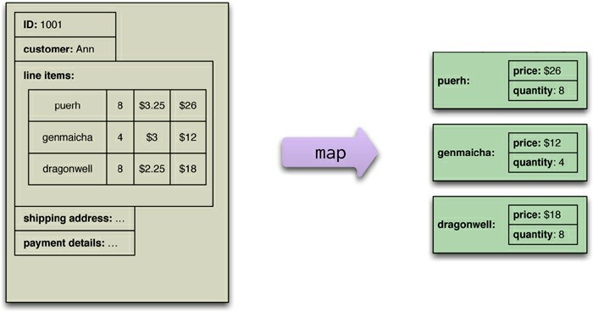
Basic Map-Reduce
map function reads records from the database and emits key-value pairs.

Slide 7
Basic Map-Reduce
A map operation only operates on a single record; the reduce function takes multiple map outputs with the same key and combines their values.
So, a map function might yield 1000 line items from orders for “Database Refactoring”; the reduce function would reduce down to one, with the totals for the quantity and revenue. While the map function is limited to working only on data from a single aggregate, the reduce function can use all values emitted for a single key.

Slide 8
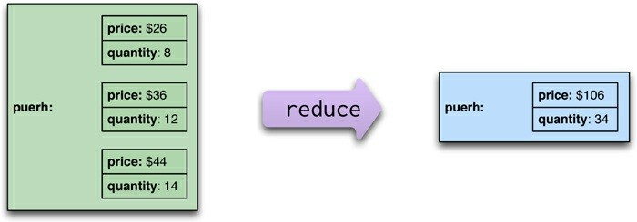
Basic Map-Reduce
A reduce function takes several key-value pairs with the same key and aggregates them into one.

Slide 9
Basic Map-Reduce
The map-reduce framework arranges for map tasks to be run on the correct nodes to process all the documents and for data to be moved to the reduce function.
To make it easier to write the reduce function, the framework collects all the values for a single pair and calls the reduce function once with the key and the collection of all the values for that key.

Slide 10
Partitioning and Combining
We think of a map-reduce job as having a single reduce function.
The outputs from all the map tasks running on the various nodes are concatenated together and sent into the reduce.
There are things we can do to increase the parallelism and to reduce the data transfer.

Slide 11
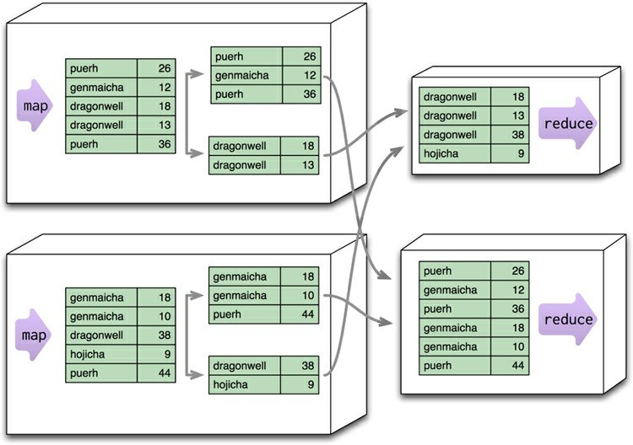
Partitioning and Combining
Partitioning allows reduce functions to run in parallel on different keys

Slide 12
Partitioning and Combining
The first thing we can do is increase parallelism is: Partitioning the output of the mappers. Each reduce function operates on the results of a single key. This is a limitation but it’s also a benefit in that it allows you to run multiple reducers in parallel.
The results of the mapper are divided up based the key on each processing node.
Multiple keys are grouped together into partitions.
The framework takes the data from all the nodes for one partition, combines it into a single group for that partition, and sends it off to a reducer.

Slide 13
Partitioning and Combining
Multiple reducers can then operate on the partitions in parallel, with the final results merged together.
This step is also called “shuffling,” and the partitions are sometimes referred to as “buckets” or “regions.”
The next problem we can deal with is the amount of data being moved from node to node between the map and reduce stages.
Much of this data is repetitive, consisting of multiple key-value pairs for the same key.
A combiner function cuts this data down by combining all the data for the same key into a single value. A combiner function is, in essence, a reducer function—indeed, in many cases the same function can be used for combining as the final reduction.

Slide 14
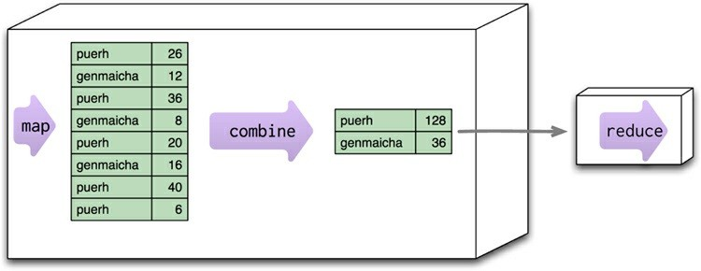
Partitioning and Combining
We call such a function a combinable reducer.
Combining reduces data before sending it across the network.

Slide 15
Partitioning and Combining
Not all reduce functions are combinable. Consider a function that counts the number of unique customers for a particular product.
The map function for such an operation would need to emit the product and the customer. The reducer can then combine them and count how many times each customer appears for a particular product, emitting the product and the count.

Slide 16
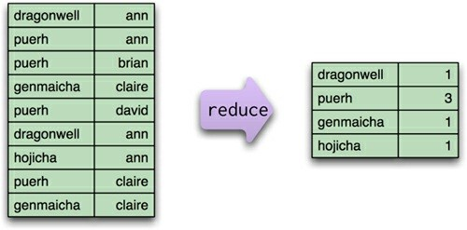
Partitioning and Combining
This reduce function, which counts how many unique customers order a particular tea, is not combinable.

Slide 17
Partitioning and Combining
When you have combining reducers, the map-reduce framework can safely run not only in parallel (to reduce different partitions), but also in series to reduce the same partition at different times and places.

Slide 18
Composing Map-Reduce Calculations
The map-reduce approach is an approach for parallelizing the computation over a cluster.
There are constraints on what you can do in your calculations:
Within a map task, you can only operate on a single aggregate.
Within a reduce task, you can only operate on a single key.
One simple limitation is that you have to structure your calculations around operations that fit in well with the notion of a reduce operation. A good example of this is calculating averages.

Slide 19
Composing Map-Reduce Calculations
Let’s consider the kind of orders we’ve been looking at so far; suppose we want to know the average ordered quantity of each product.
An important property of averages is that they are not composable — that is, if I take two groups of orders,
Instead, I need to take total amount and the count of orders from each group, combine those, and then calculate the average from the combined sum and count

Slide 20
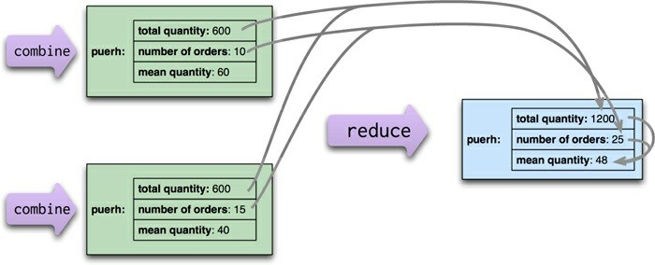
Composing Map-Reduce Calculations
When calculating averages, the sum and count can be combined in the reduce calculation, but the average must be calculated from the combined sum and count.

Slide 21
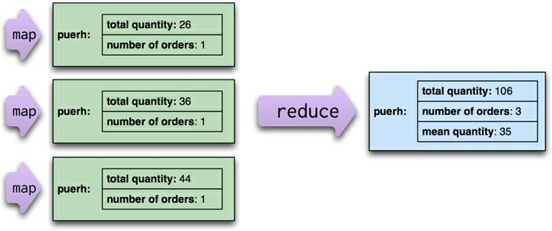
Composing Map-Reduce Calculations

Slide 22
A Two Stage Map-Reduce Example
As map-reduce calculations get more complex, it’s useful to break them down into stages using a pipes-and-filters approach, with the output of one stage serving as input to the next, rather like the pipelines in UNIX.
Consider an example where we want to compare the sales of products for each month in 2011 to the prior year.
To do this, we’ll break the calculations down into two stages:
Stage1: Produce records showing the aggregate figures for a single product in a single month of the year.
Stage2: Uses the stage1 output as inputs and produces the result for a single product by comparing one month’s results with the same month in the prior year.

Slide 23
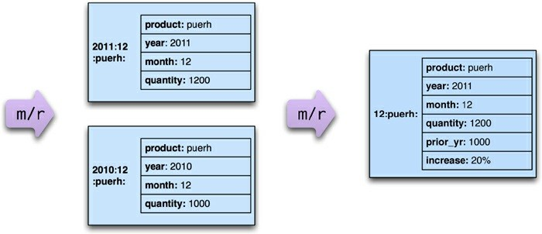
A Two Stage Map-Reduce Example
A calculation broken down into two map-reduce steps, which will be expanded further

Slide 24
Incremental Map-Reduce
We’ve discussed so far are complete map-reduce computations, where we start with raw inputs and create a final output.
Many map-reduce computations take a while to perform, even with clustered hardware, and new data keeps coming in which means we need to rerun the computation to keep the output up to date.
Starting from scratch each time can take too long, so often it’s useful to structure a map-reduce computation to allow incremental updates, so that only the minimum computation needs to be done.
The map stages of a map-reduce are easy to handle incrementally—only if the input data changes does the mapper need to be rerun.

Slide 25

THANK YOU

