Slide 1


Slide 2
HTTP
HyperText Transfer Protocol
  Stateless request/response client-server protocol
Requests:
  Method: GET, POST, HEAD, TRACE, OPTIONS, PUT, DELETE

Slide 3
HTTP
Requests, continued
  URI (required in HTTP/1.1)
  Header Fields
    E.g. how the response should be returned, under what conditions, identification and characterization of client, accounting data
  Body
    POST data
    Empty for GET

Slide 4
HTTP
Response:
  Status code (machine), reason (human)
  Header
    Metadata, e.g. Content-Type (Media type), Content-Length, Last-Modified, Etag
  Body
    (X)HTML, other XML, text, binary data …

Slide 5
URL Connections
java.net also -- connections extend Socket
Encapsulates HTTP and FTP connections
  URI, URL, URLConnection, HttpURLConnection

Slide 6
Servlets Definition
Server side component in a client server model (now the browser is the client )
Reside in a servlet container, assigned to a certain URL pattern.
Provide mechanisms for maintaining state over the stateless HTTP protocol

Slide 7
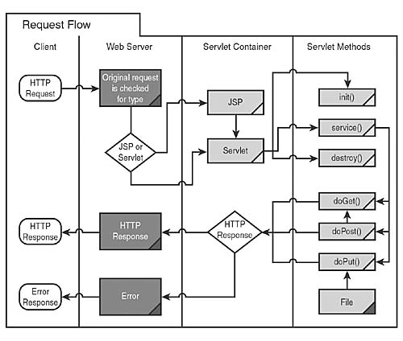
Servlet Model

Slide 8
Servlet API
Interfaces:
  HttpServletRequest
  HttpServletResponse
  HttpSession
  HttpBindingSession
  HttpSessionContext
Interfaces are implemented by server providers and can be used out of the box

Slide 9
Servlet API
Classes
  Cookie
  HttpServlet
  HttpSessionBindingEvent
  HttpUtils

Slide 10
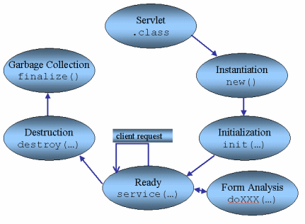
Servlet Lifecycle

Slide 11
Servlet Lifecycle
Multithreaded access (usually default)
init called first time only (by the container)
zero to many calls to service
destroy called

Slide 12
init (ServletConfig)
call super.init (config), or just use init ()
Called once
  Prior to any call to service
  Don’t worry about multithreading issues here
Sometimes used to get resources needed for the lifetime of the servlet

Slide 13
service (req, resp)
Not usually overridden
  Default impl. determines what request handler to call (based on HTTP request type), calls it
  Service method will call doGet, doPost, doPut, etc. based on service type.
  Default implementations provided for doHead, doTrace, doOptions

Slide 14
doPost, doGet, etc.
doPost (HttpServletRequest req, HttpServletResponse resp)
  Implement this to handle POSTs
  Read from req, build resp
Multithreaded access by default (depending on server config)
  Beware instance variables, shared data
  config and context are shared, session is usually safe, req/resp are not
  Use locks and/or synchronized data structures if shared data is an issue

Slide 15
destroy ()
called once
  Servlet timeout, servlet reload, container shutdown
  Other threads may still be processing service requests, no further requests will be processed
  Release resources, write data, etc.

Slide 16
Servlet Skeleton
import javax.servlet.*
import javax.servlet.http.*
import java.io.*
public class myServlet extends HttpServlet
{
void doGet (HttpServletRequest request, HttpServletResponse response)
  throws ServletException, IOException
{
response.setContentType (“text/html”);
PrintWriter out =response.getWriter();
.
.
out.close()
}
}

Slide 17

Generating output, handling form data, maintaining state

Slide 18
Servlet API Main Roles
Servlet Class for handling client request
HttpServletRequest for getting all the information that the client passed
HttpServletResponse for sending a response to the client
Cookie/Session for storing and reading session variables

Slide 19
Review
Typically used in HTTP servers
  Server side of HTTP request/response
  Interpret request, generate response
Servlets are container-managed
  Respond to events, doXXXX
  Need to consider lifecycle, threading policies, security, resource access and configuration

Slide 20
Generating (X)HTML
Set content type
Access response output stream
  As a PrintWriter, via response.getWriter ()
Use out.println, out.print
  Escape quotes
You are responsible for all content, including doctype header (and xml declaration if using XHTML)

Slide 21
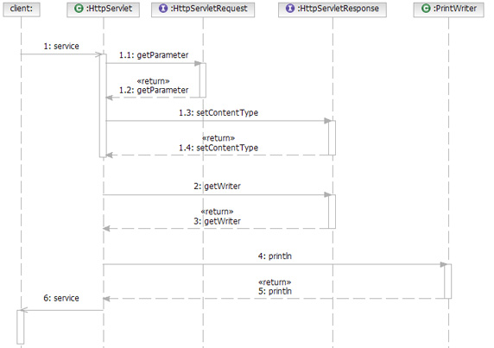

Slide 22
HTML Forms
Form data consists of name, value pairs
Values are retrieved on the server by name
GET passes data in the query string
  Always URL-encoded
POST passes data in content of request
  Either URL-encoded, or multipart/form-data

Slide 23
Structure of forms
form element
  Attributes:
    action (REQUIRED)
    method (GET)
    enctype, accept, accept-charset
    onsubmit, onreset

Slide 24
Forms contain controls
input : many kinds of form data
  Text fields, checkboxes, radio buttons, passwords, buttons, hidden controls, file selectors, object controls
button : type=submit|button|reset
select : a menu, contains option child elements
textarea : multi-line text input field
Other html tags can be present (e.g. format forms in tables)

Slide 25
Servlet support
Does decoding for you, common interface
  Just use
    request.getParameter (String name)
    for both GET and POST
  Returns null if parameter doesn’t exist
Multipart not well supported in standard API
  Use request.getReader (), request.getInputStream () ..parse yourself
  Use 3rd party API, e.g. com.oreilly.servlet.multipart.MultipartParser, org.apache.commons.fileupload.servlet

Slide 26
More Servlet Support
Retrieve all values matching name:
  request.getParameterValues (String name)
  Returns String array, or null
Retrieve all parameter names:
  request.getParameterNames ()
  Returns String Enumeration
Retrieve an immutable Map<String,String> of name, value pairs
  request.getParameterMap ()

Slide 27
Maintaining State
Cookies
  Name,value pairs with properties
  Lifetime independent of request/response
  Passed between client and server during HTTP transactions
Hidden fields, URL rewriting
  Form controls (input type=“hidden”) added dynamically to pages, containing name/value that should be associated with client.
  Hardcoded links (href) contain name/value data in query

Slide 28
Maintaining State, continued
Sessions
  Pass a single cookie (or fallback to URL rewriting) containing a session ID
  Server maintains a mapping between session ID and associated data stored on the server

Slide 29
Cookie Support
Cookie class
  Name, value
  Domain, path
  maxAge
    > 0 Persist cookie, in seconds
    -1 (default) in memory, until browser is closed
    0 delete cookie on client

Slide 30
Using Cookies
Retrieving cookies
  request.getCookies () returns array of Cookie or null
Creating cookies
  Cookie (String name, String value)
Updating client
  Existing Cookies can be modified, but must be added to response for change to take place
  response.addCookie (Cookie c)

Slide 31
Sessions Support in Java
HttpSession is an interface
  for a glorified (specialized) Map<String,Object> or similar
One-to-one mapping between jsessionID and HttpSession
Attached to HTTPServletRequest object in doXXXX methods
  request.getSession (boolean create=true)
  request.isRequestedSessionIdValid ()

Slide 32
Sessions support
Associated with one client (usually)
  Id, creation time, last accessed time
Can be invalidated manually or due to inactivity
Lifetime: new-->active-->invalid
Object getAttribute (String name)
setAttribute (String name, Object o)
Enumeration getAttributeNames ()

Slide 33
More Session details
Interface maps String to Object, you must cast ref to derived type
If your object uses generics (e.g. typed lists), you’ll get a compiler warning when casting
  Interface is pre 1.5, strips away type info
  Any other code can take e.g. a List<String> session object and treat it as an untyped list
  Solutions: be careful, store keys into external structures, use Checked wrappers on collections (runtime cost)

Slide 34
ServletConfig
Provided to a servlet upon initialization by the web server (container)
Simple read only interface to configuration details
  String getInitParameter (String name)
  Enumeration getInitParameterNames ()
  String getServletName ()
Can also access ServletContext

Slide 35
ServletContext
Lets a servlet communicate with its container
Access container-managed resources, dispatch requests, write to logs
Can be used as a global data store (like an application-wide session)
  But is specific to single web container -- does not work in clustered scenarios
  Recommendation is to use a resource that is shared (e.g. cached DataSource, directory)
We will see/use the servlet context later on

Slide 36
Questions?

