Slide 1
JMS
Java Message Service
Instructor
Professor: Charles Tappert
By
Student: Amr Fouda

Slide 2
Java 2 Platform Enterprise Edition (J2EE)
Enterprise Java Beans (EJB)
Java Server Pages (JSP)
Java Servlet
Java Naming and Directory Interface (JNDI)
Java IDL
Java Database Connectivity (JDBC)
Java Message Service (JMS)
Java Transaction (JTA)
Java Transaction Service (JTS)
Java Mail
RMI-IIOP.

Slide 3
Messaging
Messaging is a method of communication between software components or applications.
A messaging system is a peer-to-peer facility.
Messaging enables distributed communication that is loosely coupled.
Messaging differs from tightly coupled technologies such as Remote Method Invocation (RMI )
Messaging also differs from electronic mail (e-mail)

Slide 4
JMS
JMS allows Java programs to exchange messages with other Java programs sharing a messaging system.
Messaging systems, sometimes called Message-Oriented Middleware (MOM).
JMS API enables communication that is :
• Asynchronous
• Reliable

Slide 5
Real Time Example
(Automobile manufacturer)
The inventory component can send a message to the factory component when the inventory level for a product goes below a certain level, so the factory can make more cars.
.The factory component can send a message to the parts components so that the factory can assemble the parts it needs.
The parts components in turn can send messages to their own inventory and order components to update their inventories and order new parts from suppliers.
Both the factory and parts components can send messages to the accounting component to update their budgets.
The business publishes updated catalog items to its sales force and web site.

Slide 6
JMS Architecture
JMS provider
is a messaging product that implements the JMS interfaces and provides administrative and control features
Administered
objects
pre-configured JMS objects created by an administrator for the use of clients.
JMS clients
the programs or components written in the Java programming language that produce and consume messages.
Messages
the objects that communicate information between JMS clients.

Slide 7
JMS Models (Message exchange Models)
Publish-Subscribe Messaging
Point- To-Point Messaging
Request-Reply Messaging

Slide 8
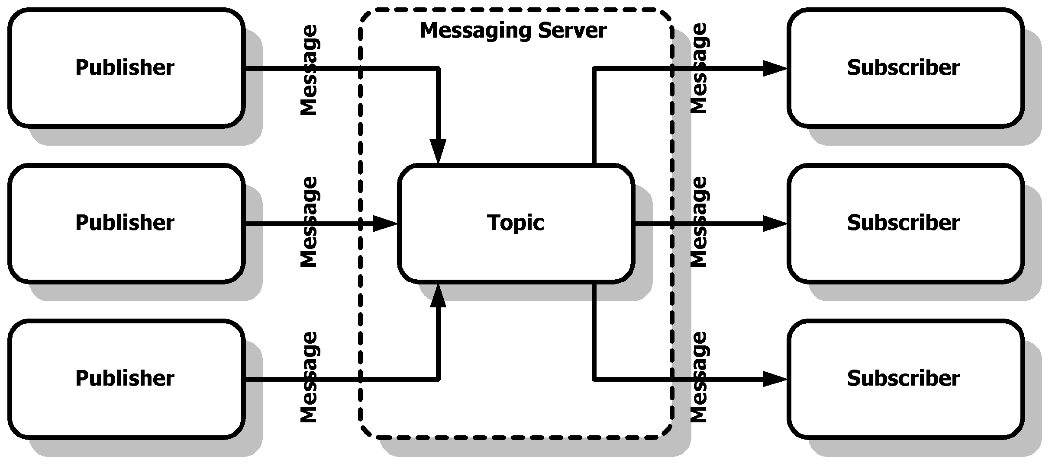
Publish-Subscribe Messaging
When multiple applications need to receive the same messages, Publish- Subscribe Messaging is used.
The central concept in a Publish-Subscribe messaging system is the Topic.
In Publish-Subscribe Messaging is that, there may be multiple Senders and multiple Receivers.

Slide 9
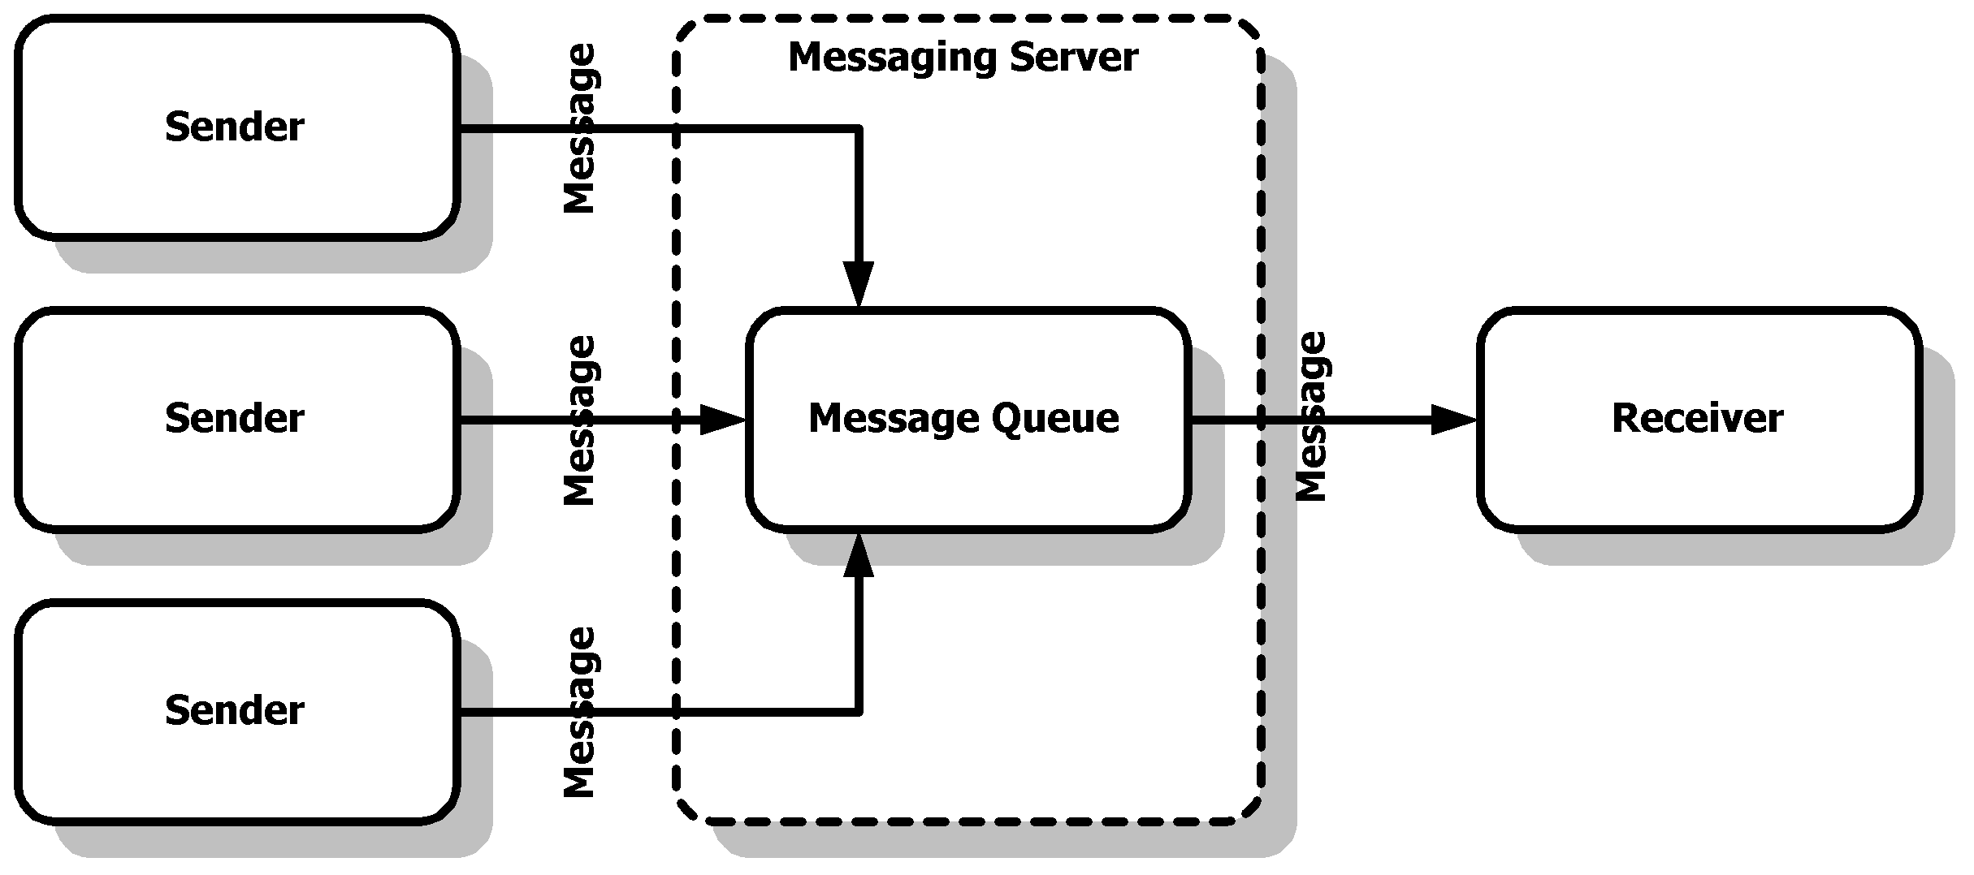
Point- To-Point Messaging
When one process needs to send a message to another process, Point-To-Point Messaging can be used.
There are two basic types:
• The first one involves a client that directly sends a message to another client.
• The second and more common implementation is based on the concept of a Message Queue.
in Point-to-Point messaging even though there may be multiple Senders of messages, but there is only a single Receiver.

Slide 10
Request-Reply Messaging
When an application sends a message and expects to receive a message in return, Request-Reply Messaging can be used.
It could be:
• Synchronous
• Asynchronous
JMS does not explicitly support Request-Reply Messaging, though it allows it in the context of the other methods.

Slide 11
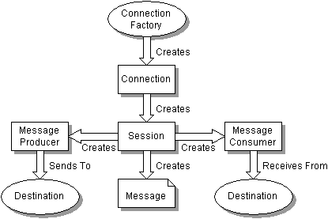
JMS Programming Model

Slide 12
Development in JMS
JMS API was first introduced in 1998
JMS provider may implement message-driven beans to process messages concurrently.
Message sends and receives can participate in Java Transaction API (JTA)
The JMS API allows for a very loosely coupled interaction between J2EE applications and existing Enterprise Information system (EIS).

Slide 13
Reference Links
J2EE
java.sun.com/products/jms/tutorial
WebLogic/ JMS/tutorial
Java Message Service(TM) 1.0.2 API Specification
JMS: An infrastructure for XML-based B2B communication

