Slide 1
RMI

Slide 2
This is a brief introduction to Java Remote Method Invocation (RMI).
Java RMI is a mechanism that allows one to invoke a method on an object that exists in another address space.
The other address space could be on the same machine or a different one.

Slide 3
There are three processes that participate in supporting remote method invocation.
The Client is the process that is invoking a method on a remote object.
The Server is the process that owns the remote object. The remote object is an ordinary object in the address space of the server process.
The Object Registry is a name server that relates objects with names. Objects are registered with the Object Registry. Once an object has been registered, one can use the Object Registry to obtain access to a remote object using the name of the object.

Slide 4


Slide 5
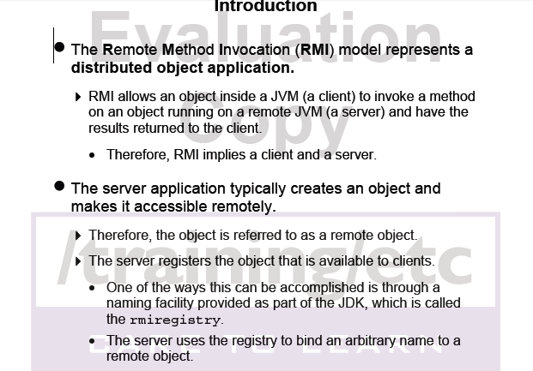

Slide 6
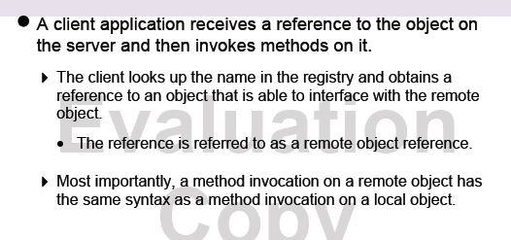

Slide 7
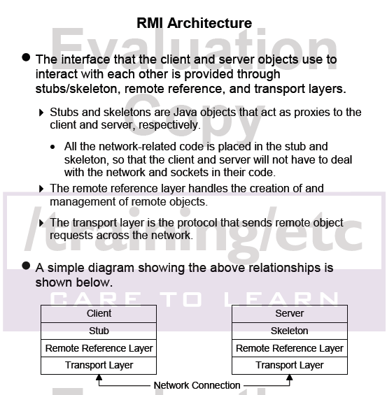

Slide 8
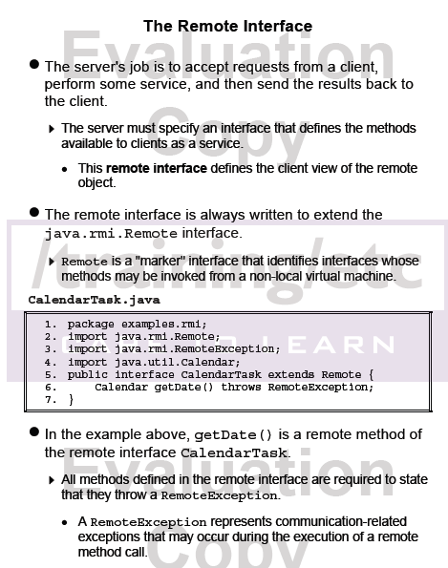

Slide 9
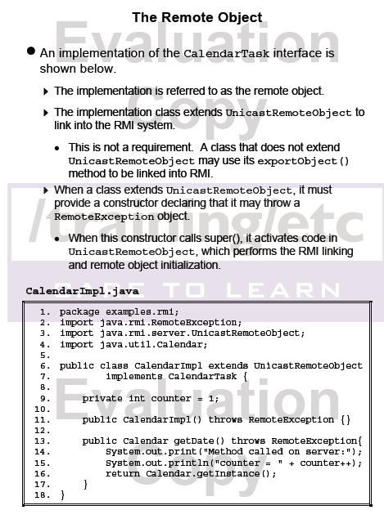

Slide 10
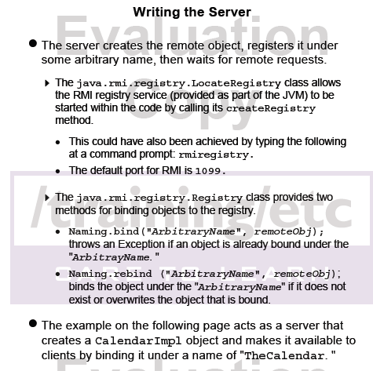

Slide 11
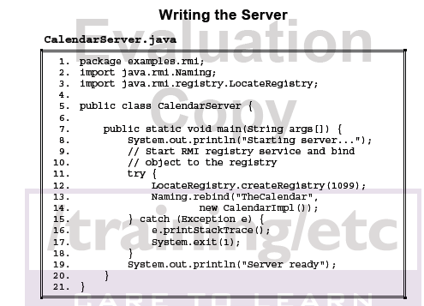

Slide 12
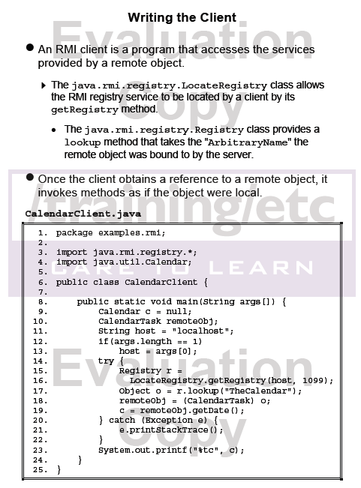

Slide 13
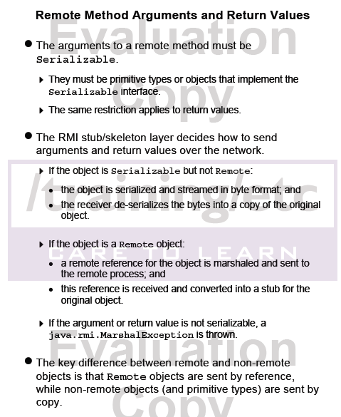

Slide 14
Exceptions During Remote Object Export
When a remote object class is created that extends UnicastRemoteObject, the object is exported, meaning it can receive calls from external Java virtual machines and can be passed in an RMI call as either a parameter or return value.
An object can either be exported on an anonymous port or on a specified port. For objects not extended from UnicastRemoteObject, the java.rmi.server.UnicastRemoteObject.exportObject method is used to explicitly export the object.

Slide 15
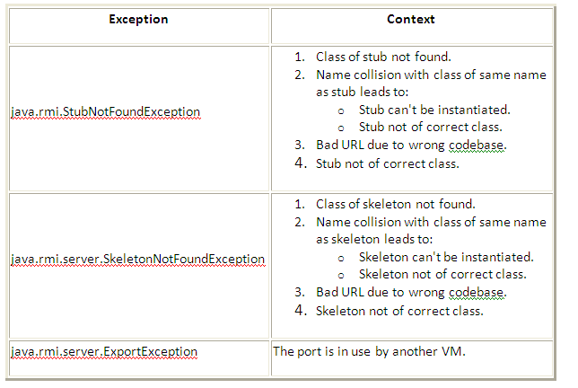

Slide 16
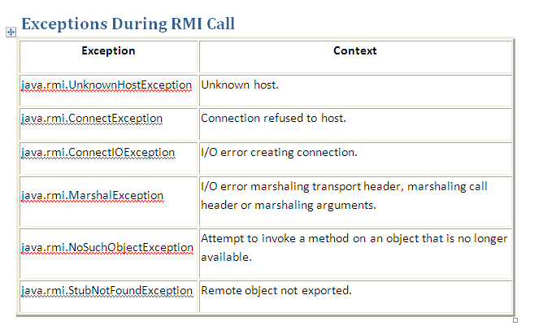

Slide 17
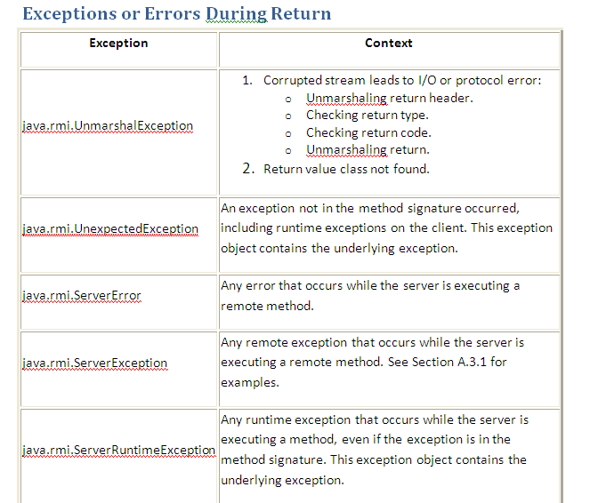

Slide 18
Possible Causes of java.rmi.ServerException
These are the underlying exceptions which can occur on the server when the server is itself executing a remote method invocation. These exceptions are wrapped in a java.rmi.ServerException, that is the java.rmi.ServerException contains the original exception for the client to extract. These exceptions are wrapped by ServerException so that the client will know that its own remote method invocation on the server did not fail, but that a secondary remote method invocation made by the server failed.

Slide 19
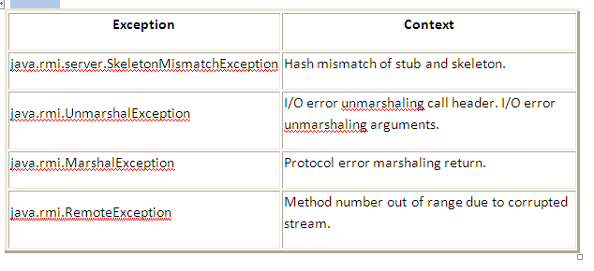

Slide 20
Naming Exceptions
The following table lists the exceptions specified in methods of the java.rmi.Naming class and the java.rmi.registry.Registry interface.

Slide 21
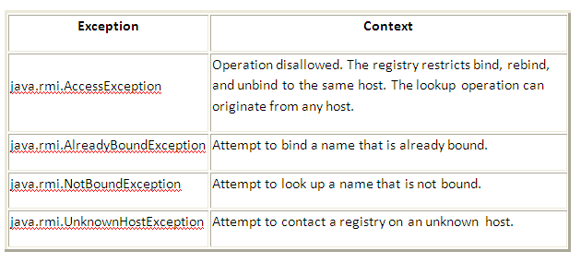

Slide 22
