Slide 1
Java bean

Slide 2
Introspection
Introspection is the ability to obtain information about the properties, events and methods of Bean.

Slide 3
Two ways
Naming patterns for Properties, Events and Methods for Bean class.
Extra classes and interfaces are used to provide this information explicitly.

Slide 4
Naming patterns for Properties, Events and Methods for Bean class.

Slide 5
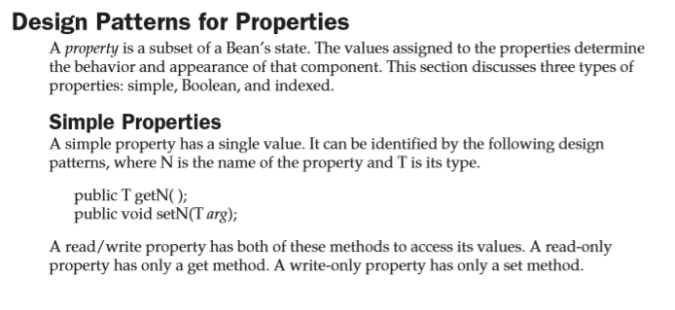

Slide 6
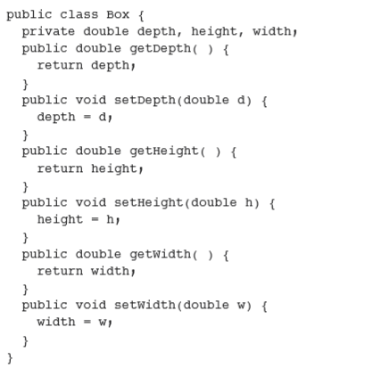

Slide 7
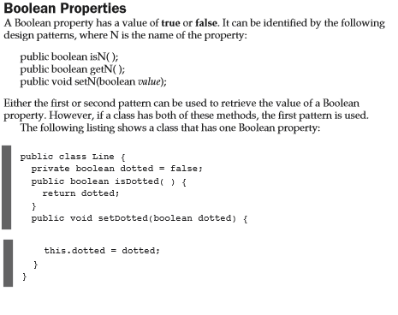

Slide 8
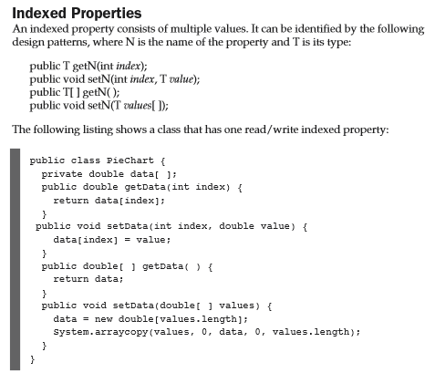

Slide 9
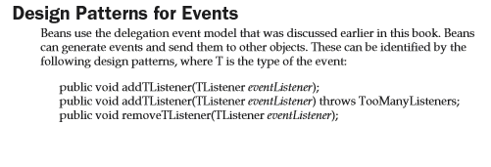

Slide 10


Slide 11
Introspector class
This class is in the java.beans package provide static methods that allow you to obtain information about the properties, events and methods of Bean.
static BeanInfo getbeanInfo(Class beanClass)
static BeanInfo getbeanInfo(Class beanClass, Class ignoreClass)

Slide 12
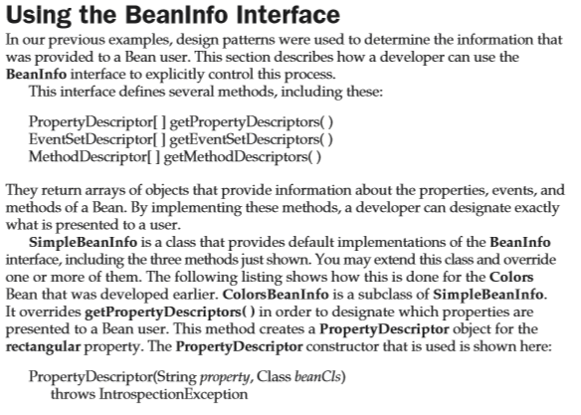

Slide 13
1:- Create class that define event.
import java.util.EventObject;
public class ColorEvent extends EventObject{
private Color color;
public ColorEvent(Object source,Color color)
{
super(source);
this.color=color;
}

Slide 14
public void setColor(Color color) {
this.color = color;
}
public Color getColor()
{
return color;
}
}

Slide 15
2:-Create Interface that receive this type of Events
import java.util.EventListener;
public interface ColorListner extends EventListener{
public void changeColor(ColorEvent ce);
}

Slide 16
3:-Source must provide methods that allows listner to register and unregister for Events notification.
public void addColorListner(ColorListner cl)
{
listners.addElement(cl);
}
public void removeColorListner(ColorListner cl)
{
listners.removeElement(cl);
}

Slide 17
4:- Source must provide code to generate events and send it to all register listeners.
public void fireColorEvent(ColorEvent ce)
{
for(int i=0;i<listners.size();i++)
{
ColorListner cl=(ColorListner)listners.elementAt(i);
cl.changeColor(ce);
}
}

Slide 18
5:- Listener must implement the interface to receive event.
public class Painter extends Canvas implements ColorListner {
6:- Listener must register to receive notification
selecto1.addColorListner(painter1);

