Slide 1
“Struts Technology”

Slide 2
Agenda
What is Struts?
Components of Struts.
Architecture.
Model-View-Controller Architecture.
Conclusion.

Slide 3
What is Struts?
A strut is the framework for building Java-based Web applications. Using the Model-View-Controller (MVC) design pattern.
Separate display logic from business logic using MVC
Model = business logic (data model)
View = presentation
Controller = navigational code between model and view

Slide 4
History :
The Struts framework was created by Craig R. McClanahan and was donated to the Apache software foundation in 2000.
Since then it is a open source software.
Struts solves many of the problems associated with developing high-performance, business-oriented Web applications that use Java Servlets and JSP.

Slide 5
Components of Struts
Base Framework :
provides the core MVC functionality and is comprised of the building blocks for your application.
JSP Tag Libraries :
tag libraries enable JSP authors to use HTML-like tags to represent functionality that is defined by a Java class.
HTML
Bean
Logic
Nested

Slide 6
Components of Struts
Tiles Plug-in :
a rich JSP templating framework that facilitates the reuse of presentation (HTML) code.
Validator Plug-in :
provides a rich framework for performing data validation on both the server side and client side (browser).

Slide 7
Architecture
Model 1 Architecture :
A request is made to a JSP or servlet and then that JSP or servlet handles all responsibilities for the request.
including processing the request, validating data, handling the business logic, and generating a response.

Slide 8
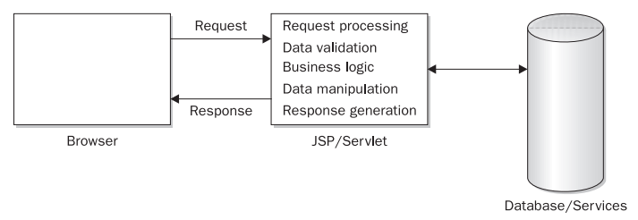
Model 1 Architecture :

Slide 9
Model 2 Architecture :
In the MVC architecture, a central servlet, known as the Controller, receives all requests for the application.
The Controller then processes the request and works with the Model to prepare any data needed by the View (which is usually a JSP) and forwards the data to a JSP.
The JSP then uses the data prepared by the Controller to generate a response to the browser.
Business and presentation logic are separated from each other.

Slide 10
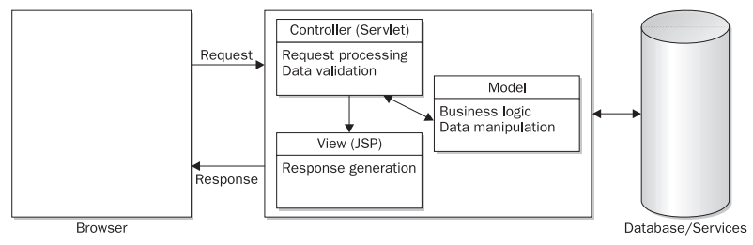
Model 2 Architecture :

Slide 11
Model-View-Controller Architecture
Model Components :
provide an interface to the data and services used by an application.
They communicate with the model components that perform data access and manipulation.
View Components :
generate the response to the browser. view components are simple JSPs or HTML pages.

Slide 12
Model-View-Controller Architecture
Controller Components :
The Controller is typically a servlet that receives requests for the application and manages the flow of data between the Model layer and the View layer.
It controls the way that the Model and View layers interact.

Slide 13
Conclusion
Takes much of the complexity out of building your own Web Application
Free to develop & open source
Stable & Mature
Feature-rich
Flexible & Extendable
Large User Community, Expert Developers
Rich tag library (html, bean tags etc)
Easy to test and debug
Encourages good design practice and modeling

Slide 14
Thank you

