Slide 2
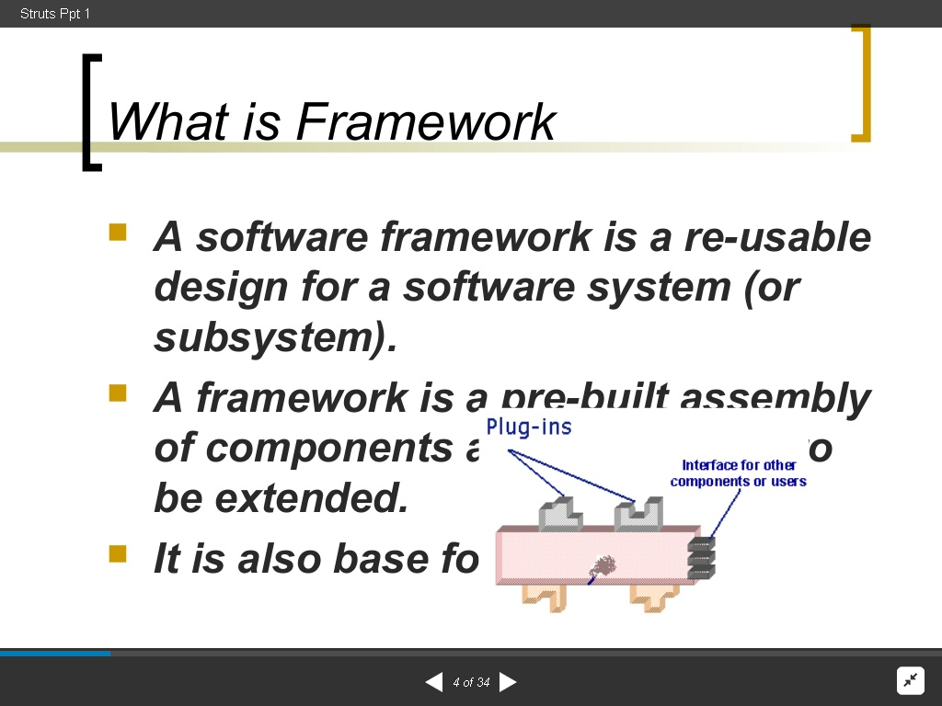

Slide 3
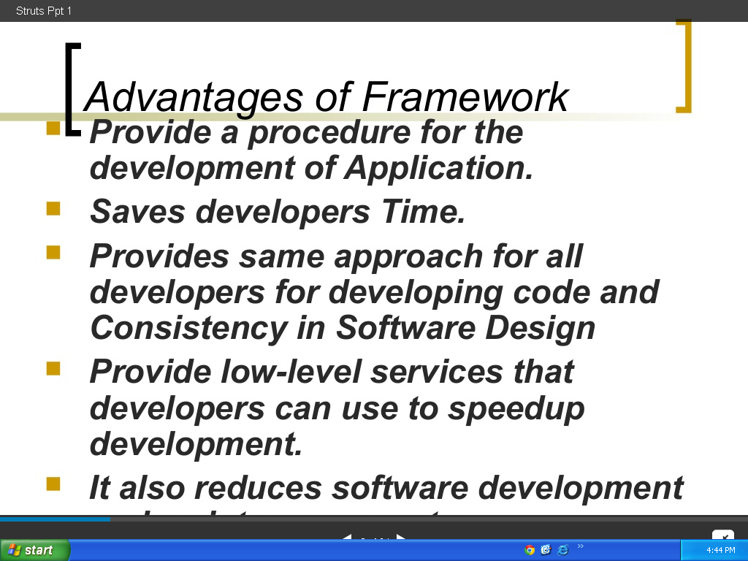

Slide 4
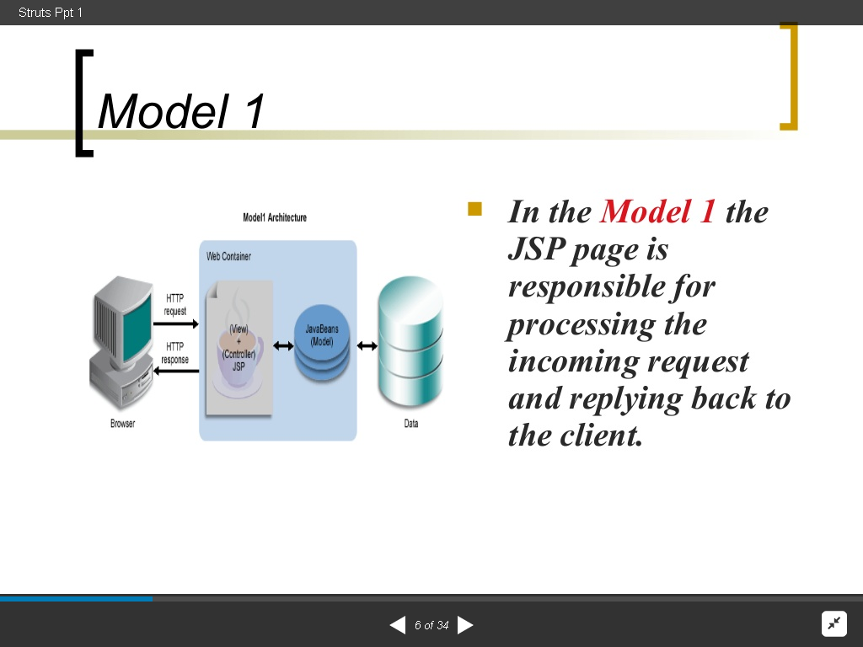

Slide 5
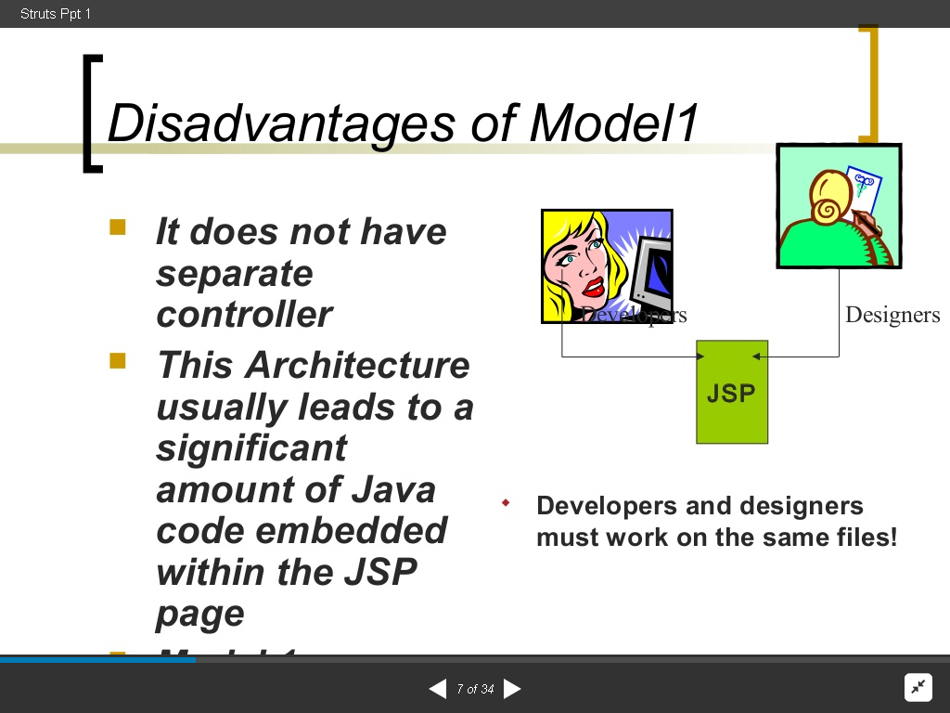

Slide 6
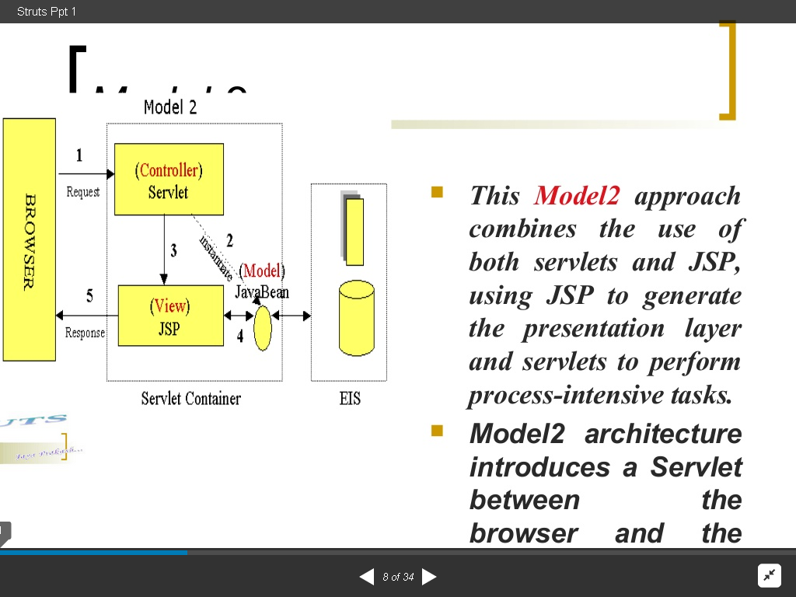

Slide 7
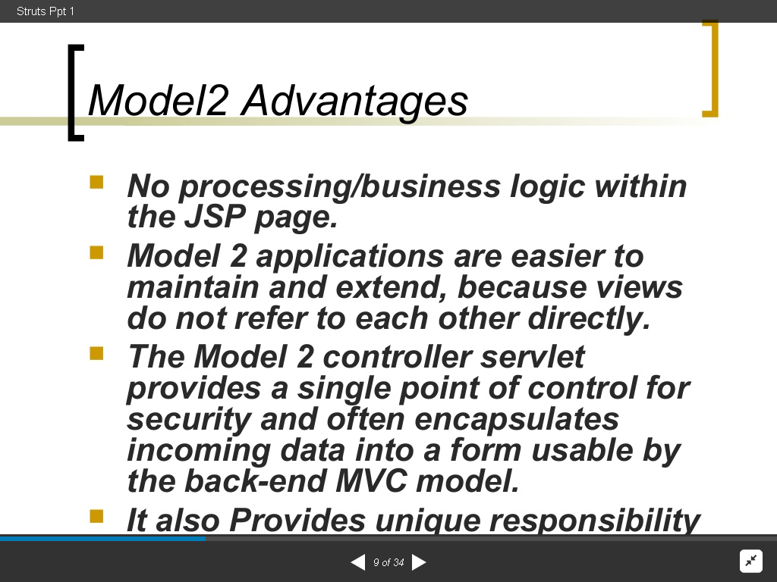

Slide 8
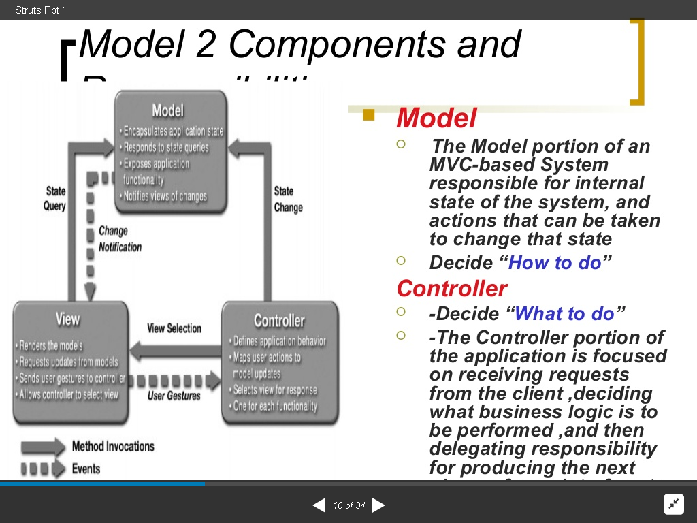

Slide 9
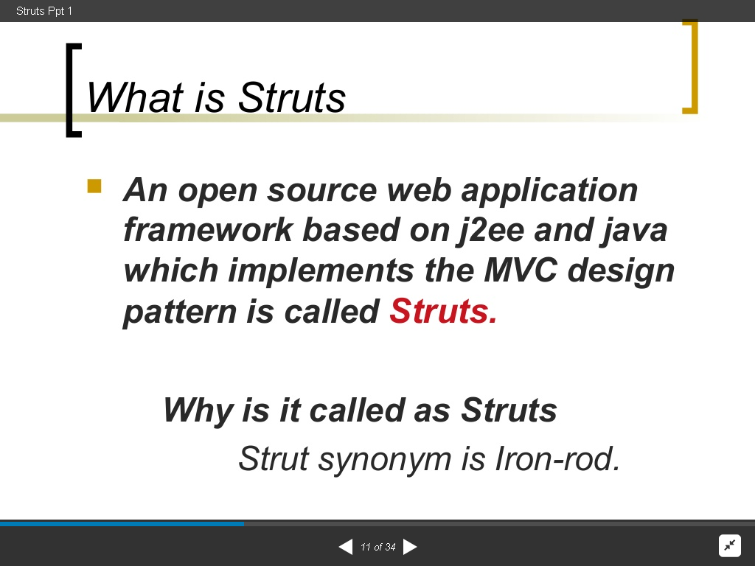

Slide 10
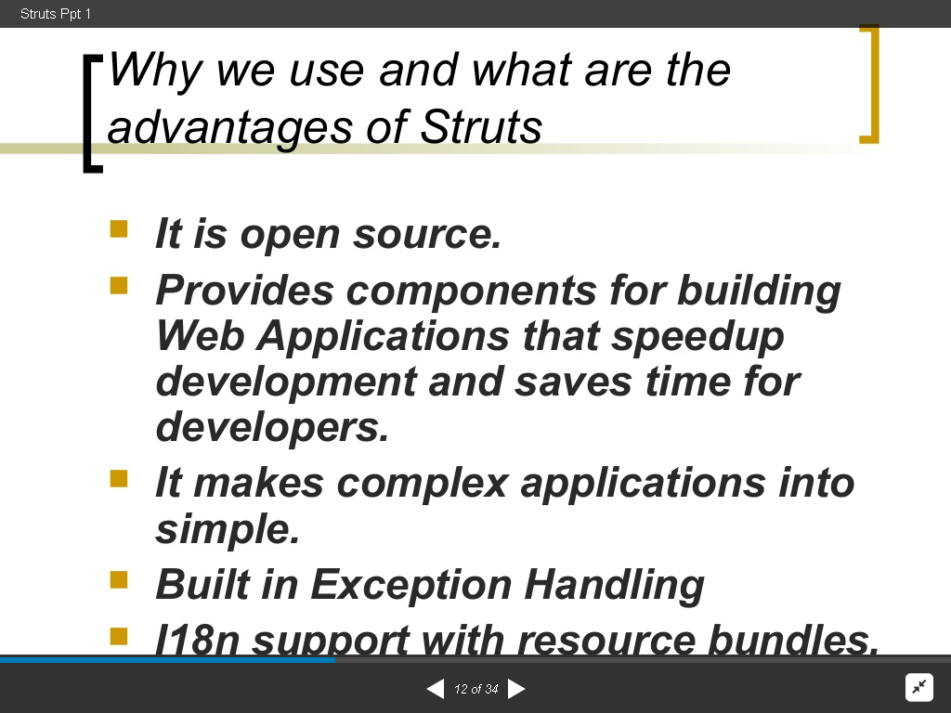

Slide 11
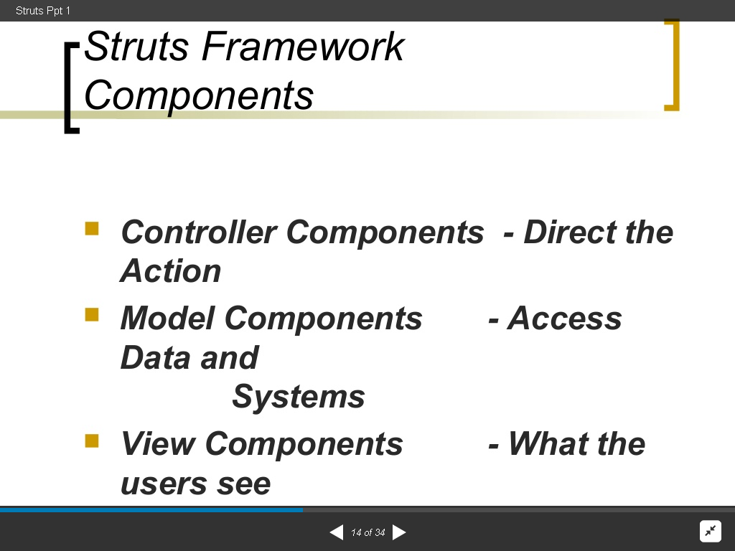

Slide 12
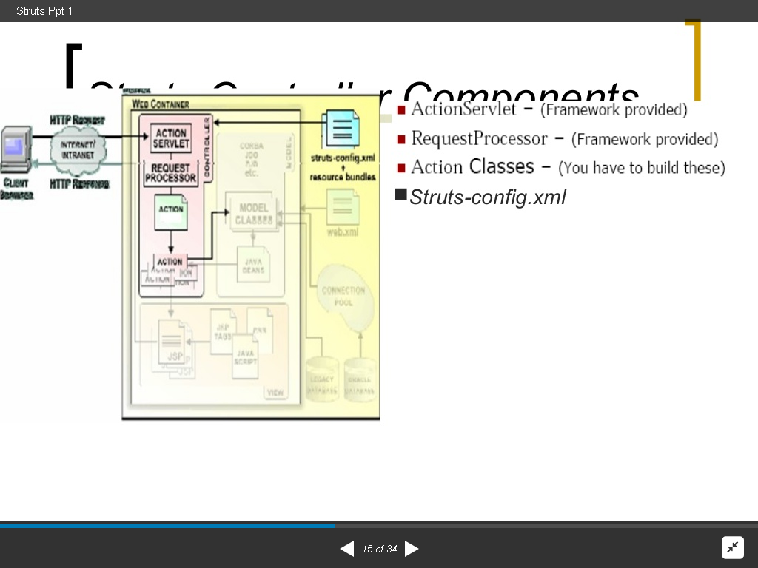

Slide 13
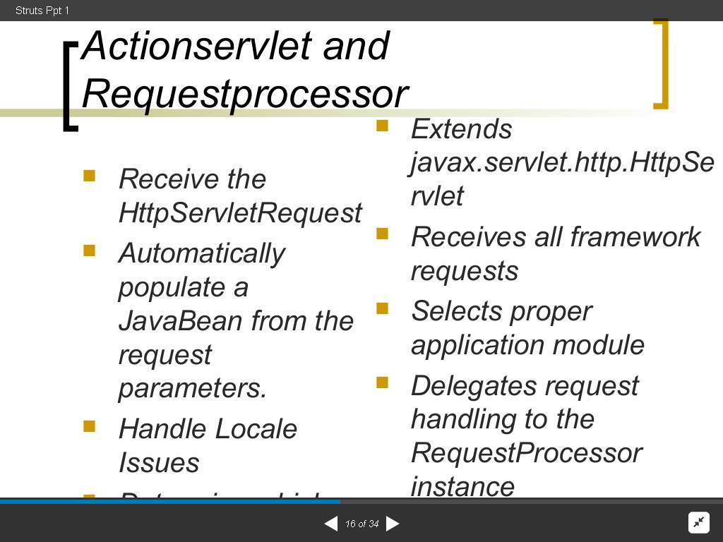

Slide 14
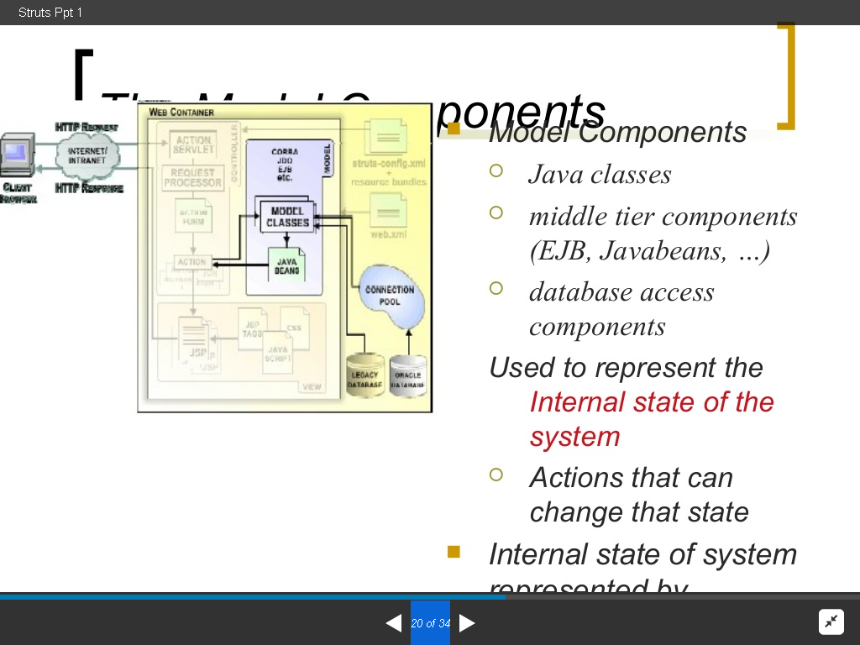

Slide 15
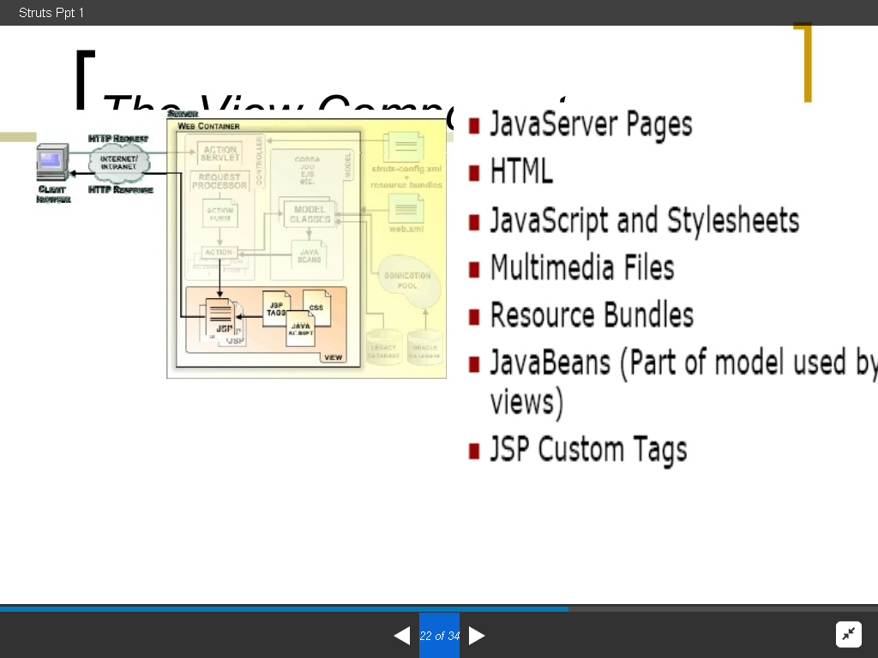

Slide 16
Struts Components
The Controller
This receives all incoming requests. Its primary function is the mapping of a request URI to an action class selecting the proper application module. It's provided by the framework.

Slide 17
The struts-config.xml File
This file contains all of the routing and configuration information for the Struts application. This XML file needs to be in the WEB-INF directory of the application.
Action Classes
It's the developer's responsibility to create these classes. They act as bridges between user-invoked URIs and business services. Actions process a request and return an ActionForward object that identifies the next component to invoke. They're part of the Controller layer, not the Model layer.

Slide 18
View Resources
View resources consist of Java Server Pages, HTML pages, JavaScript and Stylesheet files, Resource bundles, JavaBeans, and Struts JSP tags.
ActionForms
These greatly simplify user form validation by capturing user data from the HTTP request. They act as a "firewall" between forms (Web pages) and the application (actions). These components allow the validation of user input before proceeding to an Action. If the input is invalid, a page with an error can be displayed.

Slide 19
Model Components
The Struts Framework has no built-in support for the Model layer. Struts supports any model components:
JavaBeans
EJB
CORBA
JDO
any other

Slide 20
