Slide 1
Java Messaging Services
CS-328

Slide 2
Messaging Systems
A messaging System allows and promotes the loose coupling of components
  allows components to post messages for other components
  asynchronous rather than synchronous
  also known as MOM (Message-Oriented Middleware
Two basic models
  point-to-point
    one component posts a message to a server
    one component (and only one) will consume a posted message
  publish/subscribe
    allows a component to publish a message to a topic on a server
    components interested in a particular topic can subscribe to that topic (messages can be consumed by a number of components)
    when a component publishes a message, it subscribes to that topic and will receive the message

Slide 3
What Does JMS Do
A Java API that allows applications to:
  create
  send
  receive
  read messages
in principle kind of like a news system, but doesn’t involve e-mail

Slide 4
Architecture
A JMS Application consists of :
  A JMS Provider
    a messaging system that implements the JMS interfaces and provides administrative and control features
    included in Java since JDK 1.3
  JMS Clients
    Java programs/components/objects that produce and consume messages
  Administered Objects
    preconfigured JMS objects created by an administrator for the use of clients
      destinations
      connection factories
  Native Clients
    a non-Java program that uses a products native API instead of the JMS API
    a legacy application modified to use the JMS API

Slide 5
Architecture
Administrative
Tool
Bind
JNDI
Namespace
CF
D
Lookup
JMS
Client
JMS
Provider
Logical
Connection

Slide 6
Interaction
The administrator binds connection factories (CF) and destinations (D) into a JNDI namespace.
A JMS client can then lookup the administered objects and establish a logical connection to them via the JMS Provider

Slide 7
Point-to-Point Messaging Domain
Applications are built around the concepts of message queues, senders and receivers
Queues retain all messages until they are either:
  consumed
  expire
Each message has only one consumer
There are no timing dependencies
The receiver acknowledges the successful processing of a message

Slide 8
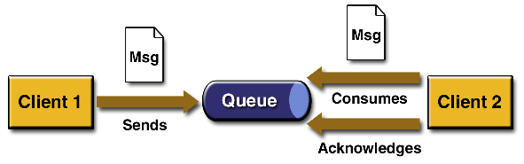
Point-to-Point Messaging Domain

Slide 9
Publish/Subscribe Messaging Domain
Clients address messages to a topic
Publishers and Subscribers are generally anonymous and may dynamically publish or subscribe to the content hierarchy
Topics retain messages only long enough to distribute them to their current subscribers
Use publish/scribe messaging when each message can be processed by zero, one or many consumers
  durable subscriptions exist for subscribers not currently active

Slide 10
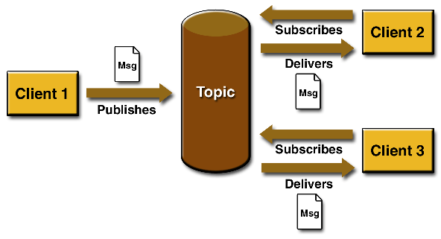
Publish/Subscribe Messaging Domain

Slide 11
Message Consumption
In JMS messages can be consumed in two ways:
  Synchronously
    a subscriber or receiver explicitly fetches a message from the destination using the “receive” method
      the “receive” method can block until a message arrives or can time out if a message does not arrive within a specified time limit
  Asynchronously
    a client can register a message listener (like an event listener) with a consumer
      whenever a message arrives at the destination the JMS Provider delivers the message by calling the listener’s “onMessage” method which acts on the contents of the message

Slide 12
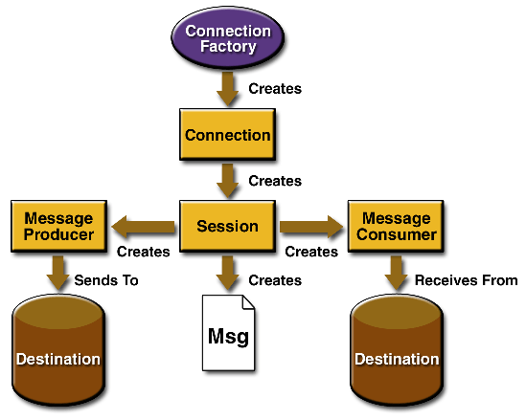
Programming Model

Slide 13
Administered Objects
Administration is better done using vendor supplied tools rather than programmatically due to vendor implementation differences
  j2eeadmin - j2ee sdk administration tool
Administered objects are configured in a JNDI namespace
  Connection Factories
  Destinations

Slide 14
Connection Factories
A connection factory object is used by a client to create a connection with a provider.
It encapsulates a set of connection configuration parameters that have been defined by an administrator
Two connection factories come preconfigured with the J2EE SDK
  are accessible as soon as you start the service.
Each connection factory is an instance of one of the following interfaces
  QueueConnectionFactory
  TopicConnectionFactory
To create new objects use j2eeadmin
  j2eeadmin -addJmsFactory jndi_name queue
  j2eeadmin -addJmsFactory jndi_name topic

Slide 15
Example
/* the administrator creates the objects by typing on the command line:
j2eeadmin -addJmsFactory MyQueueConnectionFactory queue
j2eeadmin -addJmsFactory MyTopicConnectionFactory topic */
In the client code:
/* search the classpath for jndi.properties (vendor specific file) */
Context ctx = new InitialContext();
QueueConnectionFactory queueConnectionFactory =
(QueueConnectionFactory)ctx.lookup(“MyQueueConnectionFactory");
TopicConnectionFactory topicConnectionFactory =
TopicConnectionFactory) ctx.lookup(“MyTopicConnectionFactory");
/* now the client has references to the objects */

Slide 16
Destinations
A destination is the object a client uses to specify
  the target of messages it produces
  and the source of messages it consumes.
In the PTP messaging domain, destinations are called queues, and you use the following J2EE SDK command to create them:
  j2eeadmin -addJmsDestination queue_name queue
In the pub/sub messaging domain, destinations are called topics, and you use the following J2EE SDK command to create them:
  j2eeadmin -addJmsDestination topic_name topic

Slide 17
Example
/* assume the administrator has created the the topic Mytopic by typing :
j2eeadmin -addJmsDestination MyTopic topic *.
/* in the client program to get a referance to it : */
Topic myTopic = (Topic) ctx.lookup("MyTopic");
/* assume the administrator has created the queue MyQueue by typing :
j2eeadmin -addJmsDestination MyQueue queue *.
/* in the client program to get a referance to it : */
Queue myQueue = (Queue) ctx.lookup("MyQueue");

Slide 18
Connections
A connection encapsulates a virtual connection with a JMS provider. A connection could represent an open TCP/IP socket between a client and a provider service daemon. You use a connection to create one or more sessions.
Like connection factories, connections come in two forms:
  QueueConnection (interface)
  TopicConnection (interface)

Slide 19
Example
For example, once you have a QueueConnectionFactory or a TopicConnectionFactory object, you can use it to create a connection
QueueConnection queueConnection = queueConnectionFactory.createQueueConnection( );
TopicConnection topicConnection = topicConnectionFactory.createTopicConnection( );
/* when the application is complete, remember to close the connections: */
queueConnection.close( );
topicConnection.close( );
/* Before your application can consume messages, you must call the connection's start method */
queueConnection.start( );
topicConnection.start( );
/* To stop a connection temporarily use the stop( ) method */
queueConnection.stop( );
topicConnection.stop( );

Slide 20
Sessions
A session is a single-threaded context for producing and consuming messages.
Use sessions to create message producers, message consumers, and messages.
Sessions serialize the execution of message listeners
Sessions, like connections, come in two forms:
  QueueSession (interface)
  TopicSession (interface)

Slide 21
Example
For example, if you created a TopicConnection object, you use it to create a TopicSession:
TopicSession topicSession =
topicConnection.createTopicSession(false, Session.AUTO_ACKNOWLEDGE);
-or-
QueueSession queueSession =
queueConnection.createQueueSession(true, 0);

Slide 22
Message Producers
A message producer is an object created by a session and is used for sending messages to a destination.
  The PTP form of a message producer implements the QueueSender interface.
  The pub/sub form implements the TopicPublisher interface.

Slide 23
Example
QueueSender queueSender = queueSession.createSender(myQueue);
queueSender.send(message); /* assuming that message is already created */
- or –
TopicPublisher topicPublisher = topicSession.createPublisher(myTopic);
topicPublisher.publish(message);

Slide 24
Message Consumers
A message consumer is an object created by a session and is used for receiving messages sent to a destination.
A message consumer allows a JMS client to register interest in a destination with a JMS provider.
The JMS provider manages the delivery of messages from a destination to the registered consumers of the destination.
The PTP form of message consumer implements the QueueReceiver interface.
The pub/sub form implements the TopicSubscriber interface.

Slide 25
Example
For example, you use a QueueSession to create a receiver for the queue myQueue, and you use a TopicSession to create a subscriber for the topic myTopic:
QueueReceiver queueReceiver = queueSession.createReceiver(myQueue);
TopicSubscriber topicSubscriber = topicSession.createSubscriber(myTopic);
- or –
TopicSubscriber topicSubscriber = topicSession.createDurableSubscriber(myTopic);
/ * Once you have created a message consumer, it becomes active, and you can use it to receive messages. */

Slide 26
Example
/* With either a QueueReceiver or a TopicSubscriber, you use the receive method to consume a message synchronously. You can use this method at any time after you call the start method: */
queueConnection.start(); Message m = queueReceiver.receive( );
- or -
topicConnection.start(); Message m = topicSubscriber.receive(1000); // time out after a sec.
/* To consume a message asynchronously, you use a message listener */

Slide 27
Message Listeners
A message listener is an object that acts as an asynchronous event handler for messages.
This object implements the MessageListener interface,
  contains one method, onMessage.
  In the onMessage method, you define the actions to be taken when a message arrives.

Slide 28
Example
/* You register the message listener with a specific QueueReceiver or TopicSubscriber by using the setMessageListener method. For example, if you define a class named TopicListener that implements the MessageListener interface, you can register the message listener as follows: */
TopicListener topicListener = new TopicListener( );
topicSubscriber.setMessageListener(topicListener);
After you register the message listener, you call the start method on the QueueConnection or the TopicConnection to begin message delivery. (If you call start before you register the message listener, you are likely to miss messages.)
Once message delivery begins, the message consumer automatically calls the message listener's onMessage method whenever a message is delivered. The onMessage method takes one argument of type Message, which the method can cast to any of the other message types

Slide 29
Messages
A message consists of
  a header
    destination, timestamp...
  properties (optional)
    message properties allow message receivers to select which types of messages they would like to receive.
    Message receivers use message selectors to filter out messages (filtering is done at the server)
  a body (optional)
    information part of the message

Slide 30
Java Message Service
The JMS API standardizes enterprise messaging
  APIs for point-to-point
  APIs for publish/subscribe
JMS provides five types of messages
  BytesMessages
  MapMessages
  ObjectMessages
  StreamMessages
  TextMessages

Slide 31
JMS Availability
The JMS Reference implementation is part of the J2EE SDK
Allaire Corporation - JRun Server
BEA Systems, Inc.
Brokat Technologies (formerly GemStone)
IBM
iPlanet (formerly Sun Microsystems, Inc. Java Message Queue)
Oracle Corporation
Pramati
SilverStream Software, Inc.
Sonic Software
SpiritSoft, Inc. (formerly Push Technologies Ltd.)
Talarian Corp.
TIBCO Software, Inc.

