Slide 1



IMDB MOVIE ANALYSIS
Surani Smit

Slide 2

AGENDA
Project Description
Approach
Tech-Stack Used
Data-set
Insights
Result
120+

Slide 3

Project Description
The given dataset is related to IDBM movie data.
The problem to investigate could be: "What factors influence the success of a movie on IMDB?" However, based on IDBM ratings, this is the main indicator of the film's success.
Filmmakers, investors, and producers who want to know what makes a movie successful will find this study useful in helping them make judgments about their next projects.
They give me certain data, which I then have to collect and examine in order to gain comprehensive understanding.
120+

Slide 4
Approach
For this project, first we'll get understanding of the given data.
Then We'll clean the data as per our requirement by removing null values, delete unnecessary columns, etc.
After the cleaning we'll using pivot table, various functions, and charts for desired answers for the questions.
We'llcontinues ask Whys to data to get in depth of the root of the problem.
At the end we'll present our answers with proper formatting in table and garaphs.
120+

Slide 5
Tech-Stack Used
Microsoft Excel: This tool is used to create graphical representation of the results and to understand the result set better.
Microsoft PowerPoint : To create PPT
120+
Data-set :
https://drive.google.com/file/d/1XpGThHzLnXxL_7aQo2sCpYL3SeB18MMB/view

Slide 6
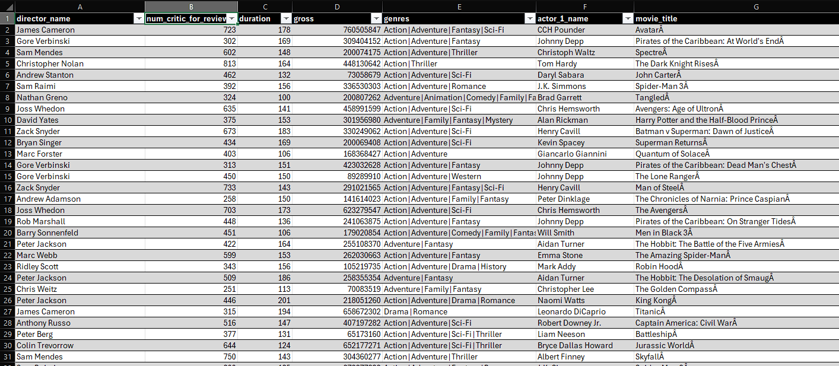
Data Cleaning
Dropping an unnecessary column and Remove Duplicates
remove blank cell or null value (NA)
Before Cleaning there is around 5044 rows and 28 column but after cleaning around 3850 rows and 14 columns

Slide 7
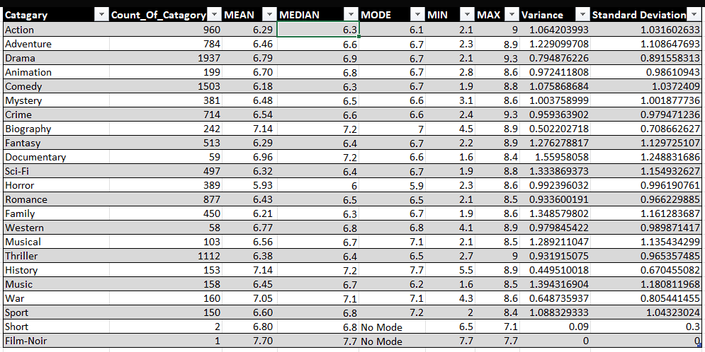
Insights
A. Movie Genre Analysis : Determine the most common genres of movies in the dataset. Then, for each genre, calculate descriptive statistics (mean, median, mode, range, variance, standard deviation) of the IMDB scores.

Slide 8
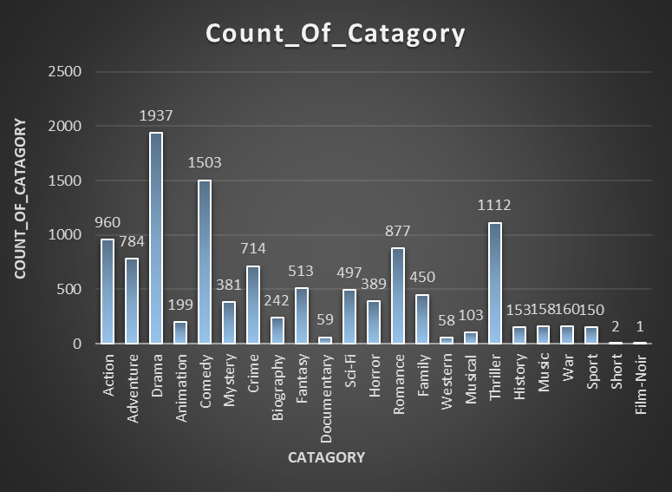
Key Insights from Movie Genre Analysis :
Drama is the most common category with `1937` entries, while Film-Noir is the least common with only `1` entry.
Biography and History categories have the highest average ratings (`7.14` and `7.12`, respectively),means they indicating that both are generally well-received or Popular.
Horror has the lowest average and median ratings (`5.93` and `5.9`), means it has low rating .
Documentary shows the highest variability in ratings with a standard deviation of `1.25`, while Short is the most consistent with a standard deviation of `0.30`.
Western has the highest maximum rating (`9.2`), it indicating a standout entry in this category.
Some categories like Short and Film-Noir don’t have a mode it means it is unique or don’t have proper rating .
Drama doesn't have the highest average ratings or mean-score , means it showing that being popular doesn't always mean higher ratings.

Slide 9

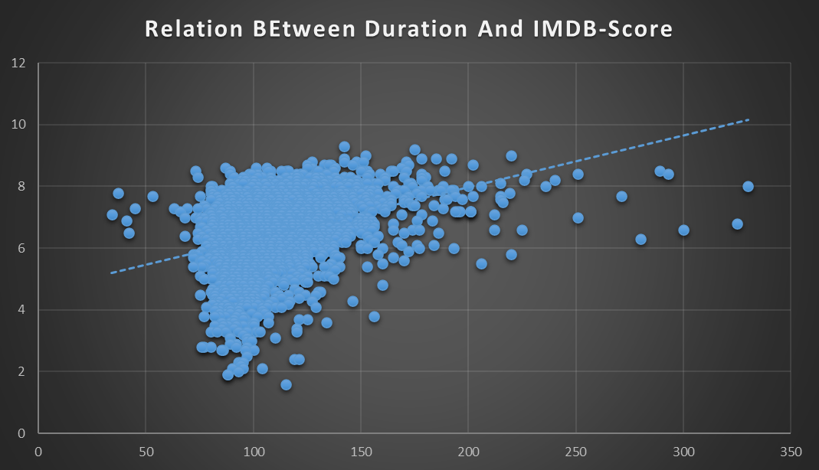
B. Movie Duration Analysis: : Analyze the distribution of movie durations and identify the relationship between movie duration and IMDB score.

Slide 10
Given scatter plot shows a positive correlation between movie duration and IMDB scores, it indicating that longer movies tend to have higher ratings.
The average duration of movies in the dataset is approximately 110 minutes, with a median of 106 minutes and Standard deviation 22.75
Most movies in between 100 to 150 minutes in duration, with IMDB scores ranging from 6 to 9 it means within this time duration there is high chance to get high rating.
The trend line in the scatter plot show that the positive correlation, suggesting that movie duration might influence higher IMDB scores.

Slide 11
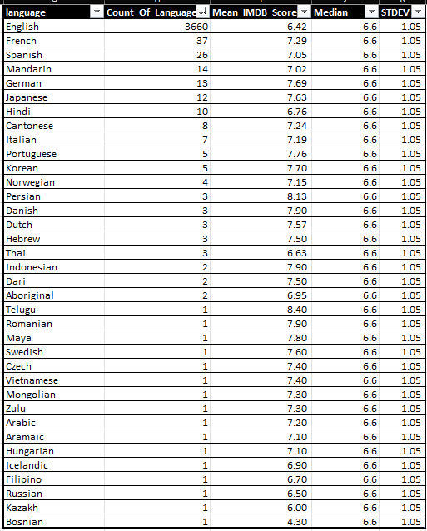
C. Language Analysis: Determine the most common languages used in movies and analyze their impact on the IMDB score using descriptive statistics.
English is the most common language with 3660 entries but has a lower mean IMDB score of 6.42, indicating that a high volume of movies does not necessarily equate to higher average ratings.
English tended to have slightly lower IMDB scores on average, indicating potential biases in audience preferences.
Telugu movies have the highest mean IMDB score of 8.40, means it suggesting that they has very well-rating on average according to given data but indata volume of telugu movie is 1 .
Bosnian movies have the lowest mean IMDB score of 4.30, means it has low rating .

Slide 12
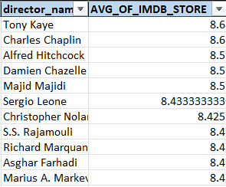

D. Director Analysis Identify the top directors based on their average IMDB score

Slide 13
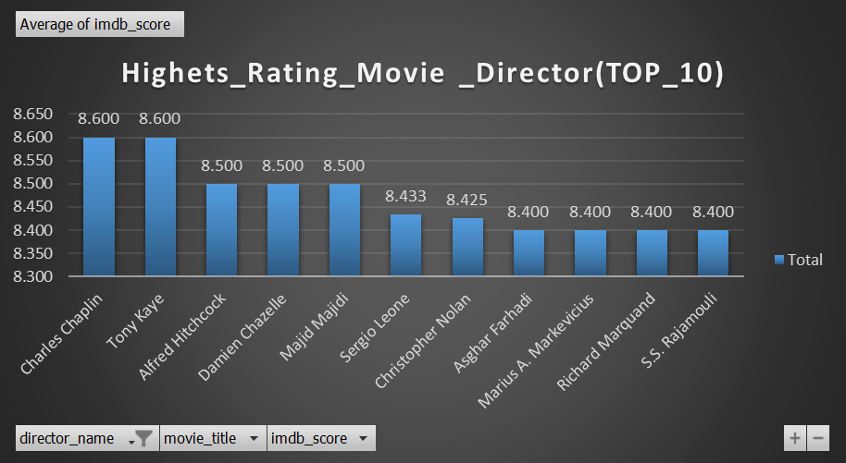

90th percdentile of all movie rating is 7.5 it means 7.5 denotes that 90% of average IMDB scores are at or below 7.5
32 director regarded as top director whose films have an average IMDb score of at least 7.5.
I identified top directors based on their average IMDB scores and analyzed their contribution to movie success.
Directors such as Charles Chaplin and Tony Kaye consistently produced movies with high IMDB ratings, reflecting their strong influence on audience perception.

Slide 14
E. Budget Analysis: Analyze the correlation between movie budgets and gross earnings, and identify the movies with the highest profit margin.
Highest Profit Movie: "Avatar" holds the top position with a highest profit margin of 525.235 million.
Movie Budget and gross earnings have a slightly positive correlation, as indicated by the correlation coefficient of 0.100580888. This suggests that a higher budget generally leads to a higher gross margin.
Additionally, I found a negative correlation of -0.952873945 between the movie's budget and its overall profit. This indicates that a higher budget might not necessarily result in a higher overall profit.

Slide 15
Result:
Through this project, we gained valuable insights into the factors influencing movie
ratings and financial performance.
By analyzing genres, durations, languages, directors, and budgets, we were able to identify trends and patterns that shed light on audience preferences and industry dynamics.
Our findings provide actionable insights for filmmakers, producers, and studios seeking to optimize their movie production strategies and maximize audience appeal .
Click To Open Excel Sheet

