Slide 1


SMART INDIA HACKATHON 2025
Problem Statement ID – SIH25134
Problem Statement Title- Student Innovation: Swadeshi for Atmanirbhar Bharat - Robotics and Drones
Theme- Robotics and Drones
PS Category- Software
Team ID- SIH 222
Team Name-: CloudWing AI

Slide 2
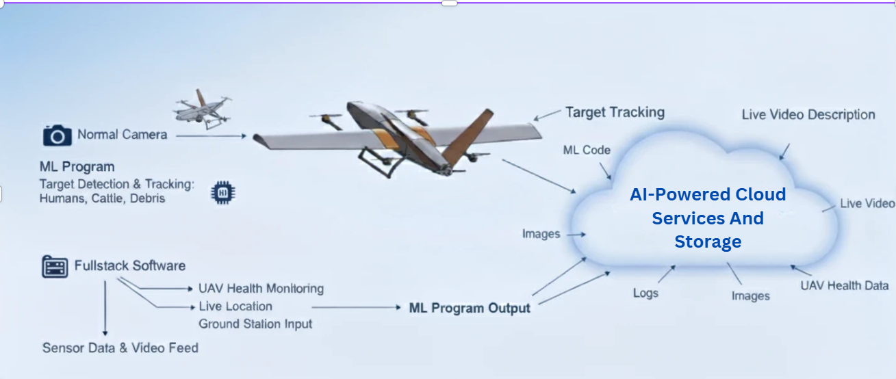

PROPOSED SOLUTION
CloudWing
AI

Slide 3
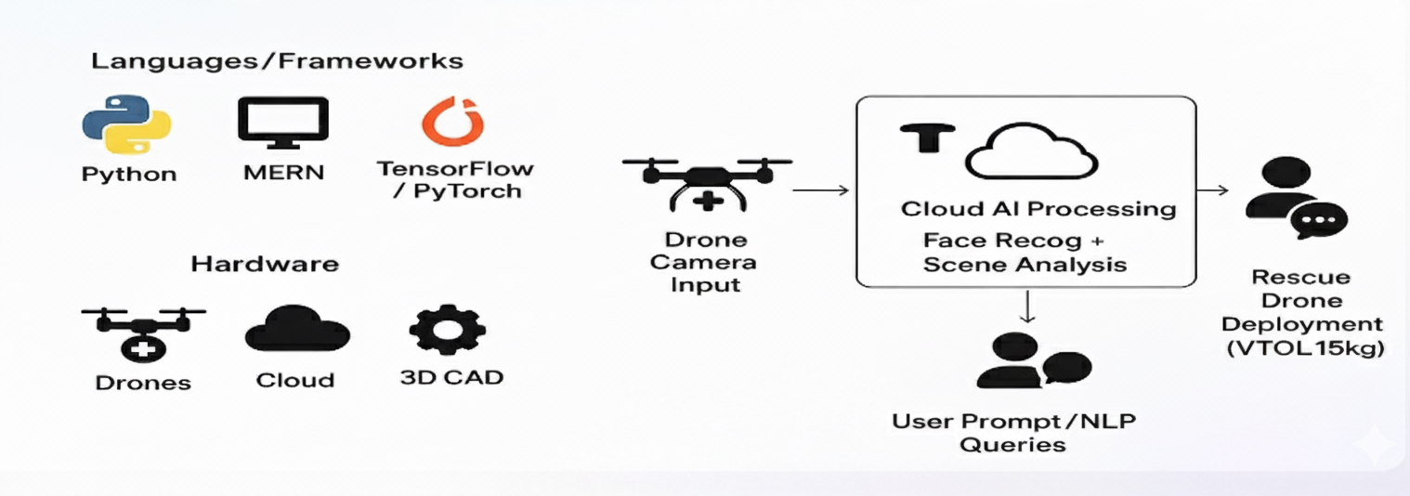
TECHNICAL APPROACH
CloudWng
AI

Slide 4
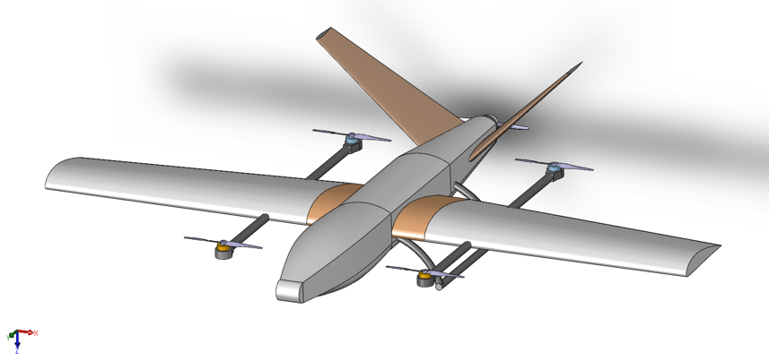
FEASIBILITY AND VIABILITY
CloudWing
AI
Feasibility of the Idea
Technical feasibility: Software-focused UAV solution with AI/ML modules
Operational feasibility: Cloud communication and virtual simulation
Economic feasibility: Cost-effective deployment and maintenance
Potential Challenges & Risks
ML accuracy and real-time streaming latency
Software integration and data security
Scalability
Strategies to Overcome Challenges
Robust ML training
Edge computing for latency reduction
Modular software architecture
Cloud security protocols and scalable design
@SIH Idea submission- Template
4

Slide 5
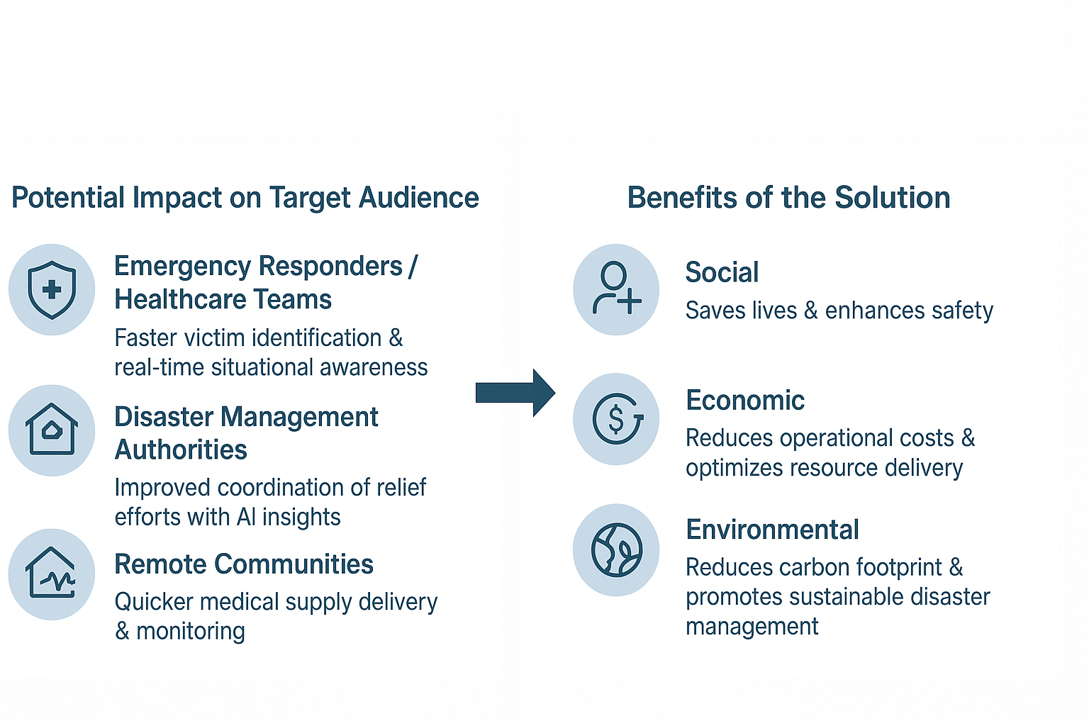
IMPACT AND BENEFITS
CloudWing
AI

Slide 6
RESEARCH AND REFERENCES
CloudWing
AI
Li, J., Li, D., Xiong, C. and Hoi, S., 2022, June. Blip: Bootstrapping language-image pre-training for unified vision-language understanding and generation. In International conference on machine learning (pp. 12888-12900). PMLR.
Gupta, B. and Vani, M.P., 2018. An overview of web sockets: The future of real-time communication. Int. Res. J. Eng. Technol. IRJET, 5(12).
Sugalski, A.J., 2022. Leveraging Vertical Take-off and Landing (VTOL) Unmanned Aerial Vehicle (UAV) Technology for Humanitarian Aid and Disaster Relief (HA/DR): The Last Tactical Mile.
Rao, B.T., 2016. A study on data storage security issues in cloud computing. Procedia Computer Science, 92, pp.128-135.
Pamadi, B.N., 2004. Performance, stability, dynamics, and control of airplanes. Aiaa.
Koning, W.J., Russell, C.R., Solis, E. and Theodore, C., 2018. Mid-Fidelity Computational Fluid Dynamics Analysis of the Elytron 4S UAV Concept (No. ARC-E-DAA-TN53886).

