Slide 1
OOP Comprehensive Assignment
Smit Shah | 19BCE259

Slide 2
Introduction
Problem: Depth first search (DFS) is a graph traversal technique that allows visiting all the nodes of a graph in depth first manner. The traversal is modified where there will be two persons who want to traverse the graph in DFS, both of them start from the same location and no two persons can occupy the same node in the graph. Each person will get the chance one by one. The one who first complete the traversal of the graph, considering the restriction that there will be no cycle during the visit of the nodes, wins the game. Simulate the two person DFS traversal using Java program.
Assumptions: Graph G is connected, undirected and weighted

Slide 3
DFS
Two standard graph traversal techniques are widely used: BFS (Breadth first search) and DFS ( Depth first search) traversal.
Traversal means visiting each node of a graph. DFS bifurcates vertices into two sets: visited & not visited
We make use of stack to keep track of adjacent nodes of the visited vertices.
It starts exploring the graph from one node and explores it’s depth before backtracking.
Two things are considered: i) visiting a vertex ii) exploring a vertex

Slide 4
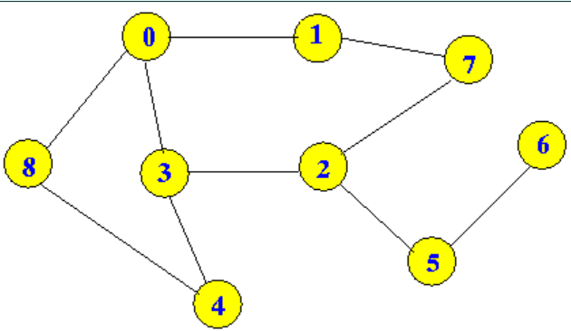
Example

Slide 5
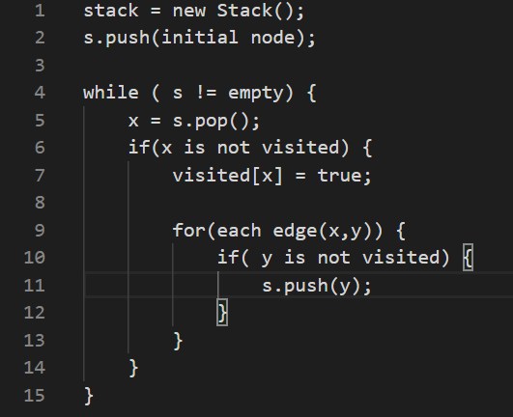
Pseudo Code

Slide 6
Thank you!

