Slide 1
My NP-Complete Project Presentation
James Smith

Slide 2
My Problem
My problem (phrase as a decision problem):
Given a graph G, can we color the vertices so that no two adjacent vertices are of the same color?
Optimization Version:
We are using brute force to find all possible combinations of colors. Each combination is tested until the requirements are satisfied and the program returns the minimum number of colors.

Slide 3
Problem Input
How does the input to your problem look?
We are using an undirected complete graph without weighted edges.
We first input how many vertices the graph has and then input the connected edges on each line after
Example Input:
3
0 1 2
1 0 2
2 0 1

Slide 4
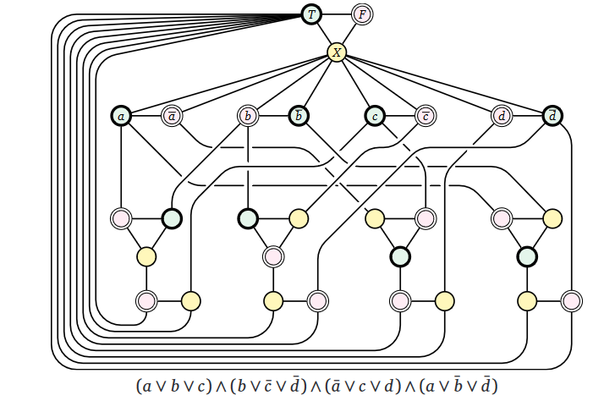
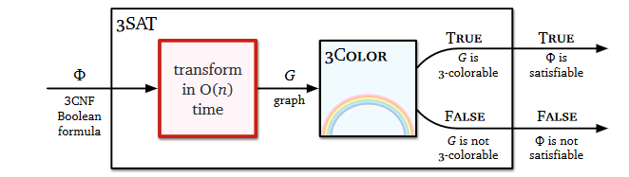
Reduction (justify its inclusion in NP-Complete)
Show the reduction that justifies the problem is in NP-Complete
We can use a reduction of 3sat to 3coloring to show that min-graph coloring is NP-complete:

Slide 5
Sketch of Exact Solution (pseudo-code)

Slide 6
Worst Case Example (if possible)

Slide 7
Test Cases
How did you generate them? (hopefully with a python program)
Test case Sizes?
Performance of test cases of different sizes?
Plot of the run time of your program as you increase the input size. You MUST run your program on inputs that cause your program to run more than 20 minutes.

Slide 8
Approximation Portion
Penny Molloy

Slide 9
Approximation
Sketch algorithm choices (anytime algorithms, greedy algorithms, stochastic algorithms).
Bounds on its performance
Plot comparing difference in run time and solution quality using your test cases.

