Slide 1
Min-Graph Coloring
James Smith, John Kurly, Alissa Sharp, Rhea Morris

Slide 2
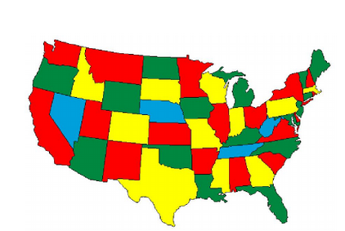
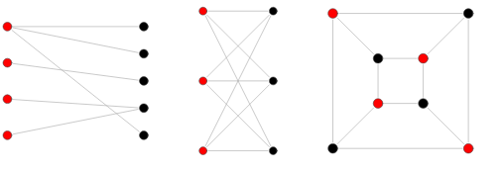
My Problem
My problem (phrase as a decision problem):
Given a graph G, can we assign one of k colors to each vertex so that no two adjacent vertices are of the same color?
It can be used for scheduling, checking if a graph is bipartite, and map coloring.
Optimization Version:
We are using brute force to find all possible combinations of colors. Each combination is tested until the requirements are satisfied and the program returns the minimum number of colors.

Slide 3
Problem Input
How does the input to your problem look?
We are using an undirected complete graph without weighted edges.
We first input how many vertices the graph has and then input the connected edges on each line after
Example Input:
3
0 1 2
1 0 2
2 0 1

Slide 4
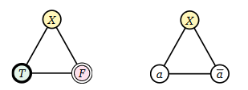
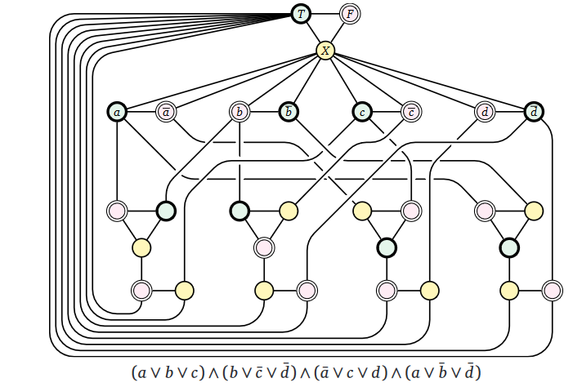
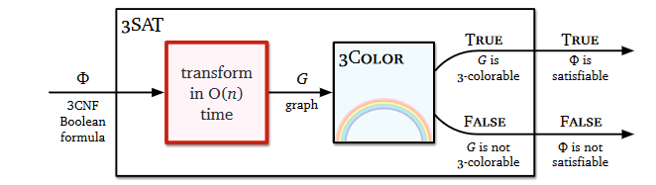
Reduction
We can use a reduction of 3sat to 3coloring to show that min-graph coloring is NP-hard:
First we can create a truth gadget with 3 three nodes a True, a False, and another node X
Then we create a variable gadget that connects a variable a with its negated form ā and then connects both of them to the X node in the truth gadget

Slide 5
Sketch of Exact Solution (pseudo-code)
main():
num_vertices = number of vertices in the graph
edges(dictionary) = vertices as keys, nodes connected to vertex as values (in list)
if num_vertices == 0:
print(0)
else:
num_colors = 1
while minimum colors has not been found and num_colors is less than num_vertices:
for color_list in all possible combinations of num_colors and vertices:
colors(dictionary) = vertices as keys, a number representing a color as values
i = 0
for all vertices v:
colors[v] = color_list[i]
i += 1
if minimum colors have been found:
print(num_colors)
break
num_colors += 1

Slide 6
Worst Case Example (if possible)

Slide 7
Test Cases
Number of Nodes | Runtime
3 | 0m0.047s
4 | 0m0.056s
5 | 0m0.060s
6 | 0m0.146s
7 | 0m6.438s
8 | 0m28.421s
9 | 11m21.164s
10 | 39m1.831s

Slide 8
Approximation Portion
Penny Molloy

Slide 9
Approximation
Sketch algorithm choices (anytime algorithms, greedy algorithms, stochastic algorithms).
Bounds on its performance
Plot comparing difference in run time and solution quality using your test cases.

