Slide 1

EE 608
​
APPLIED MODELING AND OPTIMIZATION
Machine Learning Optimization for Finger Movement Classification Using XGBoost
Team Members:
Jiajun Zhang
Smit Mineshkumar Desai
GITHUB REPOSITORY
COURSE
INSTRUCTOR: Prof. K. P. Subbalakshmi

Slide 2
Contributions Of Each Team Member
Jiajun Zhang: Designed and implemented the first-stage optimization pipeline for ECoG-based finger movement classification. This included signal windowing, movement threshold optimization, feature extraction, baseline XGBoost training, and evaluation using accuracy, macro-F1 score, classification report, and confusion matrix. Also contributed to the formulation of the optimization model and analysis of how preprocessing parameters affect classification performance.
Smit Desai: Developed and implemented the second-stage model optimization process. This included tuning XGBoost hyperparameters and regularization parameters such as max_depth, reg_alpha, reg_lambda, gamma, and min_child_weight. Also contributed to comparing baseline and optimized models, analyzing model complexity control, and interpreting the final optimization results.

Slide 3
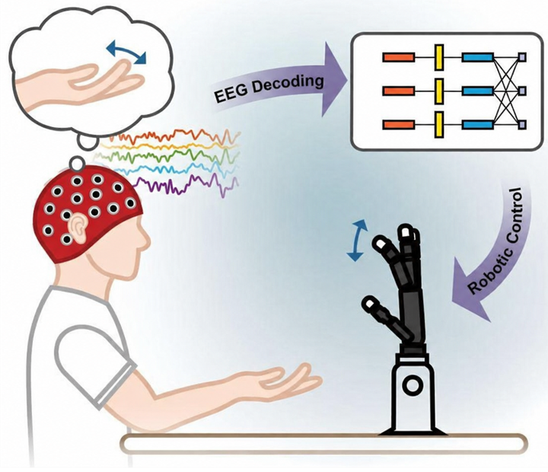
Problem Description
Unlike the mature commercial products currently available—which utilize EMG-controlled robotic arms to assist individuals with limb loss in resuming a normal life—products that employ electroencephalography (EEG/ECoG) as an input signal to control robotic hands remain exceedingly rare. This scarcity persists even though such systems hold the potential to address cases where EMG signals cannot be acquired (e.g., in the absence of an upper arm). The primary reason for this lies in the inherent complexity of the human brain, which generates significant signal noise. In this project, we developed a model trained using XGBoost to classify finger movement states based on features extracted from electrocorticography (ECoG) signals; specifically, this encompasses the resting state as well as the opening and closing movements of various finger groups.
However, the initial performance results were quite limited, yielding an accuracy of only 0.48 and a Macro-F1 score of 0.28. Consequently, this project aims to optimize this model. Specifically, we seek to enhance the overall performance of this multi-class classification task by optimizing parameters such as signal window size, movement thresholds, and the hyperparameters of the XGBoost model. Given that the dataset encompasses multiple movement categories and exhibits class imbalance, we have selected the Macro-F1 score as the primary evaluation metric for this project.

Slide 4
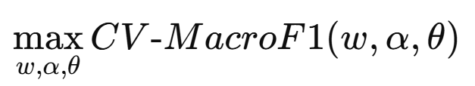
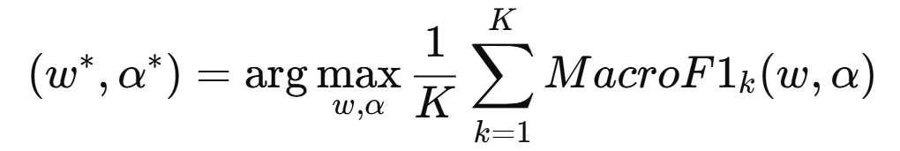
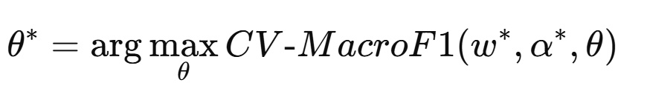
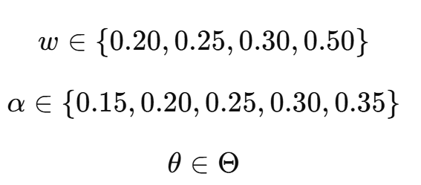
Optimization Model
The goal is to maximize the average cross-validation Macro-F1 score:
First Step： finding the best w∗ and α∗（two-dimensional grid search）：
Divide by two part
Macro-F1 is used as the main objective because this is a 9-class classification problem with class imbalance. Accuracy alone may be misleading if the model predicts the dominant class too often. The window size and threshold are optimized because they directly affect signal segmentation and movement label quality. XGBoost hyperparameters are optimized because they affect model complexity, generalization, and classification performance.
Second Step： With the best w∗ and α∗，find the best XGBoost hyperparameters（Bayesian optimization）：
Since the objective function is non-convex, non-smooth, and has no closed-form solution, numerical optimization methods are used. Grid search is used for w and α, and Bayesian optimization is used for XGBoost hyperparameters.
where Θ is the feasible set of XGBoost hyperparameters, such as max_depth, learning_rate, n_estimators, gamma, reg_alpha, and reg_lambda.

Slide 5
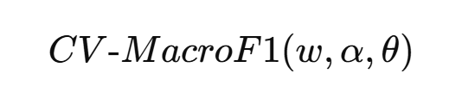
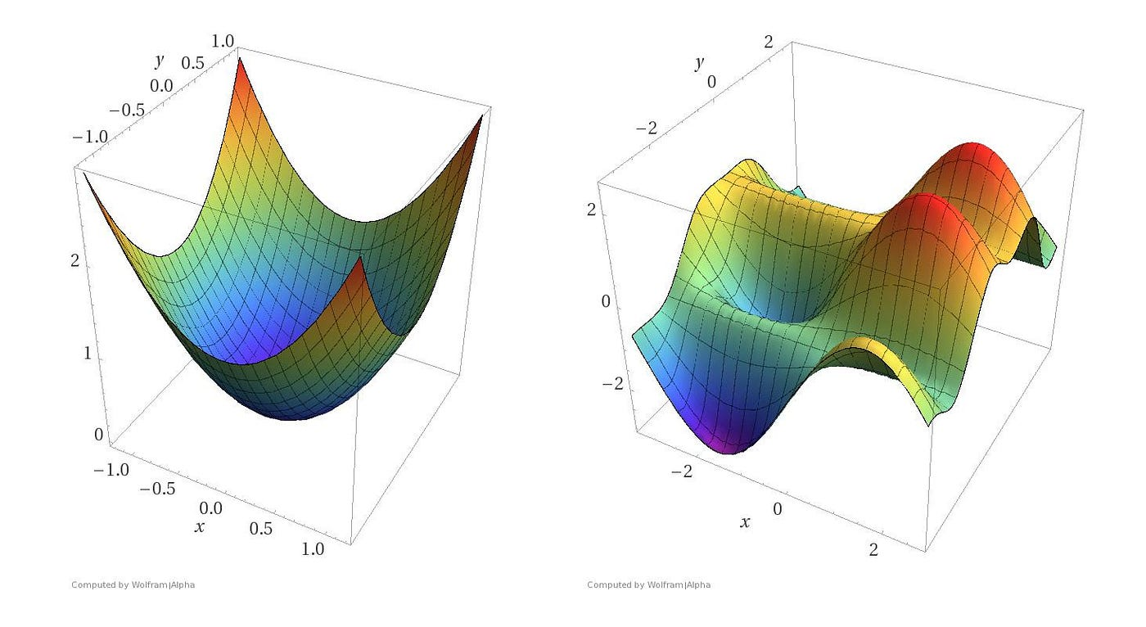
Proposed Solution
Convex or Non-convex?
This 3-level optimizationproblem (window,threshold, hyperparameters) problem is non-convex and non-smooth because the objective is based on CV Macro-F1 after model training and prediction.
Because the objective depends on the full machine learning pipeline and includes discrete variables, it has no closed-form solution, so we solve it as a black-box numerical optimization problem.
Objective: maximize cross-validation CVMacro-F1：

Slide 6
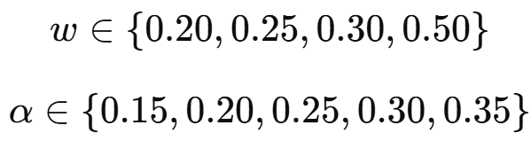


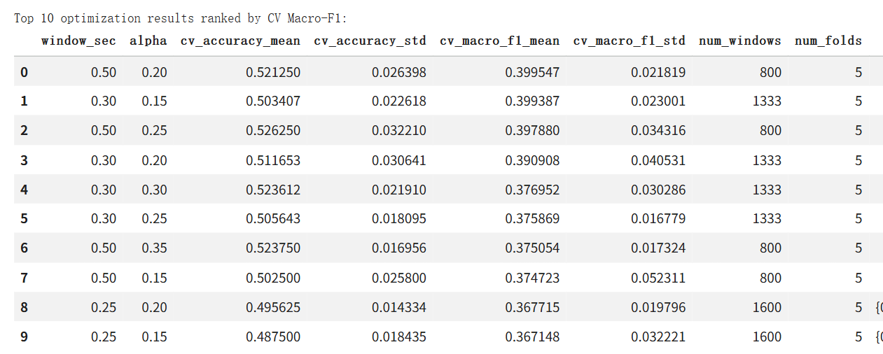
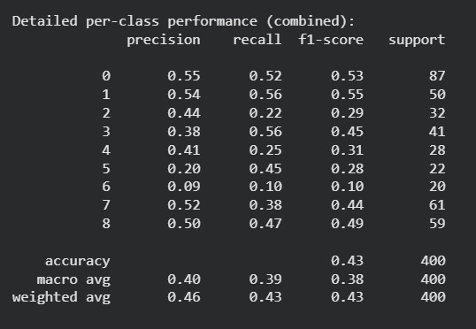
Proposed Solution
Feasible Set
For Stage 1, we optimize window size and movement threshold:
For Stage 2, after selecting the best w∗ and α∗, Bayesian optimization is used to search the feasible set of XGBoost hyperparameters:
where Θ includes allowed ranges for parameters such as max_depth, learning_rate, n_estimators, gamma, reg_alpha, and reg_lambda.
So the feasible set for Stage 1 is:

Slide 7
Proposed Solution
Why does a solution exist?
Is there a closed-form solution?
Stage 1 has a finite feasible set
  4 window sizes × 5 threshold values = 20 combinations
  Each (w,α)(w,\alpha)(w,α) pair can be evaluated by Stratified K-Fold CV
Stage 2 also has a defined feasible set
  XGBoost hyperparameters are searched within predefined ranges
  Bayesian optimization evaluates candidate parameter settings
Best observed solution can be selected
  We choose the combination with the highest mean CV Macro-F1
No closed-form solution
  The objective depends on the full ML pipeline:
      signal windowing
      label generation
      feature extraction
      XGBoost training
      prediction and Macro-F1 evaluation
  Reason
  The objective is non-smooth and non-differentiable
  Some variables are discrete
Numerical solution
  Stage 1: Grid Search
  Stage 2: Bayesian Optimization

Slide 8
Proposed Solution
Numerical Method / Toolbox
Stage 1: Grid Search
Used to optimize:
  window size w
  threshold α
Every (w,α) pair in the feasible set was tested.
Each pair was evaluated using Stratified K-Fold Cross Validation.
Stage 2: Bayesian Optimization
Used to tune XGBoost hyperparameters:
  max_depth
  learning_rate
  n_estimators
  gamma
  reg_alpha
  reg_lambda
This is more efficient than full grid search for a larger hyperparameter space.
Toolbox / Libraries
NumPy / Pandas for data processing
Scikit-learn for cross validation and evaluation metrics
XGBoost for classification
Bayesian optimization package such as Optuna / scikit-optimize
Main optimization metric
Mean CV Macro-F1 score

Slide 9
Validation — Dataset & Setup
Data source
BCI Competition IV, Dataset 4 (Miller & Schalk).
Subject 1: 62 ECoG channels, 1000 Hz sampling, 0.15–200 Hz bandpass.
Training: 400 s (400,000 samples); Test: 200 s (200,000 samples).
Finger flexion captured by 5-finger data glove (super-sampled to 1000 Hz).
Window-level setup
After windowing (window_sec = 0.25 baseline → 0.5 optimized): 800–1600 train windows / 400–800 test windows.
558 statistical features per window (9 features × 62 channels).
9 movement classes after merging ring + little finger.
Held-out evaluation
Test set never seen during optimization.
All Optuna trials operated on training set only via 5-fold StratifiedKFold.

Slide 10
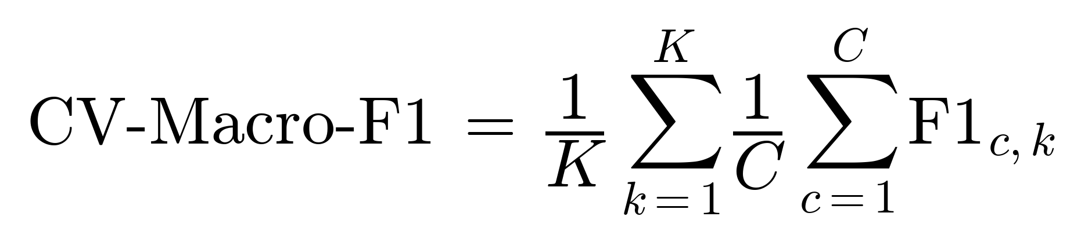
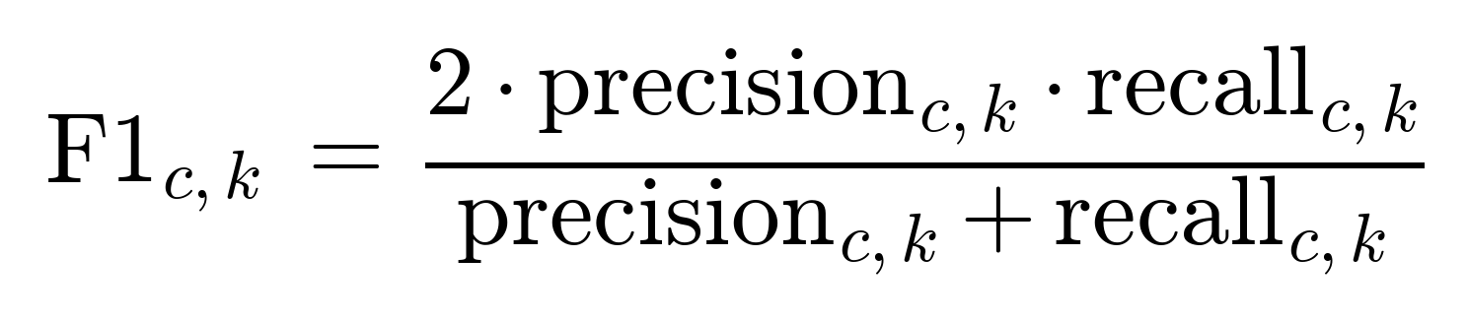
Validation — Cross-Validation as Our Truth Test
Equation:
where K = 5 folds, C = 9 classes, and F1 of class c in fold k is:
Why this metric: -
Macro-F1 weights every class equally → rewards minority-class performance.
StratifiedKFold preserves class distribution across folds → prevents biased splits.
5 folds → each trial trains 5 models, averaging out lucky/unlucky splits.
Diagram suggestion: show 5 horizontal bars representing the dataset, each split into 4/5 train (blue) + 1/5 val (orange) with the orange block shifting position across the 5 bars.

Slide 11
Validation — Problems Faced & Mitigations
#
Problem
Mitigation
Validation overfitting — single-split Optuna picked configs that won by luck, not generalization.
Class imbalance — no_movement dominated 36% of windows; could score 36% by predicting "rest" always.
1
Class imbalance — no_movement dominated 36% of windows; could score 36% by predicting "rest" always.
Applied sample_weight="balanced" and used Macro-F1 as primary metric.
2
Data-vs-balance tradeoff — longer windows improved class balance but halved the training set (1600 → 800).
Acknowledged as fundamental limit; needs more subjects, not more tuning.
3

Slide 12
Key Insights — What Moved the Needle
The optimization hierarchy we discovered: -
Data pipeline tuning (window size, threshold α) gave the biggest gain — ~6 pp accuracy improvement.
Hyperparameter tuning alone gave only marginal gains (~1 pp) and risked validation overfitting.
CV + class weighting balanced per-class performance — accuracy 48.6 → 47.6% but Macro-F1 jumped 0.28 → 0.38.
The class-weighting tradeoff is the right one for BCI: catching rare finger actions matters more than just predicting "rest".
Takeaway: Optimize the data before the model; in imbalanced safety-critical problems, balance > raw accuracy.

Slide 13
Key Insights — Where the Ceiling Is
What the optimization revealed about fundamental limits..
Three independent optimization passes (single-val Optuna, CV-Optuna, joint window+threshold+hyperparameters) all converged around 48–52% accuracy / 0.38–0.44 Macro-F1.
This convergence tells us hyperparameter tuning has hit its ceiling — further gains require changing the problem, not the optimizer.
The real bottleneck is information content: 62 channels on one subject with statistical features can only carry so much movement-related signal.
To break the ceiling: more subjects, frequency-domain features, or richer architectures (LSTM, transformer).
Takeaway: When multiple optimization strategies plateau at the same point, you've found the data's information ceiling — not a tuning failure.

Slide 14
Major Conclusions — Viability
Was our approach viable? Yes, with caveats.
Manual baseline reached 48.6% accuracy and 0.28 Macro-F1 on a 9-class problem — confirms the end-to-end pipeline works far above the 11% random baseline.
Joint optimization (window + threshold + hyperparameters) improved CV Macro-F1 from 0.34 → 0.44 — a meaningful gain from systematic tuning.
The optimization story is honest: each layer (data pipeline, then hyperparameters) contributed, but ~48% is the real ceiling for single-subject, 9-class decoding with statistical features.

Slide 15
Major Conclusions — Difficulties
Problems we ran into and how we handled them:
Validation overfitting — single-split Optuna picked configs that won by luck; fixed with 5-fold cross-validation.
Class imbalance — no_movement dominated 36% of windows; required class_weight='balanced' sample weighting.
Numerical instability — RMS computation triggered sqrt warnings on int32 data; fixed by casting to float64.
Non-convex loss — XGBoost has no global-optimum guarantee; different Optuna runs find different "best" configs.
Data-vs-balance tradeoff — longer windows improved class balance but halved the training set, capping further gains.

Slide 16
Future Work
With more time, compute, and funding...
Bigger data — combine all 3 BCI Competition patients with proper spatial electrode alignment; augment with Stanford ECoG Library.
Better models — per-subject training, LSTM/transformer for temporal context, frequency-domain features (high-gamma band power).
Working prototype — deploy on Arduino-controlled robotic hand for real-time closed-loop BCI demo.
Path to billions — partner with hospitals for clinical trials, patent the optimization pipeline, compete with Neuralink in the assistive BCI market.

