Slide 1

Real-Time Twitter Sentiment and Emotion Analysis
Internal Guide
Prof. Shivangi Matieda

Slide 2
Group Members :
Gaurav Agrawal (20C21002)
Smit Miyani (20C21031)

Slide 3
Domain of Work
Social Media Analytics:
Discuss the broader scope of social media analytics.
Highlight the significance of understanding user sentiments on platforms like Twitter for businesses, marketing, and public opinion analysis.

Slide 4
Problem Statement
The rise of social media necessitates the development of more robust and accurate methods for sentiment and emotion analysis. Platforms like Twitter, where informal language, slang, and emojis are prevalent, pose unique challenges for traditional sentiment analysis tools. These challenges can lead to inaccurate or misleading results, hindering the ability to gain valuable insights from social media data. This project aims to address these limitations by investigating the effectiveness of pre-trained sentiment analysis models, which have been trained on large amounts of text data and may offer improved accuracy in capturing the nuances of social media language.

Slide 5
Proposed Solution
Advanced Sentiment Analysis:
State-of-the-art algorithms for enhanced accuracy.
Real-time Processing:
Real-time analysis of Twitter data.
Emotion Recognition:
Advanced NLP for nuanced emotion understanding.
User-Friendly Interface:
Intuitive web interface for easy interaction.

Slide 6
Use In Different Domain
This tools has numerous applications in various fields, including:
Customer feedback analysis
Business and Branding
Political Analysis
Sports
By analyzing the emotions and opinions expressed in text data, we can gain insights into how people feel about a particular topic, brand, or issue.

Slide 7
Understanding Sentiment and Emotion classification in Tweets
Challenge: Analyzing emotions and sentiment in tweets is crucial, but informal language and slang pose challenges for traditional methods.
Limitation: Machine Learning (ML) and Deep Learning (DL) models often struggle to capture the full context of tweets.
Solution: Transformer-based models, like RoBERTa, excel at understanding context due to their self-attention mechanism.
Benefits: RoBERTa achieves state-of-the-art performance in sentiment and emotion analysis tasks on tweets.

Slide 8
cardiffnlp/twitter-roberta-base-sentiment
This is a roBERTa-base model trained on ~58M tweets and finetuned for sentiment analysis with the TweetEval benchmark. This model is suitable for English. Labels: 0 -> Negative; 1 -> Neutral; 2 -> Positive
Model description
RoBERTa is a transformers model pretrained on a large corpus of English data in a self-supervised fashion. This means it was pretrained on the raw texts only, with no humans labelling them in any way (which is why it can use lots of publicly available data) with an automatic process to generate inputs and labels from those texts.
More precisely, it was pretrained with the Masked language modeling (MLM) objective. Taking a sentence, the model randomly masks 15% of the words in the input then run the entire masked sentence through the model and has to predict the masked words. This is different from traditional recurrent neural networks (RNNs) that usually see the words one after the other, or from autoregressive models like GPT which internally mask the future tokens. It allows the model to learn a bidirectional representation of the sentence.
This way, the model learns an inner representation of the English language that can then be used to extract features useful for downstream tasks: if you have a dataset of labeled sentences for instance, you can train a standard classifier using the features produced by the BERT model as inputs.

Slide 9
System Design
Front End Design (using Django Templates):
User Interface (UI):
Homepage:
Offers two functionalities: Sentiment Analysis and Emotion Analysis.
Sentiment Analysis Page:
Allows users to:
Import live tweets by hashtag (#) or username (@).
Optionally type their own tweet for analysis.
Displays results table with tweet text, predicted sentiment (positive, negative, neutral), and corresponding emoji, and visualization analysis dash
Emotion Analysis Page:
Similar to Sentiment Analysis page, but predicts emotion (joy, sadness, anger, etc.) using the chosen model.
Displays results table with tweet text, predicted emotion, and corresponding "glowed" emoji.

Slide 10
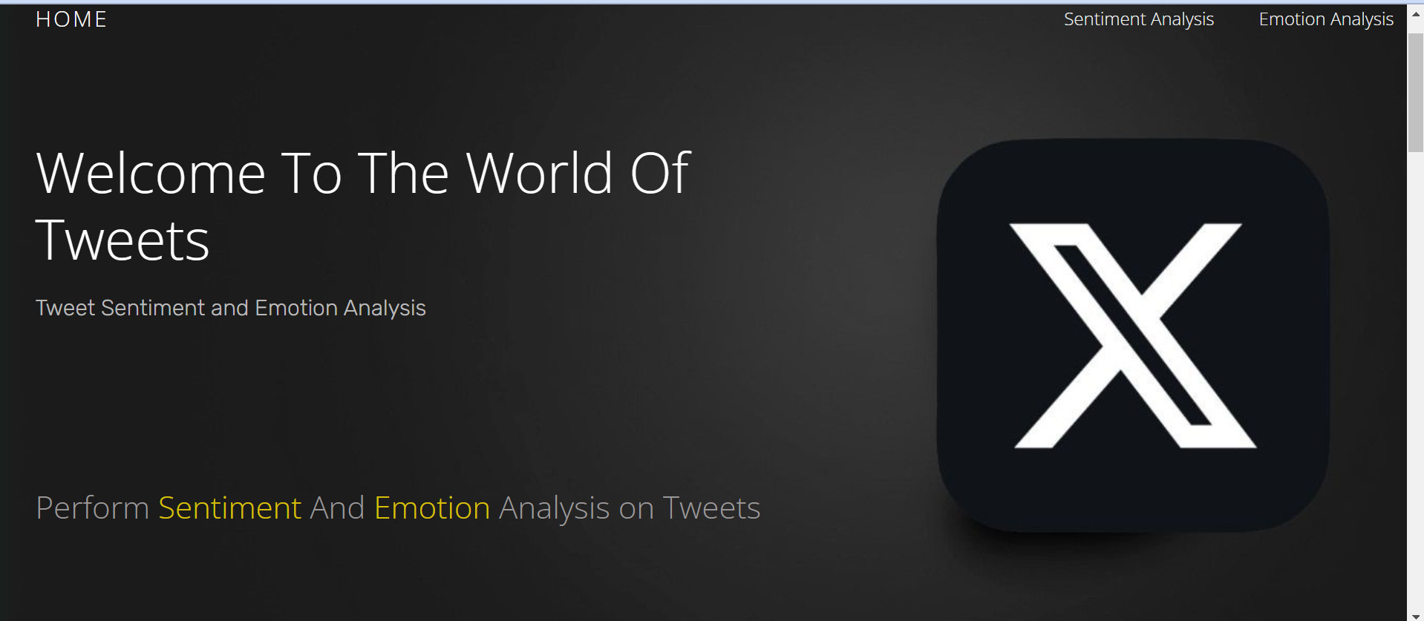

Slide 11
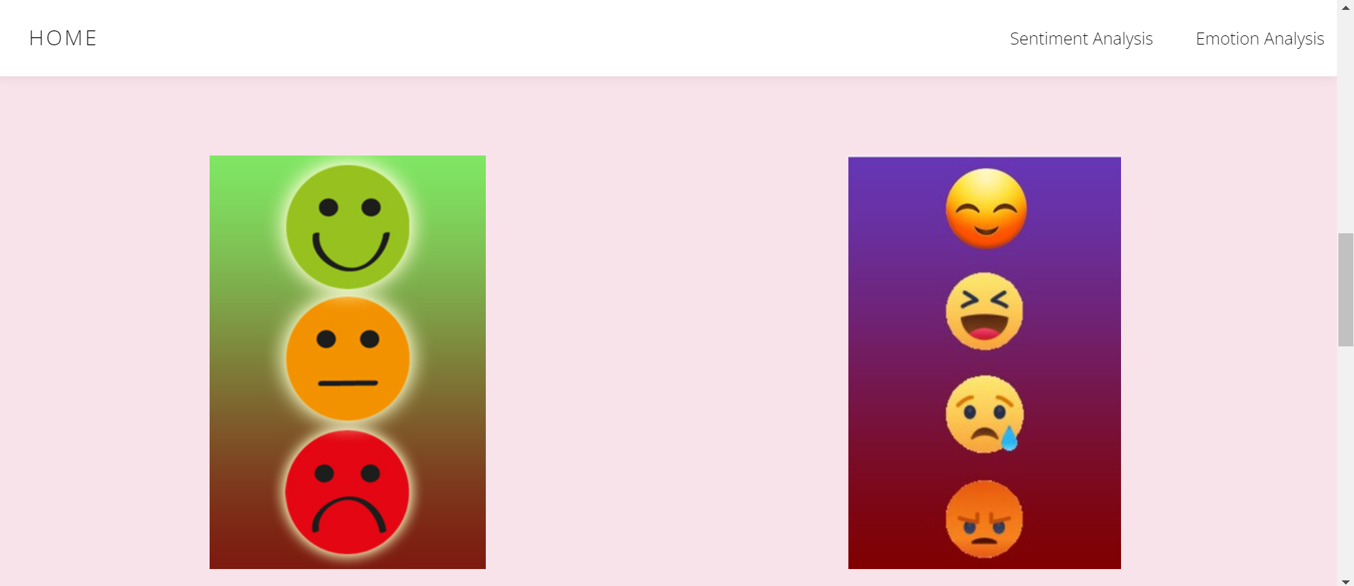

Slide 12
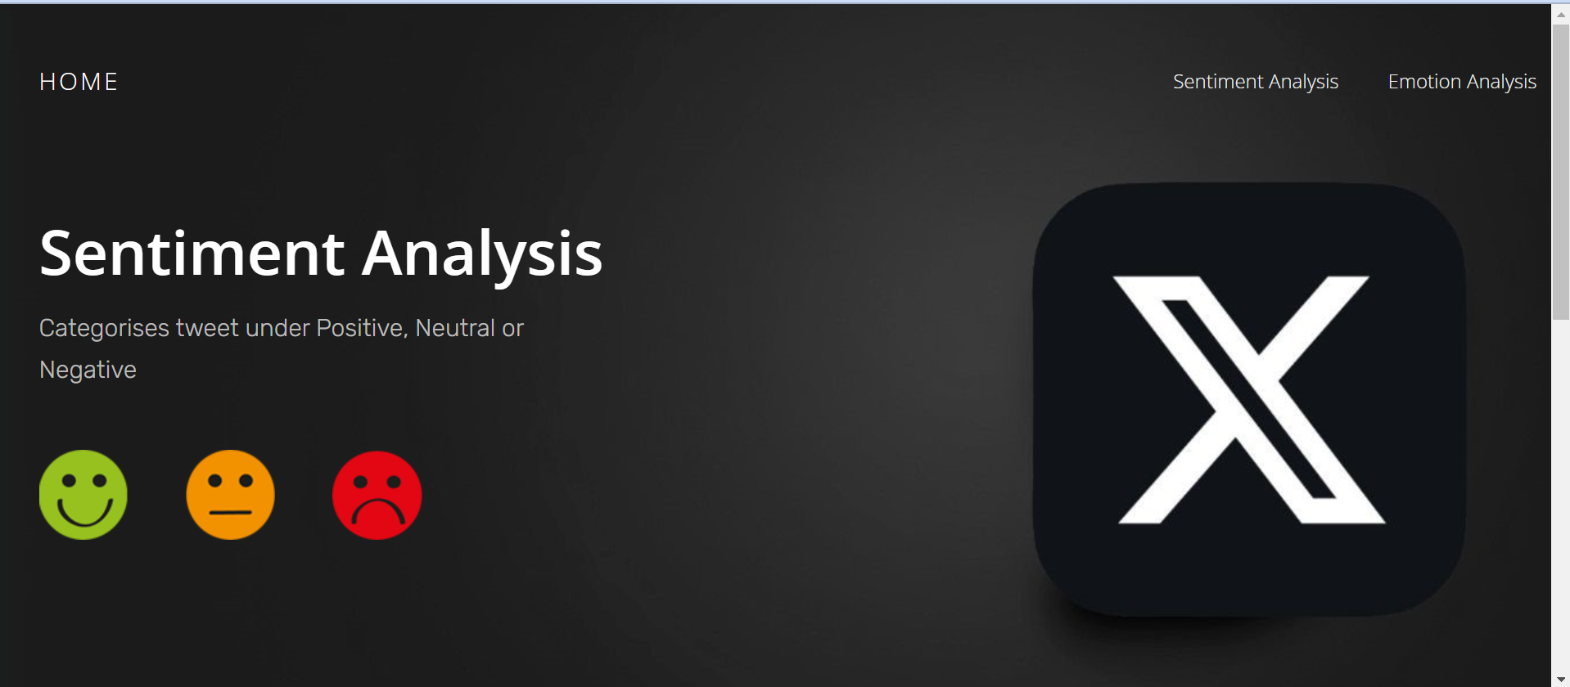

Slide 13
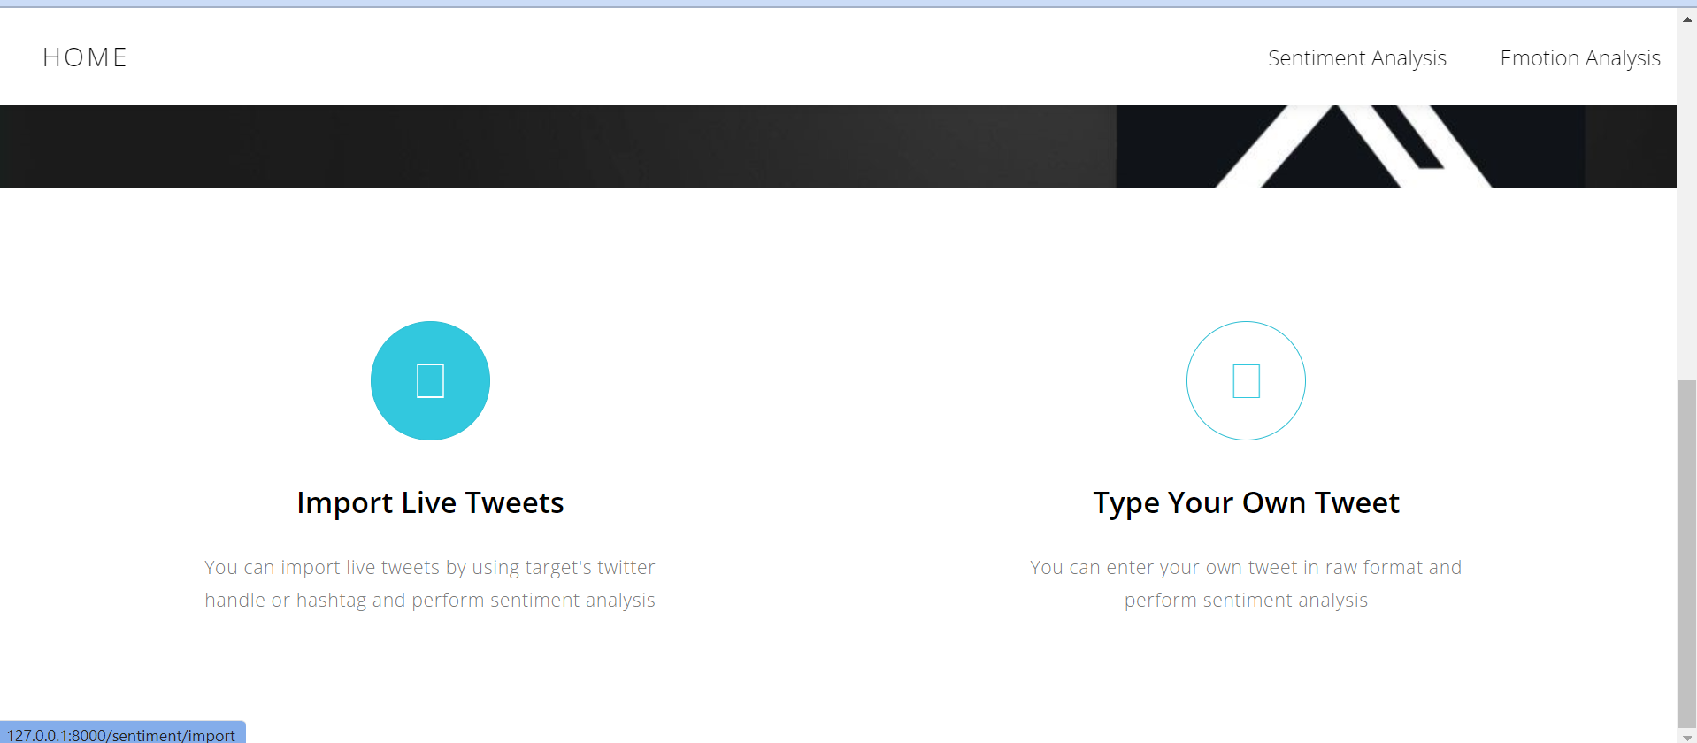

Slide 14
System design: Tweet Analysis Visualization & Dash
Sentiment Distribution: Users can interact with pie charts, bar charts, and donut charts to understand the overall distribution of positive, negative, and neutral sentiment.
Sentiment Trend Over Time: Line charts allow users to visualize how sentiment changes over time, identifying peaks and troughs in emotional response.
Tweet Word Analysis Word Cloud: Word clouds visually represent the most frequent words associated with different sentiment categories. This helps identify key terms driving positive or negative sentiment.
User Engagement by Sentiment: Charts (type to be determined) reveal how user engagement metrics (favorite, retweet, reply) vary based on sentiment.

Slide 15
System Design
Backend Design (using Django and Python):
Tweet Scraping Module (TwiKit):
Uses TwiKit library to fetch tweets based on user input (hashtags, usernames).
Handles authentication with Twitter API.
Text Pre-processing Module:
Cleans tweets (removes irrelevant characters, URLs, etc.).
Applies tokenization (breaks text into individual words).

Slide 16
System Design
Sentiment/Emotion Analysis Module:
This module integrates the transformers library from Hugging Face:
Loads the pre-trained models:
cardiffnlp/twitter-roberta-base-sentiment for sentiment analysis.
cardiffnlp/twitter-roberta-base-emotion for emotion analysis.
These models are specifically chosen because they are fine-tuned on tweet data, leading to superior performance for your application.
Utilizes PyTorch, the deep learning framework upon which transformers are built.
Takes pre-processed tweets as input and predicts sentiment/emotion using the loaded models.

Slide 17
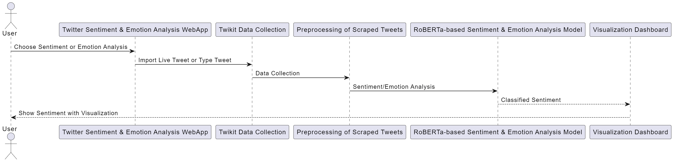
System Design

Slide 18
Algorithms/Steps of Implementation
1. Tweet Scraping:
Algorithm:
Define the search query (username or hashtag) based on user input.
Choose a library: Select either Twikit (user-friendly) or Tweepy (granular control) for interacting with the Twitter API.
Twikit:
If using Twikit, handle user login securely:
Use environment variables or a configuration file to store login credentials.
Implement a login flow for the user to provide their Twikit credentials securely.
Once logged in, use Twikit's functionalities to search for tweets based on the query (username or hashtag).

Slide 19
Algorithms/Steps of Implementation
2. Text Pre-processing:
Algorithm:
Apply regular expressions and Natural Language Processing (NLP) techniques.
Remove URLs, hashtags, special characters, and punctuation (optional: keep emojis).
Convert text to lowercase.
Tokenize text (split into individual words).
Optionally: Apply stemming or lemmatization (reduce words to their base form).

Slide 20
Algorithms/Steps of Implementation
3. Sentiment/Emotion Analysis: (using Transformers library)
Algorithm:
1. Preprocessing (built-in): RoBERTa-base likely handles basic text cleaning and tokenization internally.
2. Word Embeddings (built-in): RoBERTa-base leverages pre-trained word embeddings to represent text as numerical vectors.
3. Model Prediction: The model directly predicts sentiment labels (positive, negative, neutral) for new text data based on its learned patterns.

Slide 21
Tools and Technology selected for Implementation
Backend:
Programming Language: Python (widely used for web development and data science)
Web Framework: Django (popular Python framework for building web applications)
Tweet Scraping Libraries:
Twikit (user-friendly library for read/scrape real-time tweets)
Text Pre-processing Libraries:
NumPy (for numerical computations and array manipulation)
Regular Expressions (built-in Python module for pattern matching in text)
Sentiment/Emotion Analysis Library: Transformers (powerful library for working with pre-trained deep learning models)
PyTorch: Deep learning framework often used with Transformers

Slide 22
Tools and Technology selected for Implementation
Frontend:
HTML: for structuring the content of web pages
CSS: for styling the visual appearance of web pages
JavaScript :
Django Templates: Django's templating system for creating dynamic web pages

Slide 23
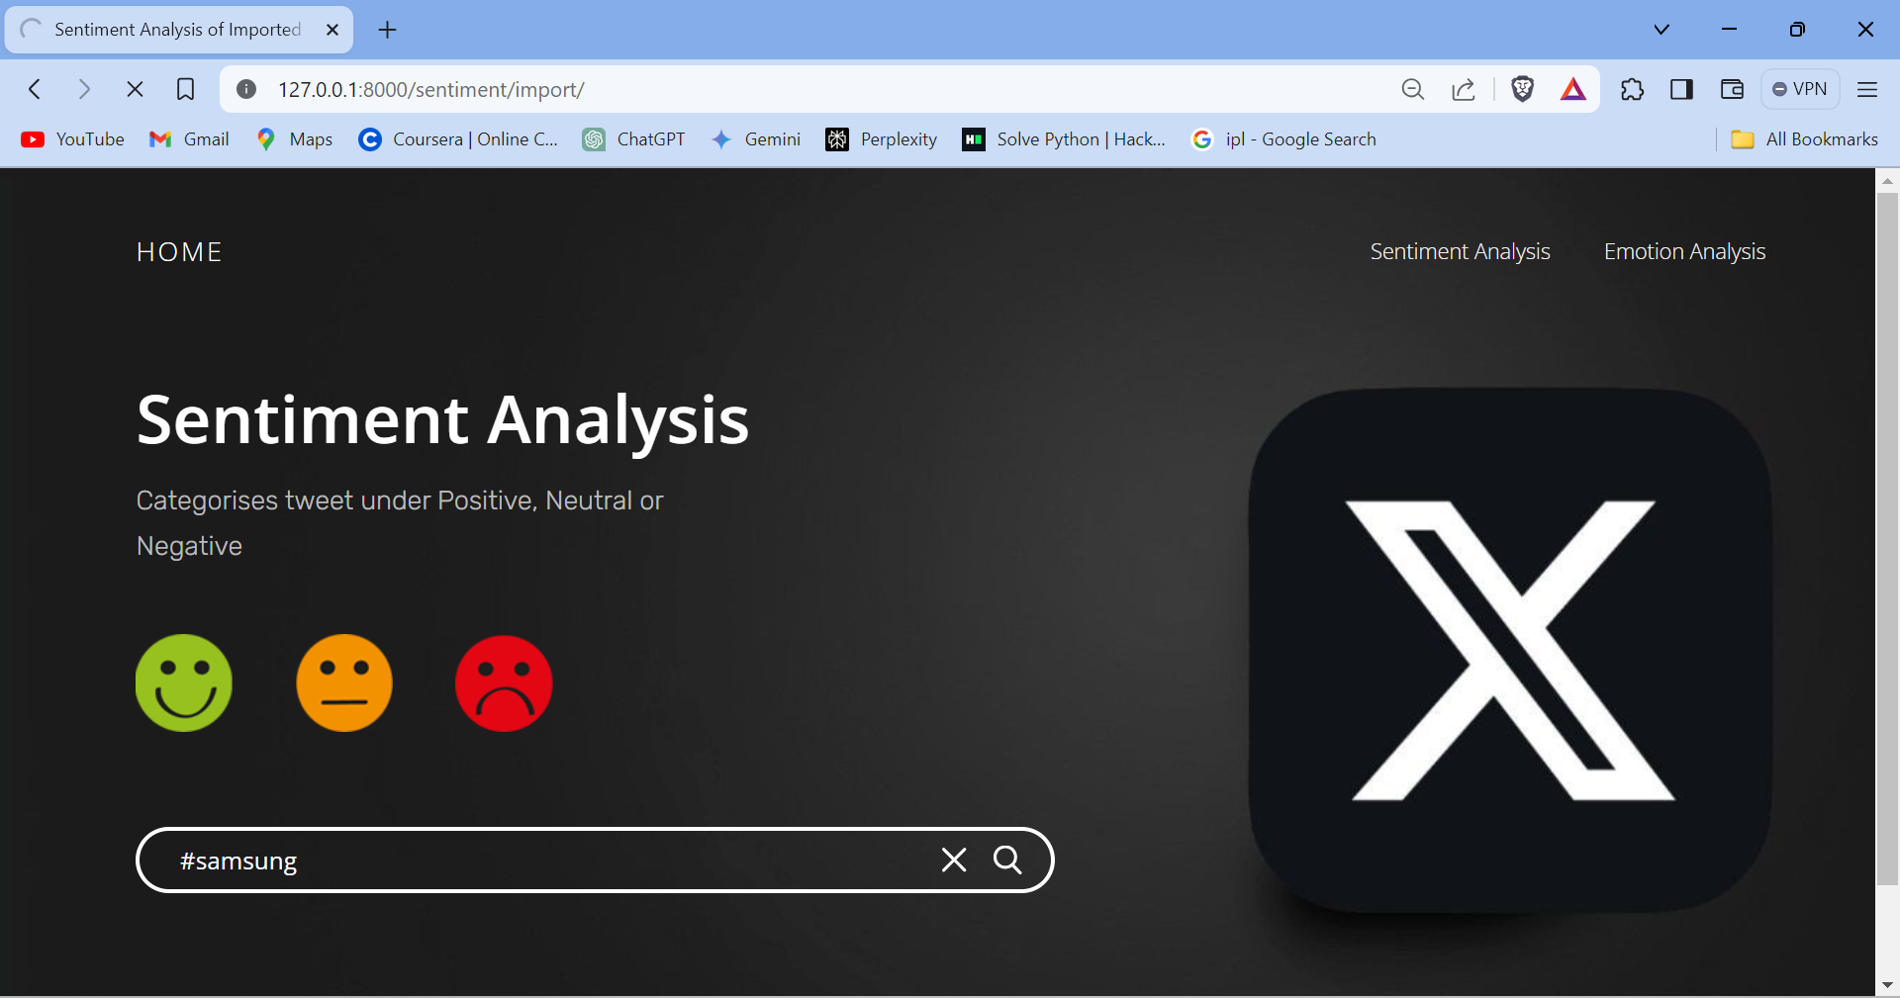
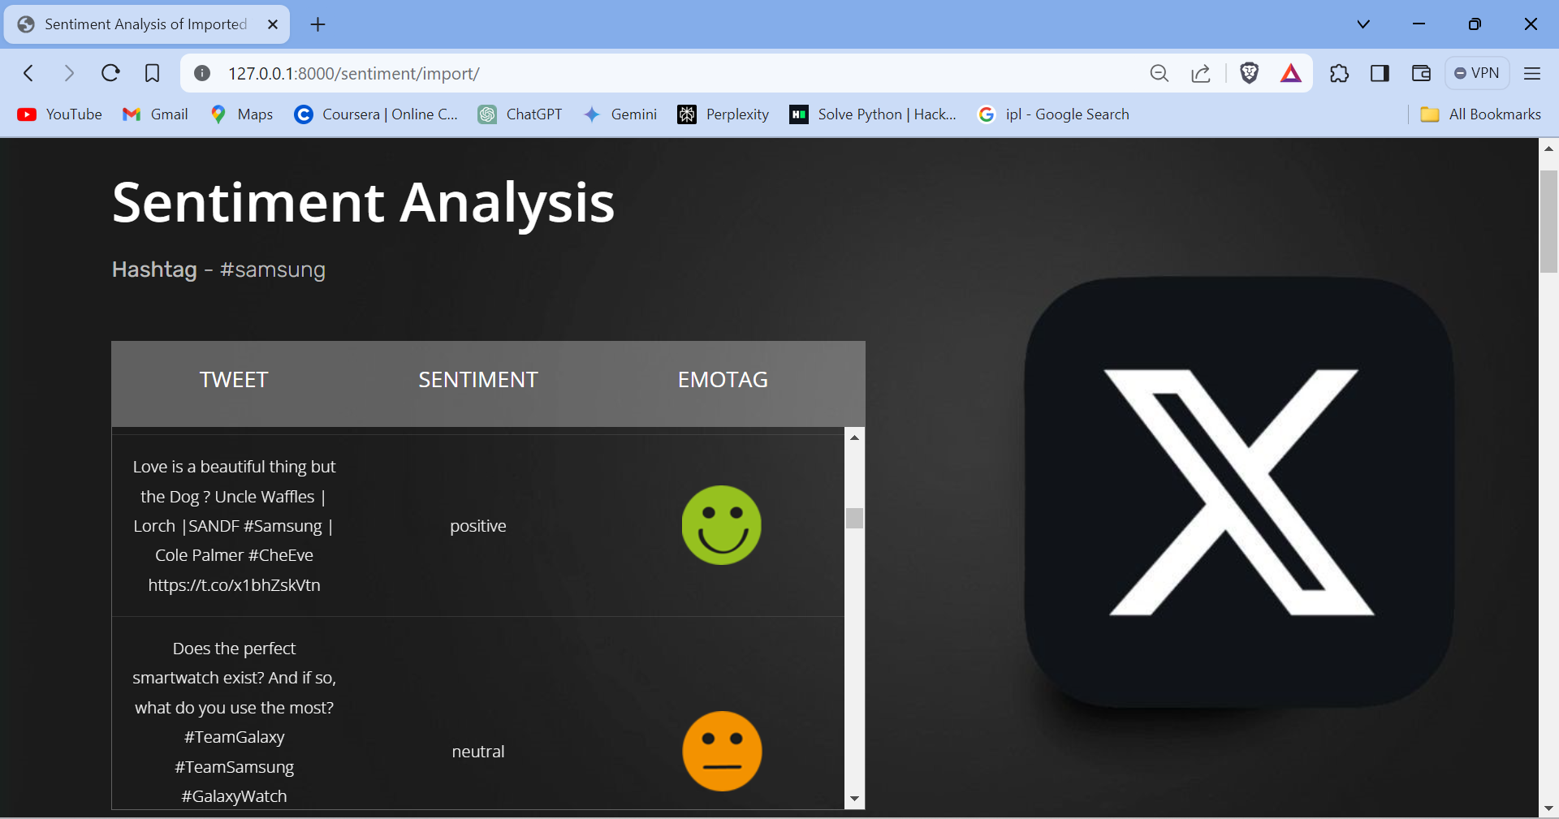
Sentiment Analysis Webapp

Slide 24
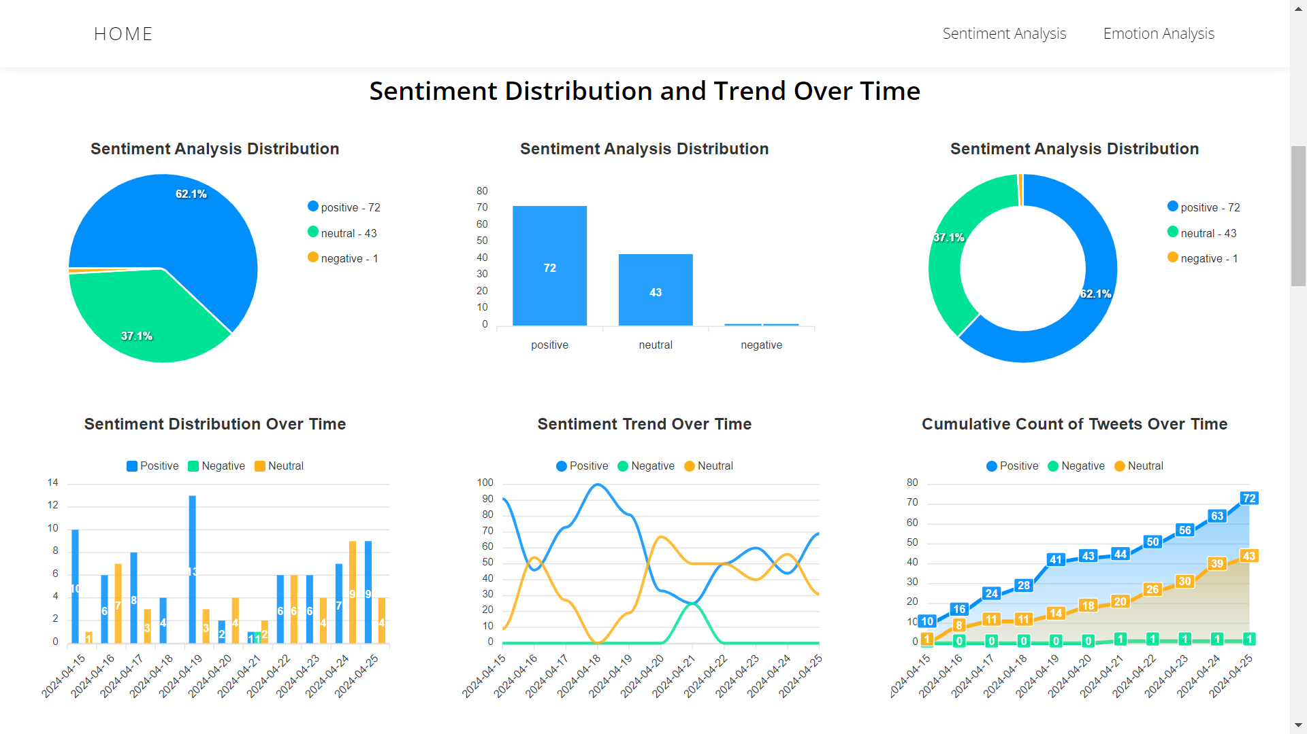
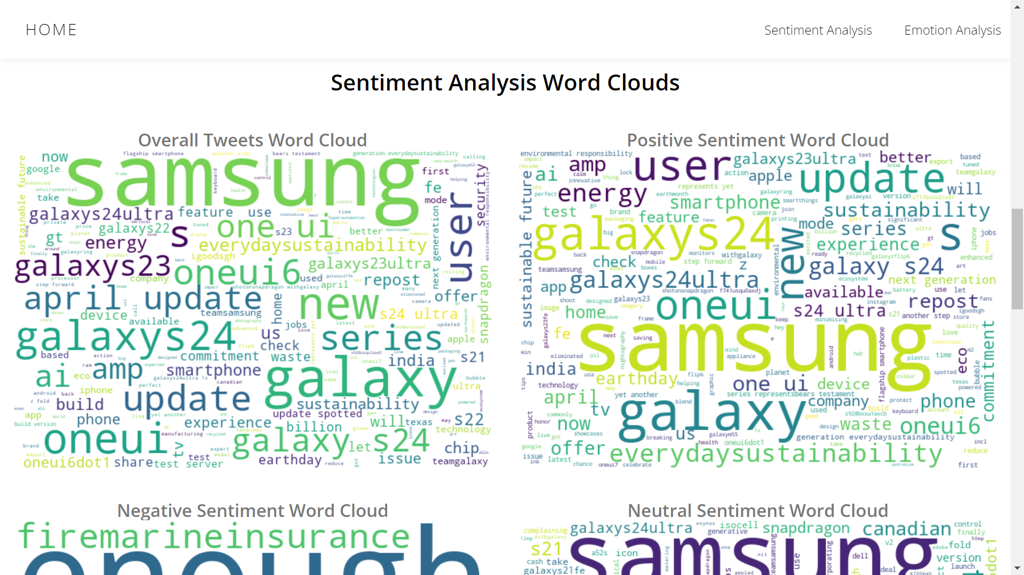
Sentiment Analysis Webapp

Slide 25
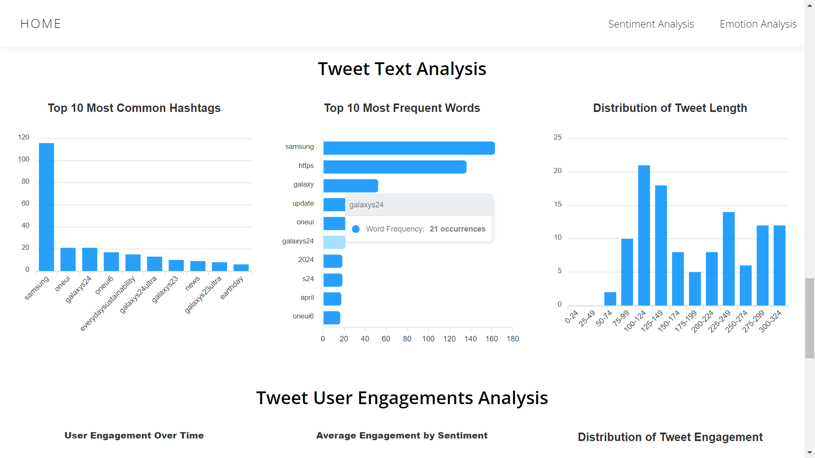
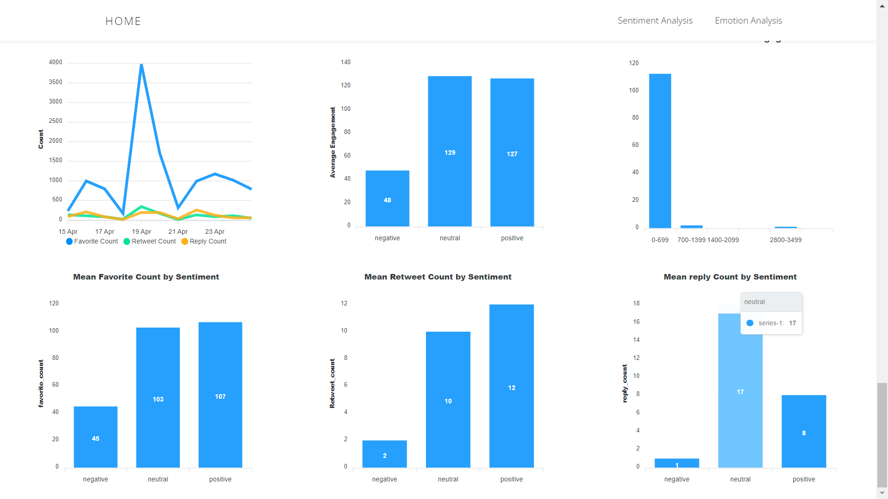
Sentiment Analysis Webapp

Slide 26
Conclusion
The Twitter Sentiment and Emotion Analysis Web App represents a powerful tool with versatile applications spanning business, politics, customer service, events, and market research. This platform provides real-time insights, enabling users to make informed decisions promptly.
Its impact on brand reputation, political strategies, customer experience, event planning, and market trends underscores its significance in the digital landscape.
Through the integration of cutting-edge sentiment and emotion analysis models, the project contributes to the advancement of natural language processing and machine learning techniques.
In summary, this web app empowers users with actionable insights derived from real-time data, facilitating informed decisions and strategic initiatives across diverse industries.

Slide 27


