Slide 1

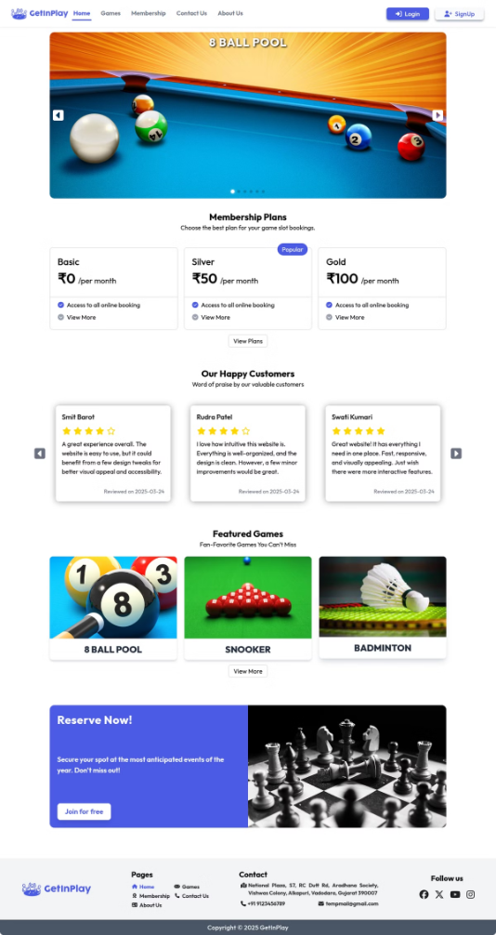
GetInPlay - Game Slot Booking System
Welcome to an overview of my web development internship at GetInPlay. During the period of Jan 20, 2025 to March 18, 2025 I worked with the Web Development team to create a real-time booking application.
Smit Barot
220413116001

Slide 2
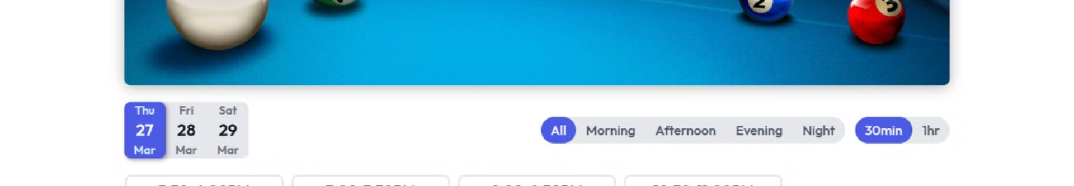
Project Overview: Real-time Game Slot Booking
The goal was to develop a real-time system for booking game slots. The technologies used were PHP, MySQL, and JavaScript (with AJAX), React JS, Tailwind CSS. The system provides a user-friendly interface and real-time updates for both game center staff and customers.
Key Tech
Primary Users
PHP
Admin
MySQL
Customers
JavaScript (AJAX)
React JS
Tailwind CSS

Slide 3
User Authentication and CRUD Operations
I implemented secure login/logout functionality. I also developed CRUD (Create, Read, Update, Delete) operations using PHP and MySQL. This included user registration with email sending on register and admin panels for managing user accounts.
Features
Technologies
Secure Login
PHP
Email While Registration
MySQL
Admin Panels

Slide 4

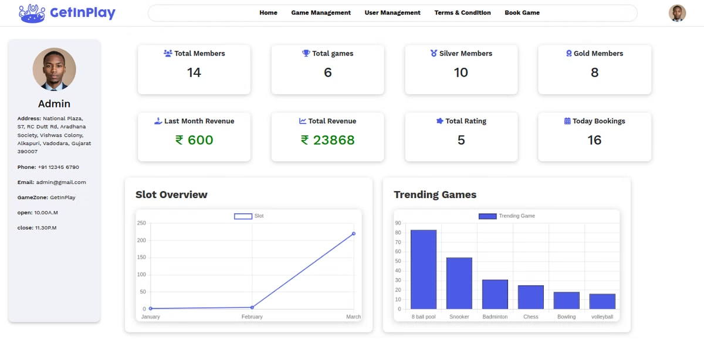


Key Tasks & Responsibilities: AJAX Updates
Implemented AJAX for real-time data updates. This improved user experience by eliminating page reloads. Technologies used: JavaScript, jQuery, and PHP. I also programmed real-time updates of available game slots and instant booking confirmation messages.
Real-time Updates
Better UX

Slide 5



Admin Dashboard: Game & User Management
I designed and implemented the admin dashboard. Key functionalities included managing games (add, edit, delete) and users (create, update, delete), and viewing booking statistics. I also created interactive charts to display booking trends and implemented role-based access control.
Manage Games
Manage Users
Booking Stats

Slide 6
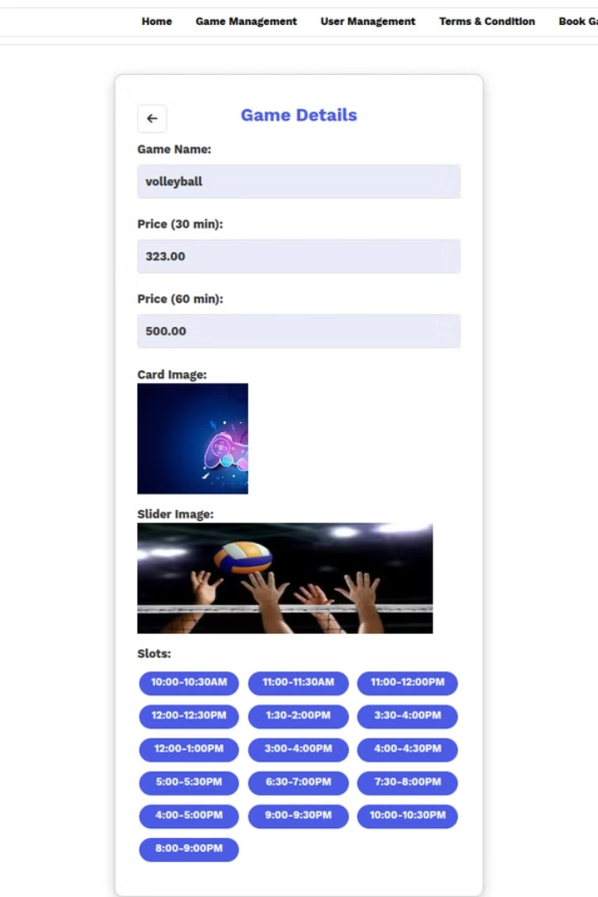
User Booking Flow & Responsive Design
I designed a seamless user booking experience and ensured responsive design across devices using HTML, CSS, JavaScript, and Bootstrap. I applied a mobile-first approach, optimizing the system for various screen sizes and resolutions. I created prototypes before development.
1
UI Design
2
Prototypes
3
Development

Slide 7




Challenges Faced: Database Synchronization
One issue I faced was database synchronization problems with real-time updates. This was due to concurrent user bookings leading to data conflicts. The solution was to implement locking mechanisms and transaction management, resolving synchronization issues and ensuring data integrity.
Identify
1
Root Cause
2
4
Outcome
3
Solution

Slide 8
Skills Growth: Frontend and Backend
I enhanced my frontend skills in HTML, CSS, JavaScript, React JS and UI/UX design. I also strengthened my backend skills in PHP, MySQL, and database management. Improved problem-solving abilities and debugging skills. I gained experience working in a collaborative environment.
1
Frontend
2
Backend
3
Problem Solving

Slide 9
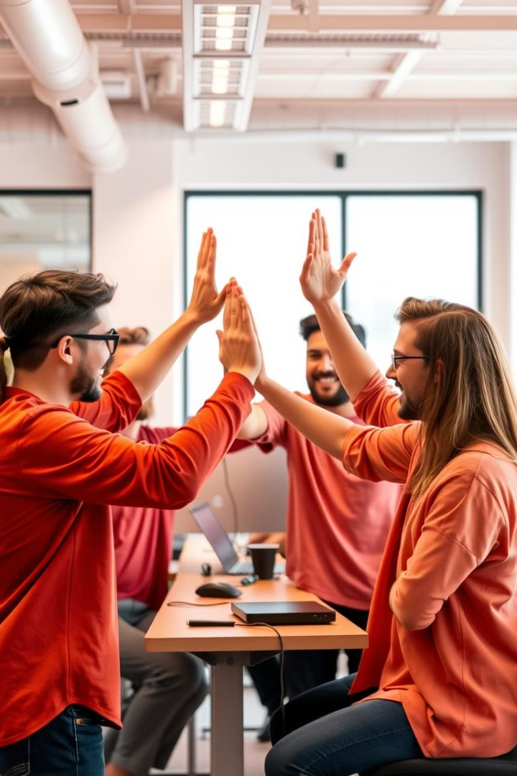
Conclusion & Acknowledgements
I gained valuable hands-on experience in web development. Thank you to the Svaapta IT-Ally Solution's team for their guidance and support. My mentor provided invaluable advice. My future goals include continued learning and growth.

