Slide 1
A Reinforcement Learning Environment For Job-Shop Scheduling

Slide 2
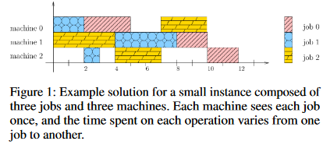
Job Shop Scheduling(JSS)
J are Jobs
M are Machines
O are Operations that Machine needs to perform to finish the job.

Slide 3
What is RL
States
Actions
Reward
Proximal Policy Optimization algorithm
What is the next question in here?

Slide 4
Why RL and not other methods?
Traditional methods do not learn new changes.
Replication of real environment.

Slide 5
What has already been done?
Image with all the details of the schedule.
18 dispatching rules
Multi-agent policy(Graph Neural Network)
Reward function complexity.
Cooperation
SAT problem, TSP, Graph optimization, limited work in case of scheduling.

Slide 6
Environment and search space reduction
Single Agent algorithm
Discrete action space with No-Op action
Multiple instance when No-Op could occur.
Non-final Prioritization
At any time step, allocating the jobs doesn't matter.

Slide 7

Reward Function
Traditional Metric of minimizing the time is not helpful
Not at the end of the episode but after every time step.
Dense reward function
Difference of the operations and the holes introduced in the machine.
Drawback for this reward function

Slide 8
State Representation
J*7 matrix
(a1) A Boolean to represent if the job can be allocated.
(a2) The left-over time for the currently performed operation on the job. This value is scaled by the longest operation in the schedule to be in the range [0, 1].
(a3) The percentage of operations finished for a job.
(a4) The left-over time until total completion of the job, scaled by the longest job total completion time to be in the range [0, 1].
(a5) The required time until the machine needed to perform the next job’s operation is free, scaled by the longest duration of an operation to be in the range [0, 1].
(a6) The IDLE time since last job’s performed operation, scaled by the sum of durations of all operations to be in the range [0, 1)
(a7) The cumulative job’s IDLE time in the schedule, scaled as a6 to be in the range [0, 1).

Slide 9
Implementation
Using RLLib, Weights and Biases, OpenAI Gym

