Slide 1
Building A Machine Learning Model On Breast Cancer Data

Slide 2
Introduction
Breast cancer (BC) is one of the most common cancers among women worldwide, representing the majority of new cancer cases and cancer-related deaths according to global statistics, making it a significant public health problem in today’s society. The early diagnosis of BC can improve the prognosis and chance of survival significantly, as it can promote timely clinical treatment to patients.

Slide 3
Motivation
The early diagnosis of BC can improve the prognosis and chance of survival significantly, as it can promote timely clinical treatment to patients. Further accurate classification of benign tumors can prevent patients undergoing unnecessary treatments. Thus, the correct diagnosis of BC and classification of patients into malignant or benign groups is the subject of much research. Because of its unique advantages in critical features detection from complex BC datasets, machine learning (ML) is widely recognized as the methodology of choice in BC pattern classification and forecast modelling.
Classification and data mining methods are an effective way to classify data. Especially in medical field, where those methods are widely used in diagnosis and analysis to make decisions.

Slide 4
Some Risk Factors for Breast Cancer
The following are some of the known risk factors for breast cancer. However, most cases of breast cancer cannot be linked to a specific cause.
Age. The chance of getting breast cancer increases as women age. Nearly 80 percent of breast cancers are found in women over the age of 50.
Personal history of breast cancer. A woman who has had breast cancer in one breast is at an increased risk of developing cancer in her other breast.
Family history of breast cancer. A woman has a higher risk of breast cancer if her mother, sister or daughter had breast cancer, especially at a young age (before 40). Having other relatives with breast cancer may also raise the risk.
Genetic factors. Women with certain genetic mutations, including changes to the BRCA1 and BRCA2 genes, are at higher risk of developing breast cancer during their lifetime. Other gene changes may raise breast cancer risk as well.
Childbearing and menstrual history. The older a woman is when she has her first child, the greater her risk of breast cancer. Also at higher risk are:
Women who menstruate for the first time at an early age (before 12)
Women who go through menopause late (after age 55)
Women who’ve never had children

Slide 5
Workflow Goals and Methodology
We have built a machine learning model using data available for breast cancer cases predicting whether a tumor is benign(not harmful) or malignant(risky).
Classifying. We may want to classify or categorize our samples. We may also want to understand the implications or correlation of different classes with our solution goal.
Correlating. One can approach the problem based on available features within the training dataset. Which features within the dataset contribute significantly to our solution goal? Statistically speaking is there a correlation among a feature and solution goal? We usually remove the highly correlated features as Correlated features in general don't improve models (although it depends on the specifics of the problem like the number of variables and the degree of correlation), but they affect specific models in different ways and to varying extents.
Converting. For modeling stage, one needs to prepare the data. Depending on the choice of model algorithm one may require all features to be converted to numerical equivalent values. So for instance converting text categorical values to numeric values.
Completing. Data preparation may also require us to estimate any missing values within a feature. Model algorithms may work best when there are no missing values.
Correcting. We may also analyze the given training dataset for errors or possibly innacurate values within features and try to corrent these values or exclude the samples containing the errors. One way to do this is to detect any outliers among our samples or features. We may also completely discard a feature if it is not contribting to the analysis or may significantly skew the results.
Creating. Can we create new features based on an existing feature or a set of features, such that the new feature follows the correlation, conversion, completeness goals.
Charting. How to select the right visualization plots and charts depending on nature of the data and the solution goals.

Slide 6
Data Collection
Features are computed from a digitized image of a fine needle aspirate (FNA) of a breast mass. They describe characteristics of the cell nuclei present in the image. n the 3-dimensional space is that described in: [K. P. Bennett and O. L. Mangasarian: "Robust Linear Programming Discrimination of Two Linearly Inseparable Sets", Optimization Methods and Software 1, 1992, 23-34].
Attribute Information:
1) ID number 2) Diagnosis (M = malignant, B = benign) 3-32)
Ten real-valued features are computed for each cell nucleus:
radius (mean of distances from center to points on the perimeter)
b) texture (standard deviation of gray-scale values)
c) perimeter
d) area
e) smoothness (local variation in radius lengths)
f) compactness (perimeter^2 / area - 1.0)

Slide 7
g) concavity (severity of concave portions of the contour)
h) concave points (number of concave portions of the contour)
i) symmetry
j) fractal dimension ("coastline approximation" - 1)
The mean, standard error and "worst" or largest (mean of the three largest values) of these features were computed for each image, resulting in 30 features. For instance, field 3 is Mean Radius, field 13 is Radius SE, field 23 is Worst Radius.
All feature values are recoded with four significant digits.
Missing attribute values: none
Class distribution: 357 benign, 212 malignant

Slide 8
Data Cleaning and Processing
Data Scientists across the word have endeavored to give meaning to Data preprocessing. However, simply put, data preprocessing is a data mining technique that involves transforming raw data into an understandable format. Real-world data is often incomplete, inconsistent, and/or lacking in certain behaviors or trends, and is likely to contain many errors. Data preprocessing is a proven method of resolving such issues.
How is this done? Just like medical professionals getting a patient prepped for surgery so is data preprocessing, it prepares raw data for further processing. Below are the steps to be taken in data preprocessing
Data cleaning: fill in missing values, smooth noisy data, identify or remove outliers, and resolve inconsistencies.
Data integration: using multiple databases, data cubes, or files.

Slide 9
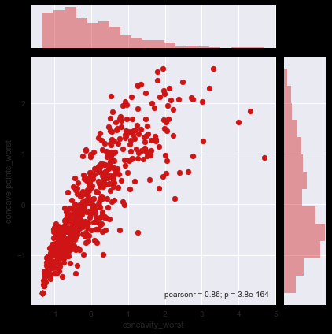
Data transformation: normalization and aggregation.
Data reduction: reducing the volume but producing the same or similar analytical results.
Data discretization: part of data reduction, replacing numerical attributes with nominal ones.

Slide 10
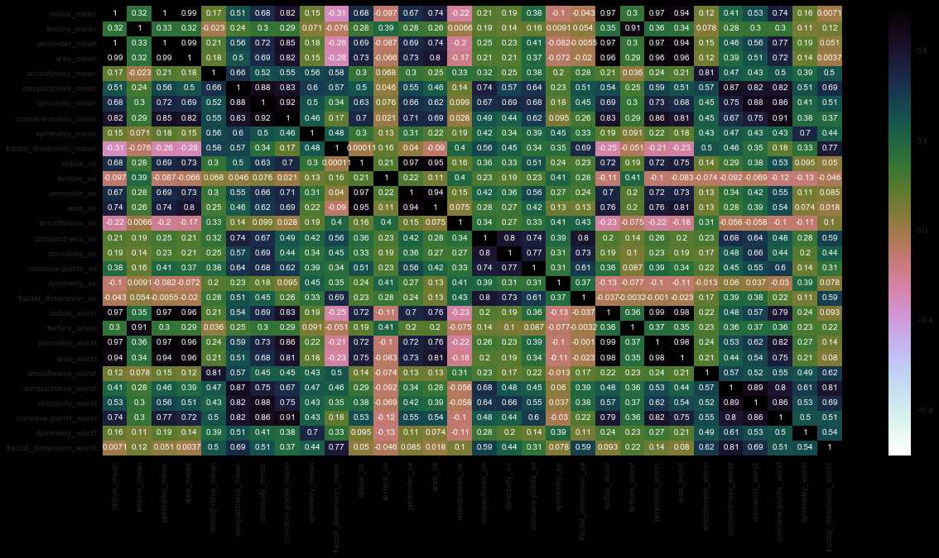
Plots
By using various plots such as lmplots, FacetGrids and Heatmaps we get the correlation between various features and it helps in eliminating highly correlated features and the features which do not help in classification
Before removing
unnecesarry features

Slide 11
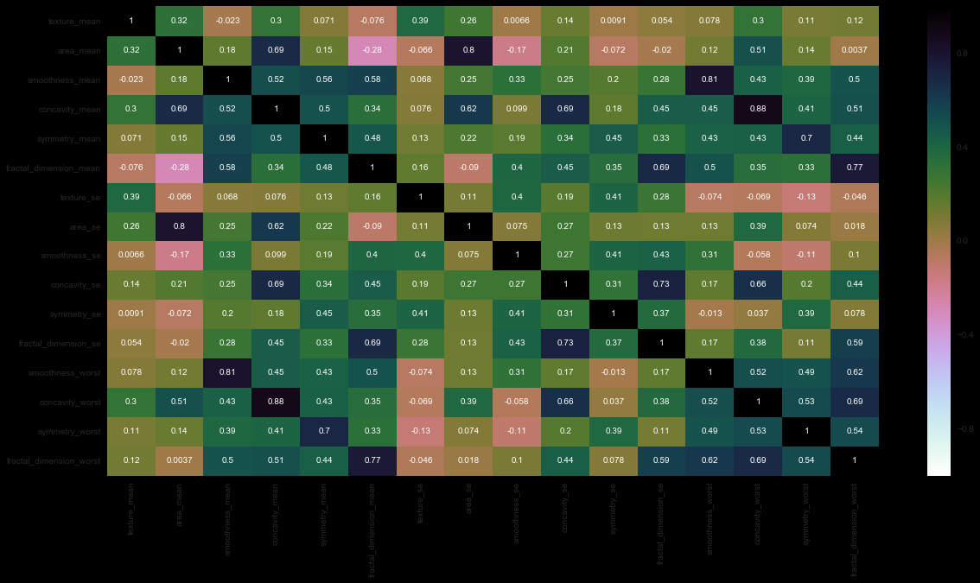
After Removal of
unnecessary features

Slide 12
Definition of ML Classifier
Since we will be using a machine learning model for our data hence the overview of what is machine learning and what are different classifiers is presented in the following slides.
Definition of Machine Learning from dictionary.com
“The ability of a machine to improve its performance based on previous results.”
So, machine learning document classification is “the ability of a machine to improve its document classification performance based on previous results of document classification”.

Slide 13
Supervised vs. unsupervised Learning
Supervised learning: classification is seen as supervised learning from examples.
Supervision: The data (observations, measurements, etc.) are labeled with pre-defined classes. It is like that a “teacher” gives the classes (supervision).
Test data are classified into these classes too.
Unsupervised learning (clustering)
Class labels of the data are unknown
Given a set of data, the task is to establish the existence of classes or clusters in the data

Slide 14
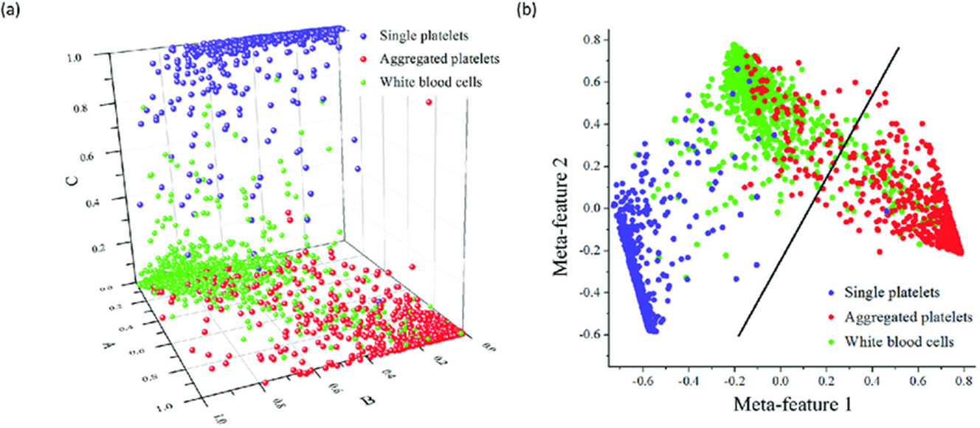
Classification—A Two-Step Process
Model construction: describing a set of predetermined classes
Each tuple/sample is assumed to belong to a predefined class, as determined by the class label attribute
The set of tuples used for model construction is training set
The model is represented as classification rules, decision trees, or mathematical formulae
Model usage: for classifying future or unknown objects
Estimate accuracy of the model
The known label of test sample is compared with the classified result from the model
Accuracy rate is the percentage of test set samples that are correctly classified by the model
Test set is independent of training set, otherwise over-fitting will occur
If the accuracy is acceptable, use the model to classify data tuples whose class labels are not known

Slide 15
We will be using different models for the prediction of Breast Cancer using the given data. The models are explained in the following slides.

Slide 16
Naïve Bayes
This method computes the probability that a document is about a particular topic, T, using a) the words of the document to be classified and b) the estimated probability of each of these words as they appeared in the set of training documents for the topic, T – like the example previously given.

Slide 17
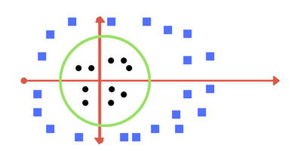
SVM(Support Vector Machine )
A Support Vector Machine (SVM) is a discriminative classifier formally defined by a separating hyperplane. In other words, given labeled training data (supervised learning), the algorithm outputs an optimal hyperplane which categorizes new examples. In two dimentional space this hyperplane is a line dividing a plane in two parts where in each class lay in either side.
Kernel
The learning of the hyperplane in linear SVM is done by transforming the problem using some linear algebra. This is where the kernel plays role.
Transforming back to x-y plane, a line transforms to circle.

Slide 18
Skewed DATA
Skewed classes basically refer to a dataset, wherein the number of training example belonging to one class out-numbers heavily the number of training examples beloning to the other.
In a binary classification, one of the following four scenarios may occur,
True Positive (TP): the model predicts 1 and the actual class is 1
True Negative (TN): the model predicts 0 and the actual class is 0
False Positive (FP): the model predicts 1 but the actual class is 0
False Negative (FN): the model predicts 0 but the actual class is 1

Slide 19
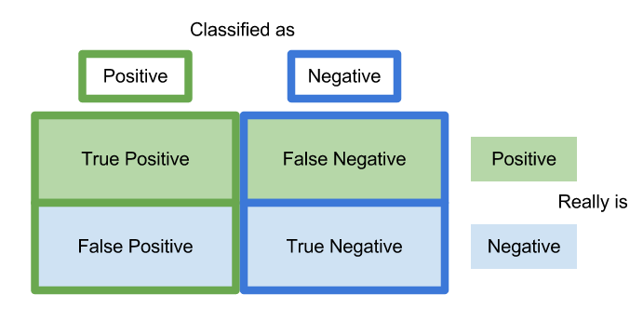
Classification of Skewed DATA

Slide 20
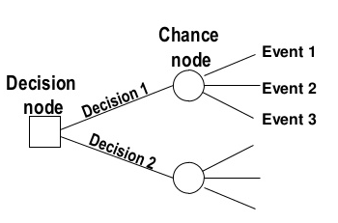
Introduction to decision tree
Decision tree learning is one of the most widely used techniques for classification.
Its classification accuracy is competitive with other methods, and
it is very efficient.
The classification model is a tree, called decision tree.
C4.5 by Ross Quinlan is perhaps the best known system. It can be downloaded from the Web.

Slide 21
Algorithm for decision tree learning
Basic algorithm (a greedy divide-and-conquer algorithm)
Assume attributes are categorical now (continuous attributes can be handled too)
Tree is constructed in a top-down recursive manner
At start, all the training examples are at the root
Examples are partitioned recursively based on selected attributes
Attributes are selected on the basis of an impurity function (e.g., information gain)
Conditions for stopping partitioning
All examples for a given node belong to the same class
There are no remaining attributes for further partitioning – majority class is the leaf
There are no examples left

Slide 22
Random forests
Random forests are bagged decision tree models that split on a subset of features on each split. This is a huge mouthful, so let’s break this down by first looking at a single decision tree, then discussing bagged decision trees and finally introduce splitting on a random subset of features.

Slide 23
Test Train Split and Cross Validation
We have implemented the model using python and we have used train_test_split for splitting the data into training and test sets.
We have used cross_val_score for checking our algorithms on the cross validation set which is an inbuilt python library.
We have also used Kfolds algorithm for checking the accuracy of the system.
The algorithms are explained below in brief-:
train_test_split-: We use the train_test_split function in order to make the split. The test_size=0.2 inside the function indicates the percentage of the data that should be held over for testing. It’s usually around 80/20 or 70/30.
cross_val_score-: cross_val_score" splits the data into say 5 folds. Then for each fold it fits the data on 4 folds and scores the 5th fold. Then it gives you the 5 scores from which you can calculate a mean and variance for the score. You crossval to tune parameters and get an estimate of the score. Cross-validation is a resampling procedure used to evaluate machine learning models on a limited data sample.
K Folds-:The procedure has a single parameter called k that refers to the number of groups that a given data sample is to be split into. As such, the procedure is often called k-fold cross-validation. When a specific value for k is chosen, it may be used in place of k in the reference to the model, such as k=10 becoming 10-fold cross-validation.
The general procedure is as follows:
Shuffle the dataset randomly.
Split the dataset into k groups
For each unique group:
Take the group as a hold out or test data set
Take the remaining groups as a training data set
Fit a model on the training set and evaluate it on the test set
Retain the evaluation score and discard the model
Summarize the skill of the model using the sample of model evaluation scores

Slide 24
Accuracy Of Prediction
The accuracy we get with the various machine learning algorithms are-:
Logistic Regression-: 98.25%
Support Vector Machines-: 97.37%
Decision Tree Classifier-: 92.28%
Random Forest Classifier-: 96.49%
KNeighborsClassifier-: 93.86%
The model is available as public repository on git hub in the following link-: https://github.com/sagar-rai/Building-A-Machine-Learning-Model-On-Breast-Cancer-Data
Hence we see that, by screening of the tumor and getting various features of the tumor, after analysing with the help of Machine Learning we can classify the tumor as benign or malignant with a very high accuracy and hence facilitate the proper forward treatment solutions for the tumor.

Slide 25
Future Scope
Largely, the appeal of ML is its ability to collect, analyze and make sense of vast amounts of unstructured and variable data—especially text, statistical numbers, and visual images—quickly and often more accurately than a human being. With the increase in digitization and computing power, there has been an ever-growing wealth of digital data produced by individuals and systems, and advances in machine learning and analytical algorithms mean ML systems will become ever more powerful and effective at performing their assigned tasks.
We’re already seeing innovative research into applications of ML across the medical and healthcare industries—some applications already seeing use, others still in development or testing but showing great promise.
And in the case of Breast Cancer prediction a large number of women die every year throughout the world due to BC and Machine Learning can help predicting breast cancer accurately and hence proper medication can then be taken.

Slide 26
Refrences
Andrew NG Machine Learning Coursera
http://archive.ics.uci.edu/ml/datasets/breast+cancer+wisconsin+%28diagnostic%29 -:for data collection
https://medium.com/datadriveninvestor/machine-learning-ml-data-preprocessing-5b346766fc48
https://machinelearningmastery.com/k-fold-cross-validation/
https://www.analyticsvidhya.com/blog/2018/05/improve-model-performance-cross-validation-in-python-r/
https://medium.com/@rabinpoudyal1995/train-test-split-and-cross-validation-in-python-434ecba10909

Slide 27
Thank You.
Regards,
Sagar Rai.

