Slide 1

Location based Taxi Aggregator and Selector
-A Taxi Aggregator Tracking and Booking System-
Milestone Submission
June 15, 2022
Done by:
Balaji Rajagopalan
Meenakshi
Smita Garg
Suresh Natarajan
Mentor :
Mr. Rohit Tiwari
IITM GL Cloud Group 5

Slide 2
Project Outline
Project Overview
Basic features
Advanced features
Architecture
Future Scope
Demo
Q&A
IITM GL Cloud Group 5

Slide 3
Project Overview
The Taxi Co-Op wants to build a competing solution to existing cab aggregators while keeping the power in the hands of users and drivers. We are developing a system to store real-time cab locations, respond to demands from customers based on proximity matches with available drivers. The whole solution are run on AWS.
This project is with limited scope to complete the basic requirements. Each user can make a request for a taxi at any time. They should be able to specify a taxi type preference including ‘All’.
System will respond to a user’s request with a limited list of closest taxis that match the requested taxi type. While doing the proximity matching using logic in the application code, the easier and preferable option is to use geospatial features in the database to automatically find relevant taxis.

Slide 4
Basic Features
Initial area boundary creation and User and Taxi registration
Taxi and user simulation code for 50 taxis and 5 users
Per minute taxi location update
Handle user request for booking a taxi
Scalable architecture which can handle large volume of customer requests, shift changes
Geo aware database – Document DB
Visualize the location of taxi and users in UI

Slide 5
Advanced Features
Sending notifications to the selected taxis and selection based on first response
Sending notification to the user with the selected taxi details
API for trip start and end from the taxi
Marking the taxi unavailable for other requests during the trip

Slide 6
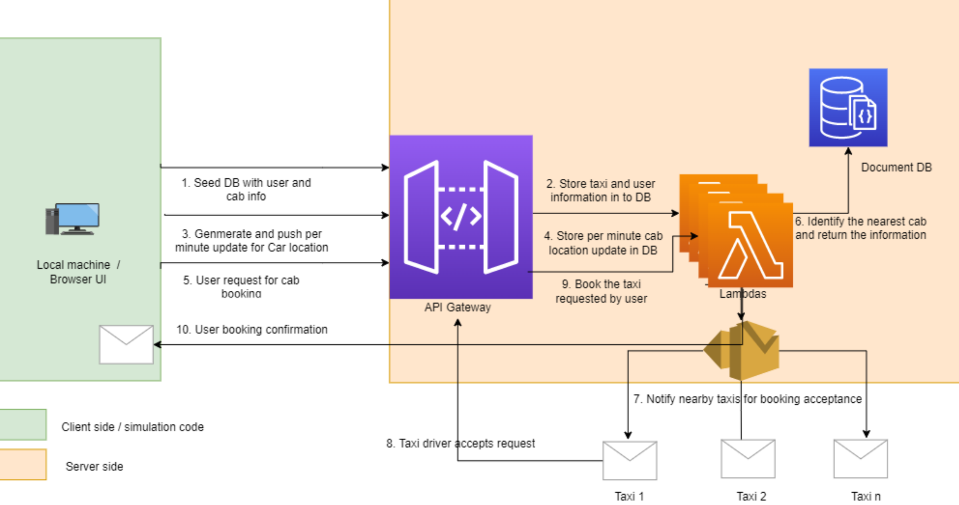
Architecture

Slide 7
Software Specification
AWS Services ( SES, Lambda, Document DB, API Gateway, IAM, VPC Subnets and security groups for Lambda )
Python Programing for simulation code, Lambda, Geospatial Library
Angular frontend browser-based application
IITM GL Cloud Group 5

Slide 8
Data Model
_id : ObjectId
customer_id : ObjectId
location: Point
timestamp: Timestamp
booking_accepted: string
booking_active: string
taxi_id: ObjectId
Bookings
name: string
location: Point
timestamp: Timestamp
email: string
name: string
location: Point
timestamp: Timestamp
email: string
hired: string
type: string
Customers
Taxi
_id : ObjectId
booking_id : ObjectId
trip_start: Timestamp
trip_end: Timestamp
Trips
IITM GL Cloud Group 5

Slide 9
API Interfaces
Customer Registration
https://3598y3s21l.execute-api.us-east-1.amazonaws.com/api/customer
Taxi/Driver Registration
https://3598y3s21l.execute-api.us-east-1.amazonaws.com/api/taxi
Taxi details
https://3598y3s21l.execute-api.us-east-1.amazonaws.com/api/taxi
Customer details
https://3598y3s21l.execute-api.us-east-1.amazonaws.com/api/customer
Booking
https://3598y3s21l.execute-api.us-east-1.amazonaws.com/api/booktaxi?userid=62a0f27ad25399bc7a1403e5
Booking acceptance
https://3598y3s21l.execute-api.us-east-1.amazonaws.com/api/bookingresponse?bookingid=62a0b9e5d8de0010df60905b&taxiid=62a0b25a9e531b402a65119e&accept=Y
Booking details
https://3598y3s21l.execute-api.us-east-1.amazonaws.com/api/bookingdetails
Trip start and end
https://3598y3s21l.execute-api.us-east-1.amazonaws.com/api/trip
Trip details
https://3598y3s21l.execute-api.us-east-1.amazonaws.com/api/trip
IITM GL Cloud Group 5

Slide 10
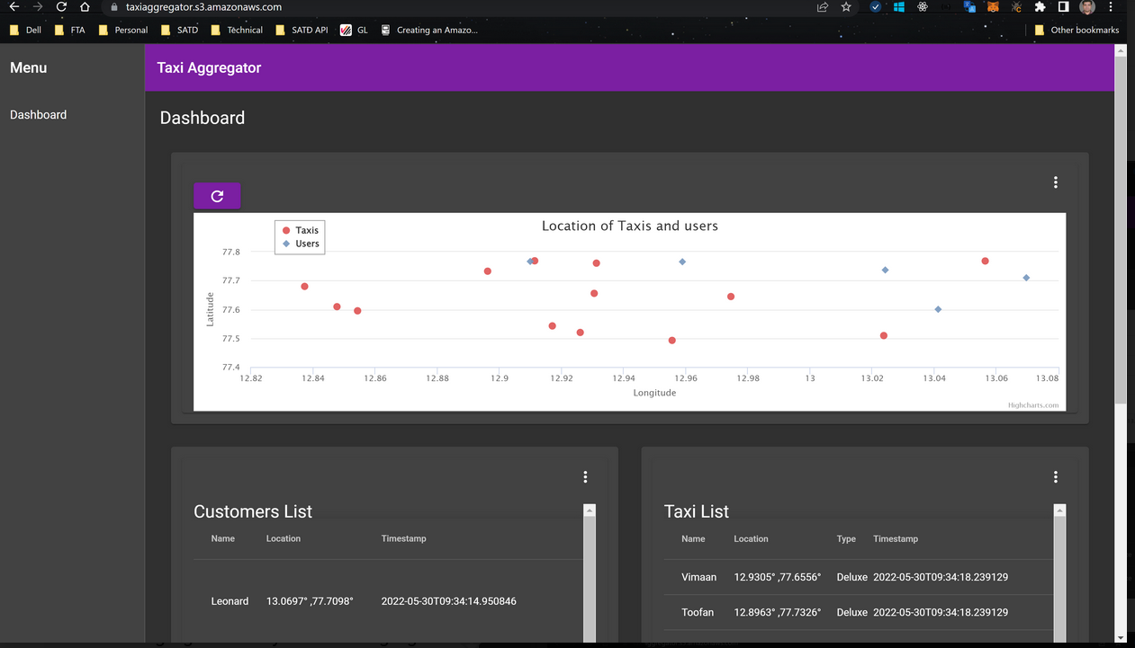
Location of customers vs taxis

Slide 11
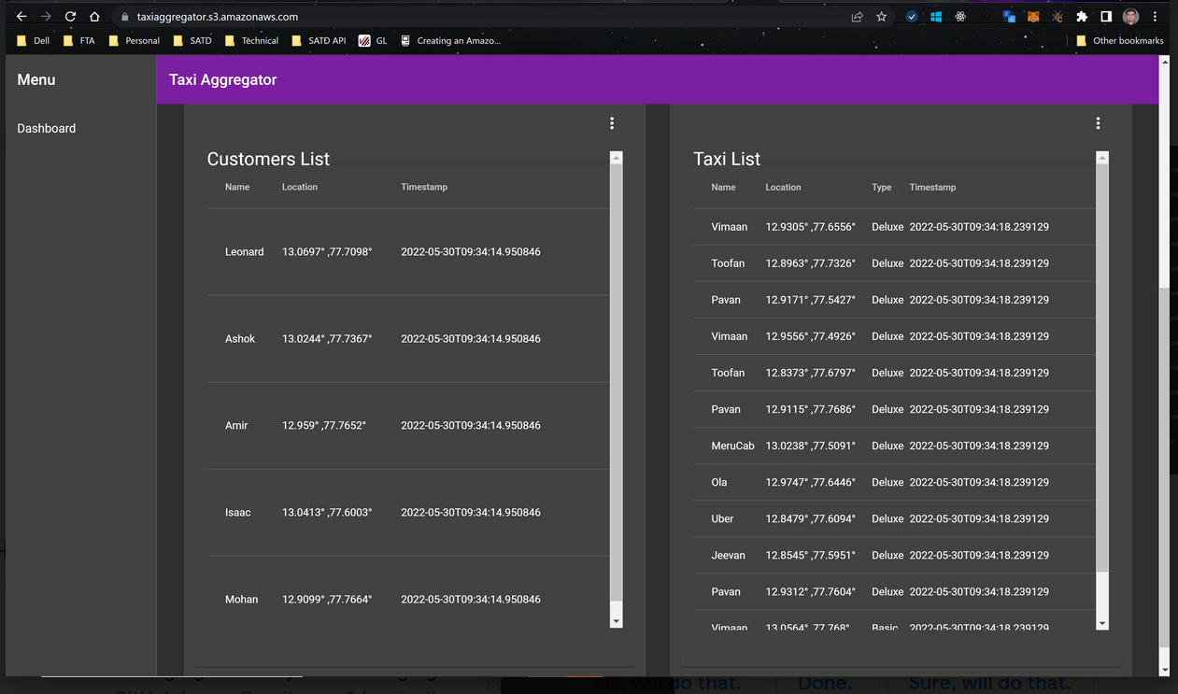
Taxi list and customer list

Slide 12
API Payload

Slide 13
Final Demo
IITM GL Cloud Group 5

Slide 14
Future Scope
Authentication and authorization of taxis and users
Authenticate APIs calls
Infrastructure automation using Terraform or CloudFormation
If the User is eligible for any offers or promotions, it will apply.
Nearby cabs will be searched by the system and if any cabs are available, the system will display the Cab/drivers details to the User.
Payment can be through Paytm or card or cash. The cab will drop you in the destination location and End of the Trip. This is the brief understanding will get from the architectural pattern given above
Advance UI and deployment done using containerization
Validations
Mobile Apps
etc

Slide 15
Q & A
Q&A
IITM GL Cloud Group 5

Slide 16
Thank You
Q&A
IITM GL Cloud Group 5

