Slide 1
Research Questions
1. What are the variables that can affect hotel reservation cancellation ?
2. How can we make hotel reservations cancellations better?
3. How will hotel will be assisted in making pricing and promotional decisions?

Slide 2
Hypothesis
More cancellations are occur when prices are higher.
When there is longer waiting list, customers tend to cancel more frequently.
The majority of clients are coming from offline travel agents to make their reservations.

Slide 3
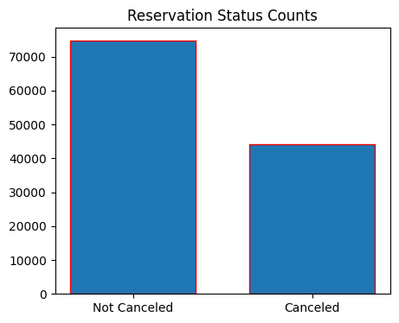
Analysis and Findings

Slide 4
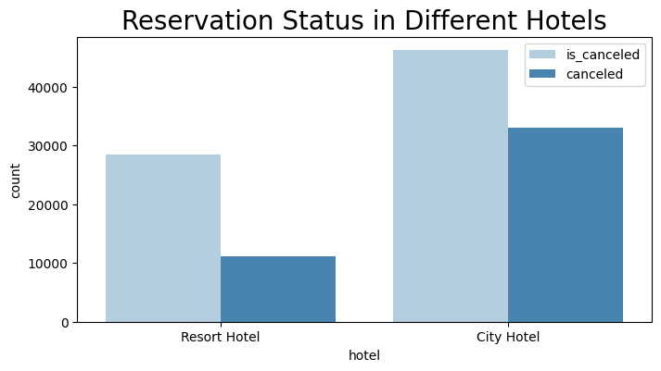
The accompanying bar graph shows the percentage of reservations that are cancelled and those that are not. It is obvious that there are still a significant number of reservations that have not been cancelled. There are still 37% clients who cancelled their reservation, which has a significant impact on the hotels earnings.
In comparisons to resort hotels, city hotels have more bookings. It’s possible that resort hotels are more expensive that those in cities.

Slide 5
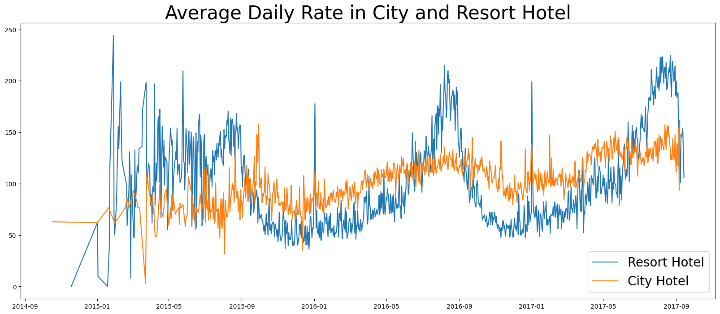
The line graph above shows that, on certain days, the average daily rate for a city hotel is less than of a resort hotel, and on other days, it is even less. It goes without saying that weekends and holidays may see a rise in resort hotel rates.

Slide 6
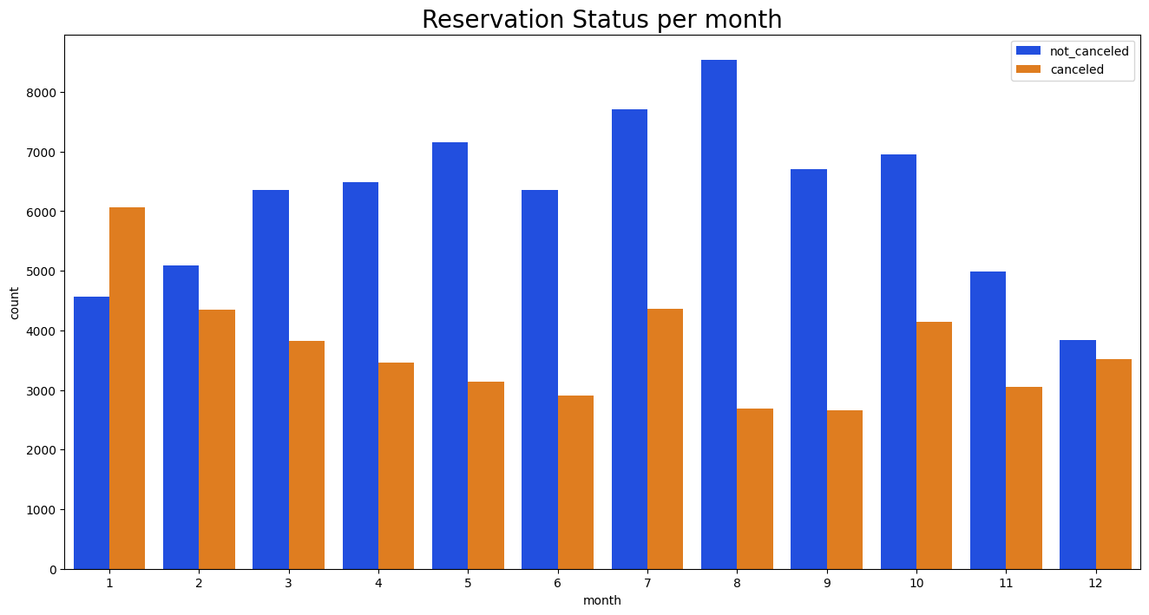
We have developed the grouped bar graph to analyse the months with the highest and lowest reservation level’s according to reservation status. As can be seen ,both the number of cancelled reservations are largest in the month of August. Whereas January is the month with the most cancelled reservations.

Slide 7
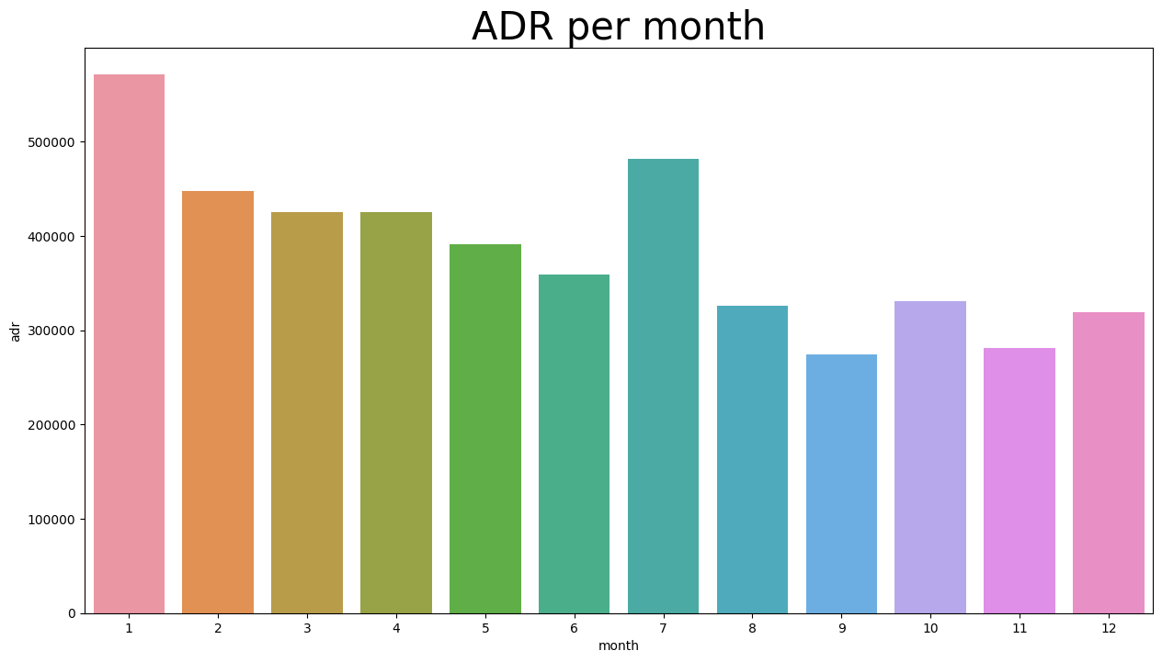
This bar graph demonstrate that cancellations are most common when prices are greatest and are least common when they are lowest. Therefore, the cost of the accommodation is solely responsible for the cancellation.

Slide 8
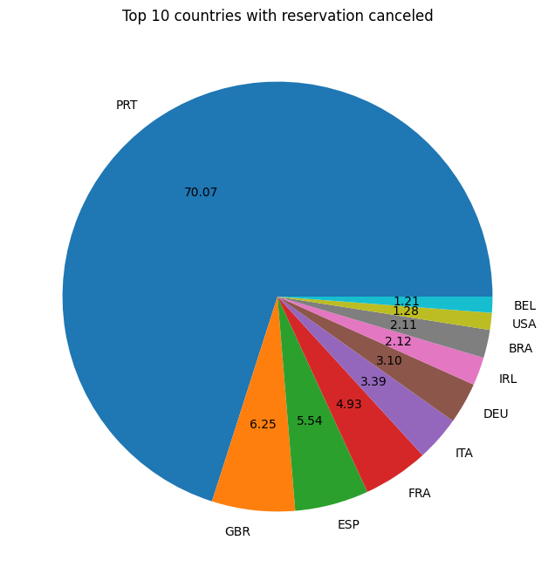
Now, let's see which country has the highest reservation cancelled. The top country is Portugal with the highest number of cancellations.

Slide 9
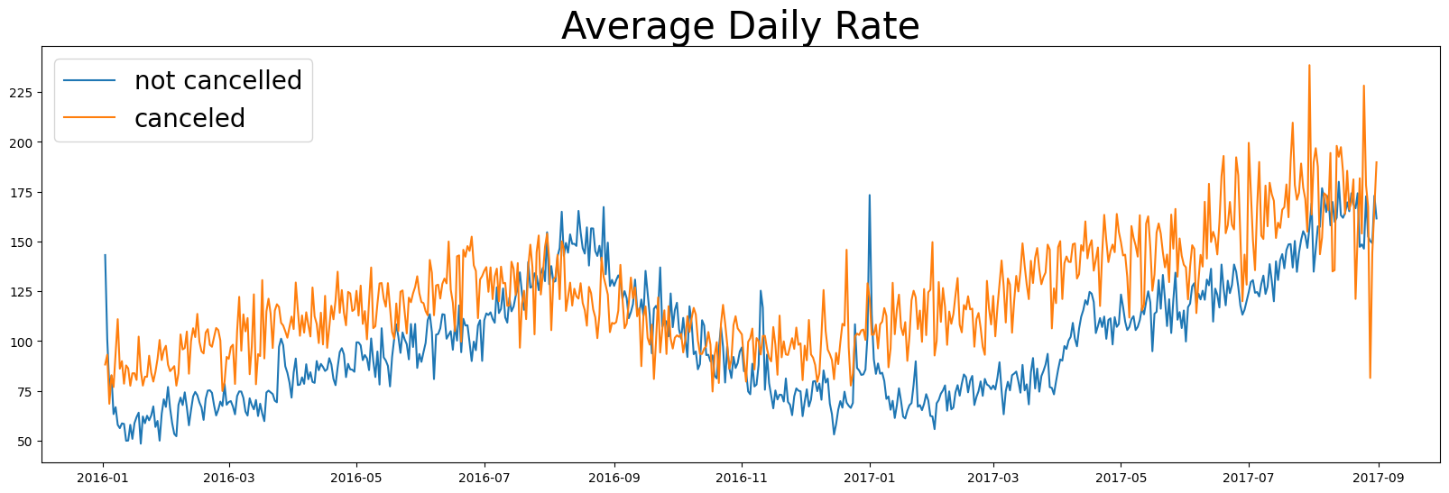
As seen the graph reservations are cancelled when the average daily rate is higher than when it is not cancelled. It clearly proves all the above analysis, that the higher price leads to higher cancellations.

