Slide 1

Big_Shop_Sales Project
https://datasquirrel.ai/

Slide 2
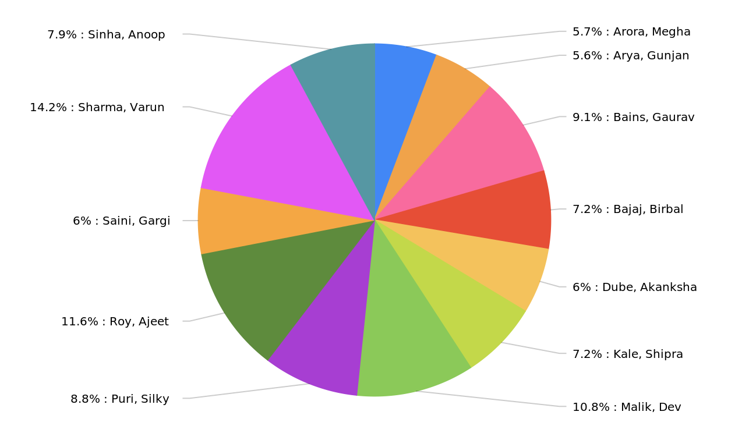
Visualizing the total sales per salesperson
Item Cost per Salesperson
Big_Shop_Sales_Project_20240527_074913.pptx
2

Slide 3
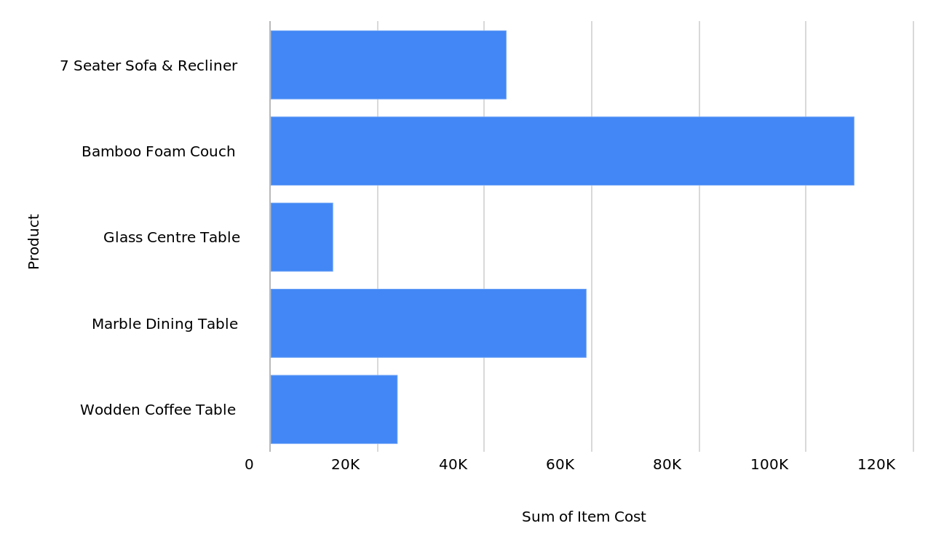
Visualizing the total sales per product
Item Cost per Product
Big_Shop_Sales_Project_20240527_074913.pptx
3

Slide 4
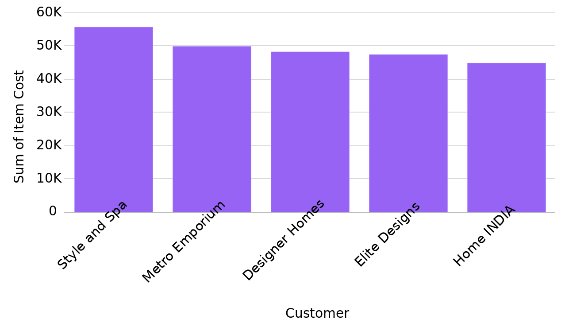
Visualizing the total sales per customer
Item Cost per Customer
Big_Shop_Sales_Project_20240527_074913.pptx
4

Slide 5
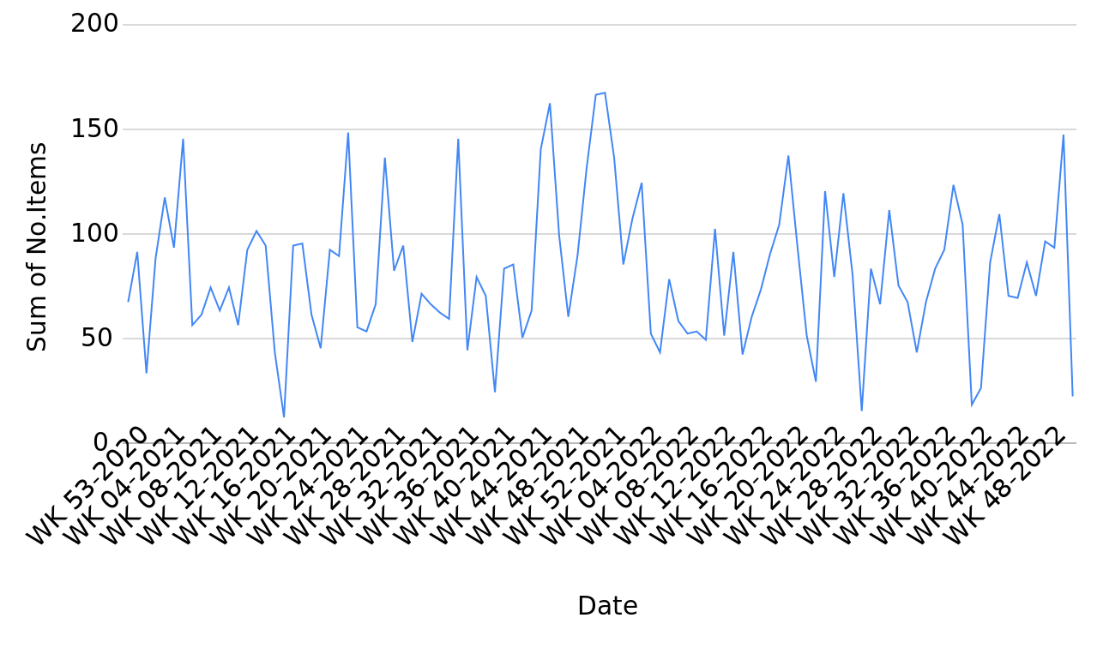
Tracking number of items sold over time
No.Items per Date
Big_Shop_Sales_Project_20240527_074913.pptx
5

Slide 6
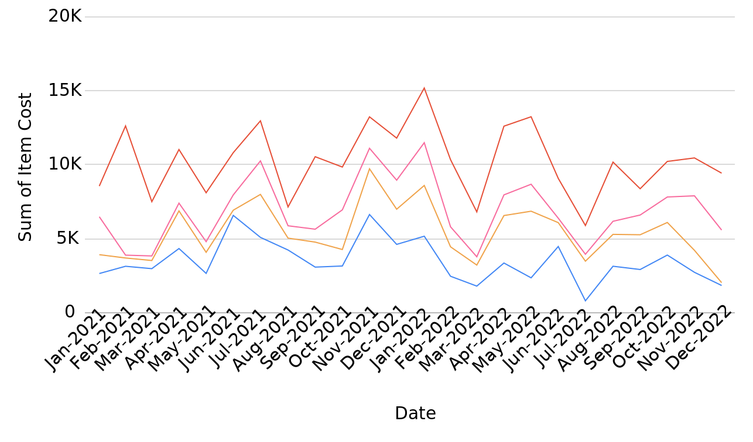
Tracking revenue over time grouped per region
Item Cost per Date, grouped by Region
Big_Shop_Sales_Project_20240527_074913.pptx
6

Slide 7
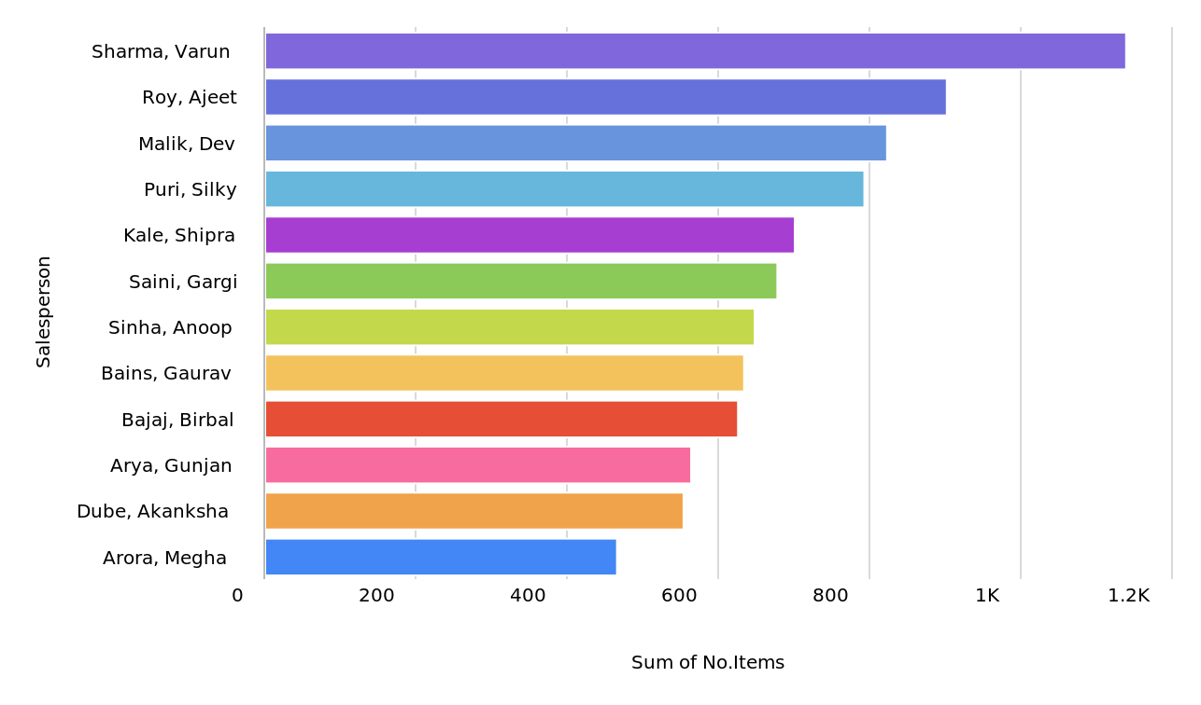
Visualizing the total number of items sold per salesperson
No.Items per Salesperson
Big_Shop_Sales_Project_20240527_074913.pptx
7

Slide 8
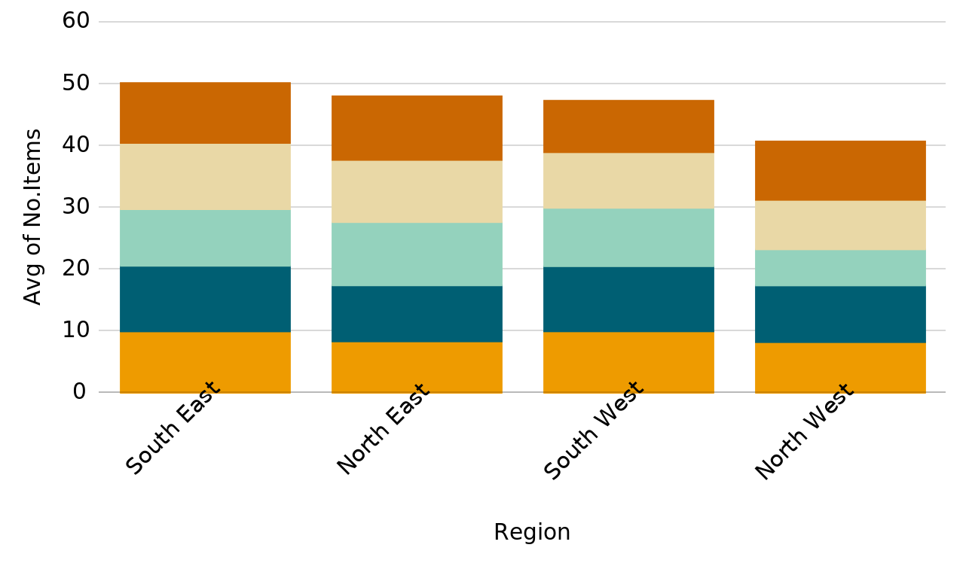
No.Items per Region, grouped by Product
No.Items per Region
Big_Shop_Sales_Project_20240527_074913.pptx
8

Slide 9
Created by: smitakesapure33@gmail.com
Created at: 2024-05-27 07:49:13
https://datasquirrel.ai/

