Slide 1

HR_Analytics_Dataset_DS_1 Project
https://datasquirrel.ai/

Slide 2
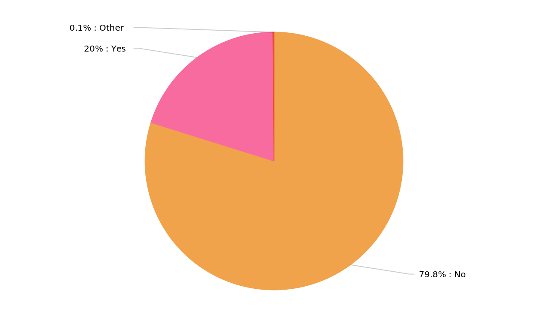
Visualizing the distribution of monthly income by attrition
MonthlyIncome per Attrition
HR_Analytics_Dataset_DS_1_Proj_20240527_075003.pptx
2

Slide 3
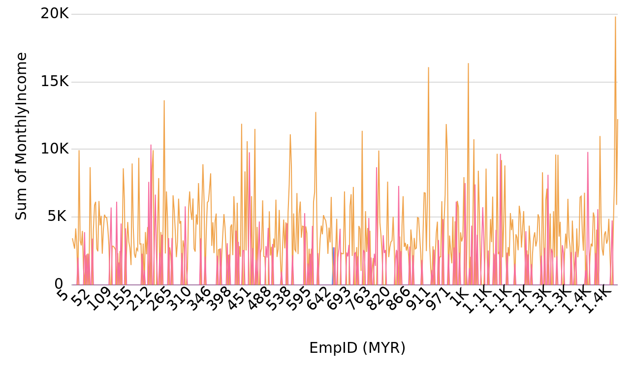
Tracking monthly income over time grouped per attrition
MonthlyIncome per EmpID (MYR), grouped by Attrition
HR_Analytics_Dataset_DS_1_Proj_20240527_075003.pptx
3

Slide 4
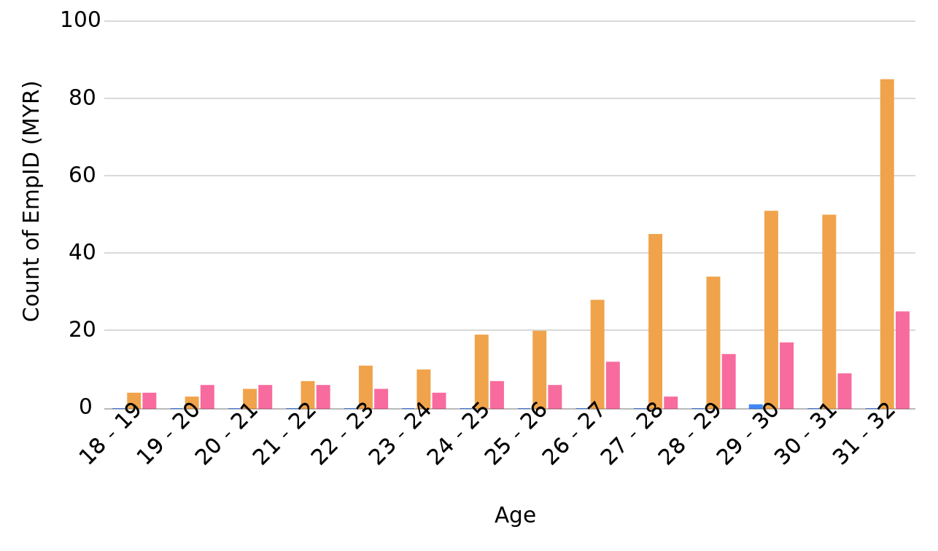
EmpID (MYR) per Age, grouped by Attrition
EmpID (MYR) per MonthlyIncome, grouped by Attrition
HR_Analytics_Dataset_DS_1_Proj_20240527_075003.pptx
4

Slide 5
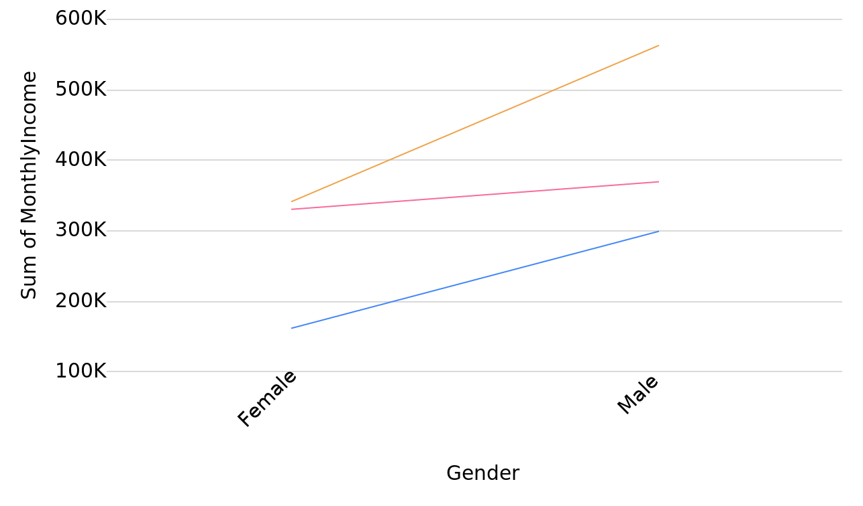
MonthlyIncome per Gender, grouped by MaritalStatus
MonthlyIncome per EmpID (MYR), grouped by Gender
HR_Analytics_Dataset_DS_1_Proj_20240527_075003.pptx
5

Slide 6
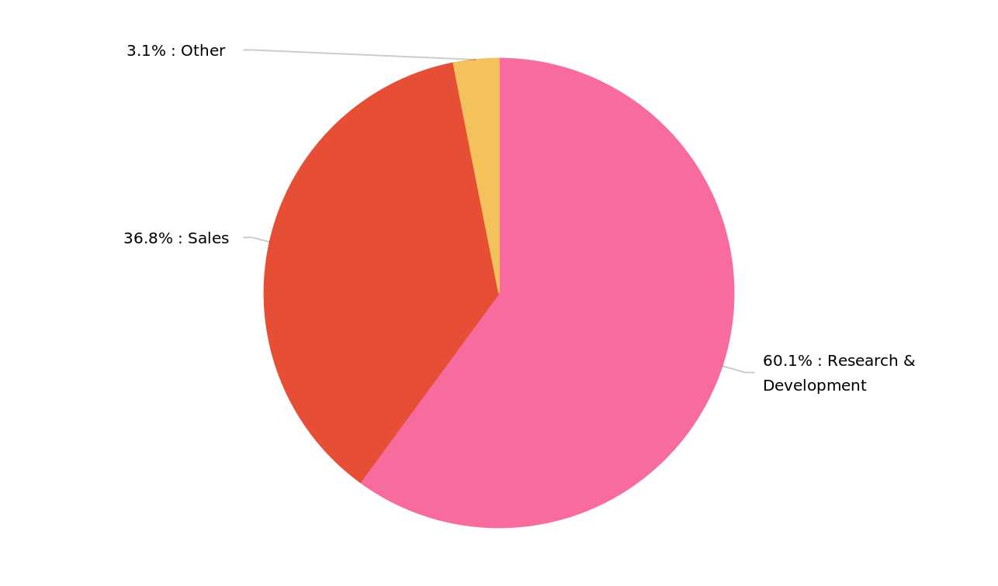
MonthlyIncome per Department
MonthlyIncome per EmpID (MYR), grouped by JobRole
HR_Analytics_Dataset_DS_1_Proj_20240527_075003.pptx
6

Slide 7
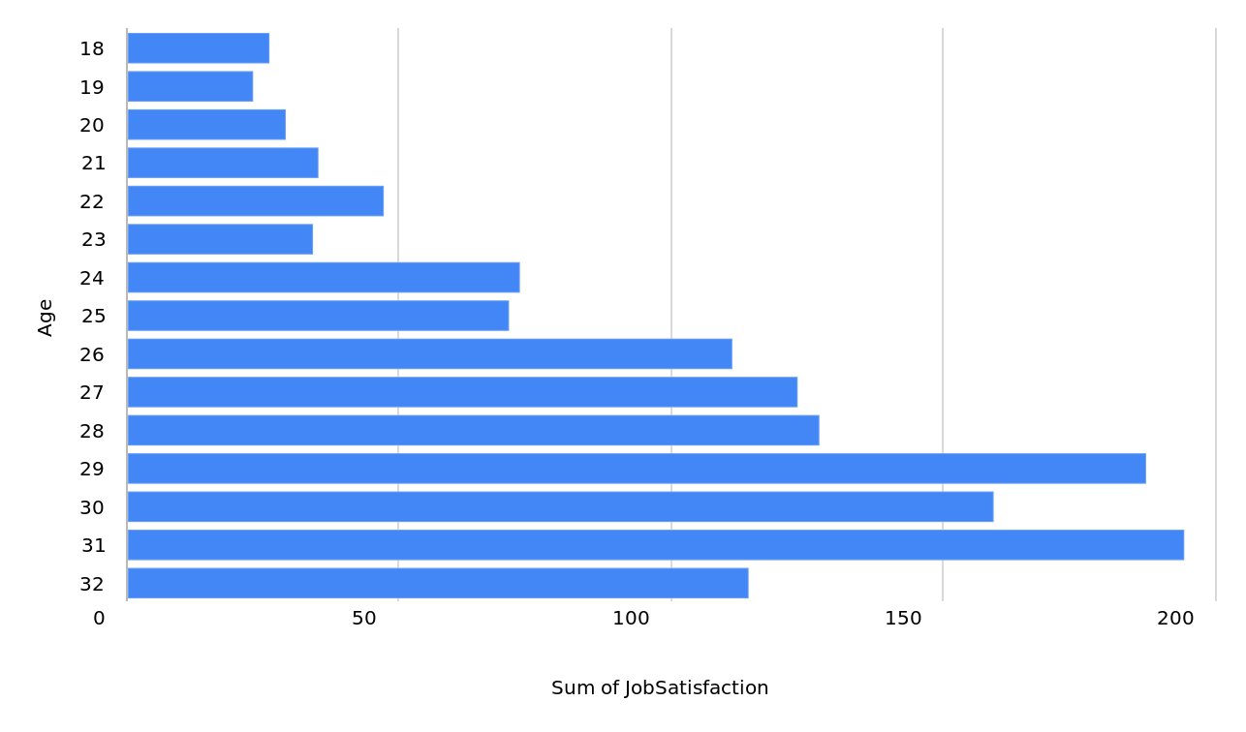
JobSatisfaction per Age
EmpID (MYR) per MonthlyIncome, grouped by JobRole
HR_Analytics_Dataset_DS_1_Proj_20240527_075003.pptx
7

Slide 8
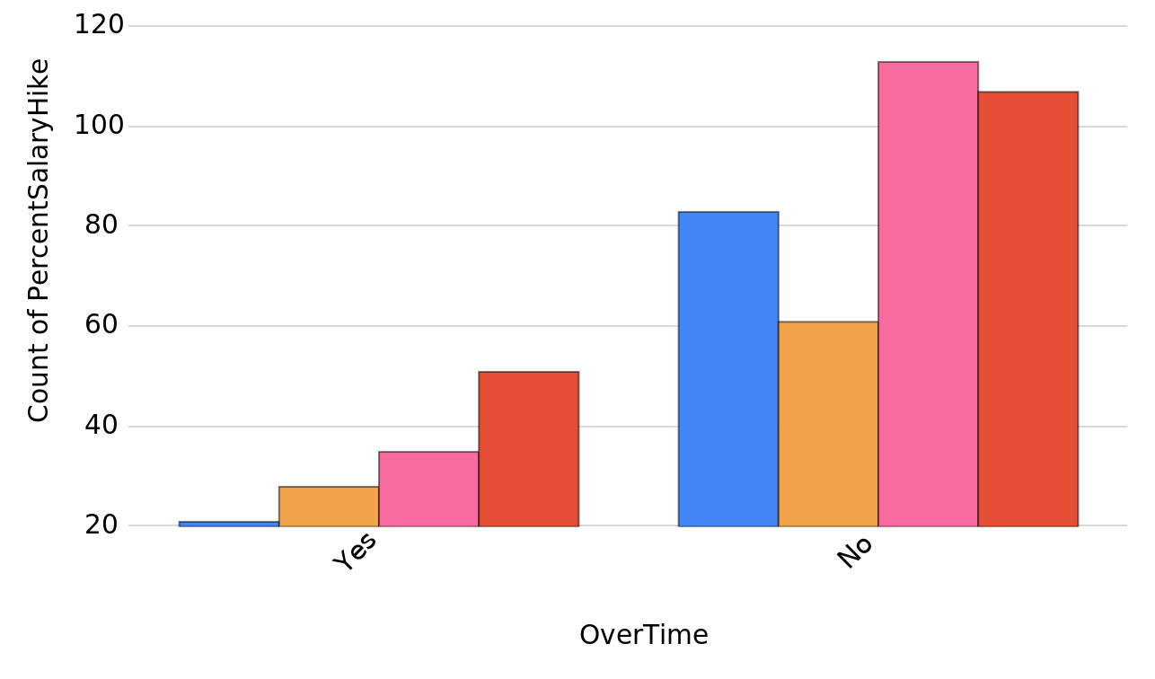
PercentSalaryHike per OverTime, grouped by JobSatisfaction
EmpID (MYR) per MonthlyIncome, grouped by JobSatisfaction
HR_Analytics_Dataset_DS_1_Proj_20240527_075003.pptx
8

Slide 9
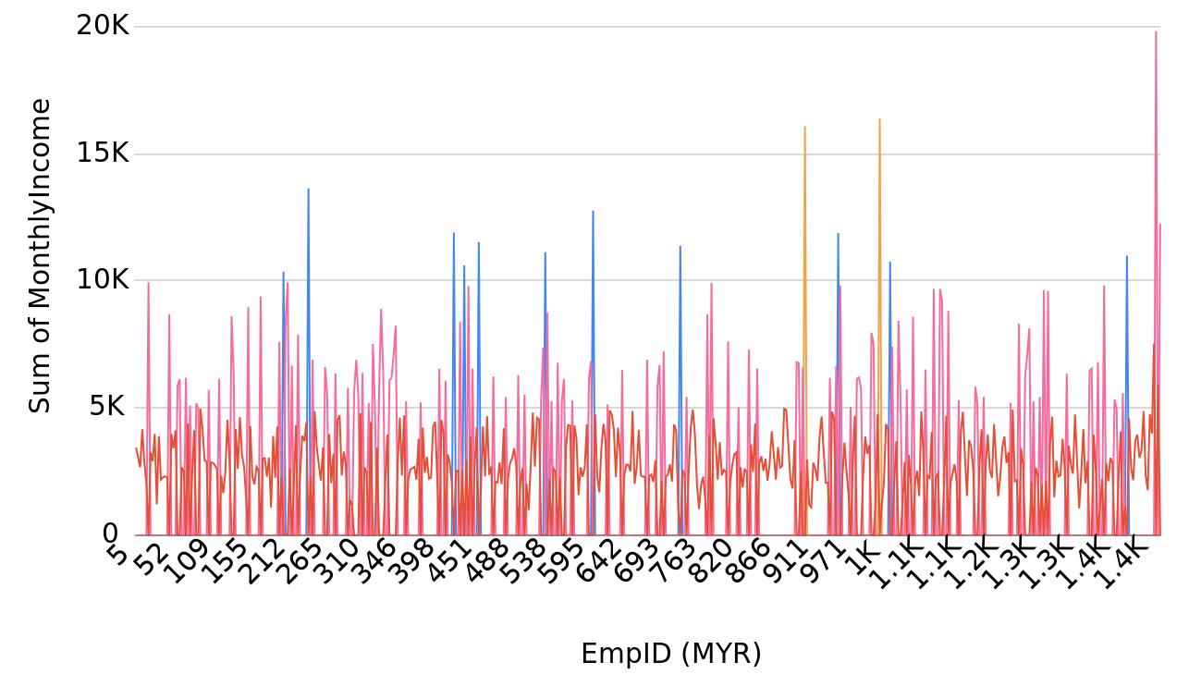
Tracking monthly income over time grouped per salary slab
MonthlyIncome per EmpID (MYR), grouped by SalarySlab
HR_Analytics_Dataset_DS_1_Proj_20240527_075003.pptx
9

Slide 10
Created by: smitakesapure33@gmail.com
Created at: 2024-05-27 07:50:03
https://datasquirrel.ai/

