Slide 1
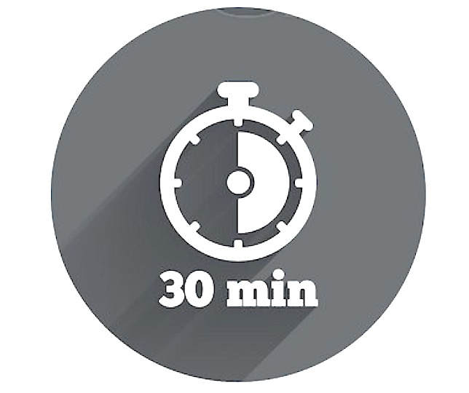

Embracing Change Team Activity
A key role of any leader during change is managing resistance, which in turn enables team members to adjust to shifting work circumstances and take advantage of the opportunities that they might present.
The Resistance Pyramid
WHY Do It?
This team activity flips three common sources of resistance in order to brainstorm the support and resources team members need to embrace change.
WHAT You Need
Approximately 30 minutes before or after a team meeting or over lunch to discuss as a group
Textas and a whiteboard, flipchart, butchers paper etc. to capture the team’s ideas
Post-it notes
A current or impending change that will impact the team
Dot stickers (optional)
WHEN To Try It
This activity is particularly useful at the onset of change and where you want to set the team up for success.
WHO Is Involved?
This activity is designed for the entire team. Depending on how the team is currently tracking, you may like to brief a couple of members about what the activity involves, so that they can think about some positive examples to share in advance.
Nieder and Zimmerman suggest that there are three primary sources of resistance to change. These are not understanding the change (why, what, how, when, who etc.), not feeling as though you have the skills or experience to successfully come to terms with the change and not having the motivation (will) to change:
Not Willing
Not Able
Not Knowing
Change the Mindset
Build Capability
Communicate / Educate
Diagnosing potential sources of resistance to change within your team enables you to manage for it.
For example, if the source of resistance is a lack of knowledge, you can share more information about the change, provide regular updates and respond to questions that your team might have.
If the source of resistance is fear that team members wont be capable of meeting changing expectations you can provide resources, training and coaching to improve their skills.
Or, if, the source of resistance is a lack of motivation, you can recognise and reinforce steps in the right direction or clearly outline the consequences of choosing not to accept the change.
=

Slide 2
Embracing Change Team Activity
Instructions
This team activity uses three categories informed by the Resistance Pyramid (described on the previous page) to facilitate a group discussion regarding the things that as a team we need to ‘Know’, ‘Do’ and “Reward’ in order to embrace change.
To get the activity underway:
Agree on a change that is or is about to impact the team to discuss
Draw a large pyramid on a whiteboard or flipchart. Label the three sections of the pyramid (from bottom to top) ‘Know’, Do’ and ‘Reward’
Divide the team into three groups, and assign a group to each level of the pyramid
Invite each group to spend 5-10 minutes discussing their level of the pyramid. Write each key question, idea, action or concept discussed on a separate post-it note. For example:
‘Know’ group – brainstorm the knowledge gaps and / or questions that you have about the change
‘Do’ group – brainstorm the skills and capabilities that you think will be important to making this change successful
‘Reward’ group - brainstorm the different ways that we could recognise and reward one another for contributing positively to the change.
5. Invite each group to stick their post-it notes on the appropriate section of the pyramid
6. Discuss / debrief each section of the pyramid in turn
7. At the end of the discussion, invite each team member to select the top three questions, comments or actions from the various post-it notes that they believe will have the biggest impact on the team’s intention and ability to embrace change (you can use sticky dots for this if available)
8. Capture these top selections as a summary of prioritised actions for follow up
9. Thank team for their participation and conclude activity.
=
Your Notes to Prepare for this Activity:

