Slide 1
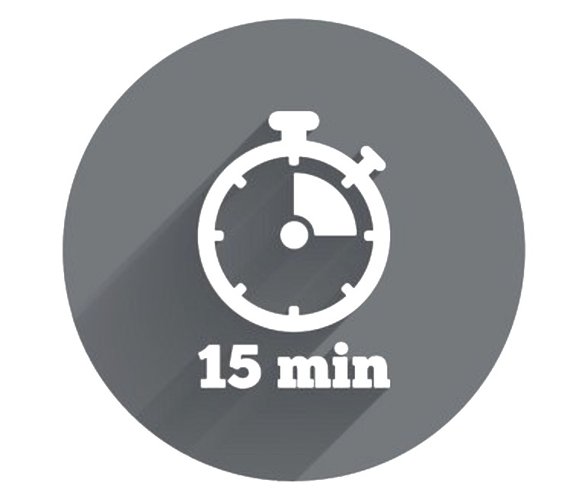

Pathway Planning and Regoaling
This activity will help you to better understand why some of the goals you set for yourself may fall off your radar. It will also help to create ’alternative routes’ to your goals, so that you have the maximum chance of seeing them come to fruition.
To achieve our goals we need two things: Will-Power and Way-Power.
Will-Power is the energy and enthusiasm we feel when deciding to pursue a goal. It helps keep us motivated when things are challenging.
However, to successfully achieve a goal in the long-term, we also need Way-Power. Way-Power is about understanding the path that leads towards
your goal, and the actions you might need to take to overcome obstacles. One of the best ways to ensure Way-Power for your goal is by pathway planning and regoaling.
Complete the activity below by writing down a key goal you want to achieve. Next, list 3 to 5 potential obstacles you might face.
Following this, come up with some strategies to overcome each obstacle. This might involve getting additional help or realigning your goal.
Lastly, note how you will measure your own success. This could be what will it looks like or even feels like to achieve your goal.
My Goal | 3-5 Obstacles | My Strategies | My Success Marker
-

