Slide 1
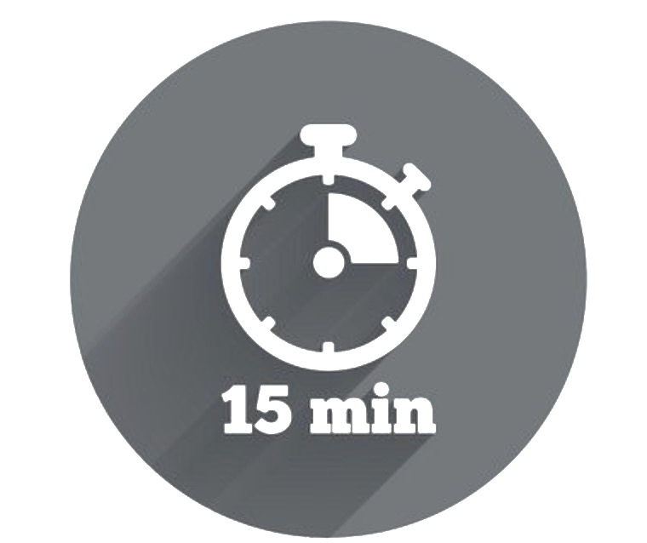


Point ‘Easy’ Conversations
Not all conversations are easy. Some conversations reflect complex situations and some may have strong emotions attached to them. Indeed, some conversations require courage.
‘Be Courageous’ is both one of our values and a key principle of ‘Everyday Conversations’:
Be Courageous as a Myer Value
Be Courageous as a Conversation Principle
It’s important to embrace change. We strive to think differently, take calculated risks and learn from our mistakes.
Own your key messages, especially the difficult ones
Remain open to hearing things that you don’t like or want to hear
Demonstrate a level of vulnerability – share something of yourself
The graph below illustrates that, somewhat ironically, when we put off having a potentially ‘difficult’ conversation, the more difficult the eventual conversation is likely to become. This is because the time between the issue first surfacing, and when it finally discussed, often results in the underlying situation becoming more complex and / or emotionally charged.
Point ‘Easy’
=
+
By being courageous and nipping issues in the bud, you increase your chances of having a conversation that falls within the ‘point easy zone’. This ensures that situations are discussed when they are at their simplest and are least emotionally charged.
Difficulty
-
Time

Slide 2
Point ‘Easy’ Conversations
Recall the last three work conversations that you would describe as ‘difficult’. Plot each conversation on the graph below, in terms of the conversation’s level of difficulty and the time that transpired from the point at which the issue first surfaced.
Point ‘Easy’
Difficulty
Time
Reflection Questions
Which conversation did you put off the longest?
Which conversation was the hardest?
Were these the same conversation?
What was the outcome of your most difficult conversation?
How might this outcome have been different if you had the conversation sooner?
=
+
-

