Slide 1

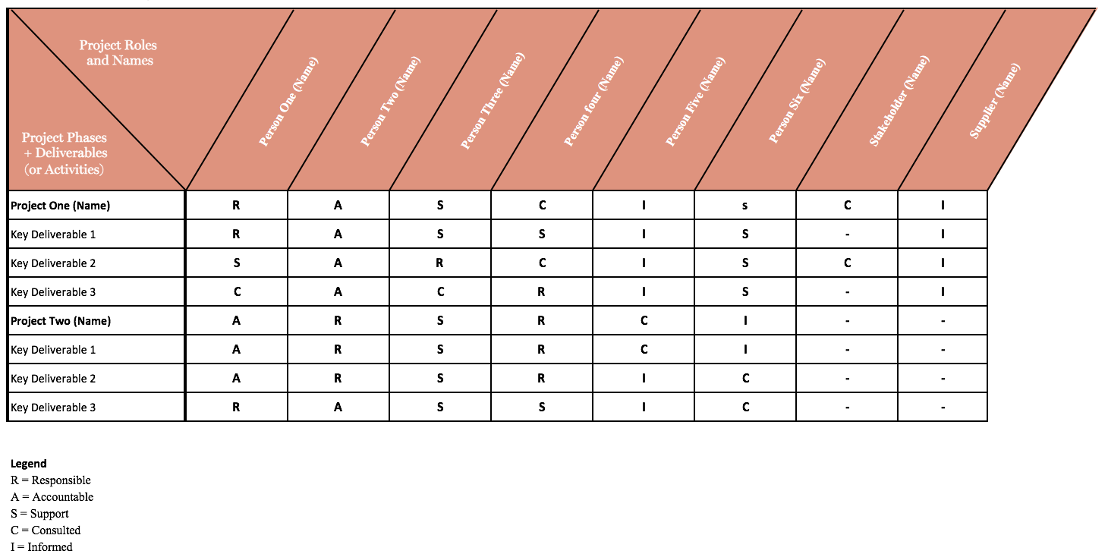
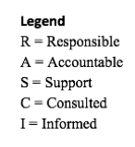

Building a RASCI Matrix
This activity is designed to help you build a RASCI matrix that can assist with project management and accountability. The key to building a successful RASCI matrix is assigning people to the correct roles. Take a look at the role descriptions and matrix example below, then have a go at populating your own RASCI matrix on the next page.
Roles
RASCI Matrix Example
Responsible
Leads delivery of the agreed work outcome
Can delegate to others
Answerable to ‘A’
Best to have one ‘R’
Accountable
Owns the work outcome
Signs off work
Is a key Sponsor
Can be only one ‘A’
Support
Provides resources, support, data
Owns delivery of agreed components contributing to the work outcome
Can be multiple ‘S’
Consulted
Provides technical expertise to inform decisions
Owns the advice they give
Buy-in needed
Can be multiple ‘C’
Informed
Needs to be kept up-to-date because of impact on them. Could be a key stakeholder
Proactively keeps themselves informed
Don’t need to be involved in decision making
Presented below is an example of a basic RASCI Matrix.
You should notice that not all projects use all people, and that only one person is assigned to the Accountable role. This helps to make sure everyone is clear on their role and responsibilities, and that ‘accountability’ can clearly be communicated.
With this example to guide you, build your own RASCI matrix using the template on the next page. Start with deciding on a project that you have coming up (along with the key milestones) and add it to the left hand column. Next, list the people resources you will have along the top row. Following this, you are ready to begin assigning roles using the RASCI framework.
+

Slide 2
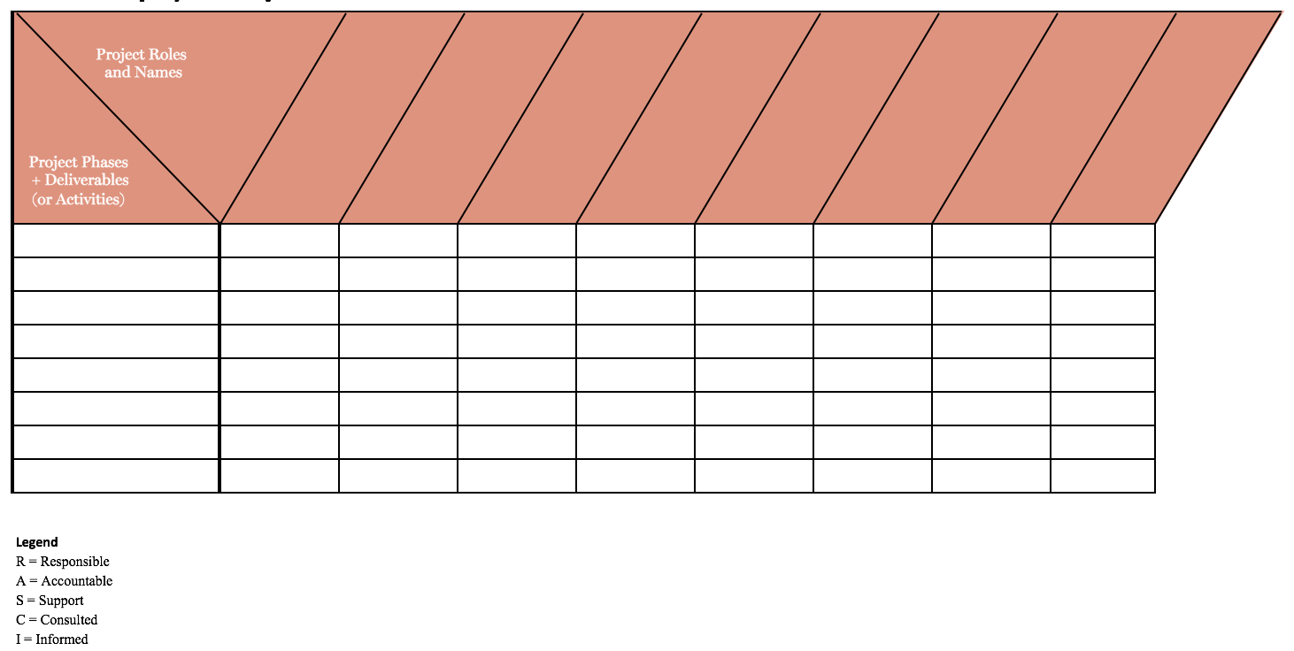
RASCI Matrix Template
Project Name: Completed By:
+

