Slide 1
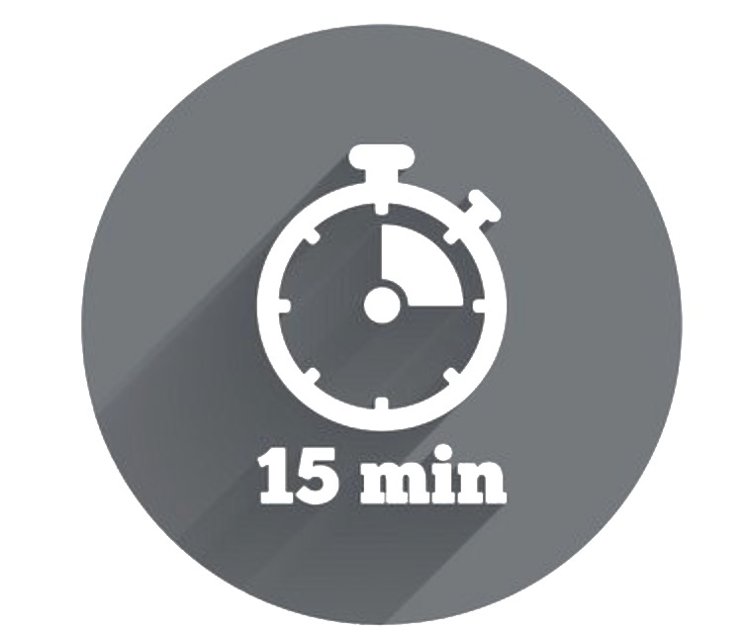

Circle of Influence Activity
This activity is designed to help you to think about the range of concerns you and your team face, and decide whether these concerns are within your circle of influence, or out of your control. By knowing what you can and cannot influence, you are better able to choose where you focus your energy, and take meaningful action on some of the concerns you encounter.
Circle of influence We can choose to focus all of our energy on the outer reaches of our circle of concern. We could be annoyed by the actions of others, and lose our temper over traffic conditions. However, becoming frustrated over things we cannot control only leads to higher levels of frustration. Instead, by choosing to focus on the things in life we can influence, we can begin to plan and take action to improve some of our key concerns. By focusing on what you can influence, you will find that your impact expands further than you initially thought.
Example
What can’t be influenced: A new retail regulation.
What can be influenced: How customers and team members are informed and taught about the regulation.
Circle of Concern
Why do it? Complete the activity to help you or your team focus on what you can control and influence. Useful when there is a lot of ‘noise’ and people are overwhelmed with the daily whirlwind.
What do you need? Space to reflect and complete the plan.
Flip chart and pen if you are in a group.
When to do it? It takes approx. 10-15 minutes.
You can use this for yourself or with your team anytime! At the beginning of a meeting, or at the start or end of the day or the week.
Who runs it? Anyone can.
Circle of
Influence
A negative and reactive mindset reduces our circle of influence
A proactive, positive mindset enlarges our circle of influence
Circle of influence Team Activity
Present the circle of influence diagram as shown above. You can transpose this onto a whiteboard or a flipchart so you can capture lots of information.
Capture your teams thoughts on their current concerns, and work together to decide weather these concerns are inside of outside your collective circle of influence.
As a group, decide the most important points to focus on that fit within the circle of influence (1-3).
You can then create SMART goals to address your primary concerns inside your circle of influence.
=
+
-

