Slide 1
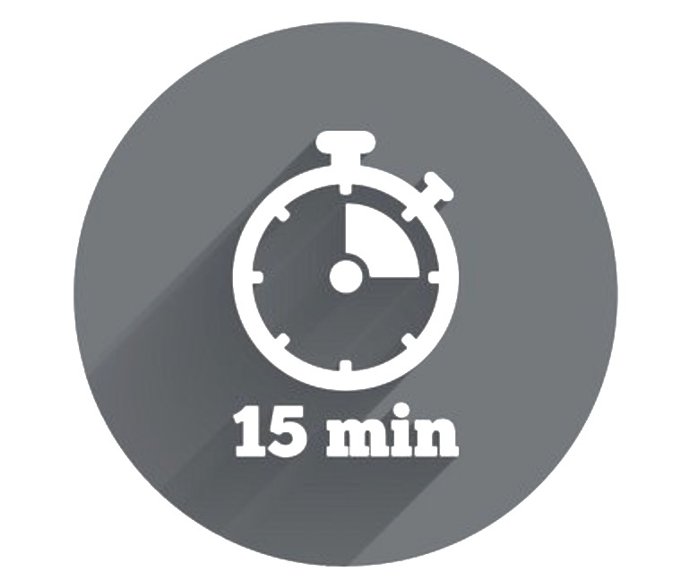
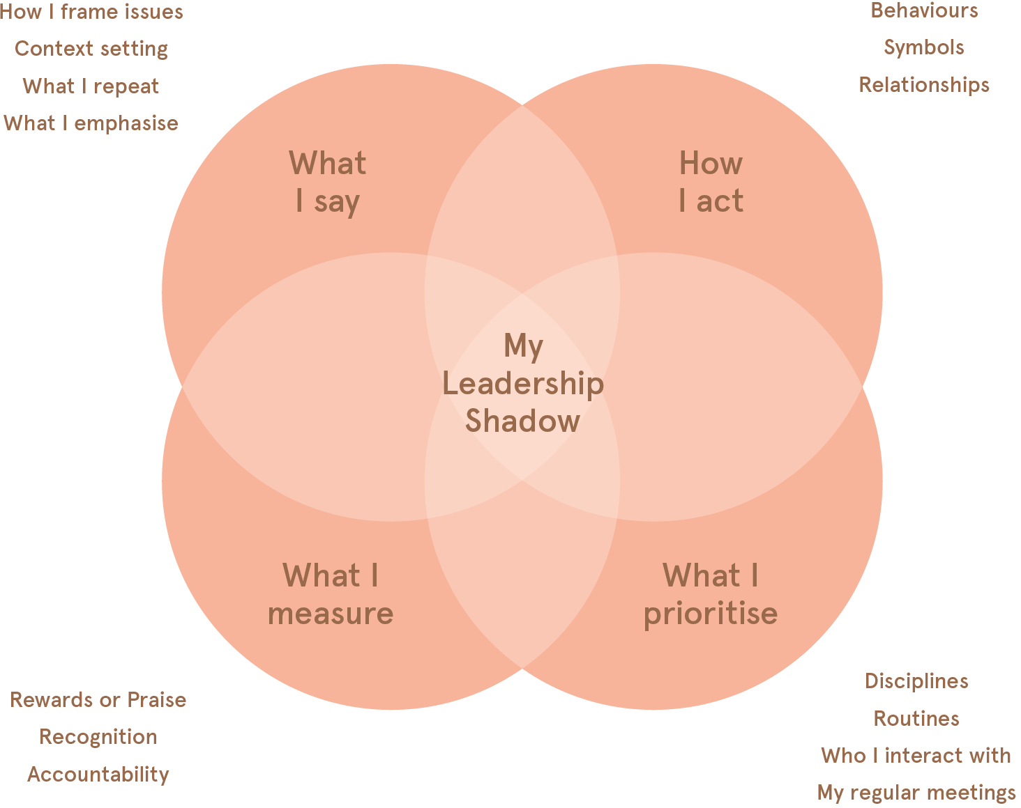

Leadership Shadow Consistency Check
This self-assessment activity is designed to help you reflect on the consistency between the leadership shadow you seek to cast, and the impact of your actual shadow on others, our business and Myer’s overall.
Leadership Shadow Recap
Casting a positive leadership shadow requires “walking the talk” and demonstrating consistency between the following four domains:
WHY Do It?
To assess the level of consistency between the impact we intend to have on others, our business results and culture overall, with the shadow we actually cast.
WHAT You Need
Feedback from others
Time and space to reflect
Your Leader Journal for capturing reflections
WHEN To Try It
You’re motivated to understand your impact as a leader
You’re in a position to be open and receptive to the views and feedback of others
WHO Is Involved?
This activity will be most useful for your development when you are able to gather feedback from a range of different people. Aim for a ‘360 degree’ view, fo example by asking your direct reports, peers and manager.
Sometimes the impact that we intend to have is not what is experienced by others, what shows up in business results, or is evident in the culture that we foster around us.
This is partly explained by leadership research demonstrating that when we assess ourselves on certain dimensions, such as our Leadership Shadow, we do not always see ourselves as others do.
Typically:
=
+
-
1/3 of leaders see their Leadership Shadow as others see it
1/3 of leaders view their Leadership Shadow more positively than others
1/3 of leaders view their Leadership Shadow less positively than others
The following Consistency Check activity will assist you to gain alignment between how you and others see your Leadership Shadow.

Slide 2
Leadership Shadow Consistency Check
Be as honest as you can when completing the following questions in the first two columns. For the final column for each area of reflection, try to seek feedback from at least three different people in order to complete it.
The Impact of My Leadership Shadow on Others
What 3 words describe how I would like to make others feel? | What 3 words do I think actually reflect how I make others feel? | What words describe how others say I make them feel?
1. 2. 3. | 1. 2. 3.
The Impact of My Leadership Shadow on Business Results
What 3 business results do I seek to have the greatest impact on? | What impact am I currently having on these 3 results areas? | How do others describe my impact on business performance?
1. 2. 3.
The Impact of My Leadership Shadow on Our Culture
What are 3 goals for positively impacting Myer’s culture that I will set for myself? | How would I rate my current progress towards these goals? Why? | What impact do others think I have on Myer’s culture?
1. 2. 3.
=
+
-
Reflection
In which areas do you experience the most and least consistency?
What do you need to be more mindful of?
What actions can you take to

