Slide 1
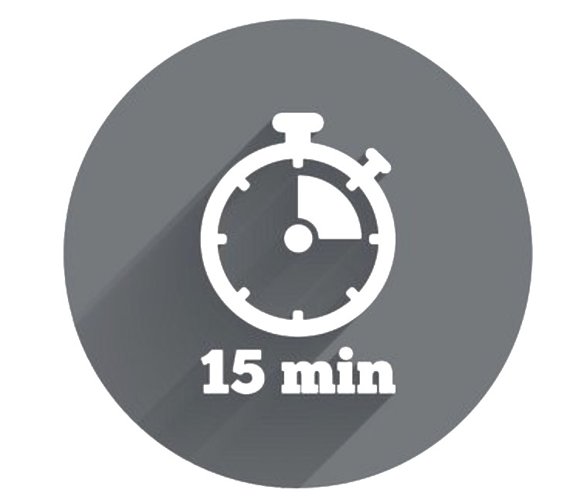
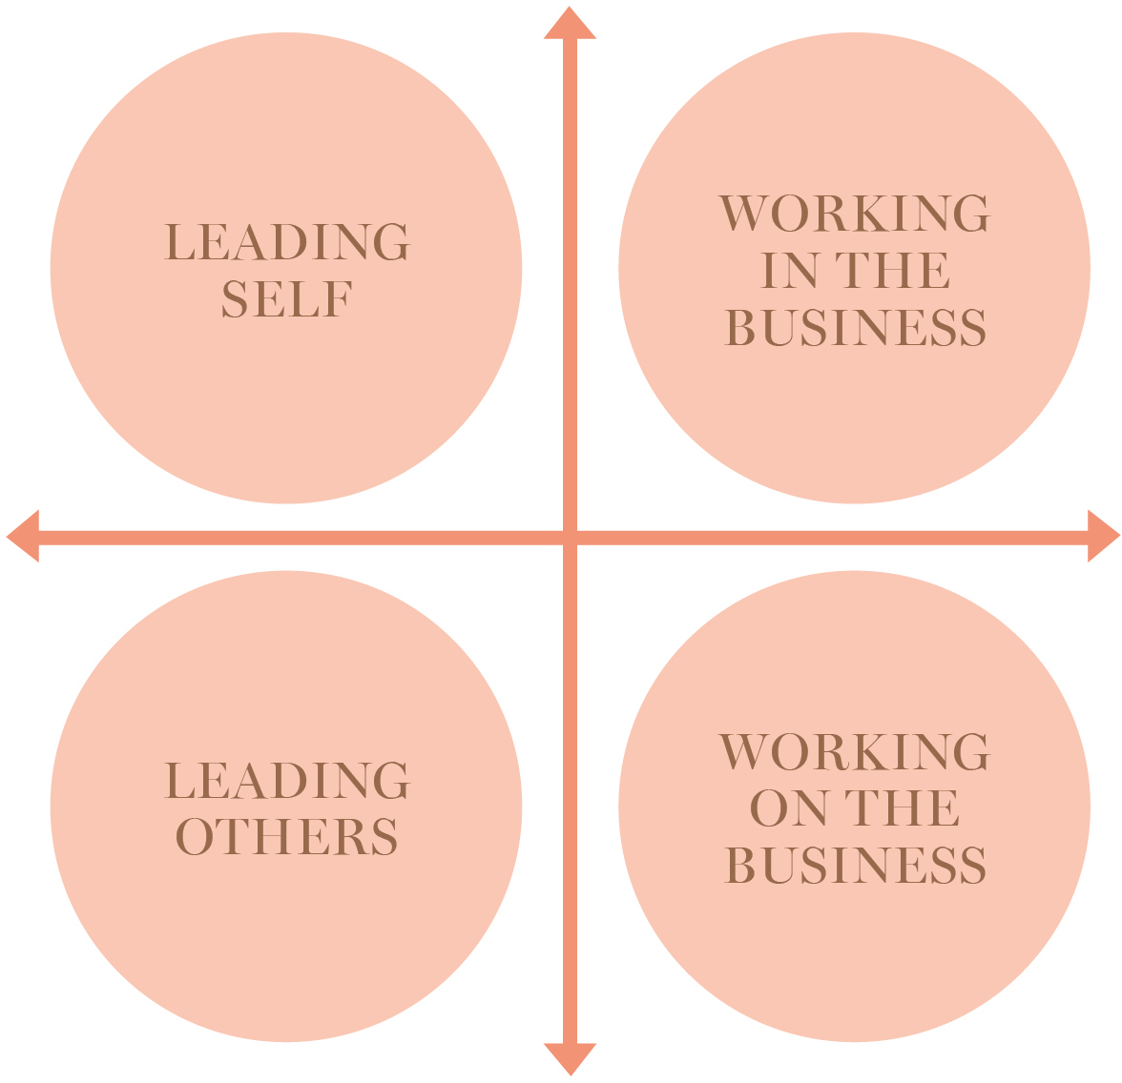

Leadership Tensions
This activity is designed to help you understand the leadership tensions you might face in your role. You will also learn more about how to work through tensions in a team based environment.
Leadership Tensions Recap
Handling leadership tensions is all about facing issues that have no clear right or wrong answer. They often require you to make a judgement call between two equally important priorities or valid perspectives. Below are the four leadership tensions that we all must consider when working at Myer. See the leadership tensions learning moment to learn more about these tensions.
WHY Do It? To understand the balancing act that we need to maintain when leading through tensions
WHAT You Need
Time and space to reflect
Your Leader Journal for capturing reflections
WHEN To Try It
You’re motivated to understand your leadership tensions, and when you want to get a better understanding of the perspectives of those you lead
WHO Is Involved?
This activity can be completed autonomously and then results can be discussed as a group.
Steps to Spotting Tensions:
Name It Name the tension to balance it effectively in decision-making.
Embrace It Admit what you ‘do not know’. Make the best decision possible with incomplete data.
Make Meaning Connect the different messages to Myer’s purpose and strategy you can help to create meaning.
Support Competing Priorities Communicate with stakeholders, align competing agendas, and make decisions regarding one goal over another on a case-by-case manner.
Think of the big picture Look for the bigger picture and how different perspectives may be interrelated.

Slide 2
Spotting Our Tensions Worksheet
Using the principles outlined on the previous page, completed the questions below. If you are making decisions as part of a broader team, consider getting each team member to fill out the sheet and collate all the information together. This will provide a balanced perspective on the tension.
Name the tension
The most difficult tension to balance is: .
Embrace it
Based on the information at hand, I think the best approach is: 1
.
Make meaning
My decision and approach connects to our strategy and purpose by: 1 1 Support competing priorities
My decision and approach takes into account (Who & How): 1
1
Think of the big picture My approach fits into the bigger picture of what we do by: 1
1
1
Follow Up Questions
What are the key risks and opportunities associated with each side of the tension? .
How will you manage risk?
1
=
+
-

