Slide 1
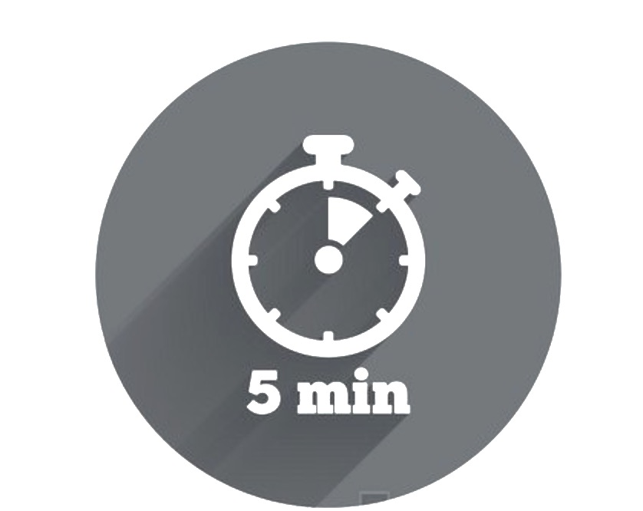

Managing Difficult Conversations
Difficult conversations typically arise when one or more people don’t feel understood. This could be because we drew an assumption, failed to consider alternative perspectives, didn’t ask the other person what they thought or chose not to listen. To avoid conversations becoming difficult try the following tips and conversation starters:
Try this…
Take regular breaks throughout your day: this will help you to stay calm and centred, making it easier to manage difficult conversations if / when they crop up
Think positive: resist labelling the conversation as “difficult” in your mind to avoid creating a self-fulfilling prophesy
Leave your assumptions at the door: often the conversation we think we are going to have is not the one we end up having. Remain open and flexible to where the conversation goes
Pause, breathe and listen: do whatever you can to slow the pace of the conversation down as this will help to diffuse emotion / tension
Don’t fan the fire: visualise a sponge absorbing the emotion that the other person is demonstrating without taking it personally or getting emotional yourself, as this will only inflame the situation
Be constructive: suggest alternatives and solutions to the problem rather than blaming, defending or justifying
Take a walk in the other person’s shoes: there is always more than one side to a story. Make sure you understand the other person’s perspective
Where do I begin?
Helpful conversation starters:
“I have something that I’d like to discuss that I think will help us to work better together …”
“I’d like to talk to you about ____________, but first I’d like to get your point of view…”
“I need your help with what just happened. Do you have a few minutes to talk?”
"I’d like to talk about ______________. I think we may have different ideas on how to _____________”
=
+
-
When I find myself in a conversation that has become difficult, the main things I need to remember are:

Slide 2
Dealing With Tricky Reactions to Feedback
Sometimes another person’s reaction to your feedback can make a conversation difficult. Below are tips for managing some of the most common ‘tricky’ reactions.
 | Do | Don’t
Resistance / Denial “I don’t know what you’re talking about. I provide great service to our customers!” | Provide sufficient examples to support your feedback Gauge the other person’s reasons for resistance Ask the recipient to reflect on the feedback and end the discussion if they are being pointlessly resistant Candidly discuss consequences if feedback is not addressed | Get angry or frustrated at their reaction Soften your feedback to alleviate their response Attack the other person’s personality based on their reaction
Shock / Anger “I’ve been working so hard and this is the thanks I get?!” | Acknowledge that the recipient is not satisfied with the feedback Invite the other person to offer their opinion Restate examples, explain your perspective | Become defensive Moderate your feedback to alleviate their reaction Attack the other person’s personality based on their reaction
Lack of Confidence, Self Pity “I can never do anything right” | Give the recipient time to regain composure if needed Highlight that this is an opportunity to improve Provide examples of small steps that they can take in the right direction Reassure him / her that they have your support | Reflect the recipient’s negative reaction Moderate your feedback to alleviate the reaction Focus on the recipient’s past inability to achieve outcomes
Avoiding Responsibility “It’s not my fault…” | Listen to the employee’s reasons and situation Restate the examples Clarify that improvement is required despite their reasons | Agree with the recipient if he / she blames other people Change your perspective based on the reasons or excuses if they are not valid
Indifference “Okay, whatever…” | Ask recipient to reflect on the feedback and confirm whether he/she is able to commit to actioning it Discuss the consequences if the recipient does not commit to improving | Overlook the recipient’s indifference toward the feedback Judge or lose patience with the other person
=
+
-

