Slide 1
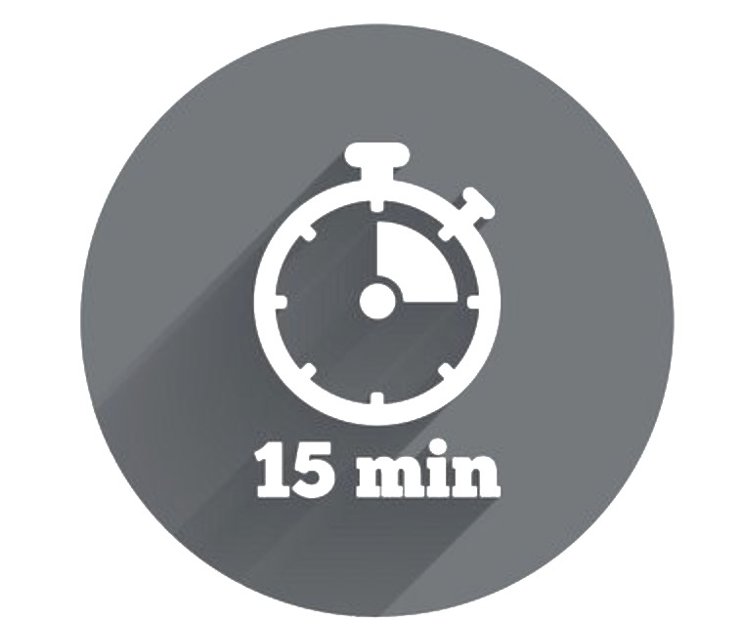

My Five Ways to Wellbeing Action Plan
Way to Wellbeing | Things I Already Do | Things I Will Give a Go | By When
Connect Talk and listen Be there, feel connected E.g. ask someone about their weekend and really listen when they tell you, pick up the phone instead of emailing
Be Active Do what you can, enjoy what you do Move your mood E.g. go for a walk at lunchtime, take the stairs not the lift or elevator, stretch throughout the day
Take Notice Remember the simple things that give you joy E.g. Have a ‘clear the clutter’ day, visit a new place for lunch, take a different journey to or from work
Keep Learning Embrace new experiences See opportunities Surprise yourself E.g. research something you’ve always wondered about, learn a new word, sign up for a class
Give Your time, your words, your presence E.g. Say ‘thank you’ at least three times a day, volunteer for a cause that is important to you
For more information visit http://neweconomics.org/2008/10/five-ways-to-wellbeing-the-evidence/

