Slide 1

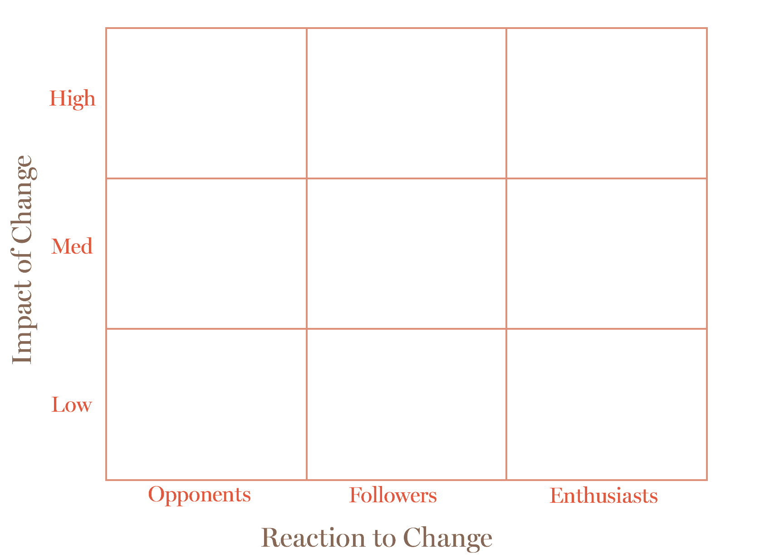

Stakeholder Analysis Activity
This activity is designed to help you think about the stakeholders who will be effected by a specific change initiative you or your team might be planning. First, consider the typical reactions towards change, as well as the level of impact the change will have on the stakeholders effected.
Your stakeholder’s reactions will likely fall into one of three categories:
1. Opponents are against the change, and will need a lot of support and buy-in to come on board.
2. Followers may feel indifferent towards the change, and will likely go along with it.
3. Enthusiasts are positive about the change, and can help spread and promote the benefits of your initiative.
It’s also important to consider how effected by the change these stakeholders are.
Consider your stakeholders, this could be specific team members, suppliers, customers, or other departments. Where do they sit on the stakeholder map below?
For Example: Stakeholders that are highly impacted and are enthusiastic about the change, sit in the top right box.
Stakeholder Analysis Map
=
+
-
After you have mapped out where each of your stakeholders sit on the map above, turnover to begin planning your change strategy.

Slide 2
Stakeholder Analysis Activity
Now that you have mapped out where your stakeholders are in terms of impact and resistance to change, you can begin to plan your action by detailing the impact to the stakeholder, their concerns, the tactics you could use to get them on board, and the ’communicator’ who will deliver or reinforce the message.
Stakeholder | Impact | Concerns | Tactics | Communicator
Reflection
Where do you need to direct most of your time and energy?
Is there a way for you to align enthusiastic stakeholders with the opponents?
=
+
-

