Slide 1
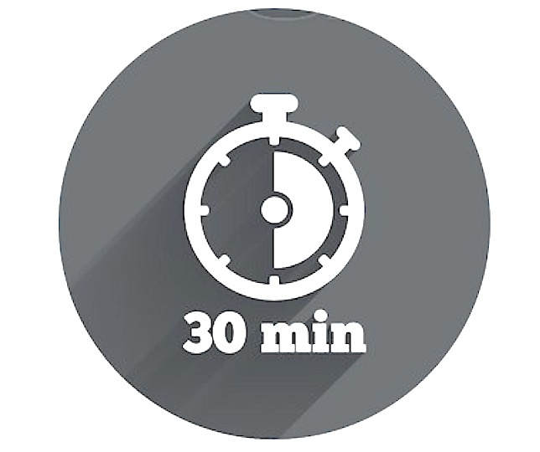
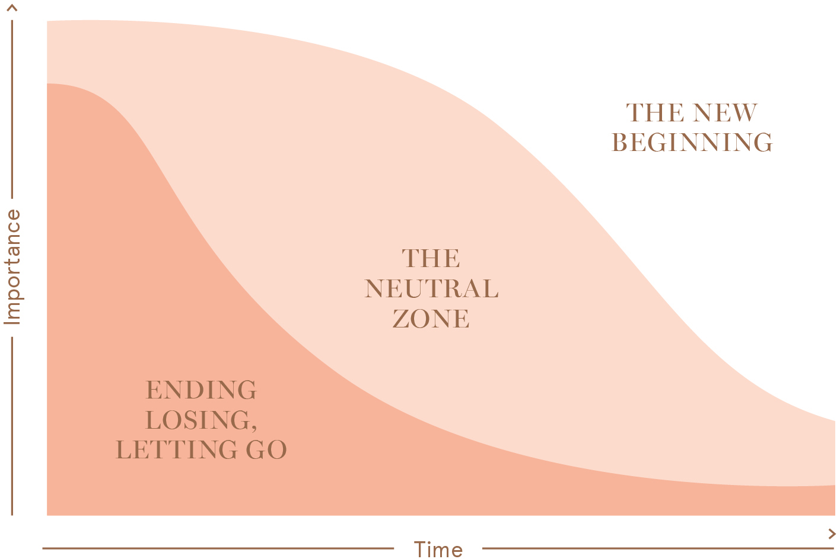

Transition Team Activity
A useful way to prepare yourself to lead your team through change is to understand the process of change, and the different ways in which people can respond.
Bridges Transition Model Snapshot
The Bridges Transition model highlights that when we experience an external change in our organisation, we also go through an internal psychological transition as we come to terms with what the change means for us, our work and our relationships:
WHY Do It?
This team activity explores practical strategies based on real life experiences of dealing with change and transition.
WHAT You Need
Approximately 30 minutes before or after a team meeting or over lunch to discuss as a group
A current or impending change that will impact the team
Space to move around (this is a fairly active session)
A whiteboard or flipchart (if available)
WHEN To Try It
This activity is particularly useful at the onset of change and where you want to set the team up for success.
WHO Is Involved?
This activity is designed for the entire team. Depending on how the team is currently tracking, you may like to brief a couple of members about what the activity involves, so that they can think about some positive examples to share in advance.
The three phases of transition are:
Ending, Letting Go: Characterised by the need to disengage from old approaches, relationships, and roles; and accept the need to move on.
The Neutral Zone: Typically involves uncertainty and possibly fear or excitement about what the future holds; mixed feelings.
The New Beginning: In this phase people are clear about the future, feeling positive, re-energised, and have a renewed sense of purpose.
The activity described on the following page will assist your team to share and apply practical techniques for proactively moving through these three phases.
=
-

Slide 2
Transition Team Activity
Instructions
To get the activity underway:
Inform the team that this activity will get underway with a game called ‘Sociometry’. You will need to form a line in order from least to most by checking in with one another to organise yourselves
Say: the first dimension that I would like you to organise yourself from least to most along is ‘the number of countries that you have visited’
Once the team have formed a line, ask for a few examples and stories to get a sense of why / how people have placed themselves where they have along the continuum
Next, invite the team member(s) who have travelled to the most countries to share some of their best travel tips
Repeat this process with a second dimension: ‘how many houses have you lived in?”
Debrief as per the first round, this time inviting team member(s) who have moved the most times in their lives to share to their top packing / moving tips
Key message to reinforce: you have practice dealing with change everyday. You can use this experience to successfully respond to change at work too
Position with team that we will complete one more round of ‘Sociometry’ – this time the dimension is how you would rate your level of comfort and confidence in the current change we are experiencing as a team on a scale from 0 to 10
Debrief as per previous rounds, this time asking the team member(s) who rated themselves as most comfortable and confident in the current change to share some of their tips, strategies or techniques for coming to terms with the change and / or viewing the change positively and as an opportunity as opposed to threat
Facilitate a group discussion, flip-charting / white-boarding as many different ways for transitioning successfully through change as possible – let the team know that you will document and send these out after the session
Invite each team member to select their number one strategy / technique to try – you can discuss how they go with these in your next 1:1 or coaching conversation
9. Thank team for their participation and conclude activity.
=
+
Your notes to prepare for this activity:

