Slide 1
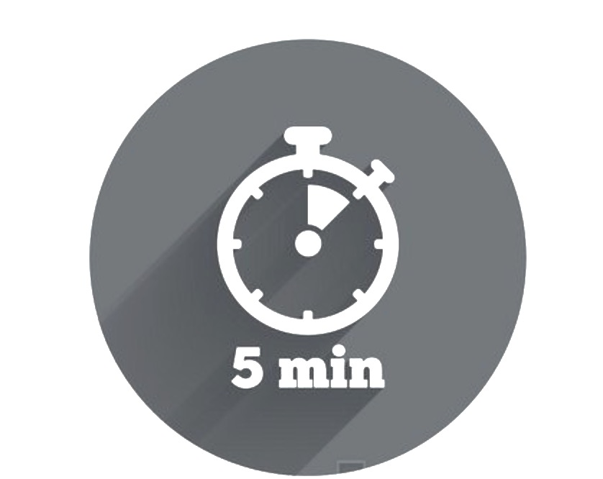

Types of Questions Cheat Sheet
In everyday conversations, questions help you to focus attention, elicit new ideas, encourage exploration and foster commitment. Use this cheat sheet to improve the quality and versatility of your question asking. Hint: this is particularly important if you find yourself talking for more than 50% of the time in any conversation!
You can also use this Cheat Sheet to set yourself a practical leadership challenge – for example reducing closed questions by 50%, asking 3 different types of questions per meeting or identifying the question type you ask the least and looking for an opportunity a day to ask it.
Question Type | Why | When | How
Open | To encourage the other person to open up, so that you can gather necessary information. They often start with why, what, where, which, and how. | You want to obtain a lot of information | “How did you go with that task?” “What can you do to keep your team on track?” “How would you respond to this customer's concerns?”
Closed | Closed questions are used when you require a 'yes' or 'no' answer. | When it is important that you control the conversation Use sparingly as closed questions can make a conversation feel one-sided and may negatively impact the ability to establish rapport and empathy | Are you happy in your job? Have you had a lunch break yet?
Probing | To clarify something that has already been said or to find out more detail about it. | You need to uncover details that may have initially been overlooked or thought irrelevant Take care not to over use probing questions as this may make people feel interrogated – use neutral or supportive verbal and nonverbal signs to reduce the likelihood of this | “What does that mean?” “What are your main concerns?” “Tell me more about what happened with that customer?”
Paraphrasing | Paraphrasing questions are one of the best ways you can check your own understanding of what the other person has said. | If the conversation has moved quite quickly and covered a lot of ground and you want to make sure you haven’t missed anything If you feel that you are starting to lose track of the conversation If you pick up that the other person is feeling misunderstood | Your conversation partner: “I can't deliver on that unless Buying get the information to me the same day.” You: “I'm hearing that you could deliver, if the Buying team were able to get you the information you need on the same day you requested it. Is that right?”
Hypothetical | Hypothetical questions allow you to gauge how someone might act or what they think about a possible situation. They are effective in getting the person to think up and discuss new ideas or approaches to a problem. | These types of questions are useful to ask when your conversation partner is feeling ‘stuck’ on a particular issue or problem | “What would you do if…?” “What would happen if…?” If we got busy next week, what’s the likelihood you could come in for an extra shift?”
Leading | Useful in situations where you require a desired answer or need to influence people's thinking. | Use leading questions with care because they imply that there is a right answer to the question, which contradicts the ethos of active listening | “So wouldn't it have been better to…?” “Don't you think we should have…?” What do you like most about the strategy?”
Reflective | To check and clarify your understanding. This style of question reflects back to the other person what they have just said. | Use to dispense having to express an interpretation or judge why the other person feels /felt this way Valuable for supporting the other person to explore their own situation more fully, without you jumping in to solve it for them | Your conversation partner: “I feel frustrated with myself.” You: “What does being "frustrated with myself“ involve?‘ Your conversation partner: “The Visual Merchandising team are always messing me about.” You: “What does ‘messing you about’ look like?”
=
+
-

