Slide 1
HOUSING: PRICE PREDICTION
Smita More

Slide 2
Introduction
A US-based housing company named Surprise Housing has decided to enter the Australian market. The company uses data analytics to purchase houses at a price below their actual values and flip them at a higher price. For the same purpose, the company has collected a data set from the sale of houses in Australia. The data is provided in the CSV file below. The company is looking at prospective properties to buy houses to enter the market. You are required to build a model using Machine Learning in order to predict the actual value of the prospective properties and decide whether to invest in them or not

Slide 3
Contents :-
Problem Statement
Problem Understanding
Importing Libraries
Loading Dataset
Exploratory Data Analysis
Graphical Visualization
Processing the dataset
Correlation
Conclusion

Slide 4
Problem Statement
Houses are one of the necessary need of each and every person around the globe and therefore housing and real estate market is one of the markets which is one of the major contributors in the world’s economy. It is a very large market and there are various companies working in the domain. Data science comes as a very important tool to solve problems in the domain to help the companies increase their overall revenue, profits, improving their marketing strategies and focusing on changing trends in house sales and purchases. Predictive modelling, Market mix modelling, recommendation systems are some of the machine learning techniques used for achieving the business goals for housing companies. Our problem is related to one such housing company.

Slide 5
Problem Understanding
You are required to model the price of houses with the available independent variables. This model will then be used by the management to understand how exactly the prices vary with the variables. They can accordingly manipulate the strategy of the firm and concentrate on areas that will yield high returns. Further, the model will be a good way for the management to understand the pricing dynamics of a new market.

Slide 6
Technical Requirements:
Data contains 1460 entries each having 81 variables.
Data contains Null values. You need to treat them using the domain knowledge and your own understanding.
Extensive EDA has to be performed to gain relationships of important variable and price.
Data contains numerical as well as categorical variable. You need to handle them accordingly.
You have to build Machine Learning models, apply regularization and determine the optimal values of Hyper Parameters.
You need to find important features which affect the price positively or negatively.
Two datasets are being provided to you (test.csv, train.csv). You will train on train.csv dataset and predict on test.csv file.

Slide 7
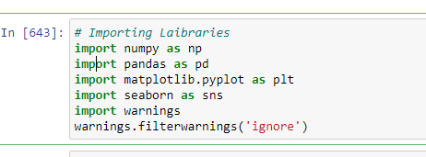
Importing Libraries

Slide 8
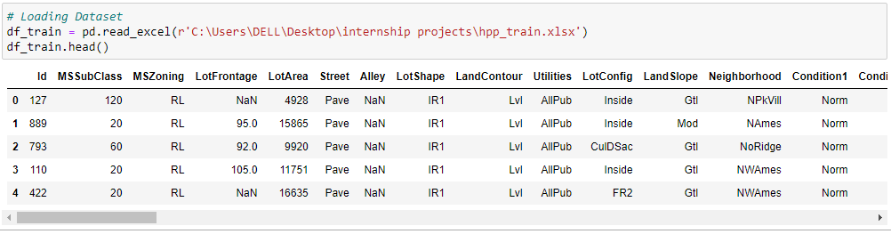
Loading Train Dataset

Slide 9
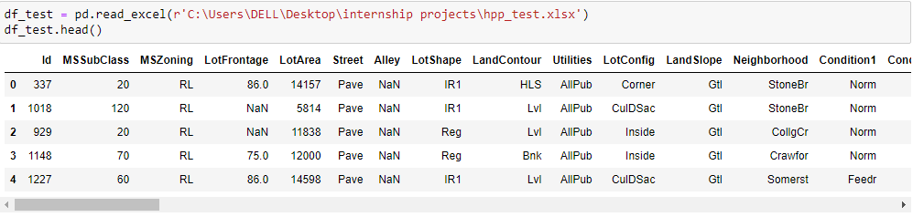
Loading Test Dataset

Slide 10
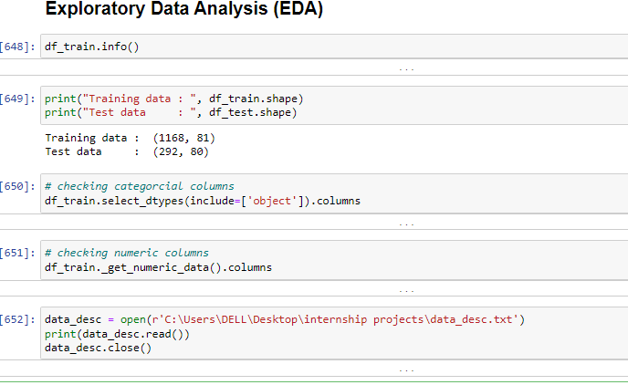
Exploratory Data Analysis (EDA)

Slide 11
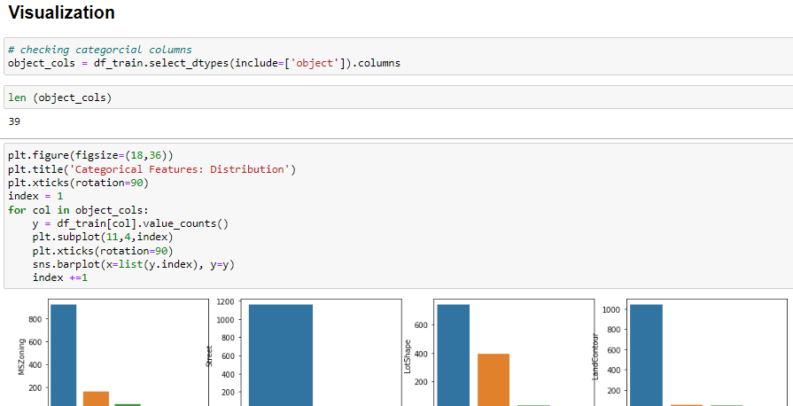
Visualization

Slide 12
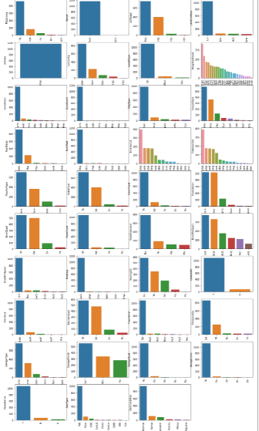
Categorcial Columns

Slide 13
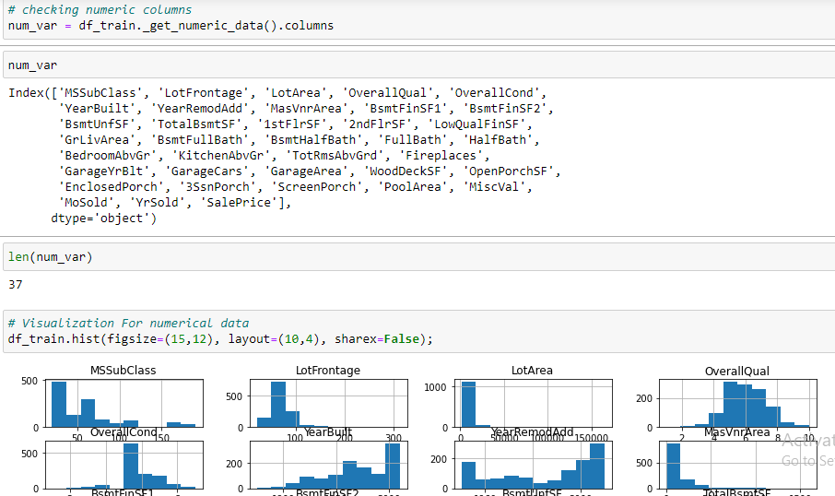
Visualization

Slide 14
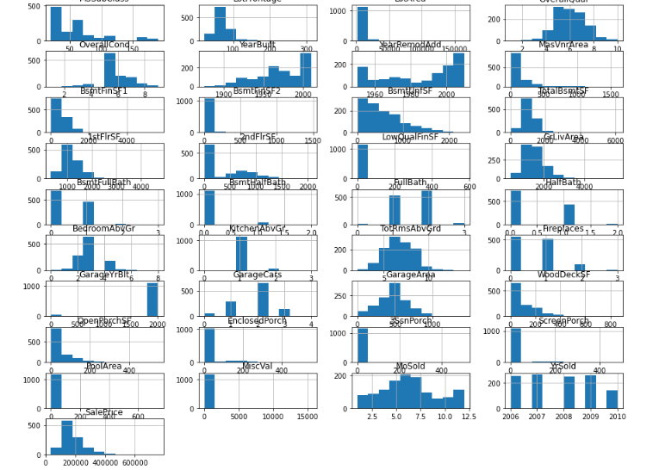
Numeric Columns

Slide 15
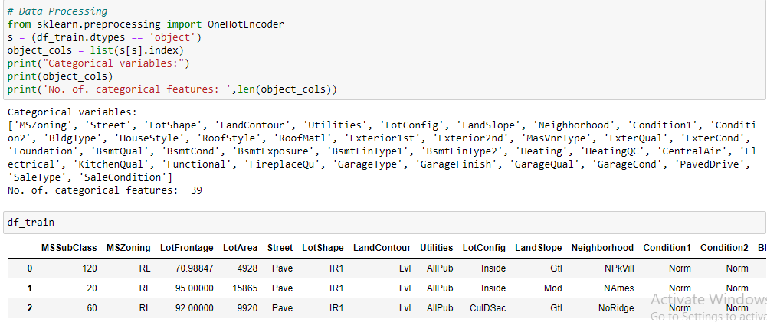
Processing the Dataset

Slide 16
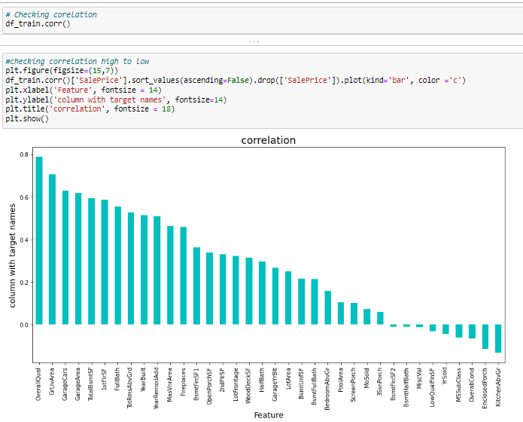
Correlation

Slide 17
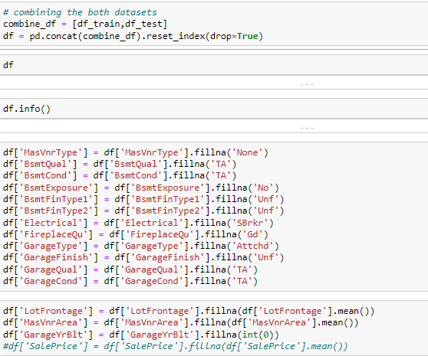
Combining the datasets

Slide 18
Model Building
Use following Machine Learning Algorithms
RandomForestRegressor
GradientBoostingRegressor
SGDRegressor
XGBRegressor

Slide 19
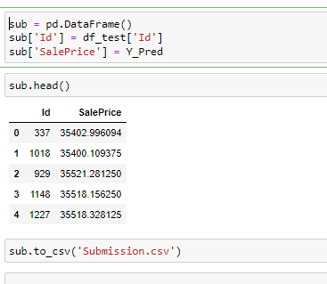
Submission File

