Slide 1











Python Battery Mathematical Modelling
The PyBaMM Team
@pybamm_
join Slack
www.pybamm.org

Slide 2

Plan: Parameters: Where to find parameters? How to change parameters? Examples? 1) Changing whole parameter set 2) Changing current example 3) Model+ current change Sub-models : Where to find sub-models How to use them? Examples?
The PyBaMM Team
@pybamm_
join Slack
www.pybamm.org

Slide 3
Parameters
The PyBaMM Team
@pybamm_
join Slack
www.pybamm.org

Slide 4
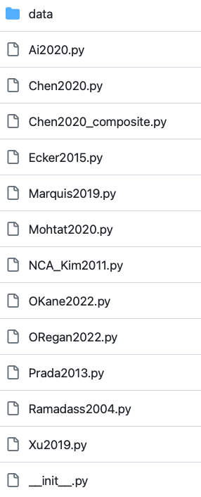
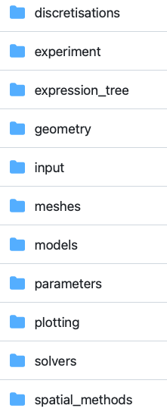
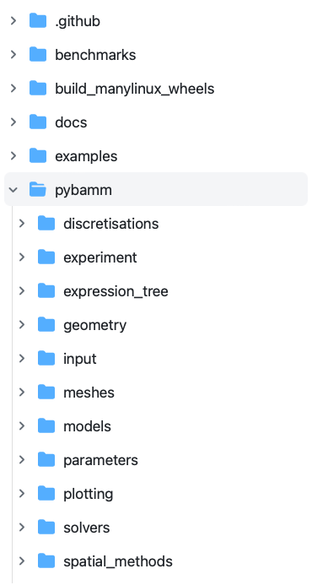
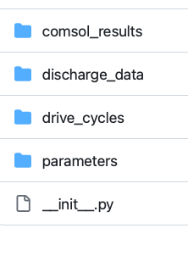
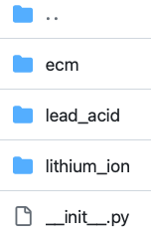
Parameters
Pybamm-team/PyBaMM/pybamm/input/parameters/lithium_ion
The PyBaMM Team
@pybamm_
join Slack
www.pybamm.org

Slide 5
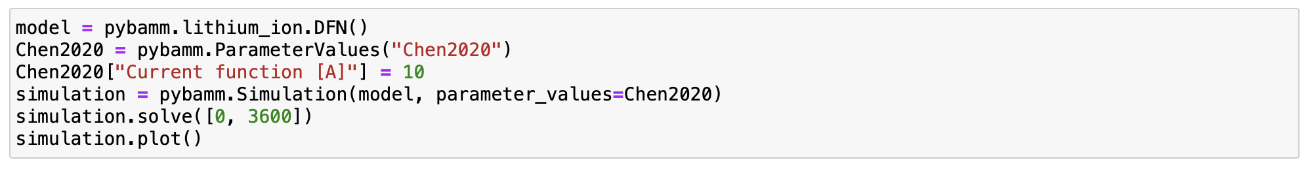
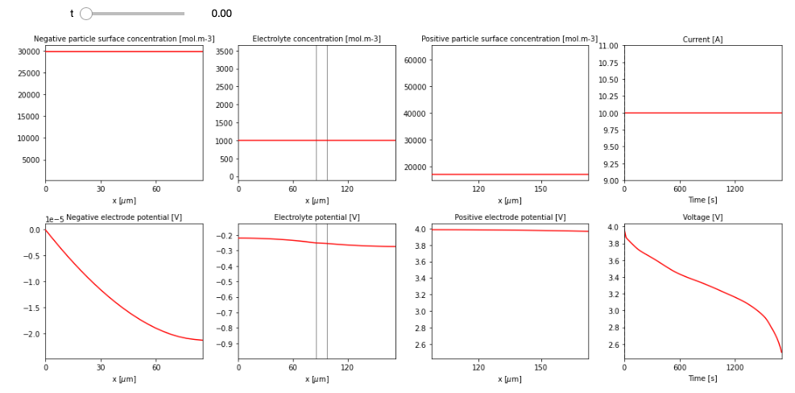
Example 1
The PyBaMM Team
@pybamm_
join Slack
www.pybamm.org

Slide 6
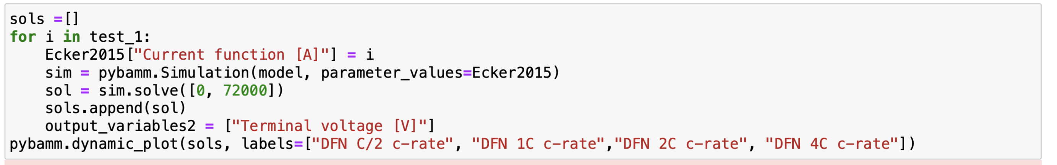
Example 2
The PyBaMM Team
@pybamm_
join Slack
www.pybamm.org

Slide 7
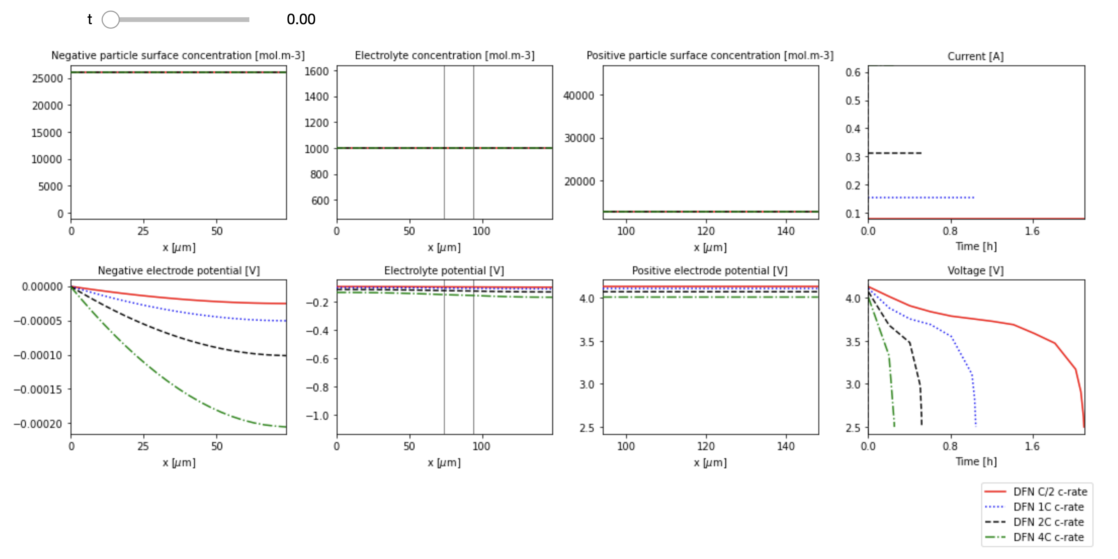
Example 2
The PyBaMM Team
@pybamm_
join Slack
www.pybamm.org

Slide 8
Sub-models
The PyBaMM Team
@pybamm_
join Slack
www.pybamm.org

Slide 9

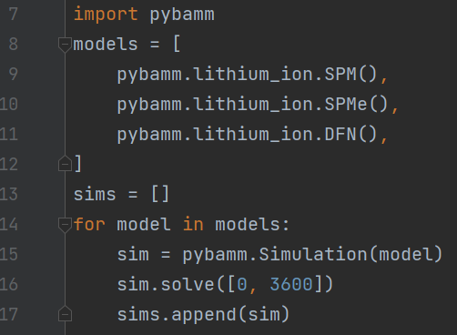
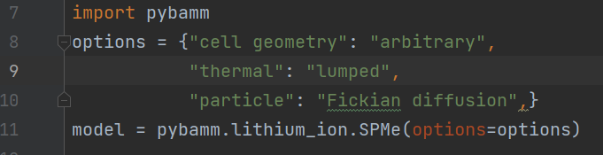
Structure
Models
Full Battery Models
Sub-models
DFN, SPM, SPMe
Particle Mechanics, Thermal
The PyBaMM Team
@pybamm_
join Slack
www.pybamm.org

Slide 10
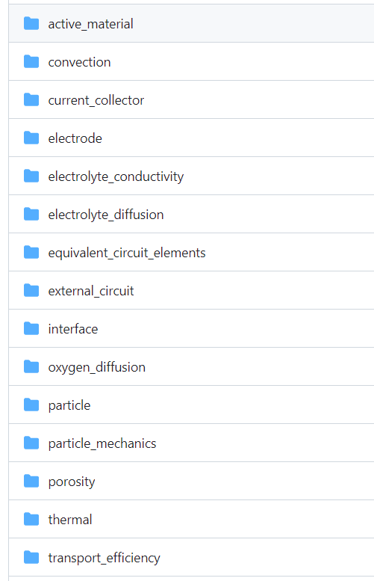
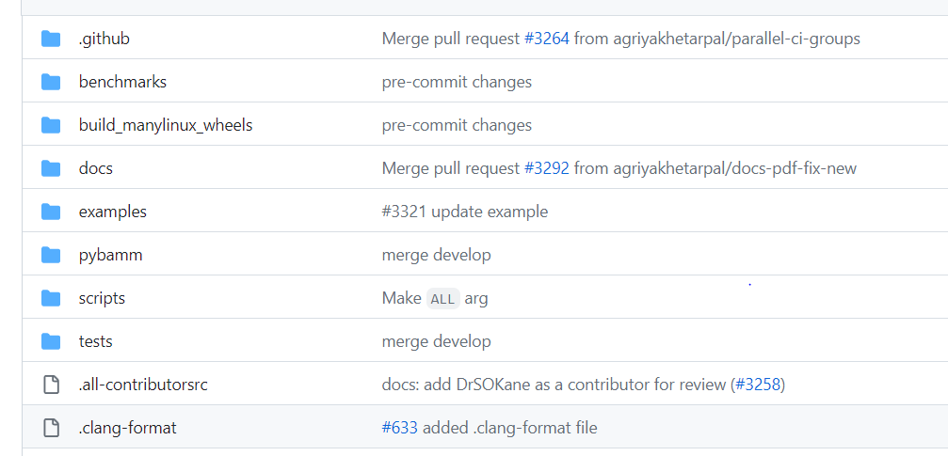
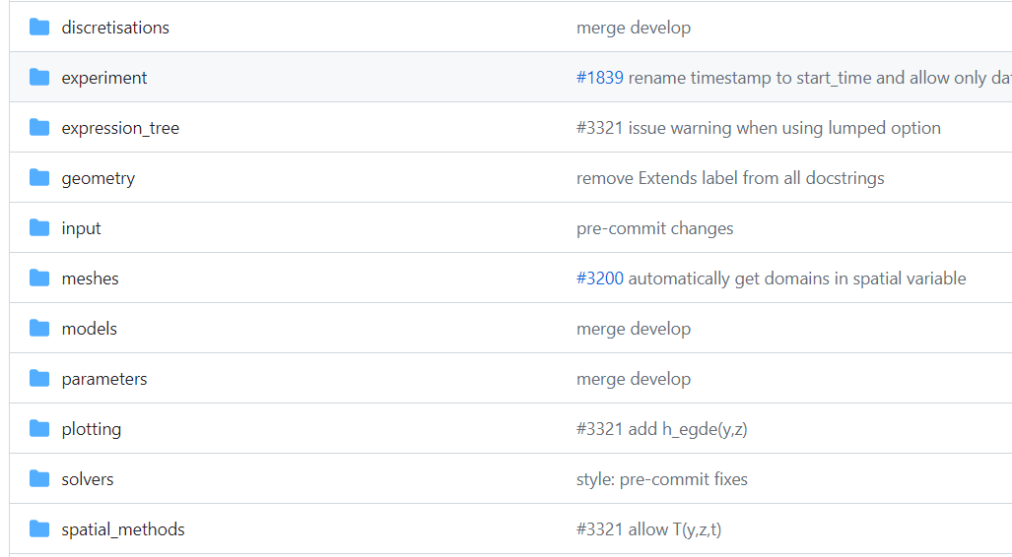
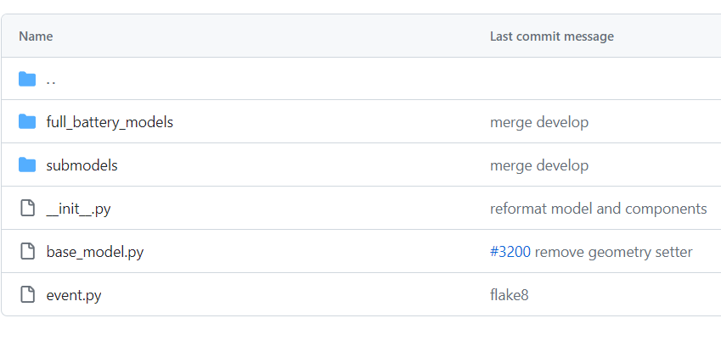
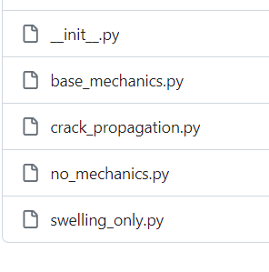
Sub-models
The PyBaMM Team
@pybamm_
join Slack
www.pybamm.org

Slide 11
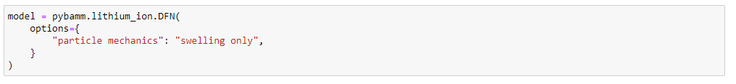
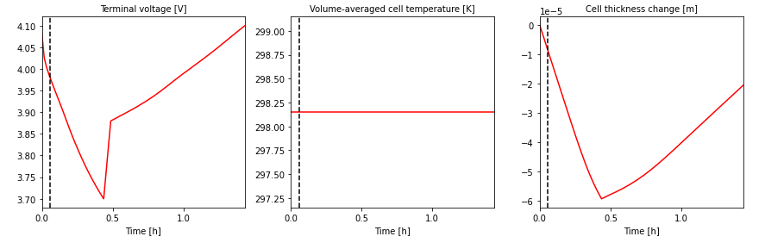
Example 1
The PyBaMM Team
@pybamm_
join Slack
www.pybamm.org

Slide 12
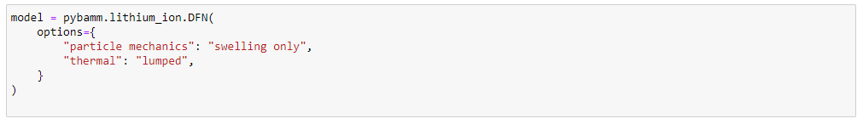
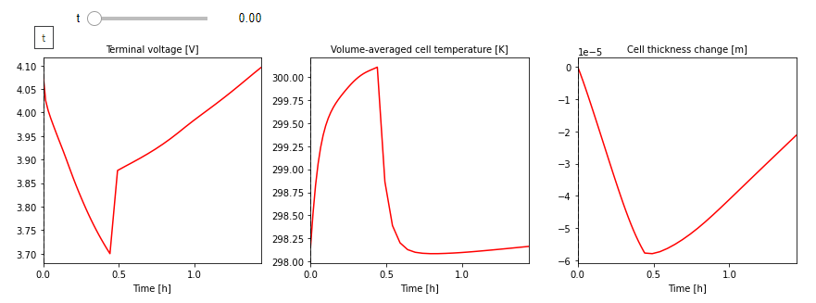
Example 2
The PyBaMM Team
@pybamm_
join Slack
www.pybamm.org

Slide 13
Reference Papers
W. Ai, et al., “Electrochemical thermal-mechanical modelling of stress inhomogeneity in lithium-ion pouch cells,” Journal of The Electrochemical Society, vol. 167, no. 1, p. 013512, 2020.
S. O’Kane, et al., “Lithium-ion battery degradation: how to model it,” Phys. Chem. Chem. Phys., vol. 24, pp. 7909–7922, 2022.
The PyBaMM Team
@pybamm_
join Slack
www.pybamm.org

Slide 14



Accessing support
PyBaMM doesn’t do something you think it should?
Not sure how to use existing features or implement your own model?
Interested in commercial or academic collaboration?
Please get in touch!
Get in touch on Slack or email
Use the #technical-questions channel, send a direct message, or send us an email
Create an issue or discussion
Head over to GitHub and post an issue or start a discussion
Implementation Sessions
One-on-one or group session to workshop your ideas, discuss implementation details and help with any issues
The PyBaMM Team
@pybamm_
join Slack
www.pybamm.org

Slide 15

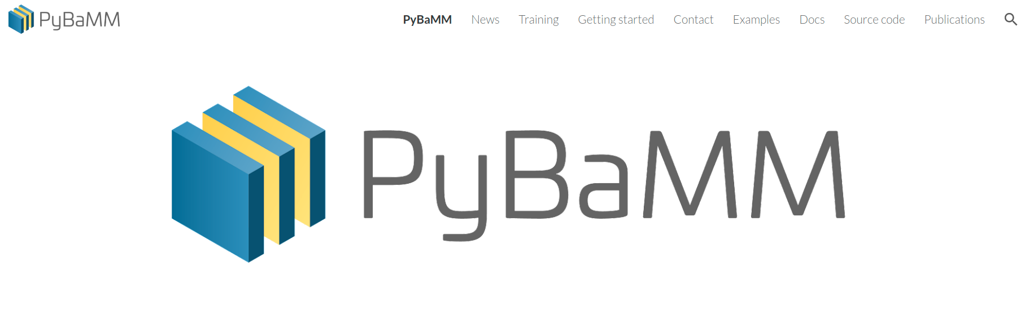



Further information – pybamm.org
Follow us on twitter - @pybamm_ and @battbot_
Star us on GitHub - PyBaMM
Join us on Slack
Try our online examples - colab.pybamm.org
The PyBaMM Team
@pybamm_
join Slack
www.pybamm.org

