Slide 1
Computer Networks(2015 Pattern) Unit III- Medium Access Control

Slide 2
Outline
Channel allocation: Static and Dynamic,
Multiple Access Protocols: Pure and Slotted ALOHA, CSMA, CSMA/CD, CSMA/CA, WDMA
IEEE 802.3 Standards and Frame Formats,
Binary Exponential Back -off algorithm,
Fast Ethernet, Gigabit Ethernet,
IEEE 802.11a/b/g/n and
IEEE 802.15 and
IEEE 802.16 Standards, Frame formats,

Slide 3
Outline
Channel allocation: Static and Dynamic,
Multiple Access Protocols: Pure and Slotted ALOHA, CSMA, CSMA/CD, CSMA/CA, WDMA
IEEE 802.3 Standards and Frame Formats,
Binary Exponential Back -off algorithm,
Fast Ethernet, Gigabit Ethernet,
IEEE 802.11a/b/g/n and
IEEE 802.15 and
IEEE 802.16 Standards, Frame formats,

Slide 4
Multiple access protocols
In LANs, Wi-Fi, satellite networks the access to the shared media should be controlled.
If more than 2 nodes send at the same time →collision
All collided packets are lost → waste of bandwidth
Ideally, the MAC protocol for a broadcast channel with the bit-rate R bps should satisfy:
if only 1 node is sending than the throughput is R
when M nodes have data to send than the throughput is R/M
decentralized protocol – no master
simple & inexpensive to implement

Slide 5
The Channel Allocation Problem
To allocate a single broadcast channel among competing users, we can use:
Static Channel Allocation in LANs and MANs
Dynamic Channel Allocation in LANs and MANs

Slide 6
Static Channel Allocation in LANs and MANs
Frequency Division Multiplexing (FDM) is an example of static channel allocation where the bandwidth is divided among a number of N users.
When there is only a small and constant number of users, each of which has a heavy (buffered) load of traffic (e.g., carriers' switching offices), FDM is a simple and efficient allocation mechanism.
However, when the number of senders is large and continuously varying or the traffic is bursty, FDM presents some problems.
1) when fewer than N users are currently interested in communicating, a large piece of valuable spectrum will be wasted.
2) when more users wants to communicate, those who have not been assigned a frequency will be denied permission.
3) even assuming that the number of users could somehow be held constant at N, each user traffic usually changes dynamically over time.

Slide 7
Dynamic Channel Allocation in LANs and MANs
Station Model: N independent stations (terminals) exists.
Single Channel Assumption: A single channel is available for all communication (send and receive)
Collision Assumption: If two frames are transmitted simultaneously, they overlap in time and the resulting signal is garbled (collision). no errors other than those generated by collisions assumed to exist.
(a) Continuous Time: Frame transmission can begin at any instant. (b) Slotted Time: Frame transmissions always begin at the start of a slot where the time is divided into discrete slots.
(a) Carrier Sense: Stations can tell if the channel is in use before trying to use it. (b) No Carrier Sense: Stations cannot sense the channel before trying to use it.

Slide 8
Multiple Access Protocols
ALOHA
Carrier Sense Multiple Access Protocols
Collision-Free Protocols
Limited-Contention Protocols
Wavelength Division Multiple Access Protocols
Wireless LAN Protocols

Slide 9
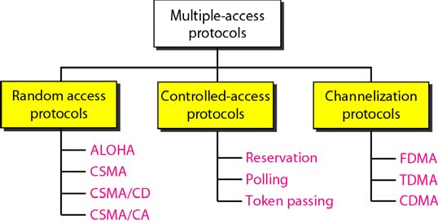
Taxonomy of Multiple-Access Protocols

Slide 10
Outline
Channel allocation: Static and Dynamic,
Multiple Access Protocols: Pure and Slotted ALOHA, CSMA, CSMA/CD, CSMA/CA, WDMA
IEEE 802.3 Standards and Frame Formats,
Binary Exponential Back -off algorithm,
Fast Ethernet, Gigabit Ethernet,
IEEE 802.11a/b/g/n and
IEEE 802.15 and
IEEE 802.16 Standards, Frame formats,

Slide 11
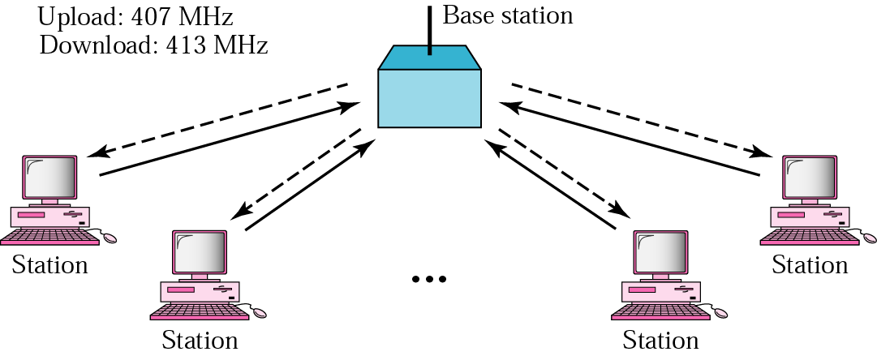
ALOHA Network

Slide 12
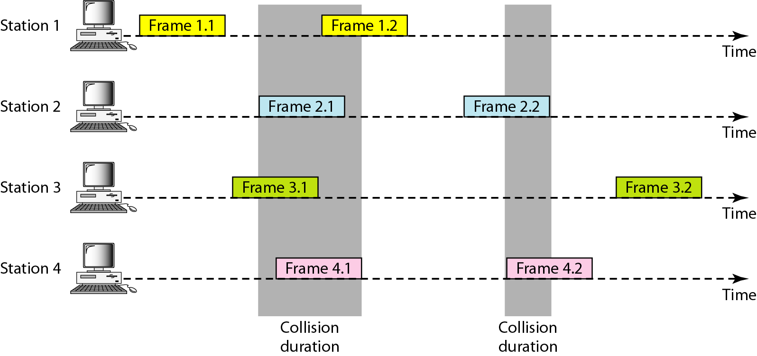
Frames in Pure ALOHA

Slide 13
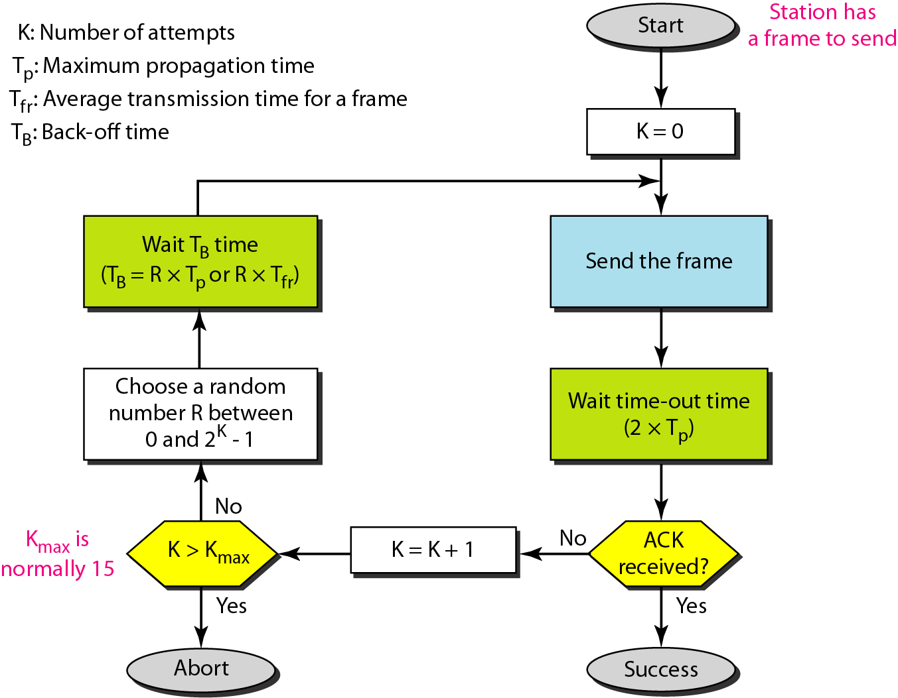
ALOHA Protocol

Slide 14
Example
Calculate possible values of T_{B} when stations on an ALOHA network are a maximum of 600 km apart
T_{p} = (600 × 10³) / (3 × 10⁸) = 2 ms
When K=1, T_{B} ∈ {0ms,2ms}
When K=2, T_{B} ∈ {0ms,2ms,4ms,6ms}
:

Slide 15
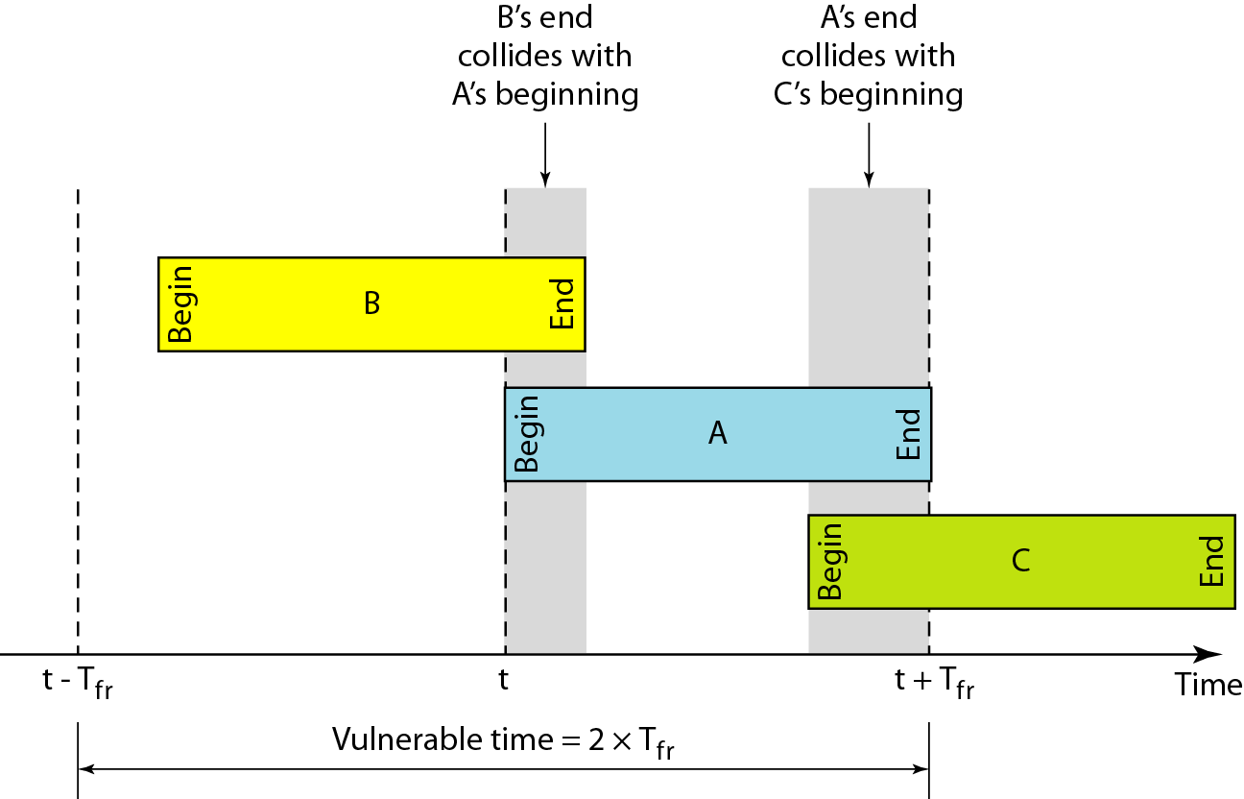
ALOHA: Vulnerable Time

Slide 16
ALOHA: Throughput
Assume number of stations trying to transmit follow Poisson Distribution
The throughput for pure ALOHA is
S = G × e^{−2G}
where G is the average number of frames requested per frame-time
The maximum throughput
S_{max} = 0.184 when G= 1/2

Slide 17
Example
A pure ALOHA network transmits 200-bit frames on a shared channel of 200 kbps. What is the throughput if the system (all stations together) produces
1000 frames per second
500 frames per second
250 frames per second

Slide 18
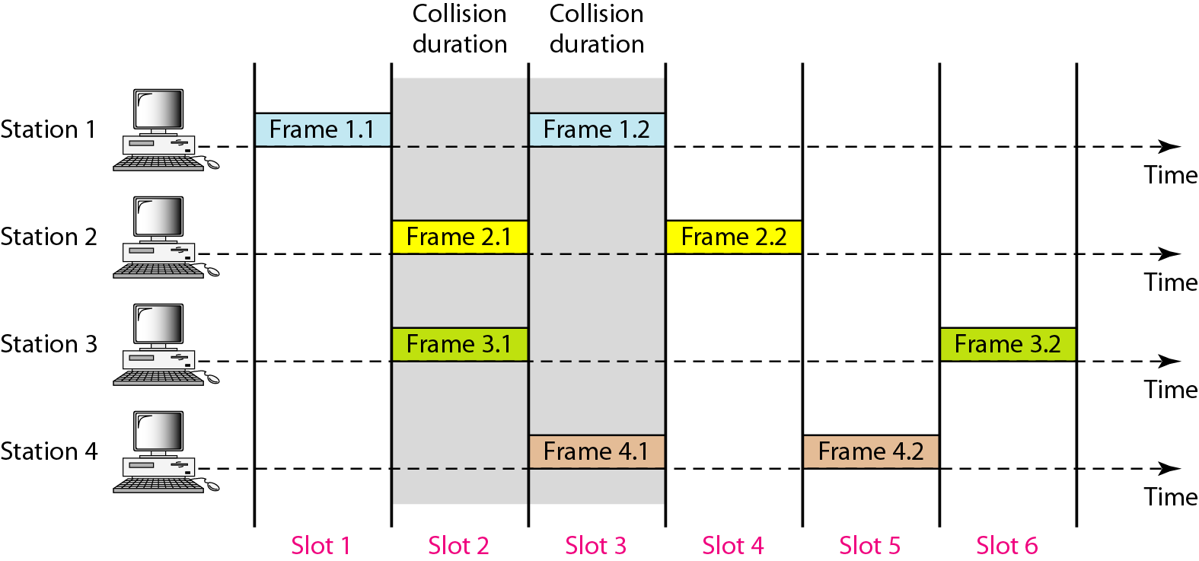
Slotted ALOHA

Slide 19
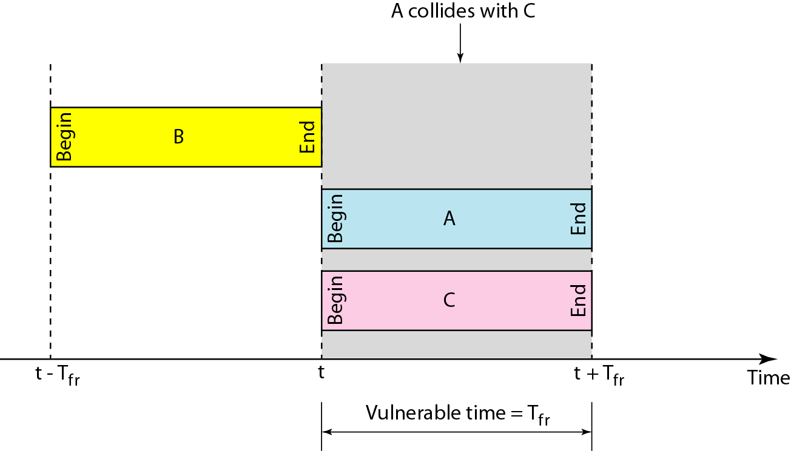
Slotted ALOHA: Vulnerable Time

Slide 20
Slotted ALOHA: Throughput
The throughput for Slotted ALOHA is
S = G × e^{−G}
where G is the average number of frames requested per frame-time
The maximum throughput
S_{max} = 0.368 when G= 1

Slide 21
Example
A Slotted ALOHA network transmits 200-bit frames on a shared channel of 200 kbps. What is the throughput if the system (all stations together) produces
1000 frames per second
500 frames per second
250 frames per second

Slide 22
CSMA
Carrier Sense Multiple Access
"Listen before talk"
Reduce the possibility of collision
But cannot completely eliminate it

Slide 23
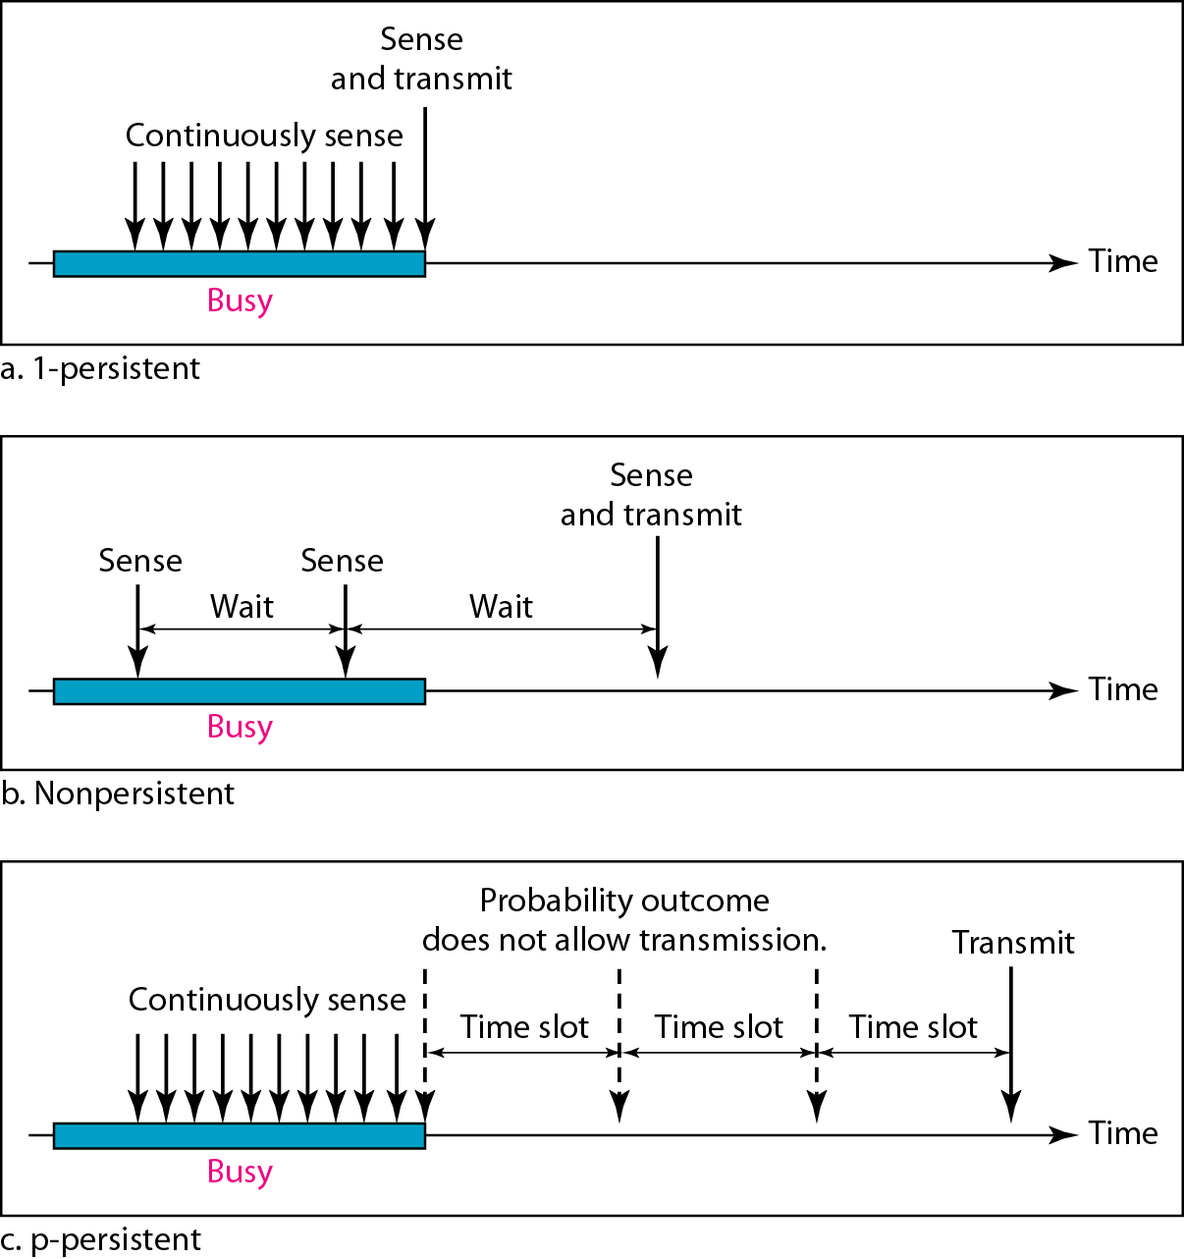
Persistence Methods
What a station does when channel is idle or busy

Slide 24
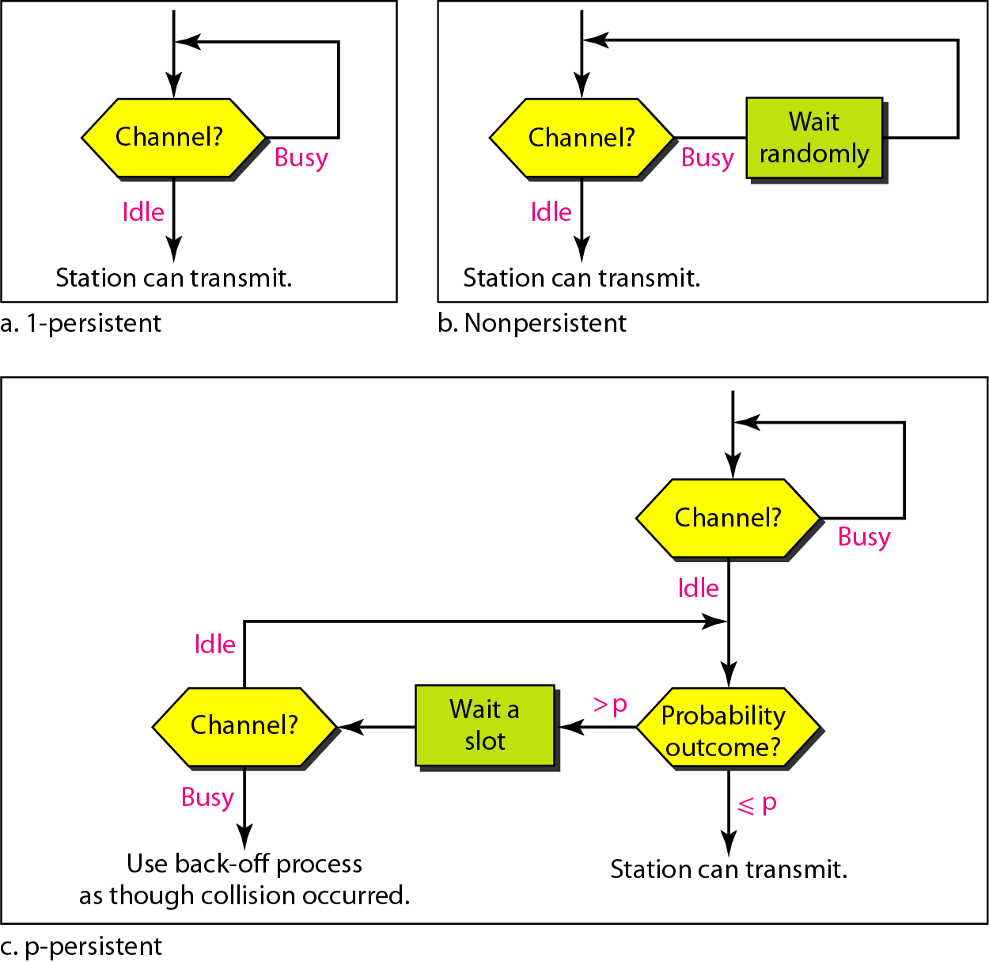
Persistence Methods

Slide 25
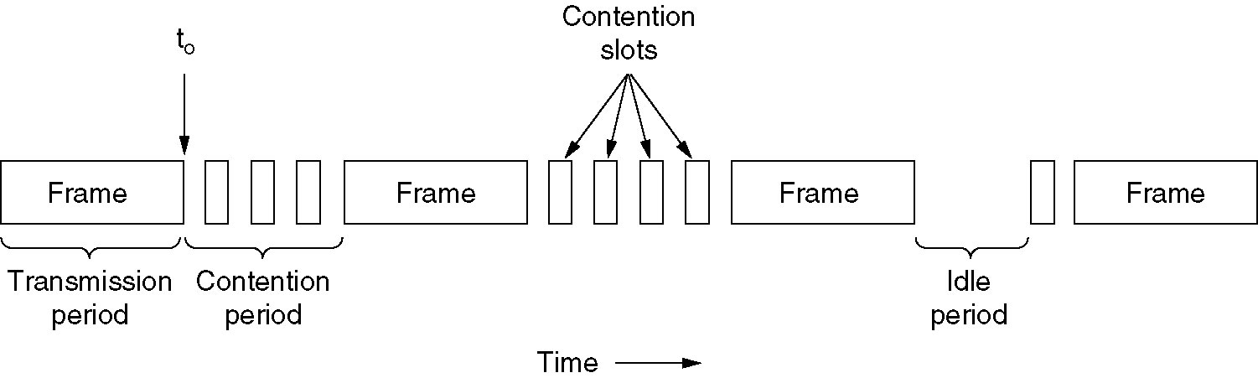
CSMA with Collision Detection
Carrier Sense Multiple Access with Collision Detection
Station monitors channel while sending a frame
CSMA/CD can be in one of three states: contention, transmission, or idle.

Slide 26
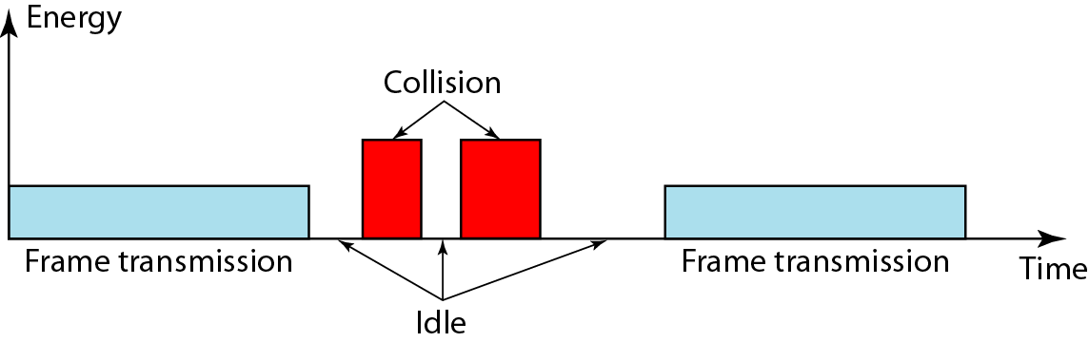
Energy Levels

Slide 27
CSMA/CD: Minimum Frame Size
Each frame must be large enough for a sender to detect a collision
Worst case scenario:
"A" is transmitting
"D" starts transmitting just before A's signal arrives
A
B
C
D
Long enough to hear colliding signal from D

Slide 28
Example
A CSMA/CD network has a bandwidth of 10 Mbps. If the maximum propagation time is 25.6 μs, what is the minimum size of the frame?
Ans:
Frame transmission time is Tfr=2* Tp=2*25.6 μs=51.2 μs
This means in worst case a station needs to transmit for a period of 51.2 μs to detect the collision.
The minimum size of the frame is
10Mbps * 51.2 μs =512 bits or 64

Slide 29
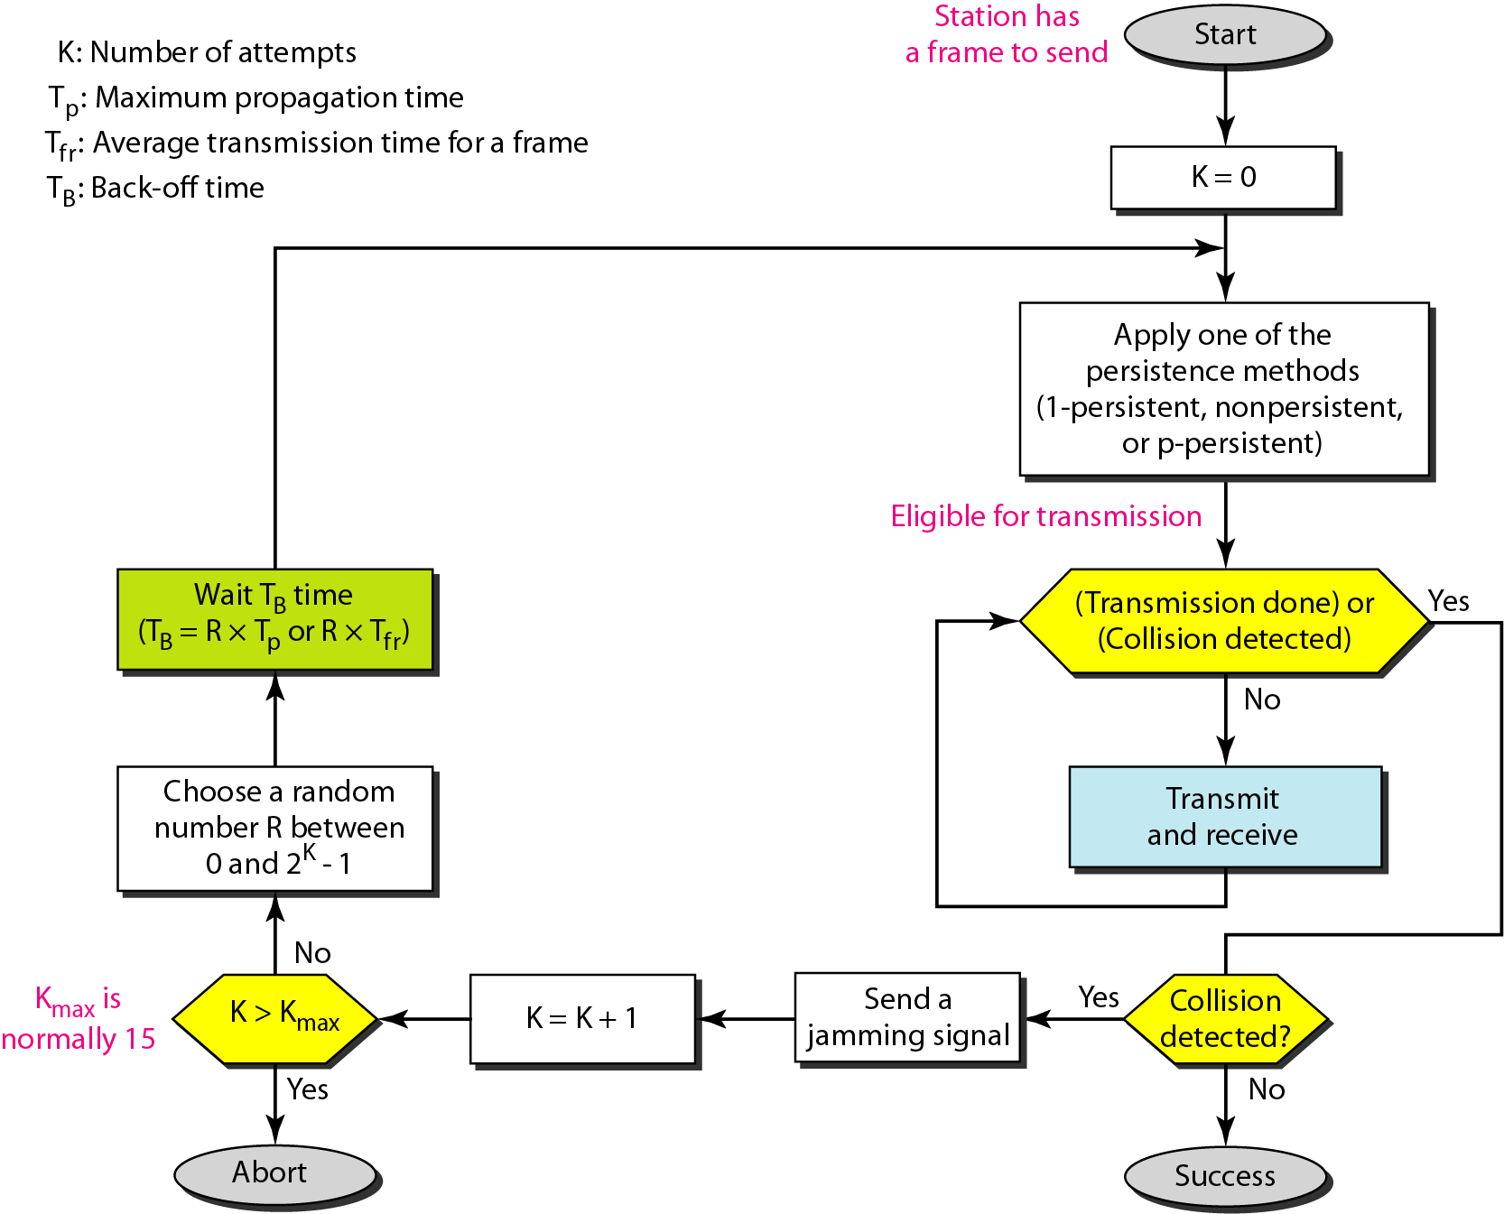
CSMA/CD: Flow Diagram

Slide 30
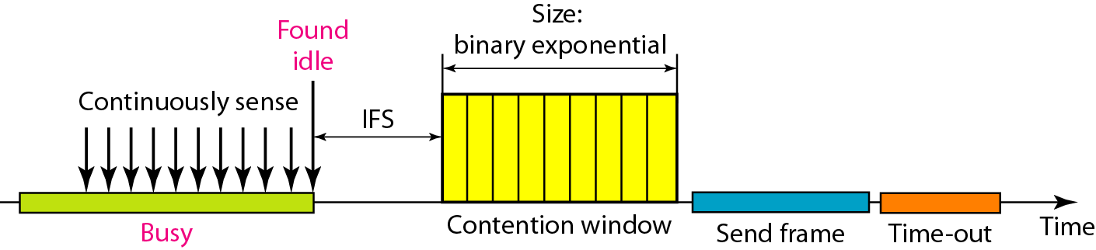
CSMA/CA
Carrier Sense Multiple Access with Collision Avoidance
Used in a network where collision cannot be detected
E.g., wireless LAN
IFS – Interframe Space

Slide 31
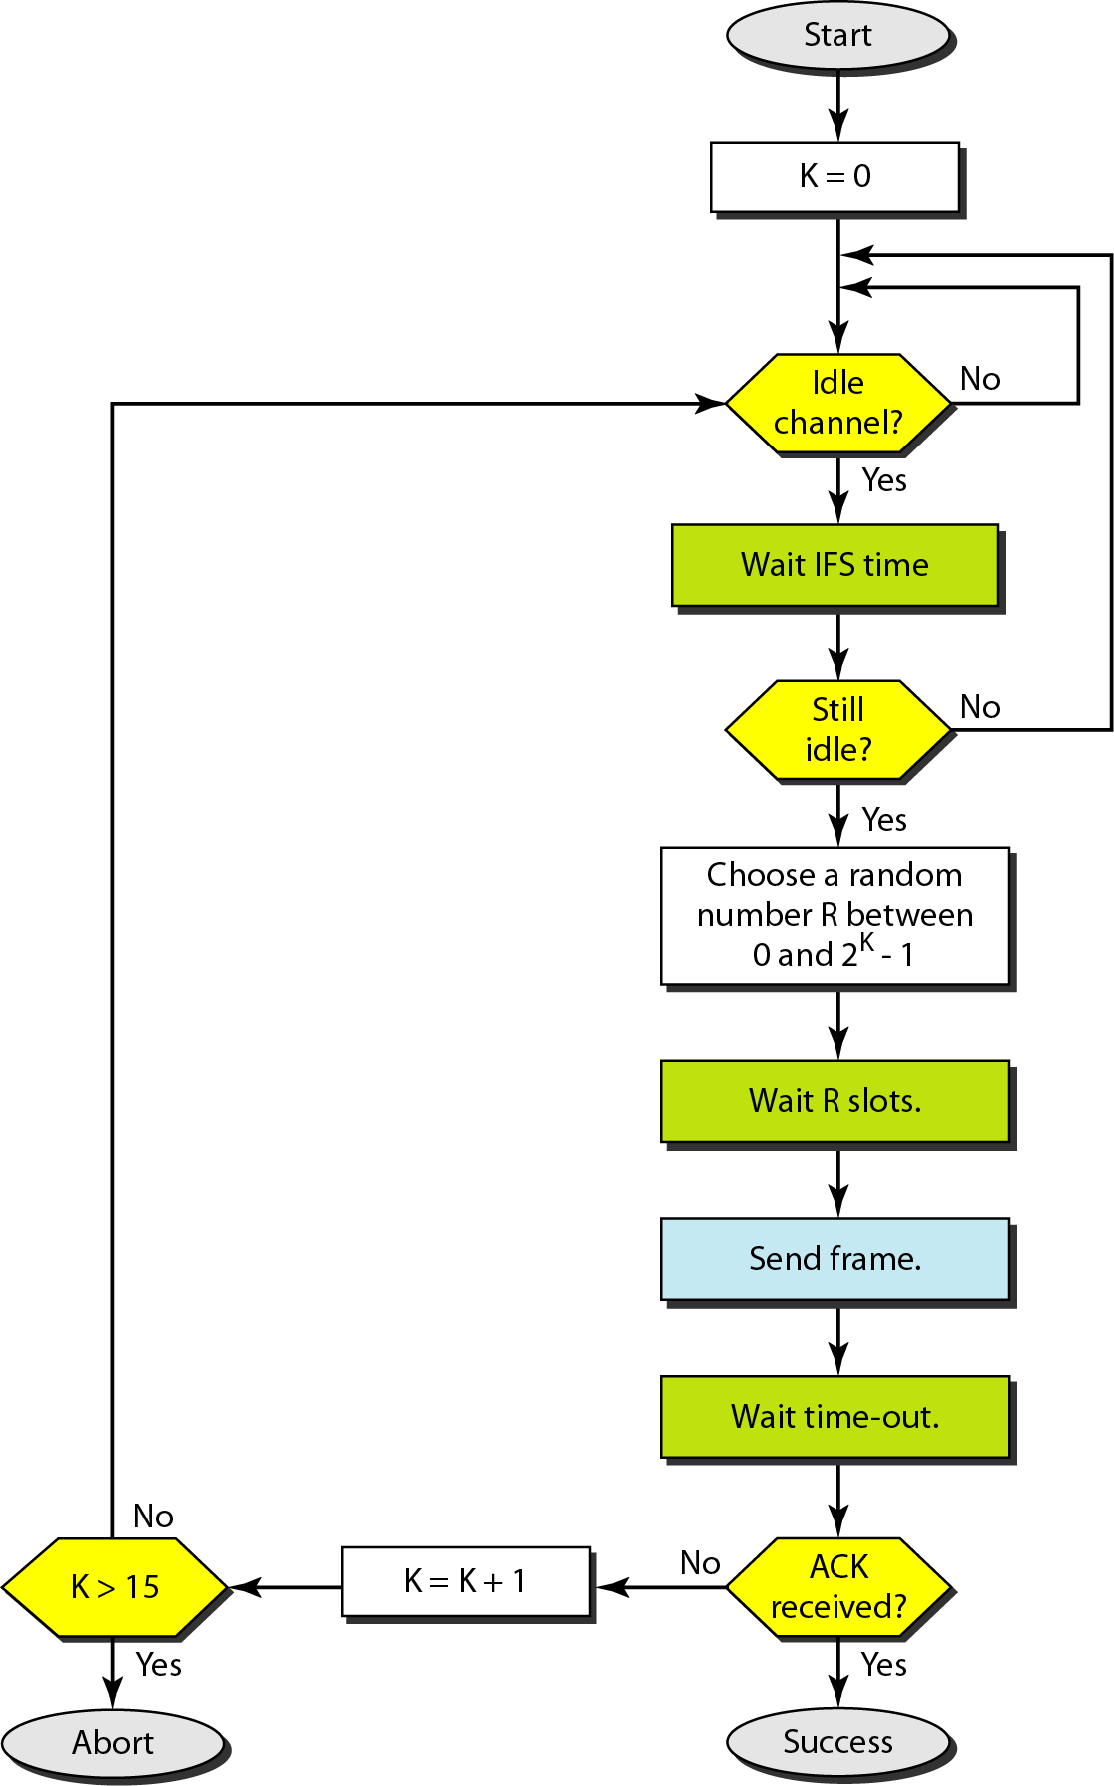
CSMA/CA
CSMA/CA flow chart

Slide 32
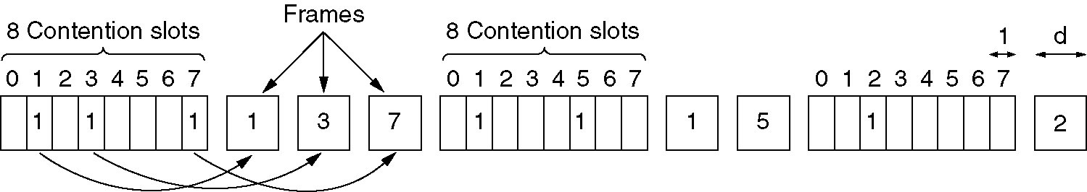
Collision-Free Protocols
The basic bit-map protocol.

Slide 33
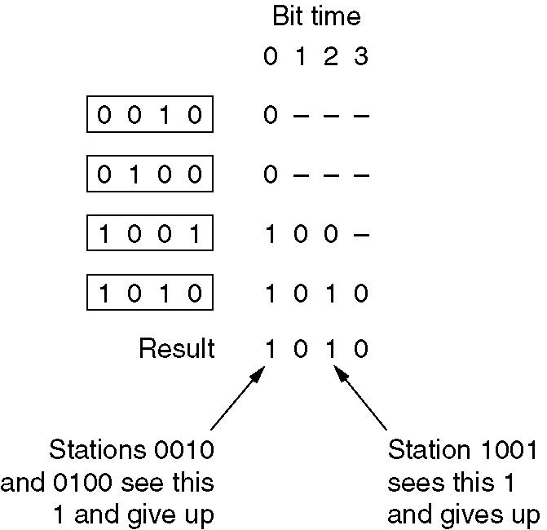
Collision-Free Protocols (2)
The binary countdown protocol. A dash indicates silence.

Slide 34
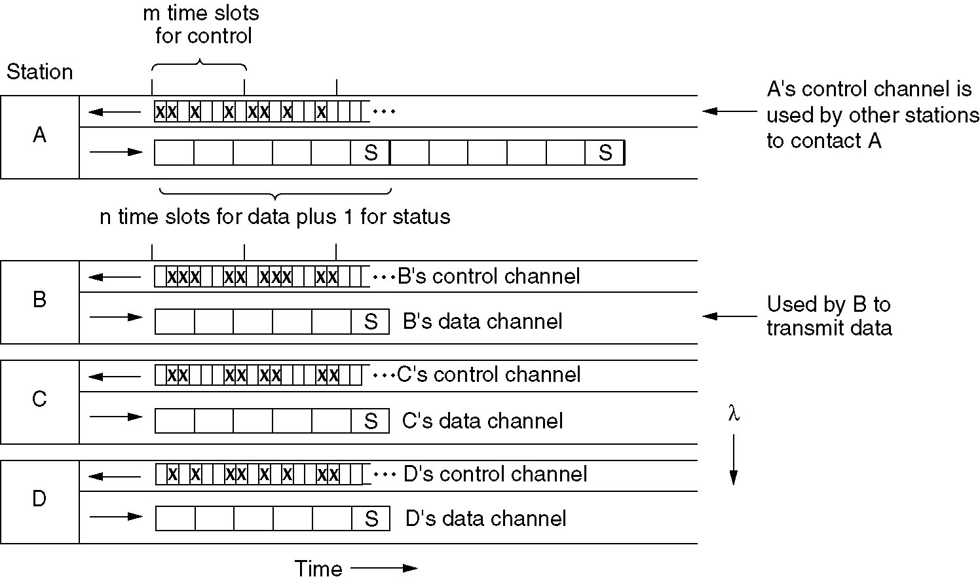
Wavelength Division Multiple Access Protocols
Wavelength division multiple access.

Slide 35
Wavelength Division Multiple Access Protocols
Support three traffic classes: (1) constant data rate CO traffic; (2)variable data rate CO traffic; (3)datagram;
For CO, A sends Connection Request frame in a free slot on B’s control channel. If B accepts, communication can take place on A’s data channel.
Each station has two transmitters and two receivers: 1. a fixed-wavelength receiver for listening to its own control channel; 2. a tunable transmitter for sending on other stations’ control channels; 3. a fixed-wavelength transmitter for outputting data frames; 4. a tunable receiver for selecting a data transmitter to listen to;

Slide 36
Outline
Channel allocation: Static and Dynamic,
Multiple Access Protocols: Pure and Slotted ALOHA, CSMA, CSMA/CD, CSMA/CA, WDMA
IEEE 802.3 Standards and Frame Formats,
Binary Exponential Back -off algorithm,
Fast Ethernet, Gigabit Ethernet,
IEEE 802.11a/b/g/n and
IEEE 802.15 and
IEEE 802.16 Standards, Frame formats,

Slide 37
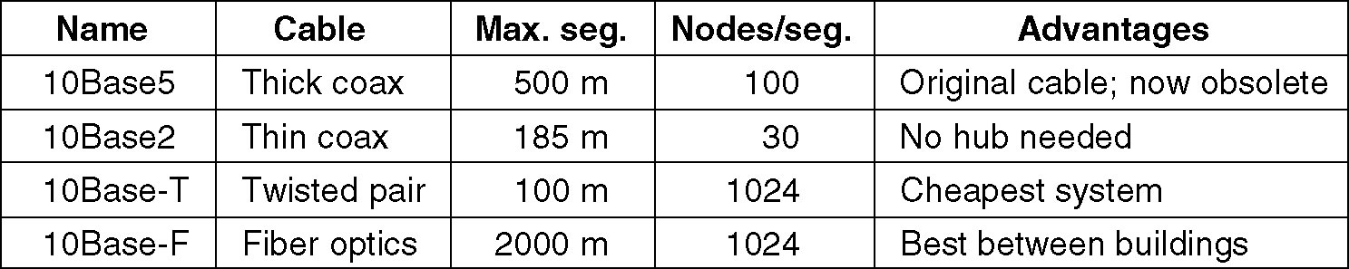
Ethernet Cabling
The most common kinds of Ethernet cabling.

Slide 38
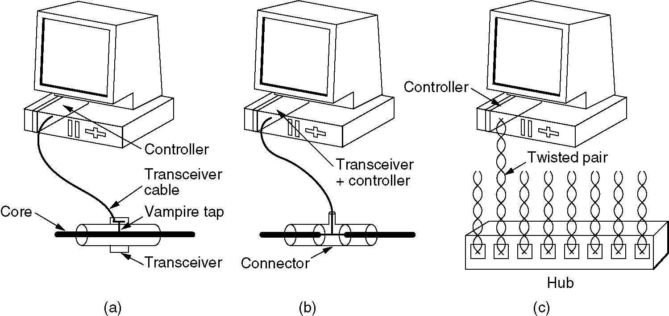
Ethernet Cabling (2)
Three kinds of Ethernet cabling.
(a) 10Base5, (b) 10Base2, (c) 10Base-T.

Slide 39
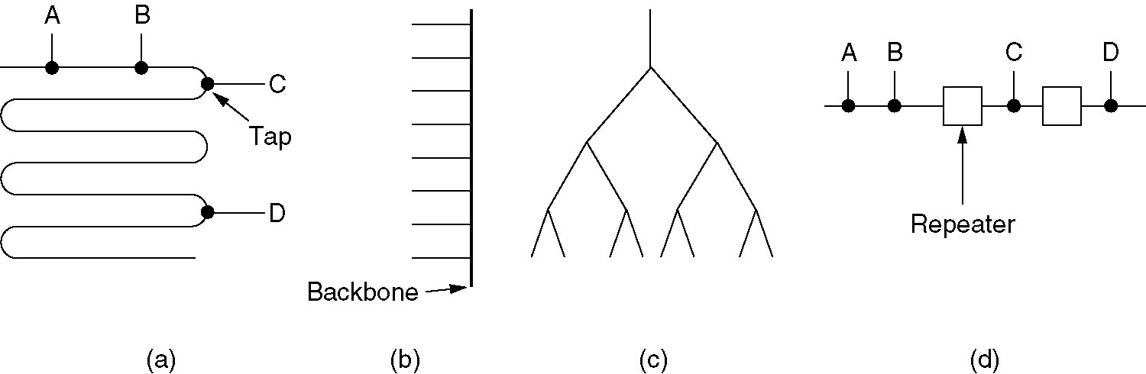
Ethernet Cabling (3)
Cable topologies.
(a) Linear, (b) Spine, (c) Tree, (d) Segmented.

Slide 40
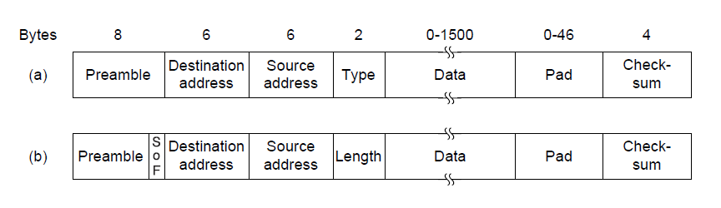
Frame formats. (a) Ethernet (DIX). (b) IEEE 802.3.

Slide 41
Ethernet Frame Format description
Preamble – 8 bytes
7x 10101010 and 10101011 <- Start of Frame Delimiter (802.3).
The Manchester encoding of this pattern produces 10-MHz wave for 6.4 μsec – used for synchronization.
The last two bits indicate the start of the frame.
Two addresses each 6 bytes – destination + source
First bit of the destination address is 0 for ordinary addresses and 1 for group addresses.
Group address allow multiple destinations to listen to a single address – Multicasting.
Special address consisting of all 1 is reserved for broadcasting.

Slide 42
Ethernet Frame Format description
Type or Length field.
Depending whether the frame is Ethernet or IEEE 802.3
Ethernet uses a Type field to tell the receiver what to do with the frame.
Multiple network-layer protocols may be in use at the same time on the same machine. So when Ethernet frame arrives, the operating system has to know which one to hand the frame to. The Type field specifies which process to give the frame to. E.g. 0x0800 indicates the frame contains IPv4 packet.

Slide 43
Ethernet Frame Format description
Length of the field could be carried as well.
Ethernet length was determined by looking inside the data – a layer violation.
Added another header for the Logical Link Control (LLC) protocol within the data. It uses 8 bytes to convey the 2 bytes of protocol type information.
Rule: Any number greater than 0x600 can be interpreted a Type otherwise is considered to be Length.

Slide 44
Ethernet Frame Format description
Data Field
Up to 1500 bytes.
Minimum frame length – valid frames must be at least 64 bytes long – from destination address to checksum.
If data portion is less than 46 bytes the Pad field is used to fill out the frame to the minimum size.
Minimum filed length is also serves one very important role – prevents the sender to complete transmission before the first bit arrives at the destination.

Slide 45
Outline
Channel allocation: Static and Dynamic,
Multiple Access Protocols: Pure and Slotted ALOHA, CSMA, CSMA/CD, CSMA/CA, WDMA
IEEE 802.3 Standards and Frame Formats,
Binary Exponential Back -off algorithm,
Fast Ethernet, Gigabit Ethernet,
IEEE 802.11a/b/g/n and
IEEE 802.15 and
IEEE 802.16 Standards, Frame formats,

Slide 46
Reason for minimum frame length(64 bytes)
Easier to distinguish valid frames from garbage
Prevent a station for completing the transmission of a short frame before the first bit has been reached the far end of the cable where it collide with another frame.
As transmission is completed before noise burst gets back at 2Tp.
To prevent this situation all frames must take 2Tp time to complete its transmission
For 10mbps LAN with max length 2500meters and 4 repeaters the round trip time has been 50micro sec. At 10mbps a bit takes 100nsec so 500bits is smallest frame that work well . So this has been rounded to 512bits i.e.64bytes.

Slide 47
Binary Exponential Back -off algorithm,
10 Mbps LAN with a maximum length of 2500 m and four repeaters the round-trip time has been determined to be nearly 50 μsec in the worst case.
Shortest allowed frame must take at least this long to transmit.
At 10 Mbps a bit takes 100 nsec
500 bits (numbit = 10 Mbps X 100 nsec) rounded up to 512 bits = 64 bytes.

Slide 48
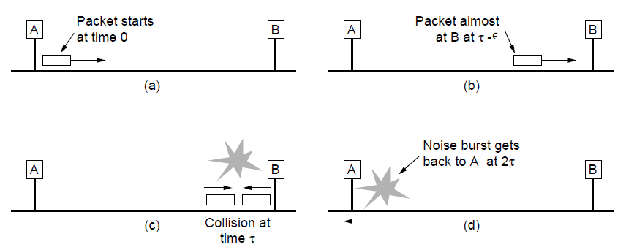
Binary Exponential Back -off algorithm,
Collision detection can take as long as 2Tp.

Slide 49
Binary exponential backoff algo
How the randomization is done when collision occurs :
After a collision, time is divided into discrete slot ,the slot time has been set to 512bits i.e. round trip propagation time on the ether.
After the first collision each station waits either 0 or 1 time slot.
If both station picks the same random number they collide again.
After the second collision each one can picks either 0,1,2 or 3 at random.
In general after ith collision a random number between 0 and
2^{i}-1 is chosen.
Maximum 16 collision are allowed after that it reports as failure

Slide 50
Outline
Channel allocation: Static and Dynamic,
Multiple Access Protocols: Pure and Slotted ALOHA, CSMA, CSMA/CD, CSMA/CA, WDMA
IEEE 802.3 Standards and Frame Formats,
Binary Exponential Back -off algorithm,
Fast Ethernet, Gigabit Ethernet,
IEEE 802.11a/b/g/n and
IEEE 802.15 and
IEEE 802.16 Standards, Frame formats,

Slide 51
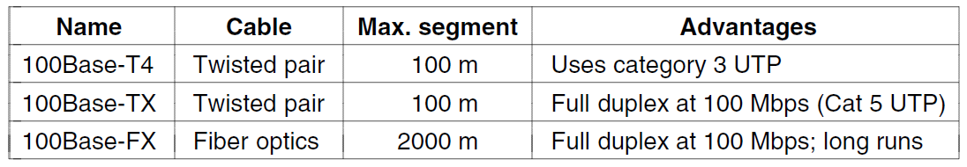
Fast Ethernet
The original fast Ethernet cabling.

Slide 52
Fast Ethernet 802.3u(2)
100 Base-T4 :
signaling speed is 25MHz ie 25% faster than standard Ether’s 20MHz
So to achieve necessary bandwidth 4 twisted pair are required
Of the 4 twisted pair, one is always to the hub , one is from hub and other two are switchable to current transmission direction
Manchester encoding is not used instead scheme 8B/6T is used
b) 100 Base-TX :
Signaling speed is 125MHz
Only two twisted pair are used , one to the hub and one from hub.
Encoding scheme 4B/5B is used , which give 32 diff. combination of which 16 used for data 16 used for control purpose.

Slide 53
Fast Ethernet 802.3u(3)
100 Base- FX :
Uses two stands of multimode fiber , one for each direction
It is full duplex 100Mbps in each direction
The distance between station and hub can be 2km

Slide 54
Gigabit Ethernet
After the standard for Fast Ethernet was adopted the work for yet even faster standard started: Gigabit Ethernet
Goals:
Increase performance ten fold over Fast Ethernet.
Maintain compatibility with both Classical and Fast Ethernet.
Unacknowledged datagram service with both unicast and broadcast.
Use the same 48-bit addressing scheme already in use,
Maintain the same frame format including minimum and maximum sizes.

Slide 55
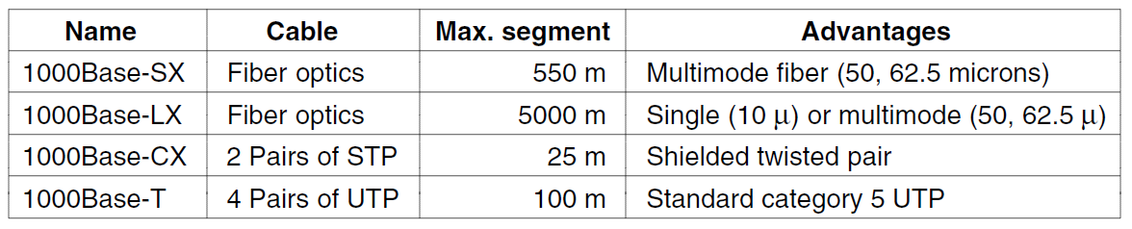
Gigabit Ethernet (3)
Gigabit Ethernet cabling.

Slide 56
Gigabit Ethernet (4)
Gigabit support both copper and fiber cabling
Signaling at 1Gbps over fiber means that light source has to be turned on and off in under 1nsec
LED’s can not operate at this speed so lasers are used
Three fiber diameters are permitted : 10,50 and 62.5 microns
Two wavelengths are permitted : 0.85 and 1.3 microns
On fiber new encoding scheme 8B/10B is used ie each 8bits is encoded as 10 bits on fiber
1024 possible code words for each input is possible so two rules are available to make the decision
1> No codeword have more than 4 identical bits in a row
2> No codeword may have more than six 0s or six 1s

Slide 57
Outline
Channel allocation: Static and Dynamic,
Multiple Access Protocols: Pure and Slotted ALOHA, CSMA, CSMA/CD, CSMA/CA, WDMA
IEEE 802.3 Standards and Frame Formats,
Binary Exponential Back -off algorithm,
Fast Ethernet, Gigabit Ethernet,
IEEE 802.11a/b/g/n
IEEE 802.15 and
IEEE 802.16 Standards, Frame formats,

Slide 58
LAN/WLAN World
Wired LANs
Limitations because of physical, hard-wired infrastructure
Wireless LANs provide
Flexibility
Portability
Mobility
Ease of Installation

Slide 59
LAN Vs WLAN
1. LAN refers to a wired network while WLAN is used to refer to a wireless network.
2. LAN is commonly used in fixed networks while WLAN is common in areas where computers are moved quite often.
3. WLAN is more convenient to users compared to LAN.
4. LAN is much faster compared to WLAN.
5. LAN is more secure compared to WLAN.

Slide 60
What is WLAN?
A wireless local area network (WLAN) is a wireless computer network that links two or more devices using a wireless distribution method within a limited area such as a home, school, computer laboratory, or office building.
This gives users the ability to move around within a local coverage area and still be connected to the network, and can provide a connection to the wider Internet.

Slide 61
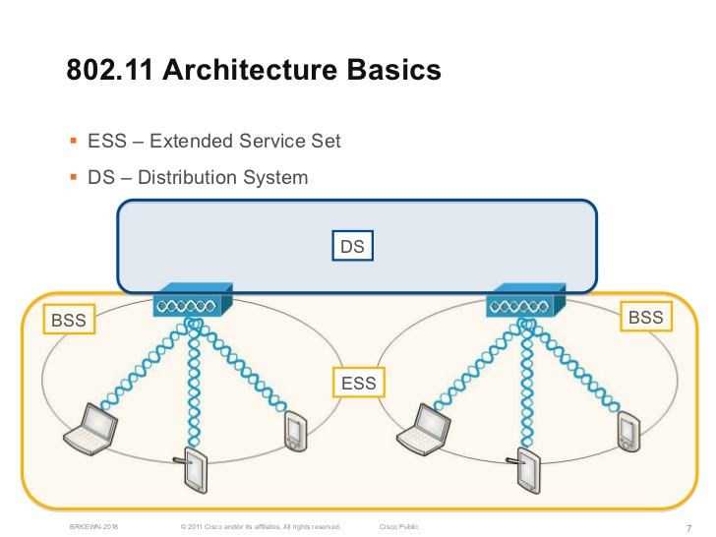
AP
AP

Slide 62
IEEE 802.11 Architecture Components
Access point (AP): A station that provides access to the DS.
Basic service set (BSS): A set of stations controlled by a single AP.
Distribution system (DS): A system used to interconnect a set of BSSs to create an ESS.
Extended service set (ESS):Two or more BSS interconnected by DS

Slide 63
IEEE 802.11 Architecture Components – Access Point
In a wireless local area network (WLAN), an access point is a station that transmits and receives data.
An access point connects users to other users within the network and also can serve as the point of interconnection between the WLAN and a fixed wire network.
Each access point can serve multiple users within a defined network area; as people move beyond the range of one access point, they are automatically handed over to the next one.

Slide 64
IEEE 802.11 Architecture Components BSS & ESS
The basic service set (BSS)
An extended service set (ESS)
Provides the basic building-block of an 802.11 wireless LAN.
Is a set of connected BSSs.
In infrastructure mode, a single access point (AP) together with all associated stations (STAs) is called a BSS
Access points in an ESS are connected by a distribution system.
Each ESS has an ID called the SSID

Slide 65
Wireless LANs: Adv & Disadv
Advantages
Flexible deployment
Minimal wiring difficulties
More robust against disasters (earthquake etc)
Historic buildings, conferences, trade shows,…
User mobility
Voice and data services
Scalable architecture
Plug-and-Play architecture
Disadvantages
Low bandwidth compared to wired networks (1-10 Mbit/s)
Security
Interference
Power consumption
Speed
Inconsistent connections

Slide 66
Wireless Networks- Categories
WLAN types/Categories
Infrastructure based
Ad-hoc

Slide 67
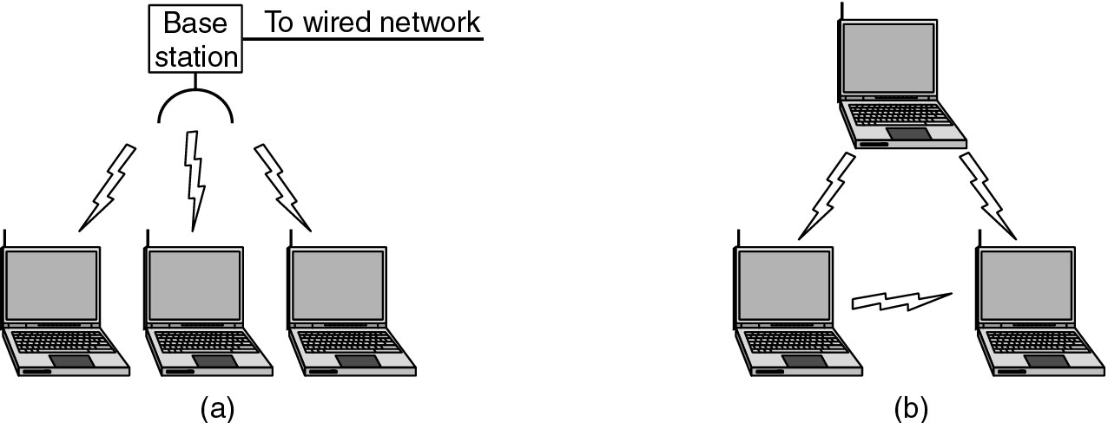
Wireless LANs network Types (Categories)
Figure (a) Wireless networking with a base station.
(b) Ad hoc networking.

Slide 68
Wireless LAN Applications
Medical Professionals(Healthcares)
Conducting everyday business
Education
Temporary Situations
Airlines
Security Staff
Emergency Centers

Slide 69
IEEE 802.11 Wireless LAN Standard
IEEE developed the first internationally recognized wireless LAN standard – IEEE 802.11 in 1997
Scope of IEEE 802.11 is limited to Physical and Data Link Layers.

Slide 70
Physical Media of 802.11 Standard
Frequency-hopping spread spectrum
Operating in 2.4 GHz ISM band
Lower cost, power consumption
Most tolerant to signal interference
Direct-sequence spread spectrum
Operating in 2.4 GHz ISM band
Supports higher data rates
More range than FH or IR physical layers
Infrared
Lowest cost
Lowest range compared to spread spectrum
Doesn’t penetrate walls, so no eavesdropping

Slide 71
What is meant by Spread Spectrum
This technique decreases the potential interference to other receivers while achieving privacy.
Two types of Spread Spectrum- FHSS and DSSS
Spread spectrum is a form of wireless communications in which the frequency of the transmitted signal is varied. This results in a much greater bandwidth than the signal (Bss >> B)

Slide 72
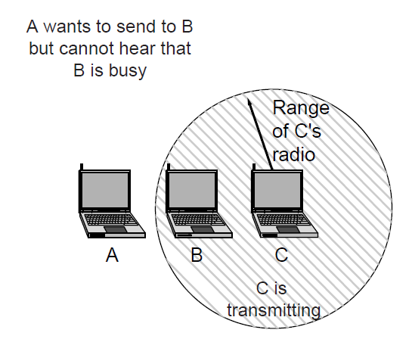
WLAN Problem:- The hidden terminal problem.

Slide 73
WLAN -Hidden Terminal Problem
A
B
C
Hidden terminals
A and C cannot hear each other.
A sends to B, C cannot receive A.
C wants to send to B, C senses a “free” medium (CS fails)
Collision occurs at B.
A cannot receive the collision (CD fails).
A is “hidden” for C.

Slide 74
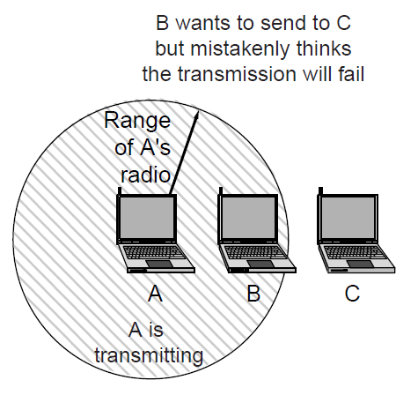
WLAN Problem : exposed terminal problem.

Slide 75
WLAN Problem- Solution
MAC Layer

Slide 76
IEEE 802.11 Medium Access Control MAC layer covers three functional areas:
Reliable data delivery
Access control
Security

Slide 77
Reliable Data Delivery
Loss of frames due to
Frame exchange protocol
Source station transmits data
Destination responds with acknowledgment (ACK)
If source doesn’t receive ACK, it retransmits frame
Four frame exchange for enhanced reliability
Source issues request to send (RTS)
Destination responds with clear to send (CTS)
Source transmits data
Destination responds with ACK
noise, interference, and propagation effects

Slide 78
802.11 MAC layer
The 802.11 standard specifies a common medium access control (MAC) Layer.
In general, the MAC Layer manages and maintains communications between 802.11
Before transmitting frames, a station must first gain access to the medium.
The 802.11 standard defines two forms of medium access
Distributed Coordination Function (DCF)
Point Coordination Function (PCF).

Slide 79
802.11 MAC layer
DCF is mandatory and based on the CSMA/CA protocol.
With DCF, 802.11 stations contend for access and attempt to send frames when there is no other station transmitting.
If another station is sending a frame, stations are polite and wait until the channel is free.
If the channel is in use, the station must wait a random period of time before attempting to access the medium again.
This ensures that multiple stations wanting to send data don't transmit at the same time.

Slide 80
Access Control
Asynchronous data service (DCF)
CSMA/CA
Time bounded service (PCF)
Polling
Inter-frame spacing (IFS)
DIFS
RTS/CTS
PIFS
SIFS

Slide 81
CSMA/CD vs. CSMA/CA
CSMA/CD (Collision detection)
For wire communication
No control BEFORE transmission
Generates collisions
Collision Detection-How?
CSMA/CA (Collision Avoidance)
For wireless communication
Collision avoidance BEFORE transmission
Why avoidance on wireless?
Difference in energy/power for transmit & receive
Difficult to distinguish between incoming weak signals, noise, and effects of own transmission
Notes:
DIFS= Distributed interframe Space
PIFS=Point Coordination Interframe Space
SIFS=Short Coordination Interframe Space

Slide 82
RTS/CTS (Request To Send/Clear To Send)
RTS
A
B
C
CTS
CTS
802.11 avoids the problem of hidden terminals
A and C want to send to B
A sends RTS to B
B sends CTS to A
C “overhears” CTS from B
C waits for duration of A’s transmission

Slide 83
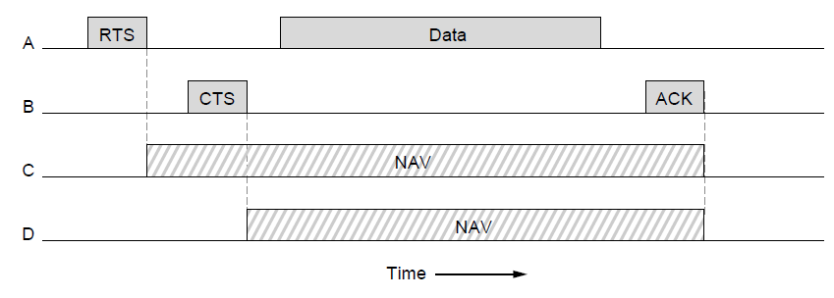
The 802.11 MAC Sublayer Protocol (
The use of virtual channel sensing using CSMA/CA.

Slide 84
purpose of NAV
The network allocation vector (NAV) is a virtual carrier-sensing mechanism used with wireless network protocols IEEE 802.11
The NAV may be thought of as a counter, which counts down to zero at a uniform rate. When the counter is zero, the virtual CS indication is that the medium is idle; when nonzero, the indication is busy.
The NAV virtual carrier sensing mechanism is a prominent part of the CSMA/CA MAC protocol used with IEEE 802.11 WLANs. NAV is used in DCF, PCF and HCF.

Slide 85
Interframe Space (IFS)
Defined length of time for control
SIFS - Short Inter Frame Spacing
Used for immediate response actions e.g ACK, CTS
PIFS - Point Inter Frame Spacing
Used by centralized controller in PCF scheme
DIFS - Distributed Inter Frame Spacing
Used for all ordinary asynchronous traffic
DIFS (MAX) > PIFS > SIFS (MIN)

Slide 86
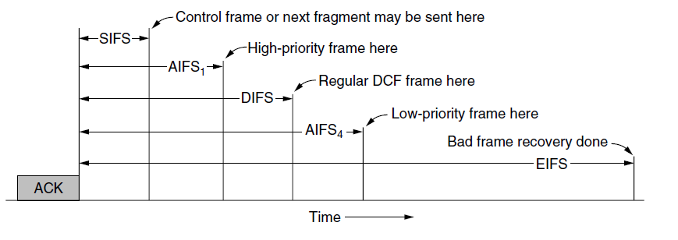
The 802.11 MAC Sublayer Protocol
Interframe spacing in 802.11

Slide 87
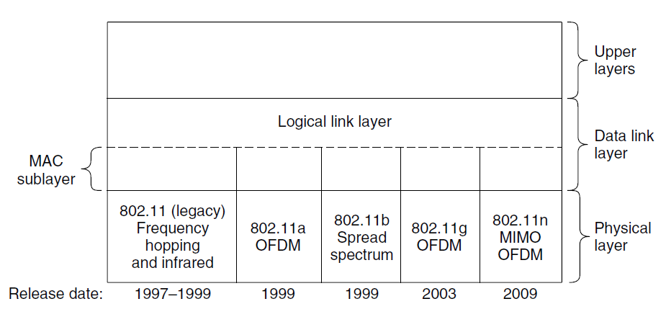
802.11 Architecture and Protocol Stack
Part of the 802.11 protocol stack.

Slide 88
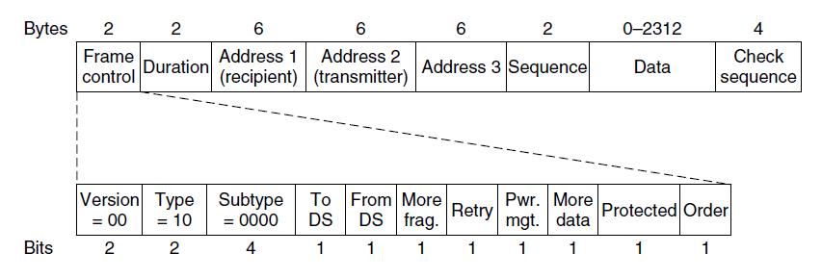
802.11 Frame Structure
Format of the 802.11 data frame

Slide 89
Frame Control field
Protocol Version:
zero for 802.11 standard
Type= frame type:
data, management, control
Subtype = frame sub-type:
ToDS:
When bit is set indicate that destination frame is for DS
FromDS:
When bit is set indicate frame coming from DS

Slide 90
Frame Control field
Retry:
Set in case of retransmission frame
More fragments:
Set when frame is followed by other fragment
Power Management
bit set when station go Power Save mode (PS)
More Data:
When set means that AP have more buffered data for a station in Power Save mode

Slide 91
Frame Control field
WEP:
When set indicate that in the Frame Body field there are datas need to processed by WEP algorithm.
Order:
When set indicate restrictions for transmission

Slide 92
IEEE 802.11 standards
IEEE 802.11 b
IEEE 802.11 a
IEEE 802.11 g
IEEE 802.11 n
IEEE 802.11 ac
IEEE 802.11 ad

Slide 93
IEEE 802.11 b
Frequency = 2.4 GHz (ISM band)
Maximum Speed =11 Mbps
Range = about 38meters(Varies)
Encoding Scheme = DSSS
Modulation Technique= BPSK(1 Mbps),
DQPSK(2 Mbps), CCK(5.5 Mbps,11Mbps)

Slide 94
IEEE 802.11 b
Pros of 802.11b
Cons of 802.11b
lowest cost;
signal range is good and not easily obstructed
slowest maximum speed;
home appliances may interfere on the unregulated frequency band

Slide 95
IEEE 802.11 standards
IEEE 802.11 b
IEEE 802.11 a
IEEE 802.11 g
IEEE 802.11 n
IEEE 802.11 ac
IEEE 802.11 ad

Slide 96
IEEE 802.11 a
Frequency = 5 GHz
Maximum Speed = 54 Mbps
Range = about 35 meters(Varies)
Encoding Scheme = OFDM

Slide 97
IEEE 802.11 a-
Orthogonal Frequency Division Multiplexing(OFDM)
OFDM a digital multi-carrier modulation method. A large number of closely-spaced orthogonal sub-carriers are used to carry data.
OFDM is popular for wideband communications today by way of low-cost digital signal processing components

Slide 98
IEEE 802.11a Advantages
Ultra-high spectrum efficiency
5 GHz band is 300 MHz (vs. 83.5 MHz @ 2.4 GHz)
More data can travel over a smaller amount of bandwidth
High speed
Up to 54 Mbps
Less interference
Fewer products using the frequency
2.4 GHz band shared by cordless phones, microwave ovens, Bluetooth, and WLANs

Slide 99
IEEE 802.11a Disadvantages
Standards and Interoperability
Standard not accepted worldwide
Not compatible or interoperable with 802.11b
Legal issues
License-free spectrum in 5 GHz band not available worldwide
Market
There is limited interest for 5 GHz adoption
Cost
2.4 GHz will still has >40% cost advantage
Power consumption
Higher data rates and increased signal require more power
OFDM is less power-efficient than DSSS

Slide 100
IEEE 802.11a Applications
Building-to-building connections
Video, audio conferencing/streaming video, and audio
Large file transfers, such as engineering CAD drawings
Faster Web access and browsing

Slide 101
IEEE 802.11 standards
IEEE 802.11 b
IEEE 802.11 a
IEEE 802.11 g
IEEE 802.11 n
IEEE 802.11 ac
IEEE 802.11 ad

Slide 102
IEEE 802.11 g
Frequency= 2.4 GHz
Maximum Speed = 54 Mbps
Range = about 38 meters(Varies)
Encoding Scheme = OFDM
Backward compatibility with 802.11 b devices

Slide 103
IEEE 802.11 g- Pros & Cons
Pros
fast maximum speed
signal range is good and not easily obstructed
Cons
costs more than 802.11b
appliances may interfere on the unregulated signal frequency

Slide 104
802.11g Advantages
Provides higher speeds and higher capacity requirements for applications
Leverages Worldwide spectrum availability in 2.4 GHz
Less costly than 5 GHz alternatives
Provides easy migration for current users of 802.11b WLANs
Delivers backward support for existing 802.11b products
Provides path to even higher speeds in the future

Slide 105
IEEE 802.11 standards
IEEE 802.11 b
IEEE 802.11 a
IEEE 802.11 g
IEEE 802.11 n
IEEE 802.11 ac
IEEE 802.11 ad

Slide 106
IEEE 802.11 n
Frequency = 5 GHz,2.4 GHz
Modulation = OFDM
Addition of MIMO (Multiple Input Multiple Output)
Speed = 54 Mbit/s to 600 Mbit/s
Range = about 70 meters(Varies)
Encoding Scheme = OFDM

Slide 107
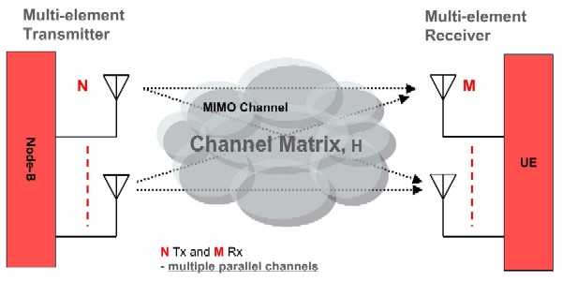
IEEE 802.11 n
Multiple Input Multiple Output(MIMO)
In radio, Multiple-input and Multiple-output is used of multiple antennas at both the transmitter and receiver to improve communication performance.

Slide 108
IEEE 802.11 n- Pros & Cons
Pros
fastest maximum speed and best signal range;
more resistant to signal interference from outside sources
Cons
standard is not yet finalized;
the use of multiple signals may greatly interfere with nearby 802.11b/g based networks.
costs more than 802.11g;

Slide 109
IEEE 802.11 standards
IEEE 802.11 b
IEEE 802.11 a
IEEE 802.11 g
IEEE 802.11 n
IEEE 802.11 ac
IEEE 802.11 ad

Slide 110
IEEE 802.11ac
Frequency = 5 GHz
Modulation = OFDM
Addition of MIMO (Multi User-Multiple Input Multiple Output)
Speed = 433.3 Mbit/s per spatial stream, 1.3 Gbit/s total

Slide 111
IEEE 802.11ac - Features
Extended channel binding
More MIMO spatial streams
Multiple STAs, each with one or more antennas, transmit or receive independent data streams simultaneously
Modulation- 256-QAM
Beamforming with standardized sounding and feedback for compatibility between vendors

Slide 112
IEEE 802.11ac Applications
Highly interactive video gaming, video conferencing,
High definition video streaming and
Many more applications that need data at rates that push the boundaries of exiting Wi-Fi systems.

Slide 113
IEEE 802.11 standards
IEEE 802.11 b
IEEE 802.11 a
IEEE 802.11 g
IEEE 802.11 n
IEEE 802.11 ac
IEEE 802.11 ad

Slide 114
IEEE 802.11 ad
Frequency = 60GHz
Speed = 7Gbps
Antenna Technology = Uses Beamforming
Modulation = OFDM

Slide 115
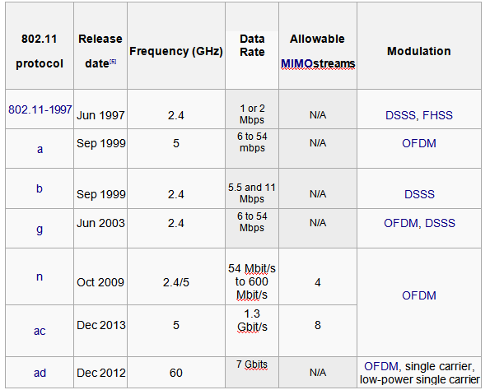
Comparison between Different IEEE 802.11 Standards

Slide 116
Outline
Channel allocation: Static and Dynamic,
Multiple Access Protocols: Pure and Slotted ALOHA, CSMA, CSMA/CD, CSMA/CA, WDMA
IEEE 802.3 Standards and Frame Formats,
Binary Exponential Back -off algorithm,
Fast Ethernet, Gigabit Ethernet,
IEEE 802.11a/b/g/n
IEEE 802.15
IEEE 802.16 Standards, Frame formats,

Slide 117
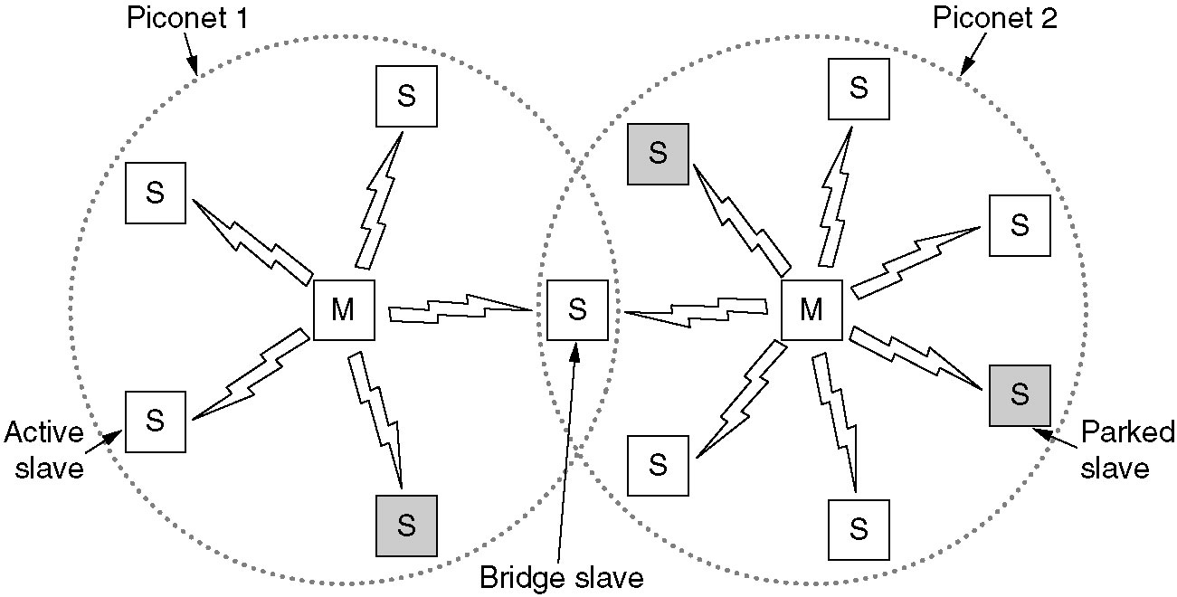
Bluetooth Architecture
Two piconets can be connected to form a scatternet.

Slide 118
Bluetooth Architecture(2)
Piconet consist of a master node and up to seven active slaves within a distance of 10 meters
In addition to seven active slave nodes , there can be up to 255 parked nodes in the net
All communication is between master/slave. slave-/slave communication is not possible
Multiple piconets can exist in the same room and can even be connected via a bridge node.
Interconnected collection of piconets is called as scatternet.

Slide 119
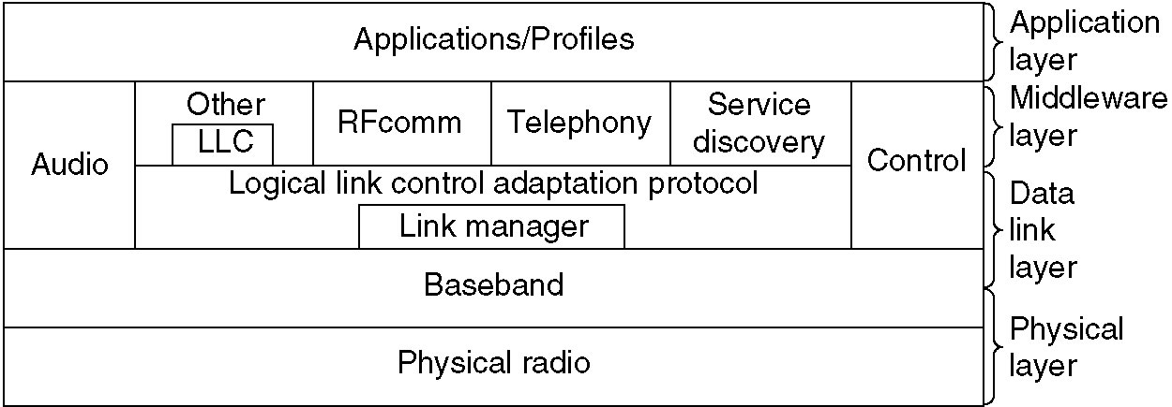
The Bluetooth Protocol Stack
The 802.15 version of the Bluetooth protocol architecture.

Slide 120
: Core System Protocols :
Radio (RF) protocol : Specifies details of the air interface, the use of frequency hopping, modulation scheme, and transmit power.
Baseband protocol : Concerned with connection establishment within a Piconet, addressing, packet format, timing, and power control.
Link Manager protocol (LMP) : Responsible for link setup between Bluetooth devices and ongoing link management.
Logical link control and adaptation protocol (L2CAP)
L2CAP provides both connectionless and connection-oriented services.
Service discovery protocol (SDP) : Device information, services, and the characteristics of the services can be queried to enable the establishment of a connection between two or more Bluetooth devices

Slide 121
: Additional Protocols :
RF COMM : It provides connections to multiple devices by relying on L2CAP to handle multiplexing over single connection
Wireless access protocol (WAP): It supports the limited display size and resolution typically found on mobile devices by providing special formats for Web pages
Object exchange protocol (OBEX): OBEX is a protocol designed to allow a variety of devices to exchange data simply and spontaneously.
Telephony control protocol : Bluetooth's Telephony Control protocol Specification (TCS) defines how telephone calls should be sent across a Bluetooth link
Point-to-point protocol (PPP): The point-to-point protocol is an Internet standard protocol for transporting IP datagram over a point-to-point link

Slide 122
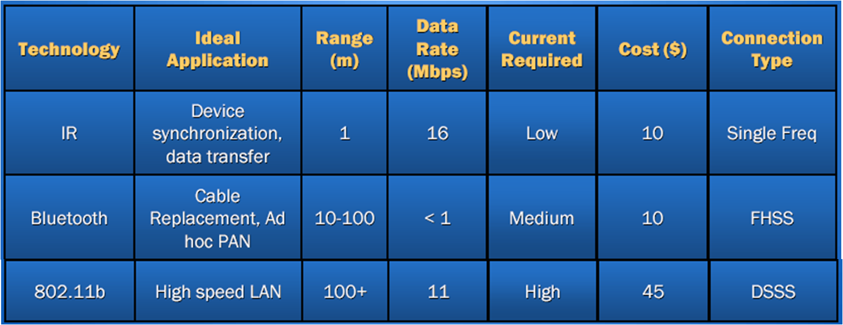
: Comparison between various Technologies :

Slide 123
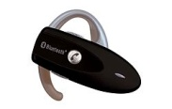
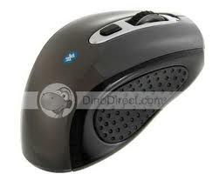

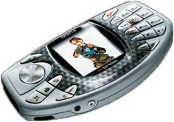

: Applications of Bluetooth :
Wireless control of and communication between a mobile phone and a hands free headset. This was one of the earliest applications to become popular.
Wireless communication with pc input and output devices, the most common being the mouse, keyboard and printer.
Transfer of files, contact details, calendar appointments, and reminders between devices with obex.
In 2004 released cars like toyota prius & lexus ls 430 have hands free call system.
Sending small advertisements from bluetooth-enabled advertising hoardings to other, discoverable, bluetooth devices.
In game consoles like sony's playstation 3 and psp go, use bluetooth for their respective wireless controllers.

Slide 124
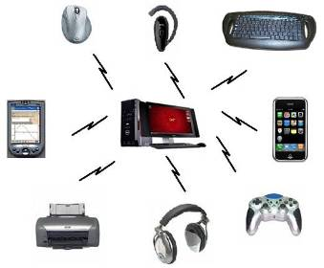
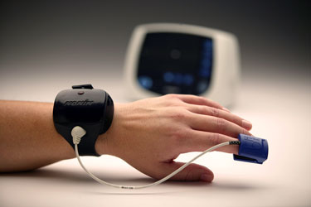
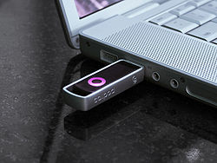
Applications
Dial-up internet access on personal computers or PDAs using a data-capable mobile phone as a wireless modem.
Personal security application on mobile phones for prevention of theft or loss of items.
In Real-time location systems (RTLS).
Digital Pulse Oximetry System
Toshiba Washer & Dryer.

Slide 125
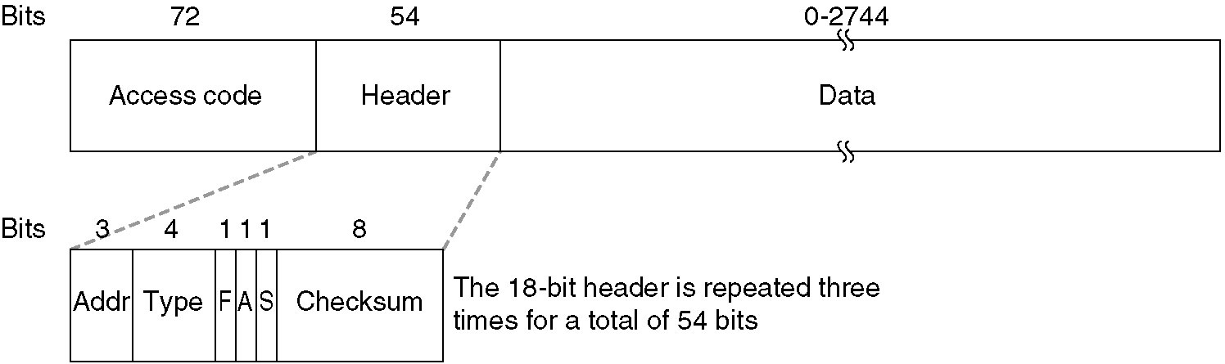
The Bluetooth Frame Structure
A typical Bluetooth data frame.

Slide 126
Access Code
72 bits
Access
code
Header
Payload
Address of piconet master.

Slide 127
Packet Header
54 bits
Access
code
Header
Payload
Purpose
Addressing (3)
Packet type (4)
Flow control (1)
1-bit ARQ (1)
Sequencing (1)
HEC (8)
Max 7 active slaves
16 packet types (some unused)
Broadcast packets are not ACKed
For filtering retransmitted packets
Verify header integrity
Notes:
How useful is header protection when payload is unprotected

Slide 128
Outline
Channel allocation: Static and Dynamic,
Multiple Access Protocols: Pure and Slotted ALOHA, CSMA, CSMA/CD, CSMA/CA, WDMA
IEEE 802.3 Standards and Frame Formats,
Binary Exponential Back -off algorithm,
Fast Ethernet, Gigabit Ethernet,
IEEE 802.11a/b/g/n
IEEE 802.15
IEEE 802.16 Standards, Frame formats,

Slide 129
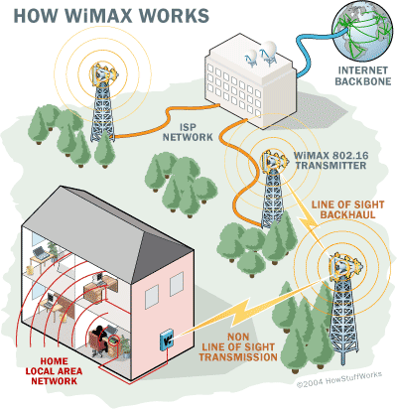
WIMAX / IEEE 802.16
Wimax networks refer to broadband wireless networks that are based on the IEEE 802.16 standard, which ensures compatibility and interoperability between broadband wireless access equipment .
The IEEE 802.16 standards define how wireless traffics move between subscriber equipment and core networks.
WiMAX was designed for the transmission of multimedia services (voice, Internet, email, games and others) at high data rates.
Source: SHASHI JAKKU

Slide 130
WiMAX
WiMAX uses radio microwave technology to provide wireless internet service to computers and other devices that are equipped with WiMAX compatible chips for example PDA’s, cell phones etc.
It works more or less like cellular network technology.
The theoretical range of WiMAX is up to 30 miles and achieves data rates up to 75 Mbps
WiMAX operates in similar manner as Wi-Fi but with two very convincing differences as compared to Wi-Fi, these are :
Data rate
Data range
Notes:
IEEE Std 802.16e-2005, “IEEE Standard for Local and Metropolitan Area Networks Part 16: Air Interface for Fixed and Mobile Broadband Wireless Access Systems,” IEEE Std 802.16e-2005, February 2006

Slide 131
Features
Use microwave for the wireless transfer of data.
Specifies a frequency band in the range between 2 GHz to 66 GHz.
For high speed wireless networking.
Basically, Wimax is a wireless internet service that is capable of covering a wide geographical area by serving hundreds of users at a very low cost.
Uses OFDM ,good for multipath environments.
It includes TDD and FDD duplexing support.
Flexible channel sizes (3.5 MHz,5 MHz,10MHz)
An easy and fast system to install.
Leading to low installation cost, when compared to fiber ,cable or DSL deployments.
Notes:
Andrew S. Tanenbaum “Computer Networks” fourth edition ;prentice hall of India 2005.
IEEE 802.16-2004 (802.16REVd)

Slide 132


802.16 Standards History
IEEE 802.16 (2001)
Original fixed wireless broadband air Interface for
10 – 66 GHz.
Connection-oriented, TDM/TDMA MAC
Targeted for Line-of-sight only
Point-to-Multi-Point applications
802.16
(Dec 2001)
802.16c
(2002)
802.16a
(Jan 2003)
IEEE 802.16a (January 2003)
Extension for 2-11 GHz
Targeted for non-line-of-sight,
Point-to-Multi-Point applications “LAST MILE” broadband access.
IEEE 802.16c (2002)
Represents a 10 to 66 GHz system profile that standardizes more details of the technology.
802.16d (802.16-2004)
(Oct 2004)
IEEE 802.16d (Oct 2004)
Combines both IEEE 802.16 and 802.16a
Some modifications to the MAC and PHY
802.16e
(802.16-2005)
(Dec 2005)
IEEE 802.16e (2005)
MAC/PHY Enhancements to support subscribers moving at vehicular speeds.
Notes:
“IEEE Standard 802.16: A Technical Overview of the WirelessMAN Air Interface for Broadband Wireless Access,” C. Eklund et al., IEEE Communication Magazine, June 2002

Slide 133
802.16 Standards
 | IEEE 802.16 | IEEE 802.16a/802.16d | IEEE 802.16e
Completed | Dec 2001 | Oct 2004 | Dec 2005
Spectrum | 10 - 66 GHz | 2 – 11 GHz | 2 - 6GHz
Application | Backhaul | Wireless DSL and Backhaul | Mobile Internet
Channel Conditions | Line of Sight Only | Non-Line of Sight | Non-Line of Sight
Bit Rate | 32 – 134 Mbps | Up to 75 Mbps | Up to 15 Mbps
Modulation | QPSK,16QAM and 64QAM | OFDM ,QPSK,16QAM, 64QAM | OFDMA
Channel Bandwidths | 20,25 and 28 MHz | 1.5 and 20 MHZ | Same as 802.16d
Notes:
“IEEE Standard 802.16: A Technical Overview of the WirelessMAN Air Interface for Broadband Wireless Access,” C. Eklund et al., IEEE Communication Magazine, June 2002

Slide 134
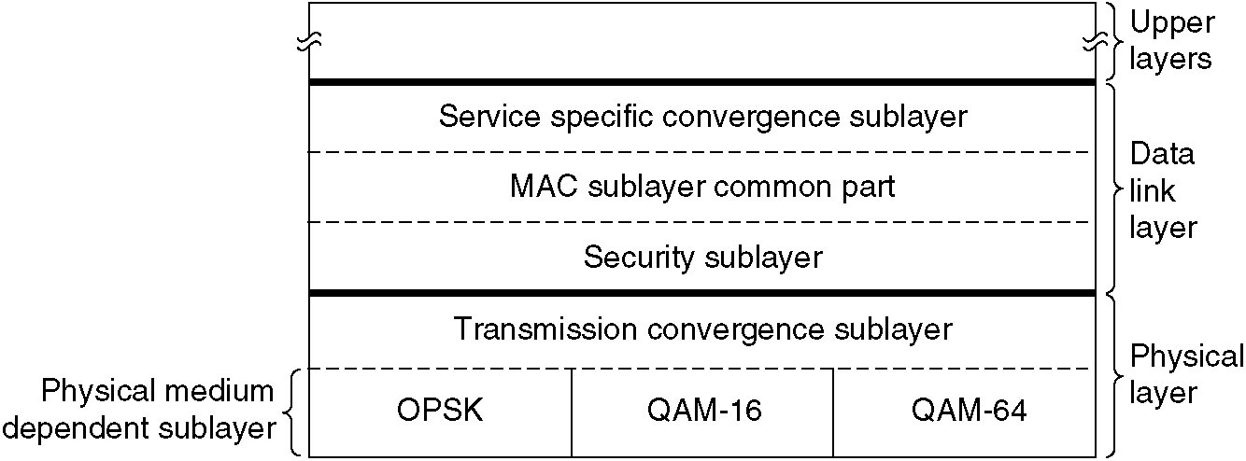
The 802.16 Protocol Stack
Notes:
Andrew S. Tanenbaum “Computer Networks” fourth edition ;prentice hall of India 2005

Slide 135
The 802.16 Physical Layer
Encoding/decoding of signals
Preamble generation/removal
Bit transmission/reception
converts frames into signals
Modulation schemes used:
QPSK: (longer distance)
QAM-16: (medium distance)
QAM-64: (short distance)
Notes:
Andrew S. Tanenbaum “Computer Networks” fourth edition ;prentice hall of India 2005

Slide 136
The 802.16 MAC Layer
provide an interface between the transport layers and physical layer.
The MAC layer takes packets from the upper layer and organizes them into MAC protocol data units (MPDUs) .
The 802.16 MAC is designed for point-to-multipoint (PMP) applications and is based on collision sense multiple access with collision avoidance (CSMA/CA).
Notes:
Tariq, U., Jilani, U. and Siddiqui, T. (2007) UAnalysis on Fixed and Mobile WiMAX U, M.S Thesis, Blekinge Institute of Technology, Karlskrona, Sweden.

Slide 137
The WiMAX MAC
The WiMAX MAC comprises three sublayers
Convergence sublayer
ATM, Ethernet,
Internet Protocol
MAC Common part sublayer
Packing,
Fragmentation,
ARQ, QoS
Security sublayer
Autentication,
Key Exchange,
Privacy (encrypt.)

Slide 138
MAC Convergence sublayer
The service specific convergence sublayer (CS) provides any transformation or mapping of external network data, received through the CS service access point (SAP) into MAC SDUs received by the MAC CPS through the MAC SAP.
Accepting higher layer protocol data units (PDUs) from the higher layer
Performing classification of higher layer PDUs.
Associating them to the proper service flow identified by the connection identifier (CID).
Delivering CS PDUs to the appropriate MAC SAP.
Notes:
Andrew S. Tanenbaum “Computer Networks” fourth edition ;prentice hall of India 2005

Slide 139
MAC Common part sublayer
Defines multiple-access mechanism
Bandwidth allocation
Connection establishment
Connection maintenance
Connection-oriented protocol
Assign connection ID to each service flow.

Slide 140
MAC Security sublayer
Deals with privacy and security.
The security sublayer provides subscribers with privacy or confidentiality across the broadband wireless network.
It manages :
Authentication
Secure key exchange
Encryption
Notes:
Andrew S. Tanenbaum “Computer Networks” fourth edition ;prentice hall of India 2005

Slide 141
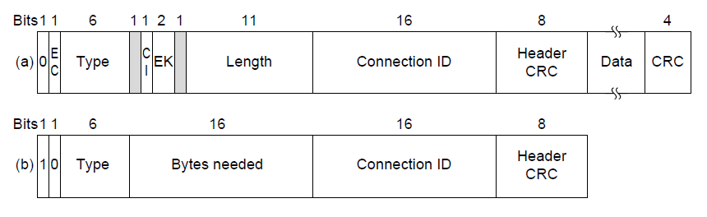
802.16 Frame Structure
(a) A generic frame. (b) A bandwidth request frame.

Slide 142
The 802.16 Frame Structure
HT(Header type): For generic frame,HT=0
EC (Encryption control)
0 = Payload is not encrypted or payload is not included.
1 = Payload is encrypted.
Type : This field identifies the frame type ,whether packing and fragmentation is present.
CI (CRC indicator)
1 = CRC is included .
0 = No CRC is included.
EKS (Encryption key sequence) : Which encryption key is used.
Length: Complete length of the frame including header.
Connection ID: Which connection this frame belongs to.
Header CRC: Header check sequence. An 8-bit field used to detect errors in the header.Header check-sum using 100000111.
ESF(Extended subheader) ESF=0 ,absent:ESF=1.present
Notes:
Andrew S. Tanenbaum “Computer Networks” fourth edition ;prentice hall of India 2005

Slide 143
References
www.csie.cgu.edu.tw/~jhchen/course/CommSys/ch12.ppt
https://www.slideshare.net/kashyapshah11/bluetooth-10369755
my.fit.edu/~vkepuska/ece4561/Chapter4-MediumAccessControlSublayer.pptx
www.csie.cgu.edu.tw/~jhchen/course/WN/802.16Overview.ppt
http://webhome.csc.uvic.ca/~wkui/Courses/networks/Notes.html

