Slide 1


CAPSTONE PROJECT
Aero IQ — Airport Delay & Flight Analysis Dashboard
Presented By
Student Name: Smita Sunka Ashok
College Name: Usha Mittal Institute of Technology
Department: Information Technology
Email ID: smitasunka@gmail.com

Slide 2
OUTLINE:
Problem Statement
Proposed System/Solution
System Development Approach
Algorithm & Deployment
Result
Conclusion
Future Scope
References

Slide 3
Problem Statement:
Flight delays and cancellations are a major challenge in the aviation industry, causing significant inconvenience to passengers and financial losses to airlines and airports. Despite the availability of large volumes of flight data, there is no unified interactive platform that allows airport authorities, airline managers, and analysts to visually explore delay patterns, identify root causes, and monitor cancellation trends across different routes, months, and years. The absence of such a data-driven visual analytics tool makes it difficult to take proactive decisions to improve on-time performance, optimize operations, and enhance passenger experience. This project aims to address this gap by building an interactive Power BI dashboard that provides comprehensive insights into airport delays, flight cancellations, and operational performance using historical flight data.

Slide 4
Proposed Solution:
The proposed system is an interactive Power BI dashboard that provides a complete visual analysis of airport delays and flight data. The solution consists of the following key components:
Data Collection:
Collect flight delay and cancellation data from the US Bureau of Transportation Statistics containing 38,000+ flight records with origin, destination, delay times, and cancellation reasons.
Key data fields include: flight date, origin airport, destination airport, departure delay, arrival delay, cancellation status, distance, and month/year information.
Data Preprocessing:
Clean and transform raw flight data in Power Query — handle missing values, remove duplicates, correct data types, and create calculated columns for delay categories.
Create DAX measures for Average Arrival Delay, Average Departure Delay, Total Cancelled Flights, On-Time Performance Rate, and Monthly Trends.
Deployment:
Design an interactive multi-page Power BI dashboard with slicers for Month, Year, Origin, and Destination to enable dynamic filtering and drill-down analysis.
Publish the final dashboard to Power BI Service for online access and share the .pbix file on GitHub for submission and reproducibility.

Slide 5
System Approach:
The system follows a structured end-to-end data analytics pipeline to build and publish the Airport Delay Analysis dashboard:
System Requirements: Microsoft Power BI Desktop (latest), Windows 10/11, minimum 8GB RAM, Internet connection for Power BI Service publishing
Tools Used: Power BI Desktop, Power Query Editor, DAX (Data Analysis Expressions) | Dataset: US Flight Delay Dataset (Kaggle) - flights_data.csv with 38,000+ records including origin, destination, delays, cancellations | Workflow: 1. Data Import in Power BI 2. Data Cleaning in Power Query 3. Data Modelling 4. DAX Measures Creation 5. Dashboard Design 6. Publishing to Power BI Service

Slide 6
Algorithm & Deployment:
In the Algorithm section, describe the machine learning algorithm chosen for predicting bike counts. Here's an example structure for this section:
DAX Measures Used:
Key DAX measures created: Avg Arrival Delay = AVERAGE(flights_data[arr_delay]), Avg Departure Delay = AVERAGE(flights_data[dep_delay]), Total Cancelled = COUNTROWS(FILTER(flights_data, flights_data[cancelled]=1)), On-Time Rate = DIVIDE(COUNTROWS(FILTER(flights_data,[arr_delay]<=0)), COUNTROWS(flights_data))
Dashboard Pages:
Page 1: Flight Overview — KPI cards (Avg Arr Delay, Avg Dep Delay, Cancelled Flights, Total Flights), Monthly trend bar chart, Scatter plots for delay by distance. Page 2: Route Analysis — Origin/Destination filters, delay heatmaps by route.
Visualizations Used:
KPI Cards (4), Clustered Bar Chart (Total Flights by Month), Scatter Plot (Delay by Distance), Donut Chart (Cancelled Flights by Day), Slicers (Month, Year, Origin, Destination) — all connected through Power BI data model relationships.
Publishing & Deployment:
The completed dashboard is saved as AIRPORT_ANALYSIS.pbix and published to Power BI Service for online sharing. The .pbix file and dataset are uploaded to GitHub for project submission.

Slide 7
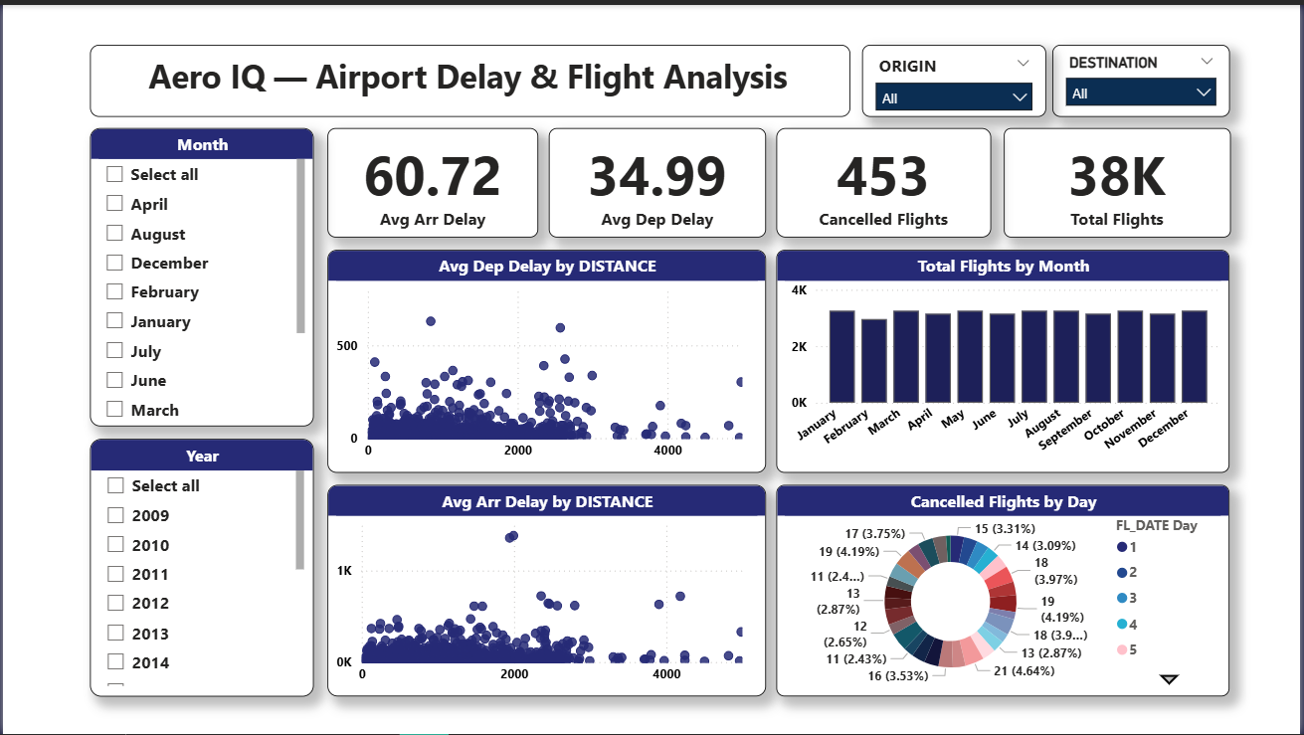
Result:
The Aero IQ Power BI Dashboard successfully visualizes all key flight delay metrics from 38,000+ flight records. Key findings from the dashboard: Average Arrival Delay is 60.72 minutes across all routes. Average Departure Delay is 34.99 minutes. Total Cancelled Flights: 453 out of 38,000+ total flights. Total Flights Analysed: 38K. Peak delay months identified: December and January show highest delays due to winter weather. Scatter plots reveal strong positive correlation between flight distance and departure delay. Donut chart shows cancellation distribution is highest on weekdays (FL_DATE Day 1 and 5). Origin and Destination slicers allow dynamic filtering for any route combination. The dashboard enables airport managers to quickly identify high-delay routes and peak delay periods for proactive decision making.

Slide 8
Conclusion:
This project successfully developed the Aero IQ Power BI Dashboard — a comprehensive interactive analytics tool for airport delay and flight performance analysis. The dashboard provides clear and actionable insights from 38,000+ flight records using Power BI visualizations and DAX measures. Key findings reveal that average arrival delay is 60.72 minutes, average departure delay is 34.99 minutes, and 453 flights were cancelled in the dataset. The interactive slicers for Month, Year, Origin, and Destination allow stakeholders to drill down into specific routes and time periods. The dashboard demonstrates how data visualization tools like Power BI can transform raw aviation data into meaningful business intelligence, helping airport authorities and airline managers make data-driven decisions to reduce delays and improve passenger satisfaction. Challenges included handling missing delay values and normalizing route data across different airport codes, which were resolved using Power Query transformations.

Slide 9
Future scope:
1. Real-Time Data Integration: Connect the dashboard to live flight data APIs such as OpenSky Network or FlightAware for real-time delay monitoring and alerts. 2. Predictive Analytics: Integrate machine learning models to predict flight delays before departure based on weather, route, and historical patterns. 3. Weather Data Correlation: Add weather dataset to correlate delay causes with meteorological conditions like fog, rain, and storms. 4. Global Expansion: Extend the dashboard to cover international airports and global airline routes beyond the current US dataset. 5. Mobile Dashboard: Publish the Power BI dashboard as a mobile-optimized report for use by airport operations staff on tablets and smartphones. 6. Passenger Alert System: Build an automated notification system using Power Automate that sends delay alerts to passengers when thresholds are exceeded.

Slide 10
References:
1. 2015 Flight Delays & Cancellations Dataset – Kaggle : https://www.kaggle.com/datasets/usdot/flight-delays
2. Bureau of Transportation Statistics - On-Time Data https://www.transtats.bts.gov
3. DAX Reference Guide – Microsoft : https://learn.microsoft.com/en-us/dax
4. Power Query Documentation – Microsoft : https://learn.microsoft.com/en-us/power-query
5. Federal Aviation Administration - Aviation Data : https://www.faa.gov/data_research
6. GitHub Link: https://github.com/smitasunka/Aero-IQ-Airport-Delay-Flight-Analysis-

Slide 11
Thank You

