Slide 1
Data Findings
Entities:
Customer
Order
Shipping
Customer Data Attributes(250 rows)
Customer_ID: A unique identifier for each customer. (Primary Key)
First: First name of the customer.
Last: Last name of the customer.
Age: Age of the customer.
Country: Country of the customer
.Order Data Attributes(250 rows)
Order_ID: Unique identifier for each order.
Item: Item purchased.
Amount: An amount of an order.
Customer_ID: The ID will link to the customer who placed the order. (Primary Key)

Slide 2
Data Findings
4. Shipping Data Attributes(250 rows)
Shipping_ID: A unique identifier for each shipping. (Primary Key)
Customer_id: Customer id
Status: status of shipping
Data Quality Checks
Customer Data
Missing Values: No missing value present across all columns.
Data Types: suitable data types (integer) to store IDs and Age, while (string) would be for Names and Country.
Unique IDs: All Customer_IDs are unique.
Order Data
Missing Values: There are no missing values across all columns.
Data Types: integers for IDs , float for amounts, and strings for items.
Unique IDs: All Order_IDs are unique.
Shipping Data
Missing Values: There are no missing values in any of the columns.
Data Types: integer for IDs, strings for status
Unique IDs: All Shipping_IDs are unique.
Completeness and Reliability
General Note: The data looks complete and reliable: it has no missing values, and IDs have unique values. There are no apparent data anomalies or incorrect data types.

Slide 3
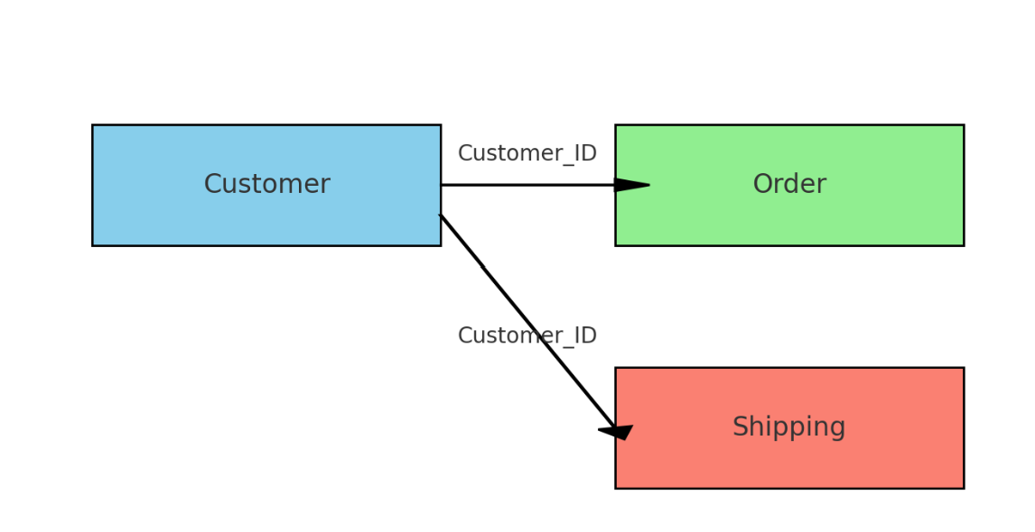
Current Conceptual Diagram
Data Entry: This process includes the entering of information into the customer database. This data forms the basis for all the subsequent processes that would ensure, from order to shipping details, these can be properly processed and attributed to the right customer.
Processing of Orders: This is the processing of orders once a customer has been established. The processing of an order includes the taking of order details, such as items, amount.
Shipping Handling: the shipping handling involved the link of orders to the shipping details, managed, and tracked.
Customer entity is at the center and has a link to each Order and Shipping via the Customer_ID. But this just means there is no direct link between Order and Shipping; this is a gap in the data structure.

Slide 4
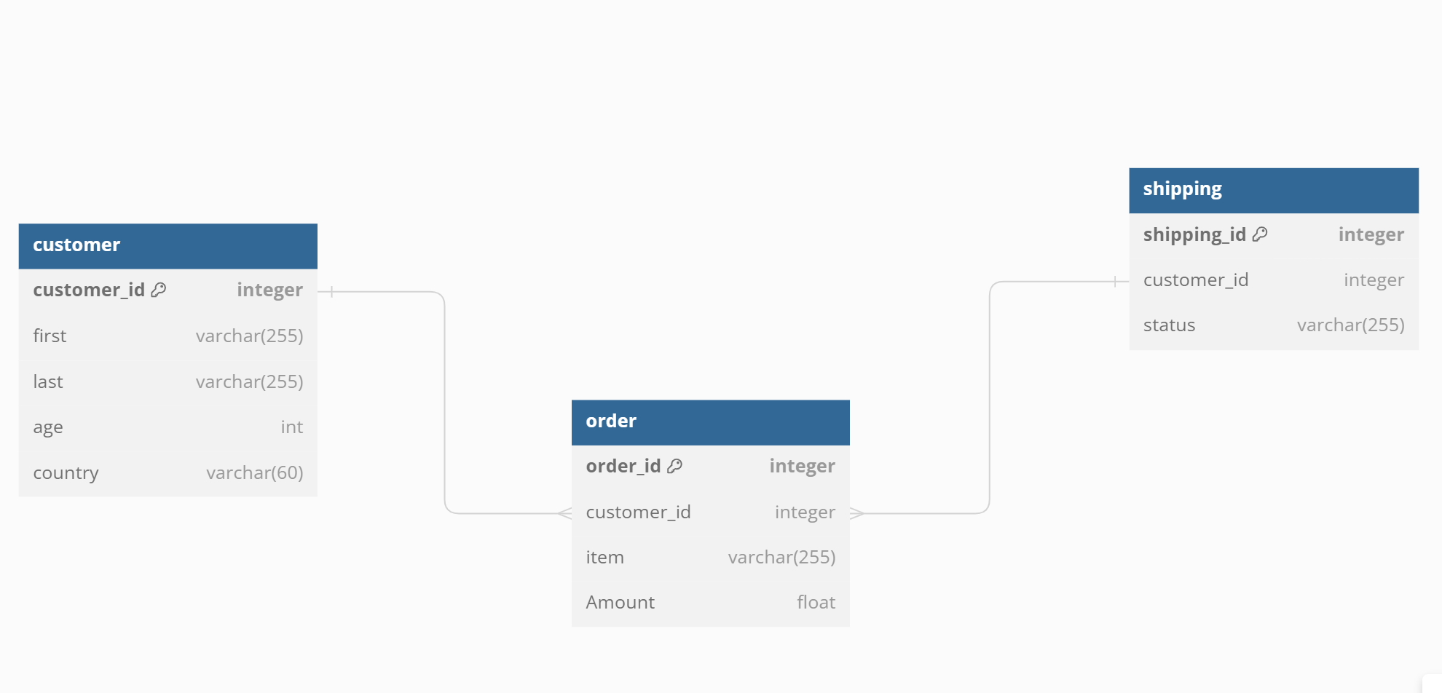
Current Data Model

Slide 5
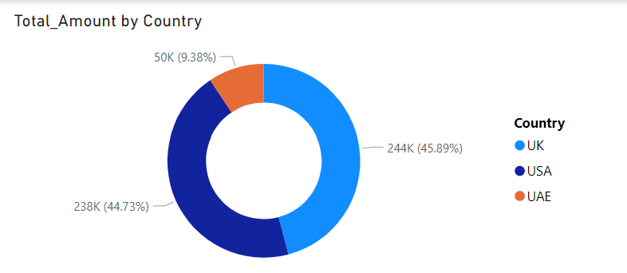
Gaps in Current Data Structure
Not able to derive a direct relationship between Order and Shipping data to derive the report "the total amount spent and country for the Pending delivery status for each country".
The reports below cannot be generated as Quantity and Product details are not available.
Total Number of Transactions, Total Quantity Sold, and Total Amount spent by the customer along with product details.

Slide 6
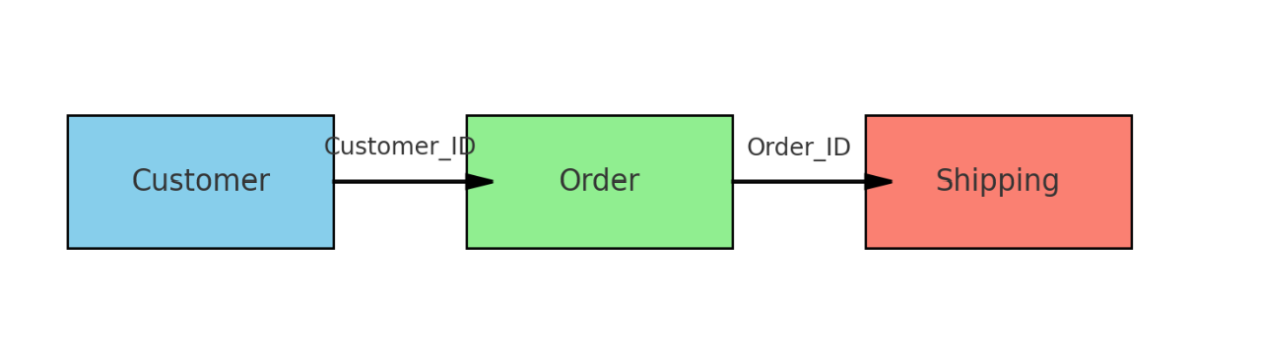
Proposed Conceptual Diagram
This would relate Order directly with Shipping by means of Order_ID. Thus, tracking statuses of shipping back to specific orders will be managed better. Such revised structure would take into consideration the gap identified from the current setup and enhance the integrity and manageability of the flowing of data.

Slide 7
For Data Scientist:
For Data Engineers:
Our datasets had to perform joins based on Customer_ID; thus, we could learn the need for reliable foreign key constraints and consistency in the data.
One of the schema design issues here is the missing Order_ID from the Shipping dataset. The missing relational link, therefore, is needed in order for effective querying to take place between Orders and Shipping.
Improve system integration in order to gain real-time updates and optimize data lag in systems that are paramount to order processing and sending out shipping status updates.
is recommended that data quality checks should be automated after the ingestion of new data. Specifically, fields like Amount should be checked whether it is in the right format.
Leveraging the relationships detailed above between customers, their orders, and shipping details, perform predictive analysis of the customer buying behavior and order delivery times.

Slide 8
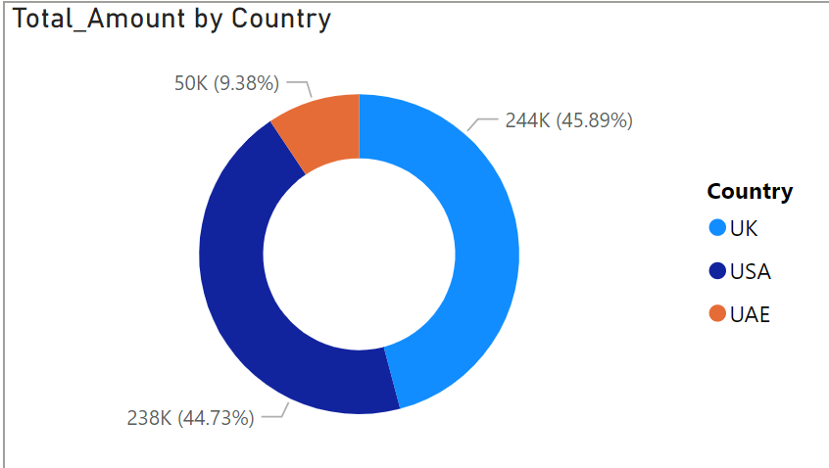
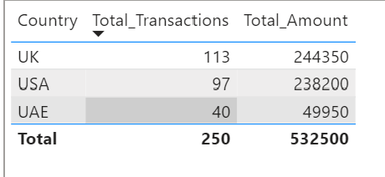
Non Technical Stakeholder
This is graphed using a donut chart, where the total amount accounts for 100% and is shared by the three countries: the USA, UK, UAE. The USA has 45.89% (244K), followed closely by the UK at 44.73% (238K).
The least percentage is from the UAE, which is 9.38% (50K).
The chart demonstrates a quite narrow distribution because both countries, as a whole, represent over 90% of the grand total, an amount relatively small in comparison to that of the UAE.
the total number of transactions, total quantity sold, and total amount spent for each customer, along with the product details.
The table shows that in terms of transaction volume, the UK is a leader, while the USA is competing closely with it in revenue, having many times fewer transactions, which suggests a higher value per transaction.
Thus, showing a growth opportunity would be the UAE, where it has the least number of transactions and revenue.
In fact, this business is strongly existing in the UK and USA, but a potential chance does exist in the UAE to expand and optimize.

Slide 9
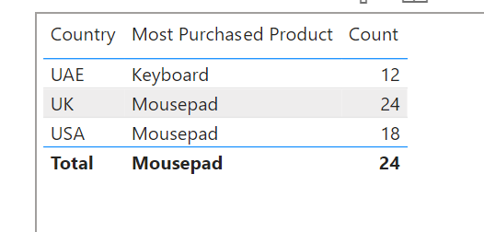
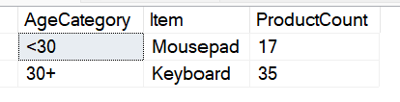
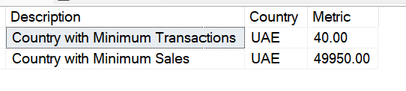
the maximum product purchased for each country.
The Mousepad is the highest-selling item among all products, with dominance in the UK, which again leads from the highest sales count.
The Mousepads dominate in both the UK and USA, signaling a preference that resonates with the other country but leans on Keyboards in UAE.
And so the very trends mean a chain reaction of inventory and marketing measures in accordance with regional demand.
the most purchased product based on the age category less than 30 and above 30.
The Mousepads sell the most, 17 to be exact, among customers under 30 years old, while Keyboards enjoy the greatest popularity among those over 30, with a sum total of 35.
This obviously would indicate a difference in purchase tendencies between young and old, so it may help in guiding marketing by target or stock placement.
The snippet of data, therefore, suggests that UAE has the least figures in both transactions and sales, among the analyzed countries, recording just 40 transactions with sales amounting to 49,950. This further reflects on the earlier donut chart that showed the UAE to have the smallest share of the total amount and indicates further that it may be an underperforming or less focused market, compared with the UK and USA.
the country that had minimum transactions and sales amount.

Slide 10
Q & A

