Slide 1
Cryptography
Module II

Slide 2
Data Encryption Standards
DES

Slide 3
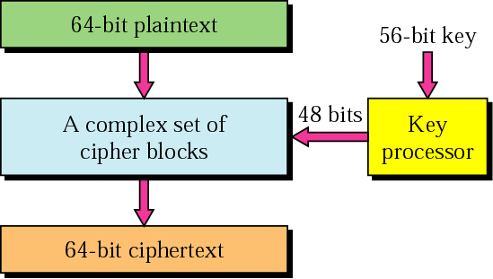
Product block
P-boxes and S-boxes can be combined to get a more complex cipher block, called Product block.
Data Encryption Standard (DES) uses an algorithm that encrypts a 64-bit plaintext chunks using a 56-bit key. The text is put through 19 different and complex procedures/rounds to create a 64-bit ciphertext.

Slide 4
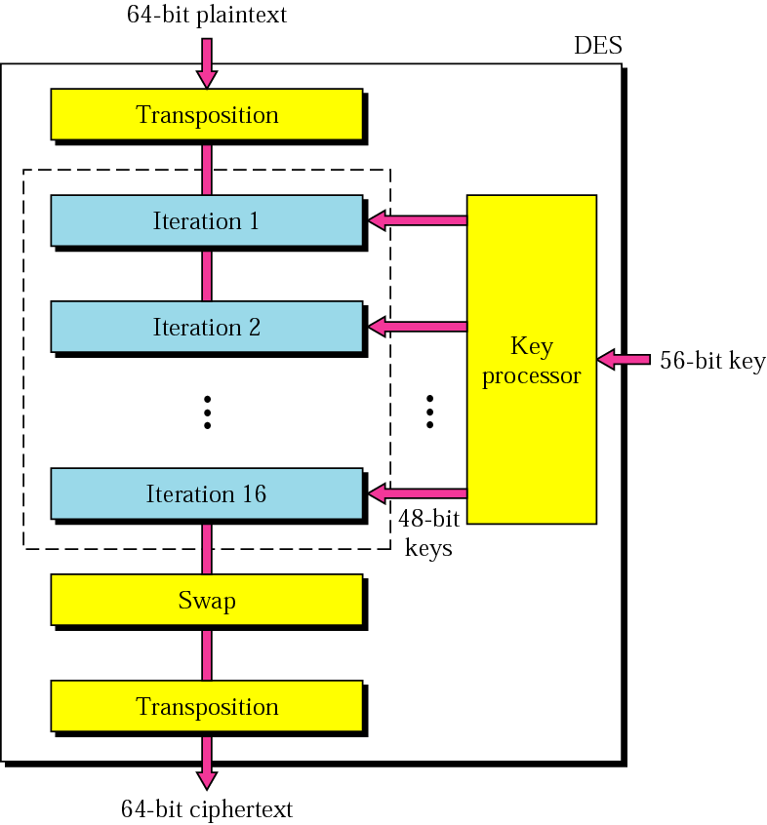
General scheme of DES
DES has two transposition blocks, one swapping block, and 16 complex blocks called iteration blocks.
The 16 iterative blocks are conceptually the same, but each uses a different key derived from the original key.
DES works on 8 characters (bytes) at a time.

Slide 5
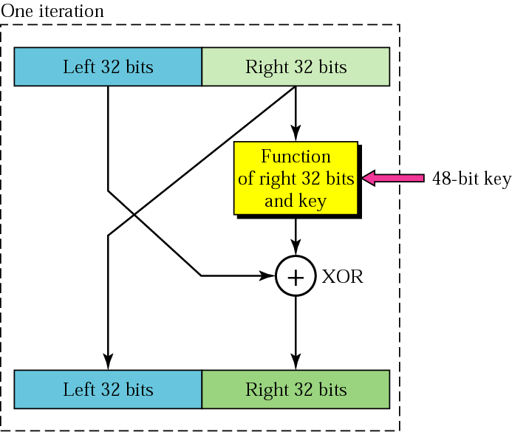
Iteration block
In each block, the previous right 32 bits become the next left 32 bits (swapping). The next right 32 bits, however, come from first applying an operation (a function) on the previous right 32 bits and then XORing the result with the left 32 bits.
The “Function” f(R,K)
  expands R to 48 bits
  xor R with K
  Result is permuted from a table
Ki (i denotes iteration) is derived from the 56-bit key with left circular shift of 1 or 2 bits that is determined by a permutation table.

Slide 6
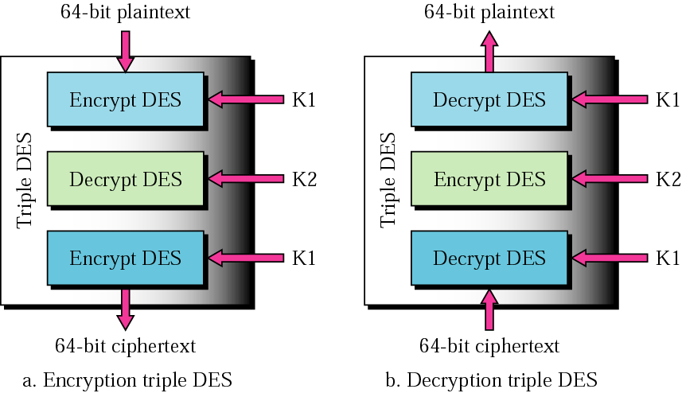
Triple DES or 3DES
DES has a key too short
3DES has 3 DES blocks and 2 56-bit key (or 112-bit key)
More complex and thus more secure

Slide 7
DES Operation Modes
ECB
CBC
CFM
CSM

Slide 8
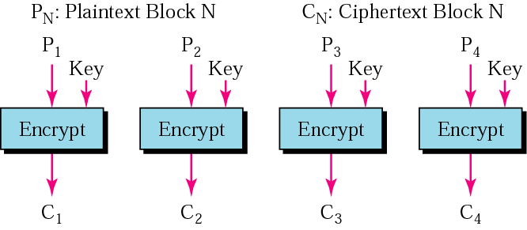
ECB mode
In Electronic code block (ECB) mode, we divide the long message into 64-bit blocks and encrypt each block separately.
Encryption of each block is independent of other blocks in ECB mode.
fault tolerant
possible to break by encrypt and compare method

Slide 9
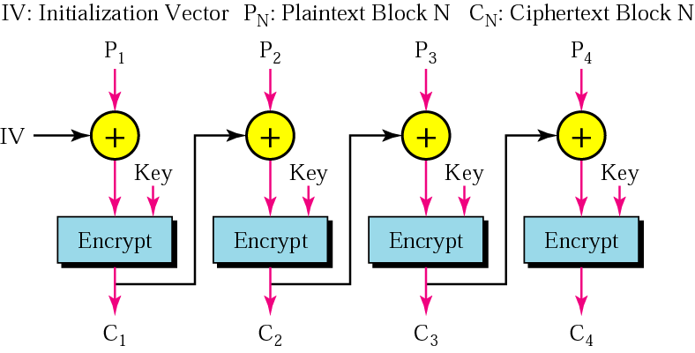
CBC mode
In cipher block chaining (CBC) mode, the encryption (or decryption) of a block depends on all previous blocks.
To encrypt the second plaintext block (P₂), we first XOR it with the first cipher block (C₁) and then pass it through the encryption process. In this way, C₂ depends on C₁.
IV is typically part of the key, or generated off the key randomly (based on a random function).

Slide 10
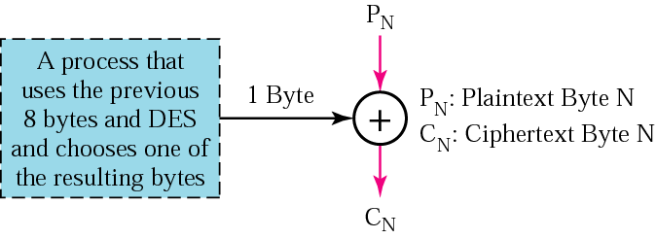
CFM
Cipher feedback mode (CFM) was created for those situations in which we need to send or receive data one byte at a time, but still want to use DES (or triple DES).
One solution is to make a 1-byte C_{N} dependent on a 1-byte P_{N} and another byte, which depends on 8 previous bytes itself.
Why previous 8 bytes?

Slide 11
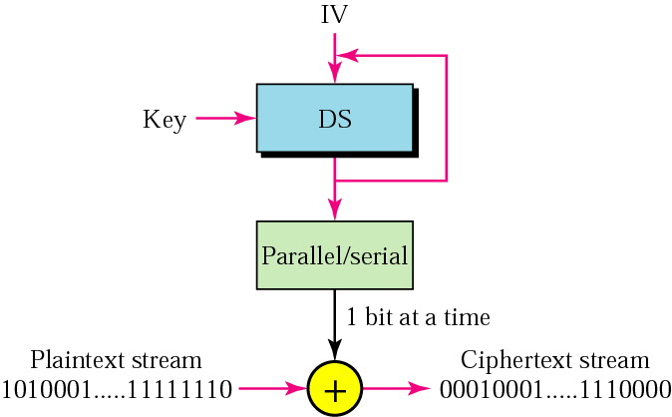
CSM
To encrypt/decrypt 1 bit at a time and at the same time be independent of the previous bits, we can use cipher stream mode (CSM).
In this mode, data are XORed bit by bit with a long, one-time bit stream that is generated by an initialization vector in a looping process.

Slide 12
Advanced Encryption Standards
AES

Slide 13
AES
DES Considered too weak
  Diffie, Hellman said in a few years technology would allow DES to be broken in days
    Design using 1999 technology published
    Diffe-Hellman is also an asymmetric algo
  Design decisions not public
    S-boxes may have backdoors
DES has built-in trapdoor. It is a claim but a strong one.

Slide 14
Advanced Encryption Standard (AES) Motivations
Replacement of DES
  Known vulnerabilities
  Broken by exhaustive key search attack
  Triple DES – secure but slow
Need new standard that is:
  Secure – practical cryptanalysis, resist known attacks
  Cost effective
  Easy to implement (software, hardware) and portable
  Flexible
AES follows the principles of
  Open algorithm
  Open disclosure
No relation to government agency → no allegations of tampering with code

Slide 15
AES Origin
Started in 1997 and lasted for several years
Requirements specified by NIST (National Institute of Standards and Technology)
  Algorithm unclassified and publicly available
  Available royalty free world wide
  Symmetric key
  Operates on data blocks of 128 bits
  Key sizes of 128, 192, and 256 bits
  Fast, secure, and portable
  Active life of 20-30 years
  Provides full specifications

Slide 16
AES Finalists
1999:
Algorithm name | Complexity | Speed | Security margin
MARS (IBM- USA) | Complex | Fast | High
Serpent (Anserson, Biham, & Knudsen - U.K.) | Simple - clean | Slow | High
Rijndael (Joan Daemen/V. Rijmen – Belgium) | Simple -clean | Fast | Good
RC6 (RSA Data Security, Ins. - USA) | Very simple | Very fast | Low
Twofish (Bruse Schneier and others - USA) | Complex | Fast | High

Slide 17
Rijndael Algorithm
Chosen for: security, performance, efficiency, ease of implementation, and flexibility
Symmetric, block cipher
Block cipher (block size variable and depends on key length)
Key size: 128, 192, or 256 bits
Block size: 128
  Processed as 4 groups of 4 bytes (state)
  Operates on the entire block in every round
Number of rounds depending on key size:
  Key=128 → 9 rounds
  Key=192 → 11 rounds
  Key=256 → 13 rounds

Slide 18
Strength of Algorithm
New – little experimental results
Cryptanalysis results
  Few theoretical weakness
  No real problem
Has sound mathematical foundation

Slide 19
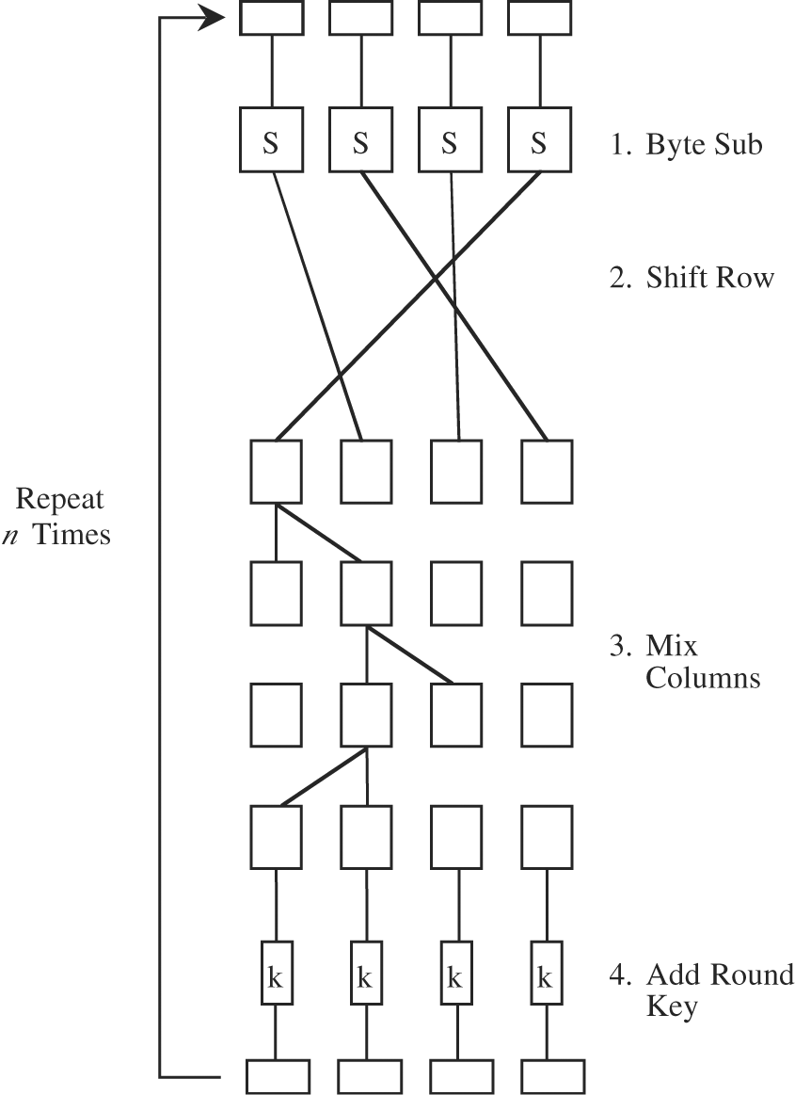
Rijndael – Basic Steps
Byte Substitution: Non-linear function for confusion
  S-box used on every byte (table look-up)
Shift Rows: Linear mixing function for diffusion
  Permutes bytes between columns
  Different for different block sizes (128, 192 same, 256 different)
Mix columns: Transformation
  Shifting left and XOR bits
  Effect: matrix multiplication
Add Round Key: incorporates key and creates confusion
  XOR state with unique key
All operations can be combined into XOR and table look-ups → Very fast and efficient
A nice demo is available at:
http://www.iaik.tu-graz.ac.at/research/krypto/AES/old/%7Erijmen/rijndael/Rijndael_Anim_exe.zip

Slide 20
AES Operation Modes
CBC (Cipher Block Chaining)
  Used with IPSec
ECB (Electronic CodeBook)
CFB (Cipher FeedBack)
OFB (Output FeedBack)
CTR (Counter).

Slide 21
Other Secret Key Algorithms
DESX: modification of DES
Blowfish: fast, compact and simple block cipher. Variable key length up to 448 bits
RC2: block cipher. Variable key length up to 2048 bits
RC4: stream cipher. Variable key length up to 448 bits
RC5: block cipher. Allows user defined key length, data block size, and number of encryption rounds.

Slide 22
Hash Functions

Slide 23
Hash Functions
A hash function is a function that maps an input of arbitrary length into a fixed number of output bits
Hash function h maps an input x of arbitrary length to a fixed length output h(x) (compression)
Given h and x, h(x) is easy to compute (ease of computation)
  MD = h(x)
  f(MD) = x does not exist
Good hash functions must be collision free or have strong collision resistance
  Two unique messages should not result in the same hash code
Must be also “Computationally Infeasible”
  Not being able to go in the reverse direction

Slide 24
Hash Functions
Message digest
Used for
  Authentication
    Password hashing (e.g SHA)
  Data integrity
    Checksum, CRC, Hashing (e.g. MD5)
Algorithms:
  Requires password or secret key
    MAC (Message Authentication Code)
      Can verify both data integrity and data origin
    HMAC (Hash and MAC)
      Used by TLS (Transport Layer Security)
  Do not require passwords
    SHA-1, MD2, MD4, MD5, RIPEMD-160
      can verify only data integrity

Slide 25
MD5 Message Digest Algorithm
Input of arbitrary length
  Gets broken into blocks of size 512 bits
Output: 128 bits

Slide 26
MD5 Processing
Append padding bits so length ≡ 448 mod 512 (padded message 64 bits less than an integer multiplied by 512)
Append length: a 64-bit representation of the length of the original message (before the padding) → total length of message k*512 bits
Initialize MD buffer: 128-bit buffer holds intermediate and final results (4 32-bit registers, ABCD)

Slide 27
MD5 Processing
Process message in 512-bit blocks:
  4 rounds of processing
  Similar structure but different logical function
  Each round takes the 512-bit input and values of ABCD and modifies ABCD
Output: from the last stage is a 128-bit digest

Slide 28
Strength of MD5
Every bit of plain text influences every bit of the the hash code
Complex repetition of the basic functions → unlikely that two random messages would have similar regularities
MD5 is as strong as possible for 128-bit digest (Rivest’s conjecture)
  Didn’t hold true
  Latest news as of August 2004, MD5 got broken
    http://csrc.nist.gov/hash_standards_comments.pdf

Slide 29
Secure Hash Algorithm
SHA was developed by NIST
1993: Published as Federal Information Processing Standard (FIPS PUB 180)
Output: 160-bit digest

Slide 30
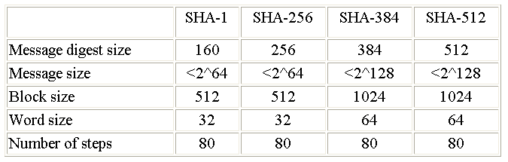
SHA-2 (256, 384, 512)

Slide 31
MD5 v.s. SHA-1
Very similar
Security: SHA’s digest is 32 bits longer → without algorithm flows SHA is more secure
  Its collision resistance is much higher
Speed: SHA has more steps and produces 160-bit buffer → SHA slower
Simplicity and compactness: MD5 has more internal steps with varying buffer modification → SHA is simpler

Slide 32
Dictionary Attacks and Salt
“can you pass the salt please?”
Use a dictionary of most commonly used passwords
Encrypt/Hash and compare
  Visit www.lostpassword.com
  Claim of 100% password recovery for any system or applications
Salted hash of the passwords
  Add a salt value to the password before hashing
  Make dictionary attack so difficult
  Each user has a salt value (random string)

Slide 33
Microsoft Hashes
Uses two hashes for backward compatibility with old system and apps
  LM Hash
    LanManager Hash
    used by old windows OS and applications
    Limited to 7 characters
    Easy to break (in matter of hours)
    To generate the LM hash, the system converts the password from UNICODE to ANSI (one byte per character), and translates all characters into uppercase. After that, the password is divided to two chunks (7 chars each, padded with zeros if needed). Each part is used as a DES encryption key, to encrypt the pre-defined constant, and the results of encryption are stored in the system (merged into a single 16-byte value). So, if your system uses LM authentication (and so LM hashes are available), the real password length (complexity) is just 7 characters, and the 14-character password is not much stronger than one of 7 characters.
  NT Hash
    More secure
    Uses MD4
    Hard to break takes years

Slide 34
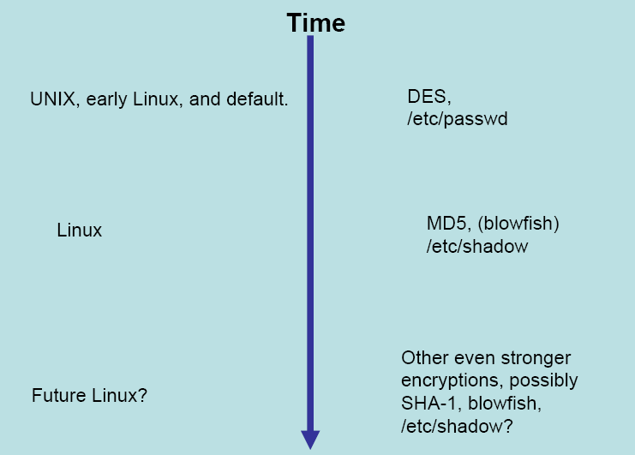
Unix & Linux Password History
/etc/shadow contains the hashed passwords and accessed by root only, however, /etc/passwd contains ***
Latest implementations of Unix & Linux uses DES and MD5 with salting, respectively.

Slide 35
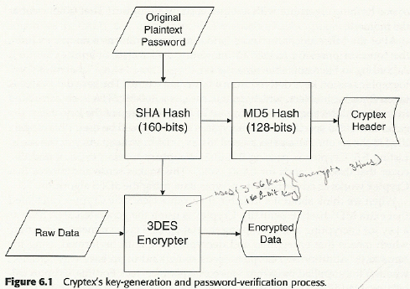
Example of file encryption with password

Slide 36
Public Key Encryption

Slide 37
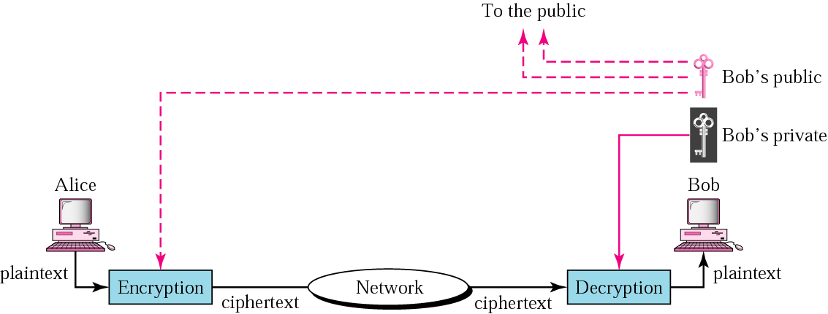
Public-key cryptography
In public-key cryptography, there are two keys: a private key and a public key. The private key is kept by the receiver. The public key is announced to the public.
Public-key used for encryption is different from the private key that is used for decryption. Public key is available to the public; the private key is available only to an individual.
Each entity creates a pair of keys; the private one is kept, and the public one is distributed. Each entity is independent, and the pair of keys created can be used to communicate with any other entity.
The second advantage is that the number of keys needed is reduced tremendously.
Public-key algorithms are more efficient for short messages.
Complexity of the algorithm; association between an entity and its public key must be verified [Certification authority].

Slide 38
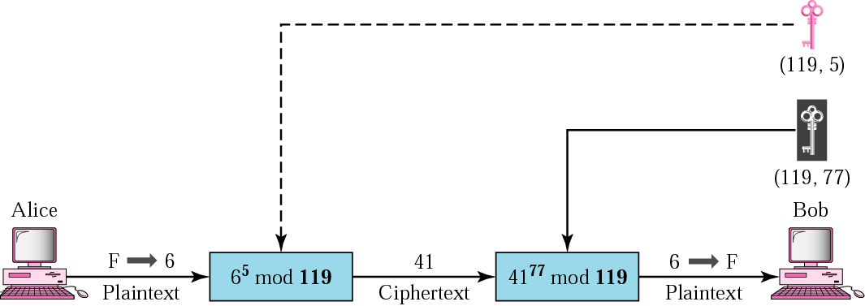
RSA
RSA (Rivest, Shamir, Adleman) is the most common public-key algorithm.
Private key is a pair of numbers (N,d).
Public key is a pair of numbers (N,e).
Note that N is common to the private and public keys.
Sender algorithm to encrypt: C=P^{e} mod N
P is plaintext, which is represented as a number; C is the number that represents the ciphertext. The two numbers e and N are components of the public key.
Receiver algorithm to decrypt: P=C^{d} mod N
Q: If I know 41 and 119, can I figure 77 by brute force?
A: Yes
Solution: ??

Slide 39
Choosing RSA public and private keys
Inventors of RSA used ‘number theory’
  Not any numbers work!
Procedure to choose three numbers N, d, and e.
  Choose two large prime numbers p and q.
  Compute N = p * q
  Choose e (less than N) such that e and (p-1)(q-1) are relatively prime (having no common factor other than 1)
  Choose d such that (e*d) mod [(p-1)(q-1)] is equal to 1.

