Slide 1
580.691 Learning Theory
Reza Shadmehr & Jörn Diedrichsen
Reinforcement Learning 2: Temporal difference learning

Slide 2
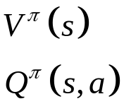
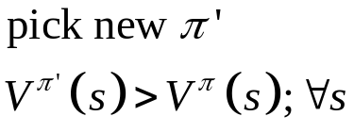
Review
A reinforcement learning problem is characterized by a collection of states and actions. These are connected by edges that indicate what the available actions from each state and what the transition probabilities from actions to the new states are.
S
A
S
Available
actions
Transition
probabilities
The goal of all reinforcement learning is to find the policy with the highest expected Return (sum of temporally discounted rewards). To find it, we can generally use the policy iteration:
Policy evaluation
Policy improvement
Estimate

Slide 3

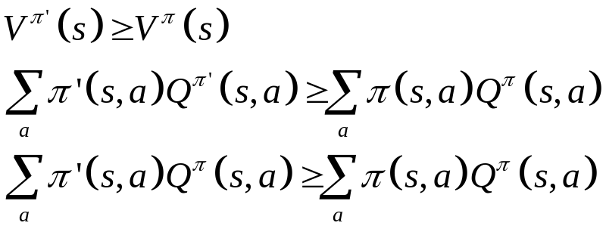

Policy improvement theorem
Improving the policy locally for some states s, such that
and leaving the policy for all others the same, ensures that above is true for all states.
Proof: Assume for a moment, that the Graph does not have any loops (tree structure). Then we can make a improved policy by changing the policy of the first state and then follow the old policy. For the first state:
For all other states:
If the Graph has loops, then the value of later states will be changed as well. But for the states where we follow the old policy:
We can extend this proof by induction to changes for multiple states.

Slide 4
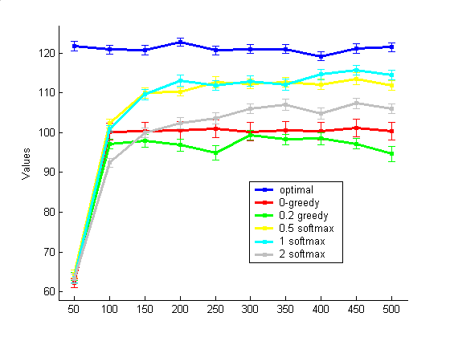
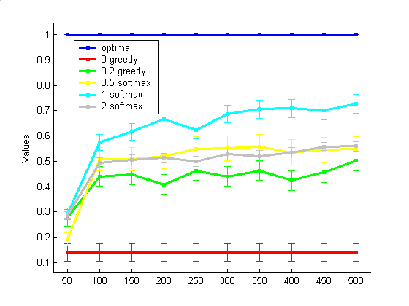
In the homework you used
A Monte-Carlo methods (50 steps) for policy evaluation
Greedy, sub-greedy or softmax method for policy improvement.
Greedy gets mostly stuck in a policy of going to the right. All others have a chance to learn the correct policy, but may not exploit the policy optimally in the end.
Expected reward
P(left first step)

Slide 5
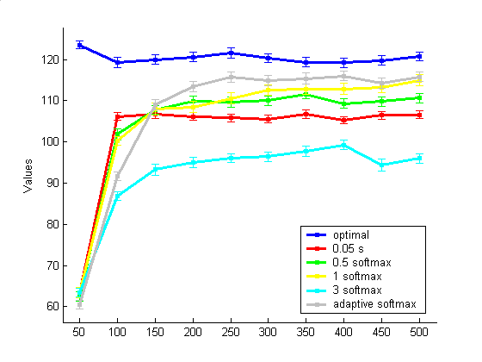
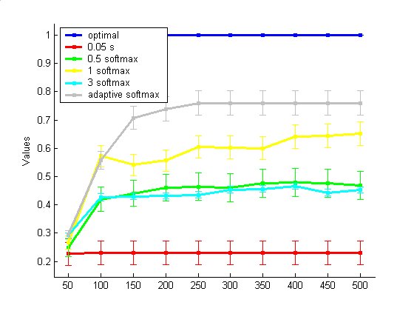
A good strategy (gray line) is to start with high exploration in the beginning and then with a high exploitation in the end.
In this example this is done by starting with a softmax-method of policy improvement and decreasing temperature parameter.
Expected reward
P(left first step)

Slide 6
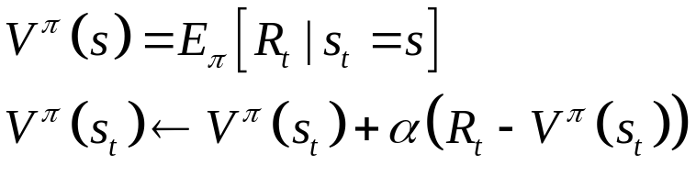
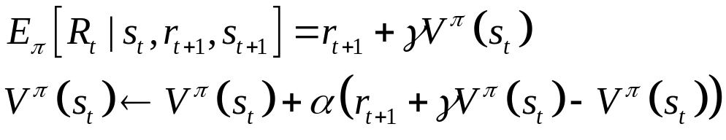
Batch vs online learning
When we learn a value function with a batch (Monte-Carlo) algorithm, we need to wait until N steps are done, then we can update.
Temporal difference learning is a iterative way of learning a value function, such that you can change the value function every step.
Let’s start like in LMS and see what gradient the batch–algorithm follows. Remember that the value function is expected return for the state. So we can find it by minimizing the difference between the value function and the measured return (by MC):
In temporal difference learning we replace the Return on every step with the expected return given the current observation and Value-function (we are bootstrapping).
This defines TD(0), the simplest way of temporal difference learning.

Slide 7
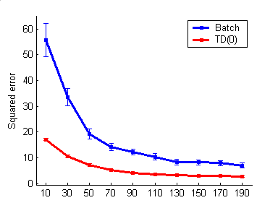
How can TD(0) do better than Batch???
Plotted is the squared error of the estimated value function (compared to the true value function) of the batch algorithm and temporal difference learning.
Given the same amount of data, TD(0) does actually better than batch. How can this be?
Assume the markov-process on the left.
Say you see the state-reward episodes:
B,1 B,1 B,1 B,0 A,0,B,1
Batch learning would assign A a value of 0, because the empirical return was always 0.
Given the data, that is the maximum-likelihood estimate.
TD will converge to V(A)=γ 0.75. This estimate is different, because it uses the knowledge A leads to B and that our problem is Markovian.
This is sometimes called the certainty-equivalence estimate, because it assumes certainty about model structure.
r=1
A
P=0.75
B
r=0
P=0.25

Slide 8
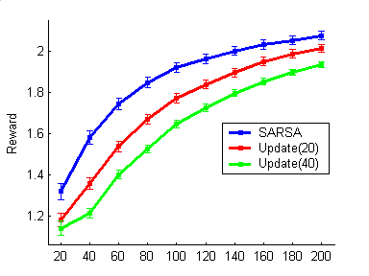
Sarsa – on-policy evaluation
Currently we are alternating between policy evaluation and optimization every N steps. But can we do policy improvement also step-by-step?
The first step is to not do TD-learning on the state-value function, but on the action-state value function.
Sarsa:
Initialize Q, Π, choose a₁
For t=1:T
Observe r_{t+1},s_{t+1}
choose a_{t+1}
Update Q
Update Π,
end
Thus, despite the fact that we change policy, we are not throwing away the old value function (as in MC), but use it as a starting point for the new one.

Slide 9
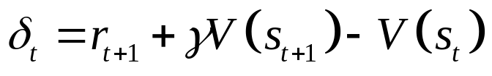
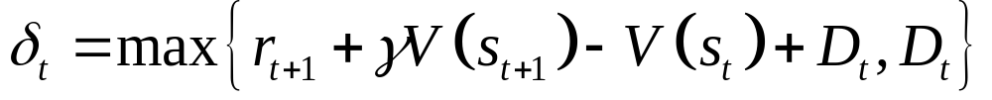
Addiction as a computational process Gone Awry
David A. Redish, Science 2004
Under natural circumstances, the temporal difference signal is the following:
The idea is that the drug (especially dopaminergic drugs like cocaine) may induce a small temporal difference signal directly (D), such that:
In the beginning the temporal difference signal is high, because of the high reward value of the drug (rational addiction theory). But with longer use, the reward value might sink, and negative consequences would normally reduce the non-adaptive behavior. But because d is always at least D, the behavior can not be unlearned.

Slide 10
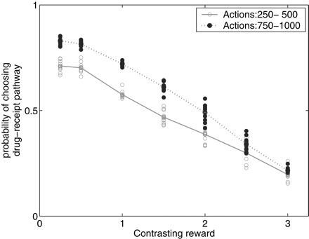
Increased wanting (not more liking)
The model predicts that with continued use, the drug-seeking behavior becomes more insensitive to contrasting reward.

Slide 11
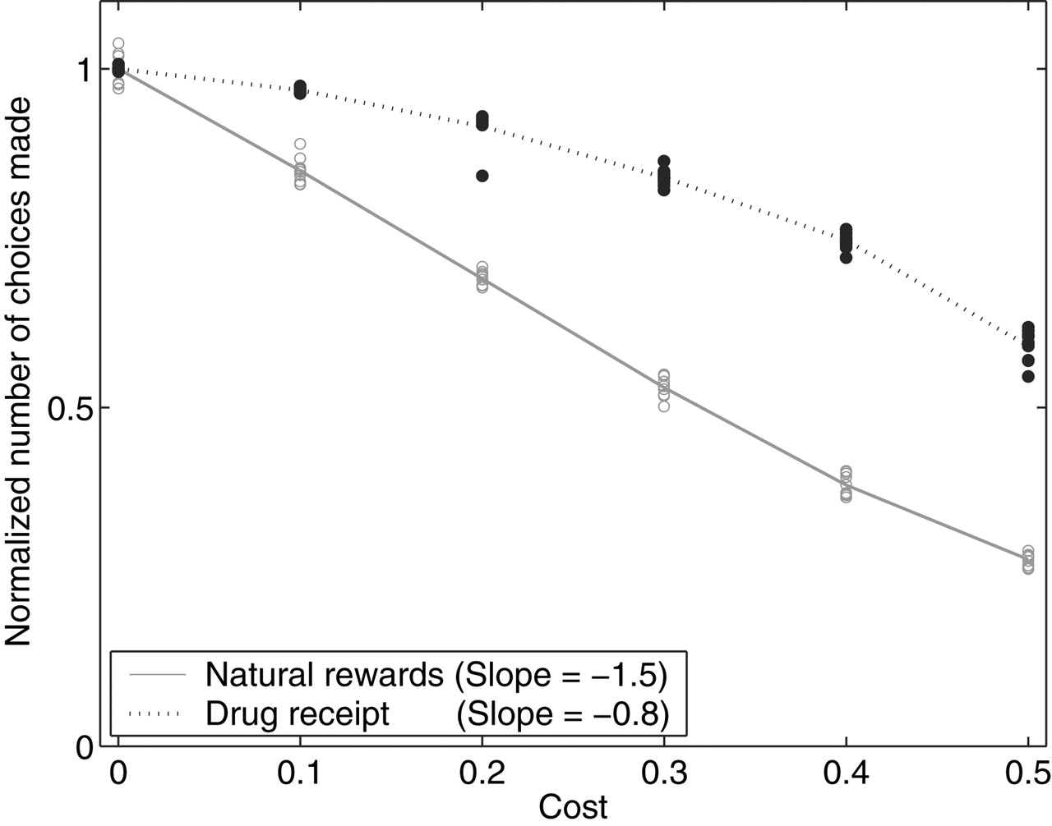
Decreased Elasticity
Elasticity is a term from economics. It measures how much the tendency to buy products decreases, as the price increases.
Because drug-seeking can not easily be unlearned, the behavior become less and less elastic with prolonged drug use.

Slide 12
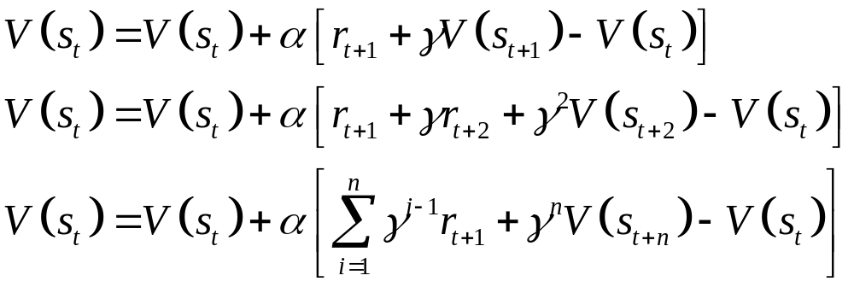
TD-nStep
So far we have only backed up the temporal difference error by one step. That means, that we have to revisit that state again, such that the state BEFORE that rewarding state can increase it’s value function.
However, we can equip our learner with a bigger memory, such that the back-up can be done by n-steps. The 1,2, and n-step TD learning rule are respectively:
This means that the states, as long as n-back are eligible for a update. We will investigate this more in the homework and the next lecture.

