Slide 1

Reinforcement Learning
CS4881 Artificial Intelligence, SE3250 Game Design, CS498 Machine Learning
Jay Urbain, PhD
Credits: Machine Learning, Tom Mitchell
AIMA, Russell and Norvig
Kardi Teknomo, Q-Learning Using Matlab

Slide 2
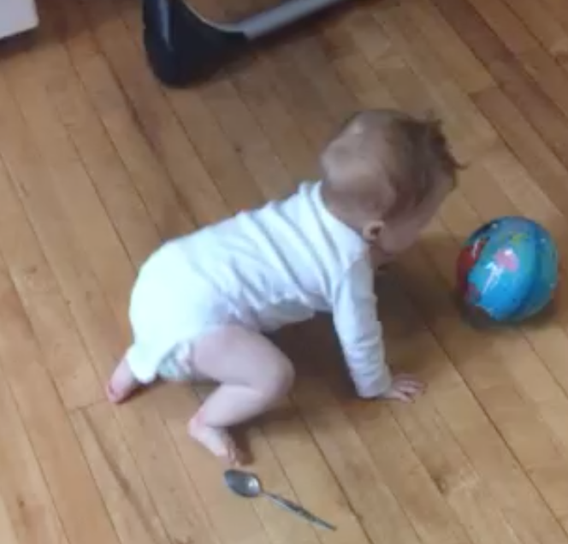

Slide 3
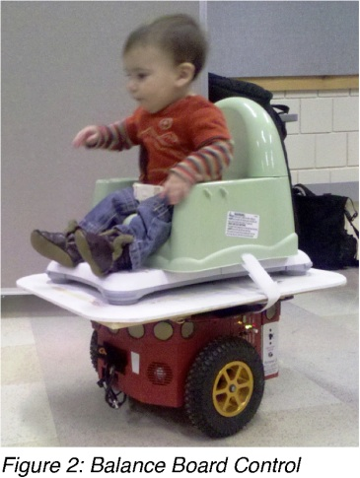
Reinforcement Learning (RL)
RL is concerned with how an agent ought to take actions in an environment so as to maximize some notion of cumulative reward.
Learning by interacting with your environment is a foundational idea underlying nearly all theories of learning and intelligence.
Babies Take the Wheel of Driving Robots
Giving disabled babies the power of movement could improve their development.
http://www.technologyreview.com/blog/mimssbits/25667/

Slide 4
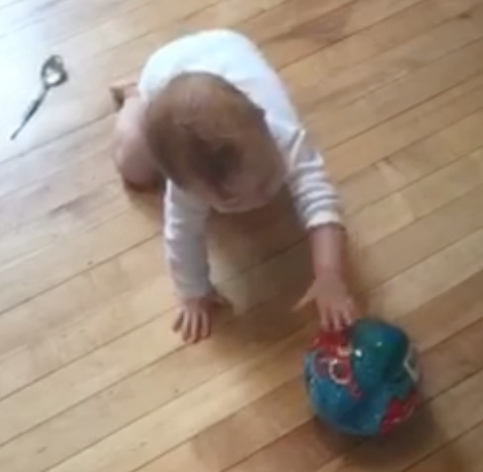
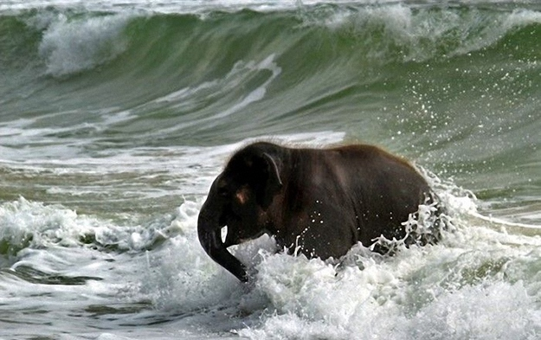
RL – Basic Idea
We learn by interacting with our environment:
  produces a wealth of information about cause and effect, about the consequences of actions, and about what to do in order to achieve goals.
  Throughout our lives, such interactions are a major source of knowledge about our environment and ourselves.

Slide 5


RL Examples - Chess
A master chess player makes a move.
The choice is informed both by planning:
  anticipating possible replies and counter replies
  and by immediate, intuitive judgments of the desirability of particular positions and moves.
Deep Blue versus Garry Kasparov

Slide 6


Slide 7
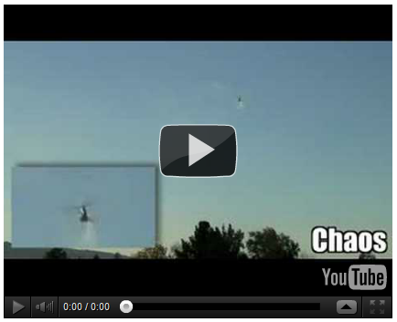
RL Examples - Controller
Helicopter flight controls given a basic model.
  Autonomous Helicopter Aerobatics through Apprenticeship Learning, Pieter Abbeel, Adam Coates, and Andrew Y. Ng. IJRR, 2010. [IJRR] Dataset
  http://heli.stanford.edu/

Slide 8
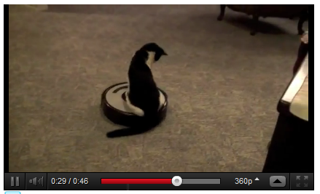
RL Examples – Roomba
A mobile robot decides whether it should enter a new room in search of more trash to collect or start trying to find its way back to its battery recharging station.

Slide 9
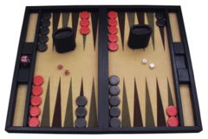
Example Backgammon, Tesauro 1995
Learn to play Backgammon
Immediate reward
+100 win
-100 lose
0 for all other states
Trained by playing 1.5M games against itself
Now ~equal to best human player
Backgammon is a board game for two players in which pieces are moved according to the roll of dice. The winner is the first to remove all of his/her own pieces from the board.

Slide 10
RL Interaction
All examples involve interaction between an active decision-making agent and its environment, within which the agent seeks to achieve a goal despite uncertainty about its environment.
  The agent's actions are permitted to affect the future state of the environment.
  Correct choice requires taking into account indirect, delayed consequences of actions, and thus may require foresight or planning.
  Effects of actions cannot be fully predicted (stochastic environment, i.e., actions do not necessarily result in desired state).
  The agent can use its experience to improve its performance over time.

Slide 11
Elements of RL
Reinforcement learning system:
  policy
  reward function
  value function
  optionally, a model of the environment.

Slide 12
RL - Policy
Policy
What the agent learns
The learning agent's way of behaving at a given time.
A mapping from perceived states of the environment to actions to be taken when in those states.
I.e., for a given state, what’s the best action to take.

Slide 13
RL – Reward and Value Functions
Reward function indicates what is good in an immediate sense, whereas value function (utility) specifies what is good in the long run.
Value of a state is the total amount of reward an agent can expect to accumulate over the future, starting from that state (discounted value).

Slide 14
RL – Model of the environment
Models provide a framework of the environment to be explored.
Models are used for planning, by which we mean any way of deciding on a course of action by considering possible future situations before they are actually experienced.

Slide 15
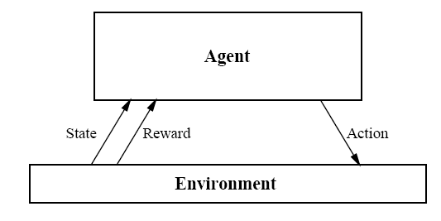


Markov Decision Process –
Reinforcement Learning Problem
Goal: Learn to choose actions that maximize discounted cumulative reward:

Slide 16
Markov Decision Process
Assume
Finite set of states S
Set of actions A
At each discrete time t, agent observes state s_{t} Є S and chooses action a_{t} Є A
Then receives reward r_{t} and state changes to s_{t+1}
Markov assumption: s_{t+1} = δ(s_{t}, a_{t})
r_{t and} s_{t+1} depend only on current state s_{t} & action a_{t}.
The value of all future rewards are subsumed by r_{t}
Functions δ and r can be nondeterministic functions, that are not known by the agent.

Slide 17

Agent’s Learning Task
Execute actions in the environment, observe results and learn action policy π : S -> A that maximizes the discounted value of future rewards:
Where is is a discount factor (from economics) for future rewards.
Problem:
Target function to learn is the action policy, but we have no training examples of form <s,a>.
Training examples are of the form of taking action a from a given state s and observing rewards:<<s,a>,r>.

Slide 18


Value Function
For each possible policy, π: (S->A), the agent might adopt, we can define an evaluation function V^{π} over states:
Where the rewards r_{t}, r_{t+1},… are generated by following policy π starting at state s.
The task is to learn (search for) the optimal policy π *

Slide 19



What to Learn
Might try to have agent learning the optimal evaluation function V*.
Could then do look-ahead search to choose best action from any state s:
Problem:
This works if the agent knows the set of states and resulting set of actions:
But when it doesn’t, it can’t select actions this way.

Slide 20
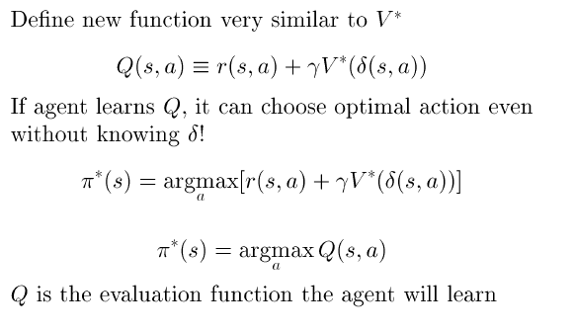
Q Function

Slide 21
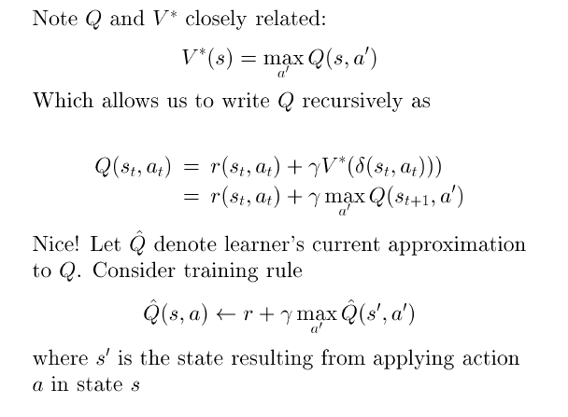
Training Rule to Learn Q

Slide 22
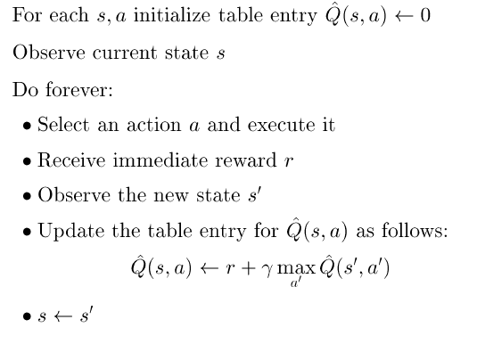
Q Learning from Deterministic Worlds

Slide 23
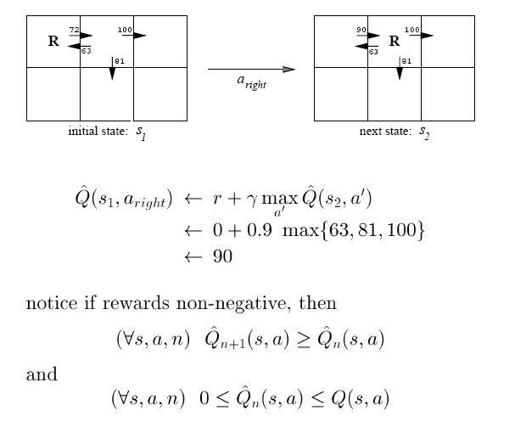
Updating Q approximation

Slide 24
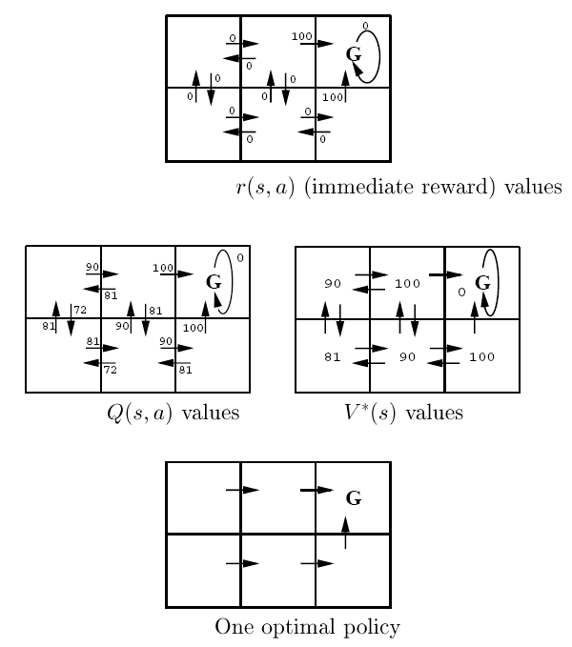

Slide 25
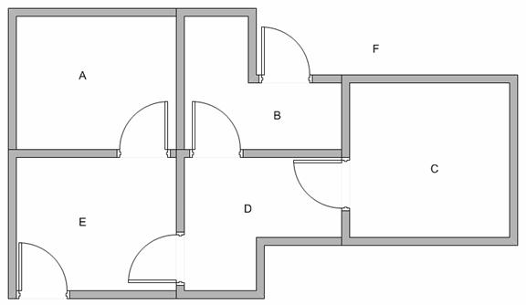
Q-Learning –
Modeling the environment
5 rooms in a building connected by doors. Goal state is F (leave building).

Slide 26
Set goal state
Represent the rooms by a graph, each room as a vertex and each door as an edge.
Set the target room to reinforce “good” behavior.
If we put an agent in any room, we want the agent to go outside the building, i.e., the goal room is the node F.
A
0
B
0
0
100
0
F
100
100
100
100
0
0
0
0
E
0
D
0
0
0
C

Slide 27
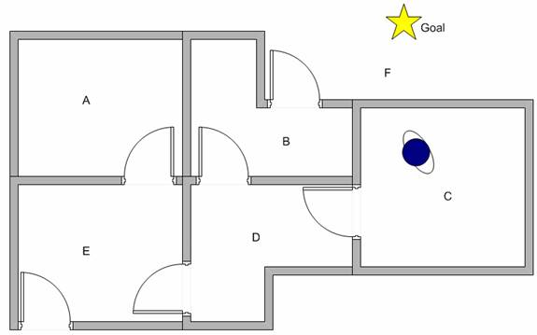
Learn through experience
Robot can learn through experience.
It does not know which sequence of doors the agent must pass to go outside the building.

Slide 28
Q Learning
We can put the state diagram and the instant reward values into the following reward table, or matrix R .
Q=R(state,action) + gama*MAX(next state, all actions)
Reward | Action
State | A | B | C | D | E | F
A | - | - | - | - | 0 | -
B | - | - | - | 0 | - | 100
C | - | - | - | 0 | - | -
D | - | 0 | 0 | - | 0 | -
E | 0 | - | - | 0 | - | 100
F | - | 0 | - | - | 0 | 100

Slide 29
Q Learning
Set the value of learning parameter gamma=0.8 and initial state as room B.
From the second row (state B) of matrix R. There are two possible actions for the current state B, go to state D, or go to state F. By random selection, we select to go to F as our action.
Reward | Action
State | A | B | C | D | E | F
A | - | - | - | - | 0 | -
B | - | - | - | 0 | - | 100
C | - | - | - | 0 | - | -
D | - | 0 | 0 | - | 0 | -
E | 0 | - | - | 0 | - | 100
F | - | 0 | - | - | 0 | 100

Slide 30
Q Learning
Now that we are in state F. Look at the sixth row of reward matrix R, i.e. state F. It has 3 possible actions to go to state B, E or F.
Q(B,F) =R(B,F) + 0.8*MAX[Q(F,B), Q(F,E), Q(F,F)]
=100 + 0.8*MAX[0,0,0]=100

Slide 31
Q Learning
We update the goal state F with 100 (which is the current value) and stop since this is a goal state.
This completes an episode.
Q (1) | Action
State | A | B | C | D | E | F
A | - | - | - | - | 0 | -
B | - | - | - | 0 | - | 100
C | - | - | - | 0 | - | -
D | - | 0 | 0 | - | 0 | -
E | 0 | - | - | 0 | - | 100
F | - | 0 | - | - | 0 | 100

Slide 32
Q Learning - another episode
For the next episode, start with a random initial state. This time our initial state is D.
Look at the fourth row of matrix R; it has 3 possible actions, that is to go to state B, C and E. By random selection, we select to go to state B as our action.
Reward | Action
State | A | B | C | D | E | F
A | - | - | - | - | 0 | -
B | - | - | - | 0 | - | 100
C | - | - | - | 0 | - | -
D | - | 0 | 0 | - | 0 | -
E | 0 | - | - | 0 | - | 100
F | - | 0 | - | - | 0 | 100

Slide 33
Q Learning - another episode
Now we are in state B. Look at the second row of reward matrix R (i.e. state B). It has 2 possible actions to go to state D or state F. Then, we compute the Q value.
Q(D,B) =R(D,B) + 0.8*MAX[Q(B,D), Q(B,F)]
=0 + 0.8*MAX[0,100]=80
Q (2) | Action
State | A | B | C | D | E | F
A | - | - | - | - | 0 | -
B | - | - | - | 0 | - | 100
C | - | - | - | 0 | - | -
D | - | 80 | 0 | - | 0 | -
E | 0 | - | - | 0 | - | 100
F | - | 0 | - | - | 0 | 100

Slide 34
Q Learning - another episode
The next state is B, which now becomes the current state.
Repeat the inner loop in the Q learning algorithm because state B is not the goal state.
There are two possible actions from the current state B, that is to go to state D, or go to state F. By lucky draw, our action selected is state F.
Now we think of state F that has 3 possible actions to go to state B, E or F. We compute the Q value using the maximum value of these possible actions.
Q(B,F) =R(B,F) + 0.8*MAX[Q(F,B), Q(F,E), Q(F,F)]
=100 + 0.8*MAX[0,0,0]=100

Slide 35
Q Learning - another episode
This result does not change the Q matrix.
Because F is the goal state, we finish this episode.
Our agent's brain now contains an updated matrix Q:
Q (2) | Action
State | A | B | C | D | E | F | max
A | - | - | - | - | 0 | - | 0
B | - | - | - | 0 | - | 100 | 100
C | - | - | - | 0 | - | - | 0
D | - | 80 | 0 | - | 0 | - | 80
E | 0 | - | - | 0 | - | 100 | 100
F | - | 0 | - | - | 0 | 100 | 100

Slide 36
Q Learning - more episodes
As our agent learns more episodes, it will evolve towards convergence for values of the Q (reward) matrix:
Q (1) | Action
State | A | B | C | D | E | F | max
A | - | - | - | - | 80 | - | 80
B | - | - | - | 0 | - | 180 | 180
C | - | - | - | 0 | - | - | 0
D | - | 80 | 0 | - | 80 | - | 80
E | 0 | - | - | 0 | - | 180 | 180
F | - | 80 | - | - | 80 | 180 | 180

Slide 37
Q Learning - many episodes
If our agent learns more and more experience through many episodes, it will finally reach convergence values of Q matrix as:
Q (n) | Action
State | A | B | C | D | E | F
A | - | - | - | - | 144 | -
B | - | - | - | 64 | - | 244
C | - | - | - | 64 | - | -
D | - | 144 | 0 | - | 144 | -
E | 64 | - | - | 64 | - | 244
F | - | 144 | - | - | 144 | 244

Slide 38
Q Learning - many episodes
This Q matrix, then can be normalized into a percentage by dividing all valid entries with the highest number.
We can now read optimal policy from max state.
Q (n) | Action
State | A | B | C | D | E | F | max | Max State
A | - | - | - | - | 59% | - | 59% | E
B | - | - | - | 26% | - | 100% | 100% | F
C | - | - | - | 26% | - | - | 26% | D
D | - | 59% | 0% | - | 59% | - | 59% | B
E | 26% | - | - | 26% | - | 100% | 100% | F
F | - | 59% | - | - | 59% | 100% | 100% | F

Slide 39
Q Learning Algorithm
Set parameter , and environment reward matrix R
Initialize matrix Q as zero matrix
For each episode:
  Select random initial state
  Do while we have not reached the goal state
    Select one among all possible actions for the current state
    Using this possible action, consider to go to the next state
    Get maximum Q value of this next state based on all possible actions
    Compute
    Set the next state as the current state
End Do
End For

Slide 40
Algorithm to utilize the Q matrix
Input: Q matrix, initial state
Set current state = initial state
From current state, find action that produce maximum Q value
Set current state = next state
Go to 2 until current state = goal state

Slide 41
Q_{hat} convergence
Q_{hat} (Q approximation) converges to Q in a deterministic world where each <s,a> is visited infinitely often.
Proof: Define a full interval to be an interval during which each <s,a> is visited. During each full interval the largest error in Q_{hat} table is reduced by a factor of

Slide 42
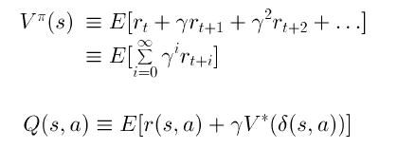
Non-deterministic case
What if reward and next state are non-deterministic?
Redefine V and Q by taking expected values:
Note: Bayesian RL is an active research field

Slide 43
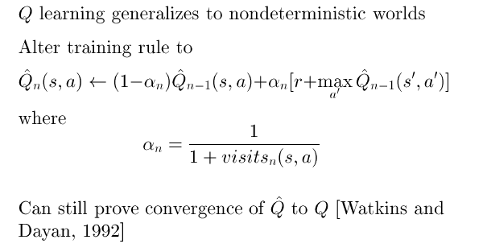
Non-deterministic case

Slide 44
Temporal difference learning
The number of training iterations necessary to sufficiently represent the optimal Q-function scales poorly with respect to the size of the time interval between states.
The greater the number of actions per unit time, the greater the number of training iterations required to adequately represent the optimal Q-function.
TD uses the concept of discounting the cumulative reinforcement versus the reinforcement from a single state transition.

Slide 45

Temporal difference learning
Given the MDP with 1000 states.
State 0 is initial state & state 999 is an absorbing state.
Each state transition returns a cost (reinforcement) of 1, and the value for 999 is defined to be 1.
Q-learning, value interaction can solve this problem.
However TD(lambda) can solve it faster.
TD(lambda) updates the value of the current state based on a weighted combination of the values of all future states versus only the value of the immediate successor state. Basic Bellman eqn:

Slide 46
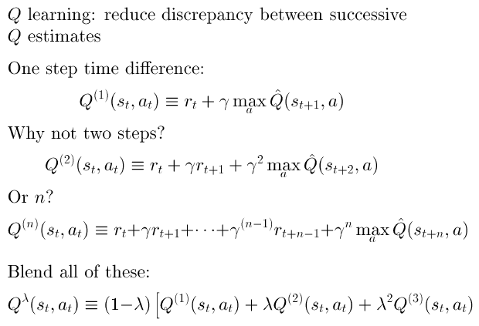
Temporal difference learning –
Update rule uses difference in utilities between successive states

Slide 47
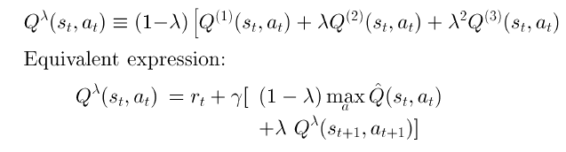
Temporal difference learning – the reinforcement is the difference between the ideal prediction and the current prediction

Slide 48
Ongoing research
Replace Q approximation table with Deep Neural Net, Bayes Net or other generalized classifier
Handle case where state only partially observable
Design optimal exploration strategies
Extend to continuous action, state
Learn and use delta function: S x A->S
Relationship to dynamic programming
Applications to dynamic markets (Stock, auctions, etc.)

Slide 49
Applications of Reinforcement Learning
Intelligent Trading Agents for Massively Multi-player Game Economies, John Reeder, Gita Sukthankar, M. Georgiopoulos, G. Anagnostopoulos
Learning to be a Bot: Reinforcement Learning in Shooter Games, Michelle McPartland, Marcus Gallagher
Agent Learning using Action-Dependent Learning Rates in Computer Role-Playing Games, Maria Cutumisu, Duane Szafron, Michael Bowling, Richard S. Sutton
Combining Model-Based Meta-Reasoning and Reinforcement Learning for Adapting Game-Playing Agents, Patrick Ulam, Joshua Jones, Ashok Goel

Slide 50
Demos
Demo - Control of an octopus arm using GPTD
http://videolectures.net/icml07_engel_demo/
Reinforcement Learning Repository at UMass, Amherst
http://www-all.cs.umass.edu/rlr/domains.html
Robot arm
http://iridia.ulb.ac.be/~fvandenb/qlearning/qlearning.html
Cat-Mouse applet
http://www.cse.unsw.edu.au/~cs9417ml/RL1/applet.html

Slide 51
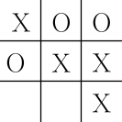
RL Example – Tic Tac Toe
How might we construct a player that will find the imperfections in its opponent's play and learn to maximize its chances of winning?

Slide 52
Tic Tac Toe – Minimax
Minimax algorithm assumes a particular way of playing by the opponent – an infallible opponent.
Minimax player would never reach a game state from which it could lose – even though this may be a valuable strategy.
Minimax will not scale to complex environments with large state space.

Slide 53
Tic Tac Toe – Dynamic Programming
Dynamic programming, can compute an optimal solution for any opponent, but requires as input a complete specification of that opponent – not realistic in many game playing settings.

Slide 54
Tic Tac Toe – Learning a Model
Assume that information is not available a priori for this problem, as it is not for the vast majority of problems of practical interest.
Such information can be estimated from experience playing many games against the opponent!
Learn a model of the opponent's behavior up to some level of confidence, and then apply dynamic programming to compute an optimal solution given the approximate opponent model.

Slide 55
Reinforcement Learning
How can an agent learn from success/failure, or reward/punishment to achieve a goal?
An agent can learn to play chess by supervised learning – given examples of game situations along with the best moves for those situations.
What if there is no friendly teacher providing examples for us to learn from, what can a poor agent do?
How can an agent learn from it’s own experiences?

Slide 56
Reinforcement Learning – Basic Idea
By trying random moves and observing the outcomes of its actions, an agent can eventually build a predictive model of its environment.
Given enough experience playing a game, an agent will know what the board will look like after it makes a given move and even how the opponent is likely to reply in a give situation.

Slide 57
RL– Step #1
Set up a table of numbers, one for each possible state of the game.
Each number will be the latest estimate of the probability of our winning from that state.
We treat this estimate as the state's value, and the whole table is the learned value function.
If state A has higher value than state B, or is considered "better" than state B, i.e., current estimate of the probability of winning from A is higher than it is from B.
Assuming we always play X’s, then for all states with three Xs in a row/diagonal the probability of winning is 1.
All states with three O’s in a row/diagonal, we loose.
Set the initial values of all the other states to 0.5, representing a guess that we have a 50% chance of winning.

Slide 58
RL– Step #2
Play many games against the opponent.
Select our moves by examining the states that would result from each of our possible moves (one for each blank space on the board) and look up their current values in the table.
Most of the time we move greedily, selecting the move that leads to the state with greatest value, that is, with the highest estimated probability of winning.
Occasionally, we select randomly from among the other moves instead: exploratory moves because they cause us to experience states that we might otherwise never see.

Slide 59
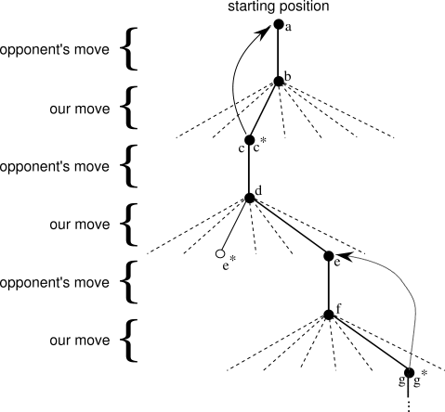

Slide 60
RL Tic-tac-toe – Step #3
While learning/playing, change the values of the states in which we find ourselves during the game.
Make them more accurate estimates of the probabilities of winning.
Do this, by "backing up" (discounting) the value of the state after each greedy move to the state before the move.
I.e., the current value of the earlier state is adjusted to be closer to the value of the later state.
This can be done by moving the earlier state's value a fraction of the way toward the value of the later state.

Slide 61

RL Tic-tac-toe –
Temporal Difference Learning
is the earning rate for convergence
is the temporal difference
Without the learning rate, the value function may not converge. Illustrates difference between evolutionary learning and policy based learning.
Demo Tic Tac Toe project!

Slide 62
RL Tic-tac-toe – Key features
Emphasis on learning while interacting with an environment.
There is a clear goal, and correct behavior requires planning or foresight that takes into account delayed effects of one's choices.
  The simple reinforcement learning player would learn to set up multi-move traps for a shortsighted opponent.
  Striking feature of the reinforcement learning solution that it can achieve the effects of planning and

Slide 63
RL Tic-tac-toe - Summary
TTT: relatively small, finite state set, whereas reinforcement learning can be used when the state set is very large, or even infinite.
Gerry Tesauro (1992, 1995) combined the algorithm described above with an artificial neural network to learn to play backgammon, which has approximately 10²⁰ states.
  With this many states it is impossible to experience more than a small fraction of the states.
  The neural network provides the ability to generalize from its experience.
  New states it selects, are based on information saved from similar states faced in the past, as determined by its network.
How well a reinforcement learning system can work in problems with such large state sets is intimately tied to how appropriately it can generalize from past experience.

Slide 64
RL Summary
Machine learning approach for understanding and automating goal-directed learning and decision-making.
Distinguished from other approaches by its emphasis on learning by the individual from direct interaction with its environment.
RL uses a formal framework defining the interaction between a learning agent and its environment (table) in terms of states, actions, and rewards.
Use of value functions distinguishes reinforcement learning methods from evolutionary methods that search directly in policy space guided by scalar evaluations of entire policies.

