Slide 1
M
Mobile Sales Analysis
Full dashboard review: Oct 2021 to Oct 2024
Time trends, brands, models, cities, payments and customers
Notes:
Three full years of mobile sales: 9 Oct 2021 to 8 Oct 2024.

Slide 2
The business at a glance
769M
19K
3,835
Total sales
Units sold
Transactions
40K
3.69 / 5
Average price per unit
Average customer rating
Period: 9 Oct 2021 to 8 Oct 2024 | 5 brands | 15 models | 19 cities
Notes:
Headline KPIs. Average price is per unit; average rating is out of 5.

Slide 3
Sales peaked in 2022 and have since levelled off
262M
2022: the best full year
-3.3%
2023 vs 2022; 2024 is flat at about 21M a month
Notes:
2021 covers only Oct-Dec and 2024 only Jan to 8 Oct. 2024 runs at about 21M a month, in line with 2023 (21.1M).

Slide 4
July, March and January are the peak months
69.6M
July is the strongest month
56.9M
September is the weakest: a window for offers
Notes:
Each month adds up the same calendar month across three years. February has fewer days, which partly explains its dip.

Slide 5
Saturday and Monday lead sales
114.6M
Saturday is the best day
9%
gap between Saturday and Wednesday, the weakest day
Notes:
Total sales by day of week across all three years.

Slide 6
Five brands share the market almost equally
21.0%
Apple leads, but only 2.3 points above Xiaomi
+12.9%
OnePlus grew fastest in 2023; Apple fell 13.7%
Notes:
Brand shares of total sales. Growth is 2023 vs 2022 (full years): OnePlus +12.9%, Samsung +3.5%, Vivo -0.2%, Apple -13.7%, Xiaomi -16.5%.

Slide 7
iPhone SE leads 15 closely matched models
59.6M
iPhone SE leads, followed by OnePlus Nord (57.9M)
44.7M
Redmi 9 is last; the gap is small, no single hit
Notes:
Only the top three models appear on the dashboard chart; this is the full ranking.

Slide 8
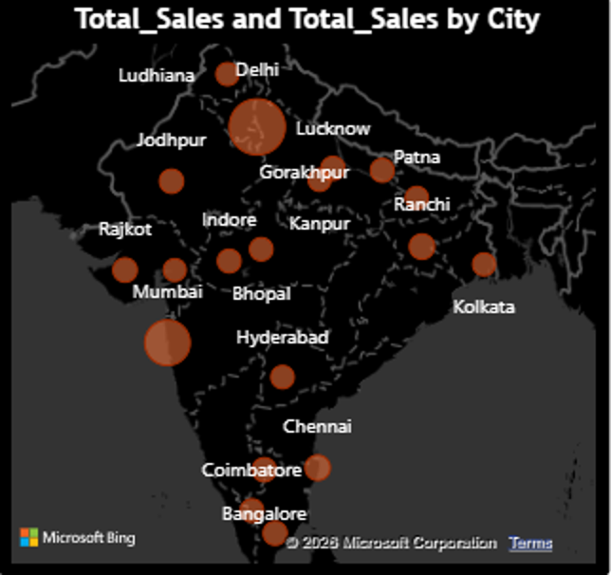
Delhi and Mumbai drive 43% of sales
Delhi: 203.9M (26.5%) | Mumbai: 127.2M (16.5%)
Notes:
19 cities in total. The other 17 average about 3.5% each.

Slide 9
Customers pay every way; UPI edges ahead
26.2%
UPI is first, with 1,011 transactions
2 pts
gap between UPI and Cash (24.1%)
Notes:
Share of total sales by payment method. Transactions: UPI 1,011, Debit 948, Credit 947, Cash 929.

Slide 10
Six in ten customers rate us 4 or 5 stars
60.8%
give 4 or 5 stars (2,331 reviews)
22.2%
give 1 or 2 stars (852 reviews): the area to fix
Notes:
Rating counts: 1 star 309, 2 stars 543, 3 stars 652, 4 stars 843, 5 stars 1,488. Average 3.69.

Slide 11
Customers aged 46 to 59 buy the most
32%
of sales come from customers aged 46-59
19%
from ages 18-25, the smallest group: a growth chance
Notes:
The 46-59 band spans 14 years versus 8-10 years for the others, which partly explains its size.

Slide 12
Key takeaways and actions
Growth has stalled
Two cities carry sales
Time the campaigns
2023 fell 3.3% from 2022; add new growth levers.
Delhi and Mumbai are 43%; push the other 17 cities.
July peaks at 69.6M and September dips to 56.9M; promote in September.
Back what is growing
Fix the low ratings
Reach younger buyers
OnePlus is up 12.9%; review Apple and Xiaomi declines.
22% of reviews are 1 or 2 stars; improve after-sales care.
Ages 18-25 give only 19% of sales; target them with UPI offers.

