Slide 1
PfPDG
Design and Calibration
John Henry
8/31/18

Slide 2
Model Description
Main Features:
Individual-based model
Discrete 1 Week Time Step
“Age of Infection”, Parasite Cohorts
Fever and Treatment Seeking
Immunity, acts on parasite densities
Notes:
IBM - heterogeneity

Slide 3
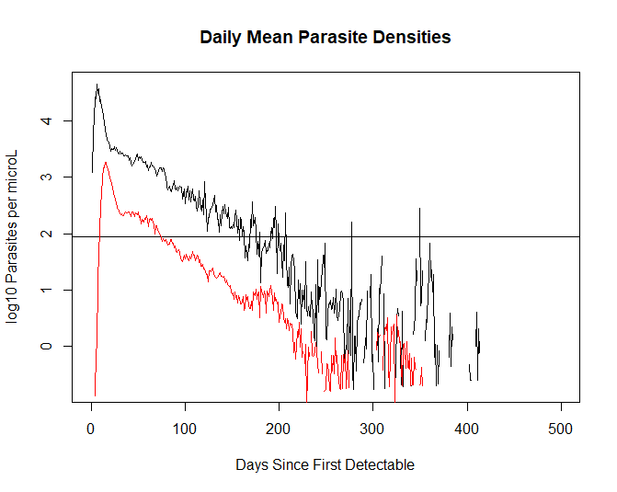
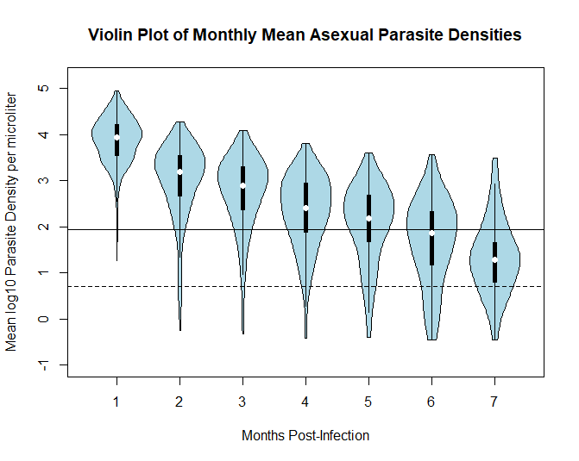
Motivation: Malaria Therapy Data

Slide 4
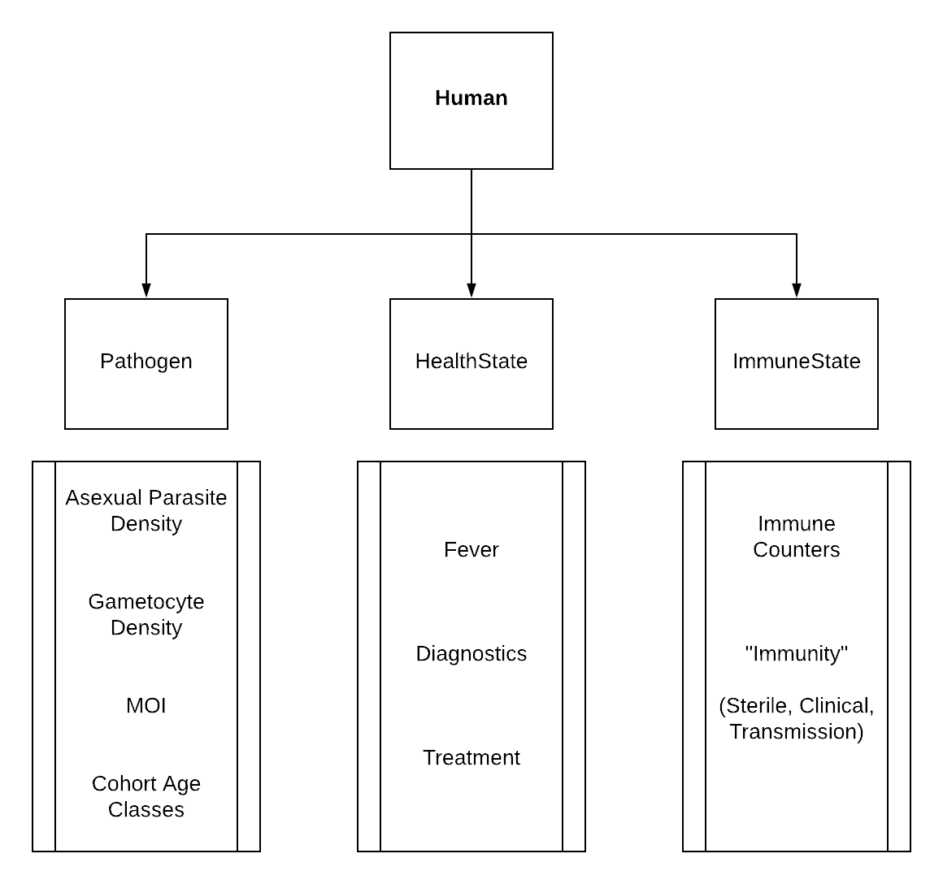
PDG Overview

Slide 5
PDG Overview

Slide 6
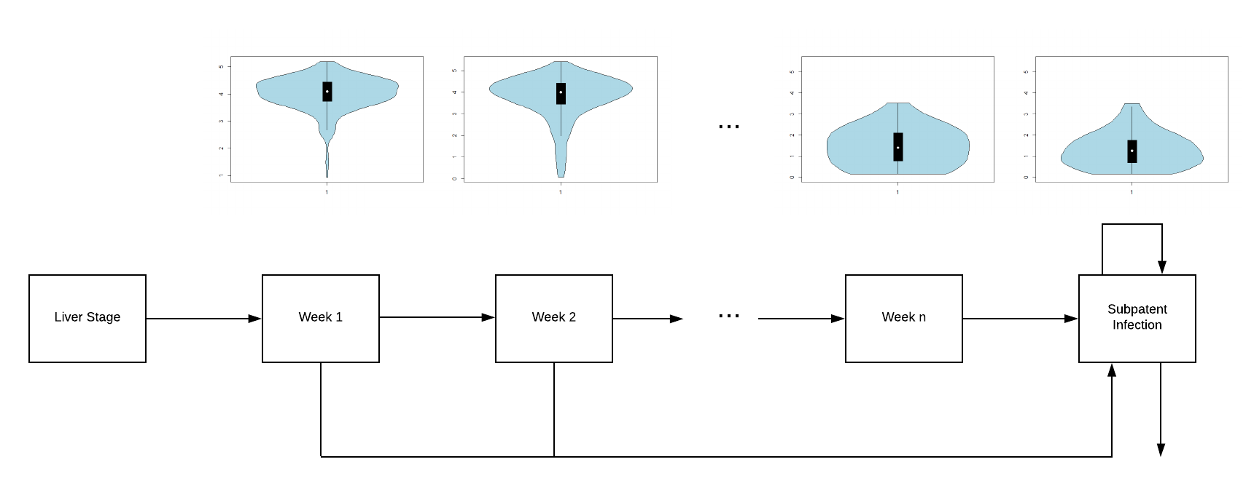
Progression Through AoI Compartments

Slide 7
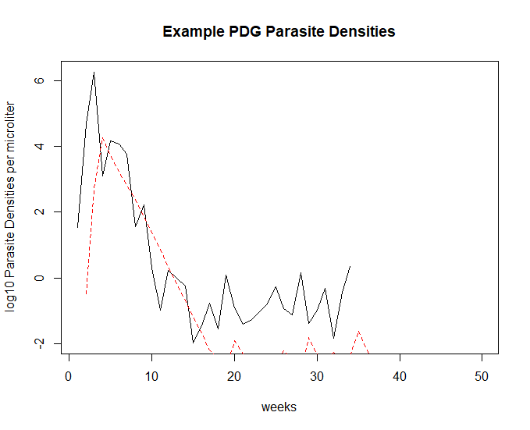
Example Infection Profile
“Tent-like” behavior
Hidden Markov component for low densities
Gametocytes based off of asexuals,
TE based off of gametocytes
Notes:
Older infections long tails

Slide 8
PDG Overview

Slide 9
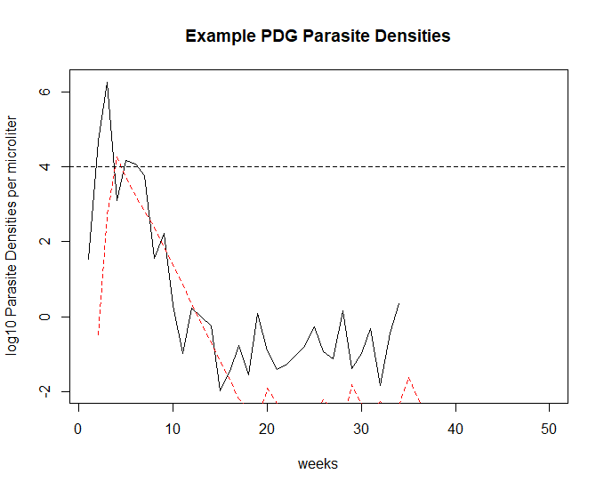
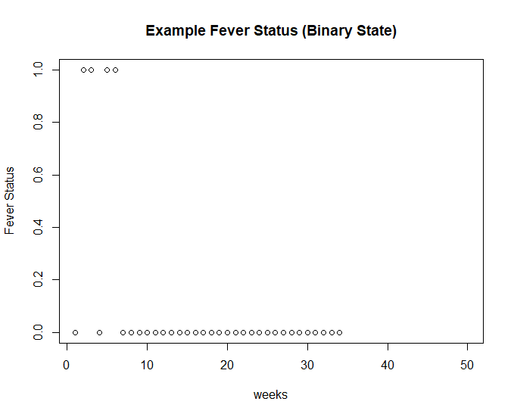
Health State: Fever and Treatment Seeking
“Fever Threshold” – binary fever state based off of asexual parasite densities
Fever primarily acts on health-seeking behavior

Slide 10
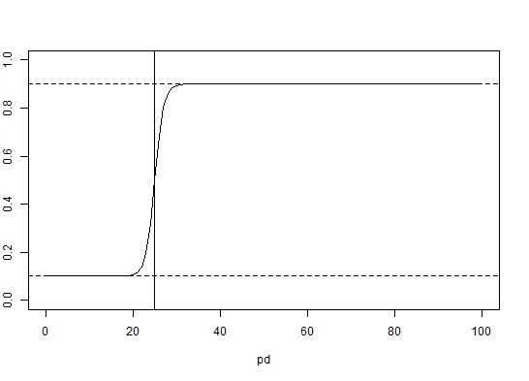
Health State: Clinical Aspects
Diagnostics – Bernoulli RV with parameter p(PD), monotonic wrt PD
Treatment – multinomial with parameters N=MOI, p(Drug), set dependent on inherent drug characteristics
PCR
Probability of Testing Positive
Parasites per microliter

Slide 11
PDG Overview

Slide 12
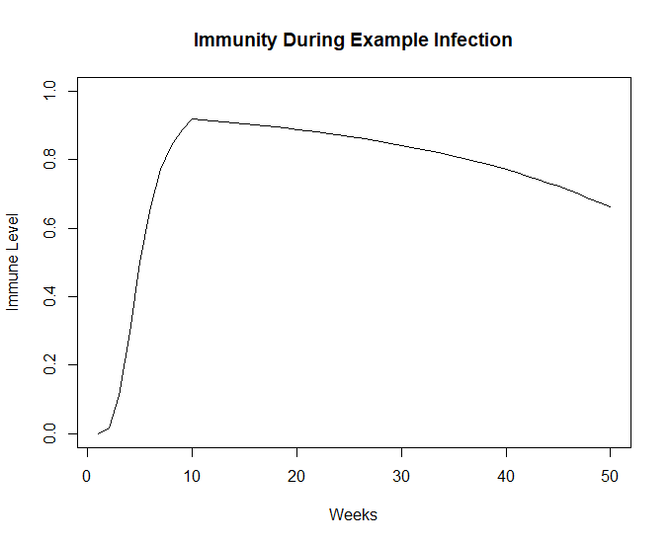
Immunity
Immune Counters based on thresholds – count up if above, down if below
Counters summed, converted to phenomenological “Immunity” (between 0 and 1)
Immunity acts to reduce parasite density and increase fever threshold

Slide 13
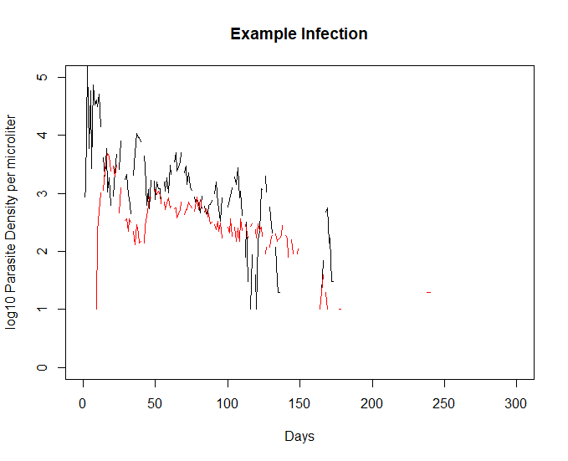
MT Data Exploration
+ PDG Calibration

Slide 14
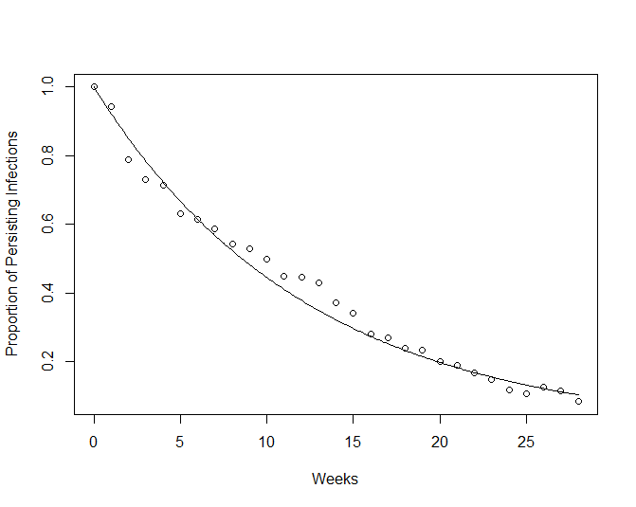
Duration of Infection

Slide 15
Longitudinal Densities

Slide 16
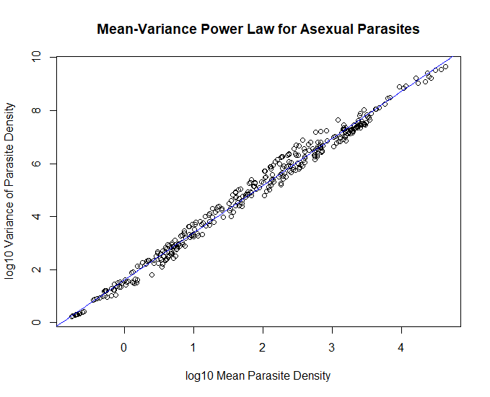
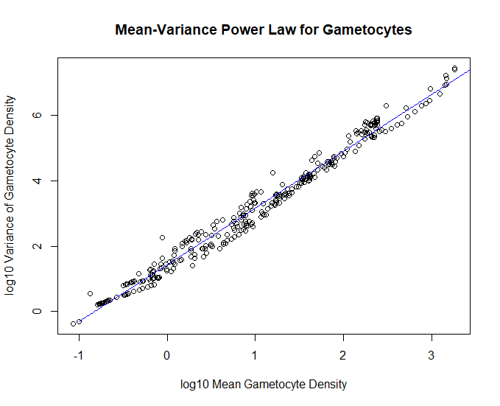
Mean-Variance Relationships

Slide 17
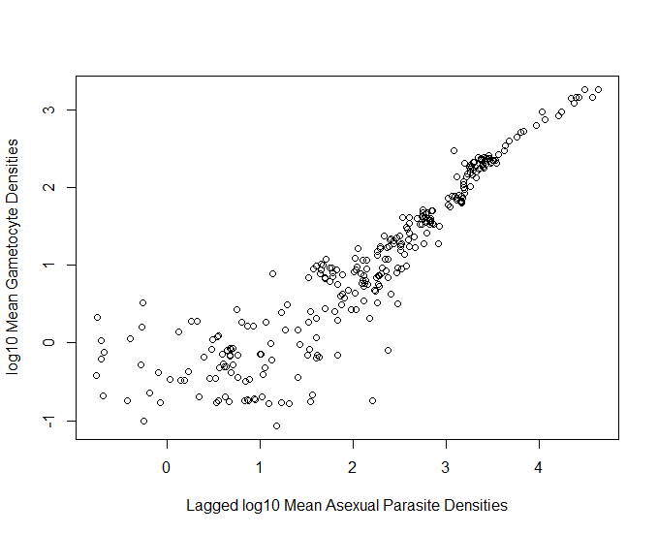
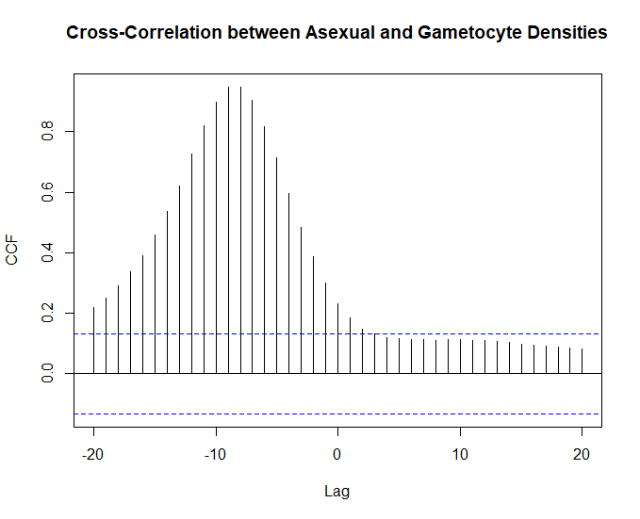
Gametocytogenesis

Slide 18

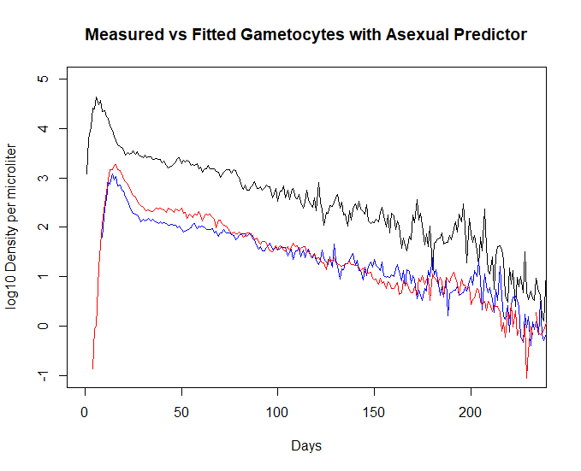
Simple Linear Fit

Slide 19
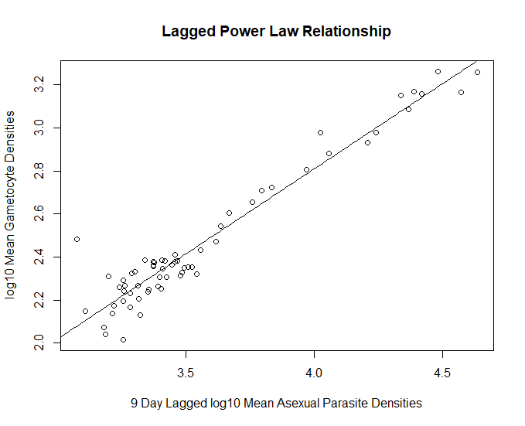
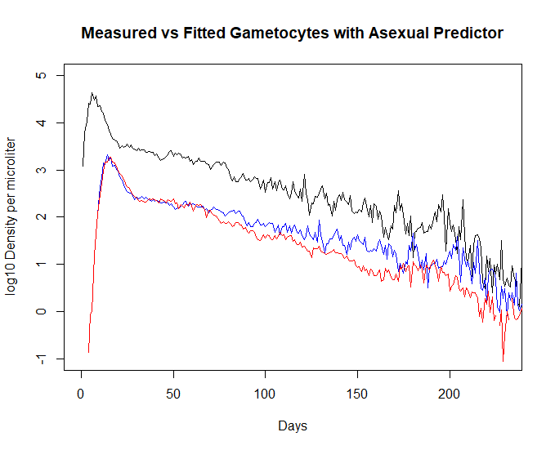
Restricted Data Fit

Slide 20
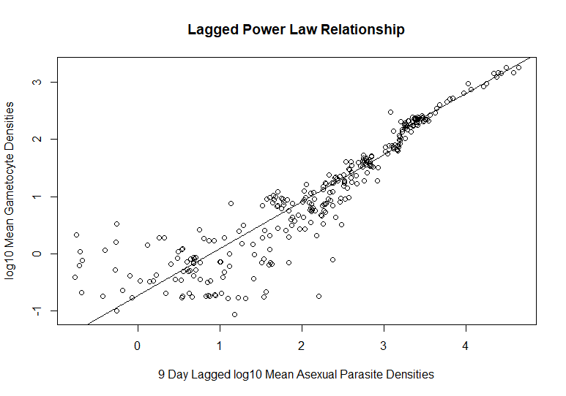
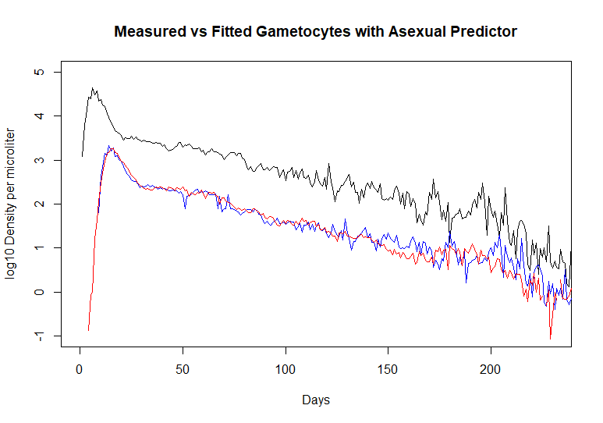
Piecewise Fit

Slide 21
Individual Vs Population
Analysis done on means and variances across individuals
Autocorrelation Correction? Is it necessary?

Slide 22
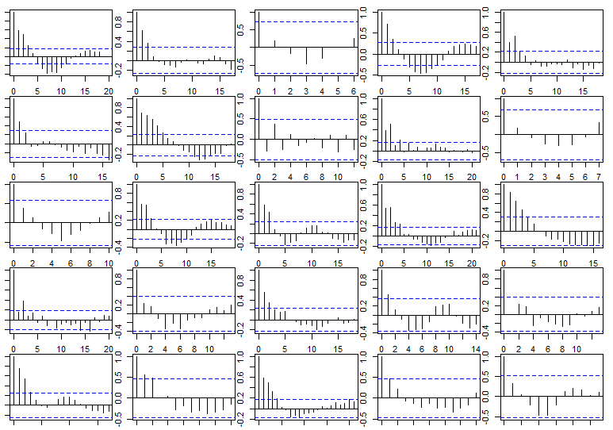
ACFs after Linear Fits to Densities

Slide 23
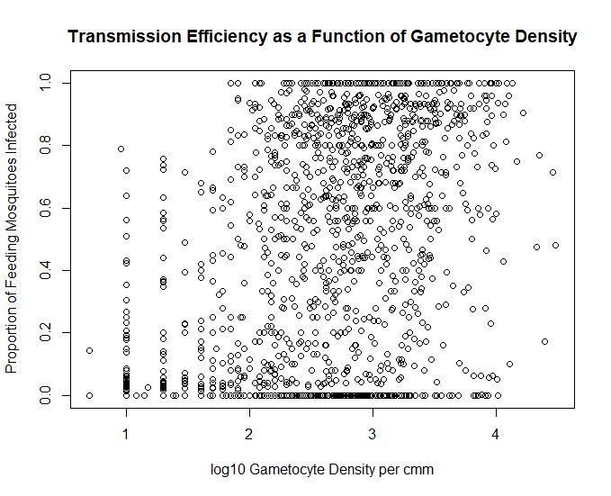
Transmission Efficiency
Main idea: transmission efficiency increases
with gametocyte density, but it’s noisy

Slide 24
Binned Densities

Slide 25
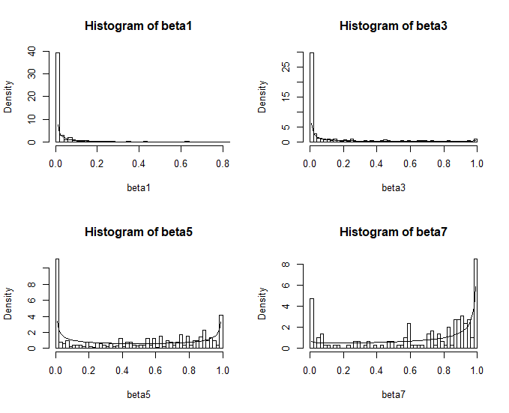
Beta Binomial
Given N susceptible bites in a week time step, the number of actual transmissions will follow beta-binomial
Probability monotonically increases with gametocyte density
Consider zero/one-inflation in future fit

Slide 26
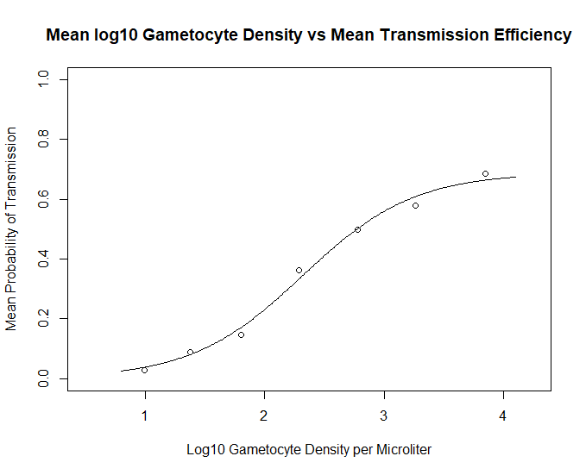
Saturating Effect on Transmission

Slide 27
Future Work
Fit distributions for use in PDG
Further analyze individual correlations/periodicity due to antigen switching
Calibrate fever and immunity, decide on number of counters & thresholds
Do these power law relationships extend to P. vivax? Will periodicity be a more prominent feature?

