Slide 1
IBM University Engagement Project Submission
“Exploring the Power of Agentic AI with IBM Granite and LangFlow”

Slide 2

Project Tile – Setu — AI-Powered Personalized Learning & Teacher Assistant Platform
Domain of Project – Education
Student Name | Recent Passport Photo | Email ID | Mobile number [WhatsApp]
Smit Dighe |  | smitdighe@gmail.com | 7863002486

Slide 3
Problem Statement -
Problem Statement: AI-Powered Personalized Learning & Teacher Assistant Platform
The Challenge
Many government and rural schools in Gujarat face diverse student learning levels, limited access to personalized learning resources, increasing administrative workload for teachers, and insufficient real-time insight into student progress. Teachers need AI-powered assistance to create engaging lesson plans, assess student performance, and support individual learners while reducing repetitive tasks.
The Objective
Build an Agentic AI solution that personalizes student learning experiences, assists teachers in lesson planning and content generation, automates assessment and feedback, identifies students requiring additional support, and provides actionable insights to improve learning outcomes — while remaining accessible to Gujarat's government and rural school context.

Slide 4
Proposed Solution -
Proposed Solution: Setu — AI Personalized Learning & Teacher Assistant Platform. Setu is a multi-agent AI platform built using IBM Bob, IBM Granite (via watsonx.ai), and IBM Cloud to deliver personalized, real-time learning support and teacher assistance. The system addresses challenges in student personalization, lesson planning, assessment, and progress tracking through an intelligent, modular architecture.
At its core, an Orchestrator routes requests to five specialized agents, each backed by IBM Granite for reasoning and content generation.
The system consists of five key agents: 1. Personalized Learning Recommendation Agent suggests adaptive learning paths and resources based on each student's pace and skill level. 2. AI Lesson Plan & Content Generation Agent generates differentiated (remedial / on-track / advanced) lesson plans, curriculum-ready, in minutes. 3. Student Performance & Learning Analytics Agent tracks skill distribution and risk scores per student/class, flagging at-risk students in real time. 4. Automated Assessment & Feedback Agent generates assessments and reviews student responses with instant feedback. 5. Teacher Assistant & Classroom Support Agent answers teacher queries about their class instantly, conversationally.
The solution includes a Teacher Dashboard (built with Next.js) that visualize class-wide analytics, at-risk students, and individual progress — with full English/Gujarati language support for accessibility in rural and government school settings. IBM Bob orchestrates agent development, watsonx.ai ensures scalable model deployment and governance, and Granite models power reasoning, content generation, and personalization.
Overall, this solution delivers an end-to-end intelligent teaching companion that reduces teacher workload and improves learning outcomes through personalization, automation, and real-time insight.

Slide 5
Technology Used
IBM Bob — compulsory dev-assistant tool used to build and orchestrate the multi-agent architecture.
IBM Granite model (via watsonx.ai) — for natural language understanding, reasoning, content generation, and personalization across all five agents.
IBM Cloud — provides the infrastructure to build, deploy, and scale Setu efficiently; includes watsonx.ai Runtime/Studio, Cloudant, and Cloud Object Storage for a reliable, secure, scalable environment.
IBM Cloudant — NoSQL database storing student/teacher/class data, lesson plans, assessments, and analytics.
IBM Cloud Object Storage (COS) — caches generated lesson plan content and printable materials.
IBM watsonx.ai — for Granite model deployment, prompt orchestration, and AI governance.
Next.js (TypeScript) — full-stack framework powering the Teacher and Student dashboards, API routes, and orchestrator logic.
NextAuth — role-based authentication for Teacher/Student/Admin access.

Slide 6
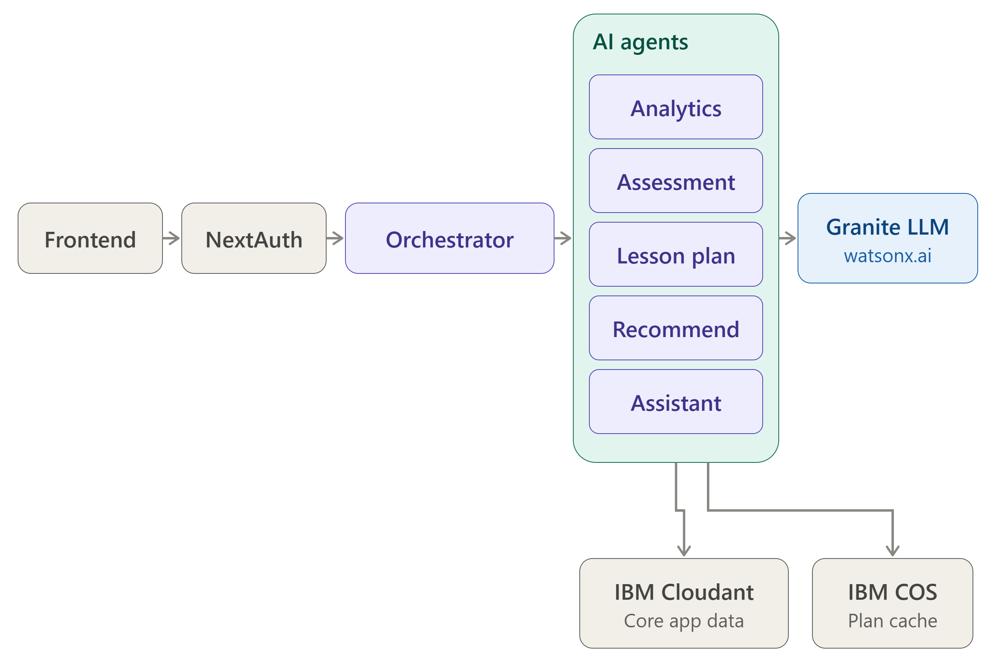
Architecture blueprint

Slide 7

Role of Agentic AI in Setu
Agentic AI lets Setu function as an intelligent, autonomous system rather than a simple chatbot. Using IBM watsonx.ai and IBM Granite models, it coordinates five specialized agents — Recommendation, Lesson Plan, Analytics, Assessment, and Teacher Assistant — through a shared orchestrator.
Each agent handles a specific task: recommending learning paths, generating differentiated lesson plans, tracking student risk and skill levels, creating/reviewing assessments, and answering teacher queries. This multi-agent approach delivers efficient, accurate, and targeted results.
Agentic AI brings context awareness (skill level, pace, risk score per student) and real-time adaptation, continuously updating recommendations as new data comes in. Agents share context through the orchestrator, enabling coordinated decisions across the platform.
Overall, Agentic AI makes Setu proactive and personalized — acting as a dedicated AI teaching assistant for every classroom and personal learning guide for every student.

Slide 8
Novelty and Uniqueness
Setu stands out by combining multi-agent AI, real-time analytics, and bilingual accessibility into a single intelligent platform for education.
Multi-Agent Intelligence — Instead of a single chatbot, five specialized agents collaborate to deliver personalized learning, lesson planning, and assessment support.
Differentiated Content Generation — Automatically generates three levels (remedial / on-track / advanced) of lesson content per topic, tailored to each student's actual skill level.
Real-Time Risk Detection — Continuously tracks student performance and pace to flag at-risk students early, before they fall further behind.
Bilingual by Design — Full English/Gujarati support across the entire platform, built for Gujarat's government and rural school context — not an afterthought.
Teacher-in-the-Loop Workflow — Generated assessments and feedback go through teacher review/approval before reaching students, keeping educators in control.
Conversational Classroom Support — Teacher Assistant agent answers class-specific queries instantly, reducing administrative overhead.
Scalable & Enterprise-Ready — Built on IBM watsonx.ai with IBM Granite models, IBM Cloudant, and Cloud Object Storage for reliability and governance.
This makes Setu a proactive, adaptive teaching companion — not just a content generator, but a system that closes the loop between personalization, generation, and real classroom outcomes.

Slide 9
Git Hub Link: https://github.com/smitdighe/setu-ibm

Slide 10
Future Scope
Attendance & Behavioral Data Integration — Setu can integrate with attendance systems to correlate attendance patterns with academic risk, giving teachers an earlier and more complete picture of which students need support before performance data alone would reveal it
Voice Input & Expanded Multilingual Support — Adding voice-based interaction for the Teacher Assistant and student dashboard would improve accessibility for low-literacy or low-typing-speed users, especially in rural classrooms. Expanding beyond English/Gujarati to other regional languages would further widen access across diverse school populations.
Parent & Admin Dashboards — Read-only parent/guardian views (student progress, risk score) and school-wide admin analytics rollups (across classes and teachers) would close the loop between classroom, home, and school administration — turning individual insights into institution-wide visibility.
·
·
·

Slide 11
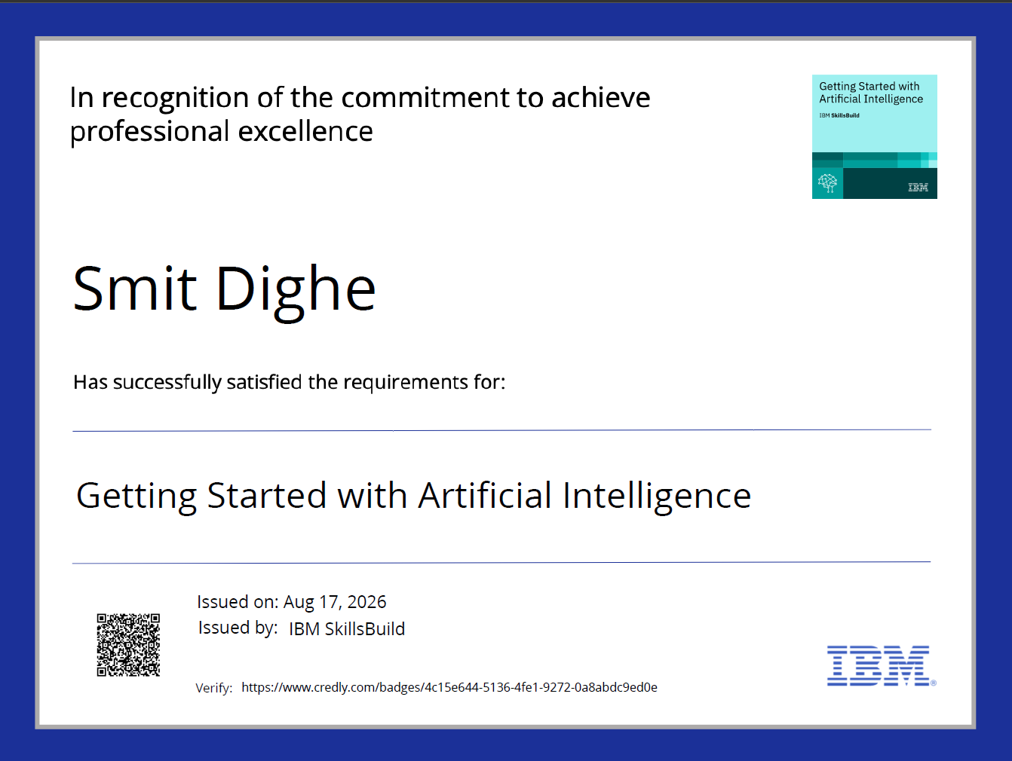
Certificates Earned:

Slide 12
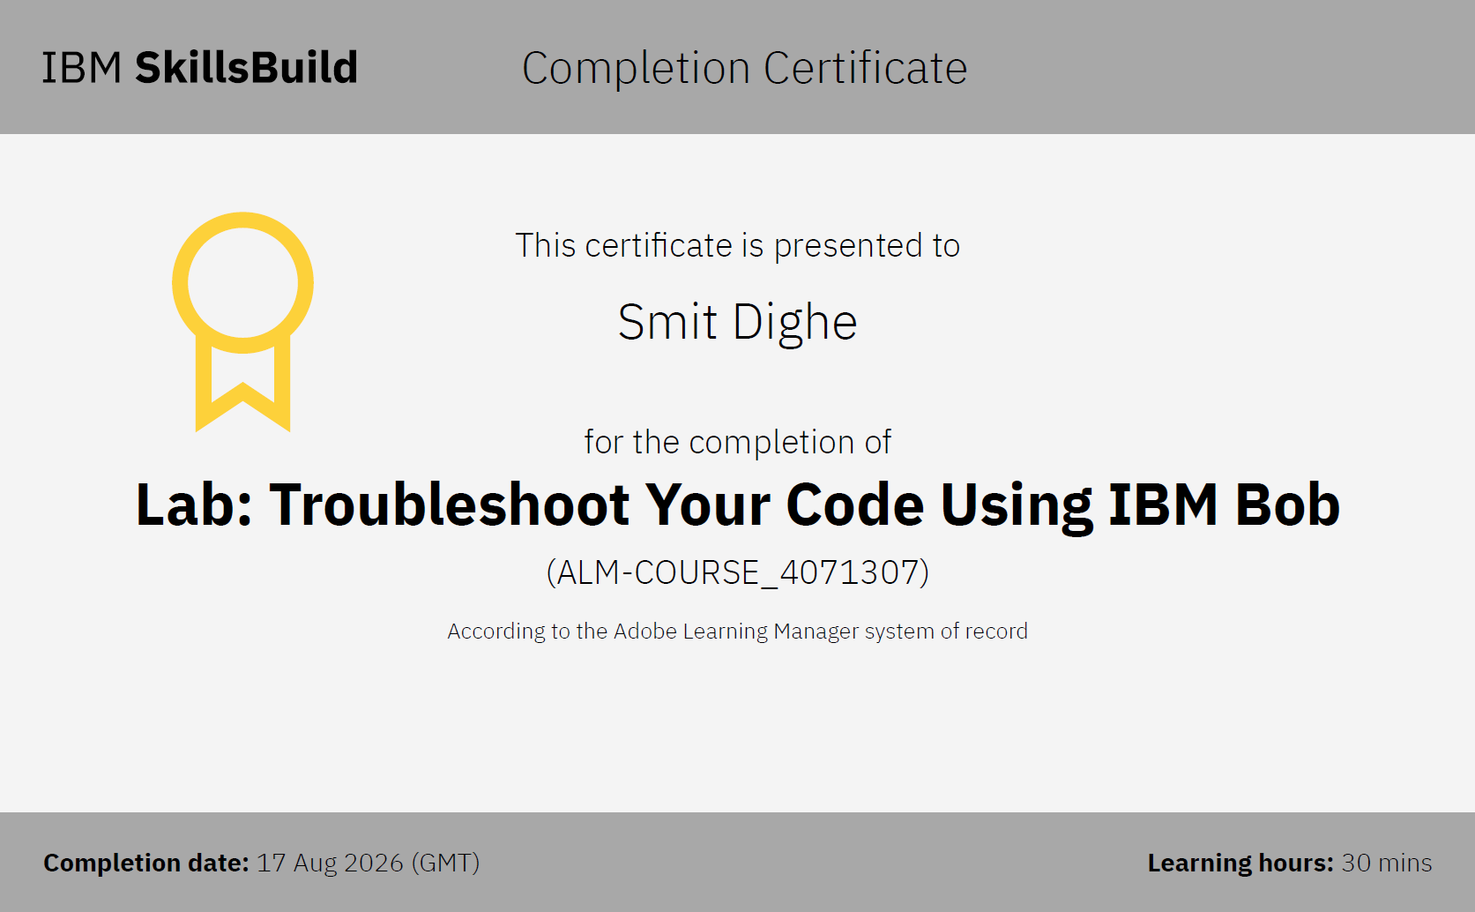
Certificates Earned:​

Slide 13
Thank You

