Slide 1
The Property Market Has Realism in the Market entirely set in yet?
June 2012

Slide 2
Aspiration/Expectation Mismatches through cycles
Introduction phase – aspirations/expectations lag reality
Growth Phase – aspirations/expectations accelerating but still lagging reality
Mature Phase – Aspirations/expectations catching up with “slowing” reality
Decline Phase – Aspirations/Expectations “Ahead” of “Weakening” Reality = TENSION

Slide 3
House price slightly up recently, but don’t expect wonders yet

Slide 4
House price slightly up recently, but don’t expect wonders yet

Slide 5
25% “Over-valued”??? – Pick a Number – but further real price decline likely

Slide 6
Urbanisation continues to drive urban land scarcity higher

Slide 7
The Big Build gathers steam, but still too slow
The Big Build has many years to run
2010 started the infrastructure delivery ball rolling
Delivery is too little too late but it is gathering steam
Somebody has to pay, but in the end it will enhance economic growth

Slide 8
Urban adjustment to land scarcity (and rates and tariff hikes?)

Slide 9
Urban adjustment to land scarcity (and rates and tariff hikes?)

Slide 10
Urban adjustment to land scarcity and declining fertility rates

Slide 11
Urban adjustment to land scarcity

Slide 12
SA Long term economic growth rate trends

Slide 13
Long term consumer price inflation and short term rates trends

Slide 14
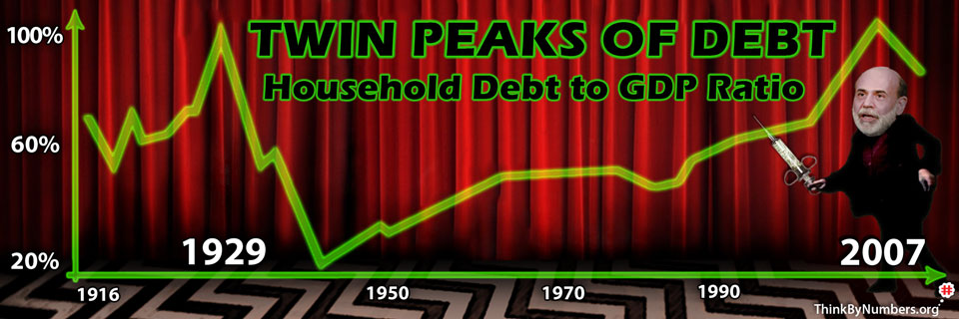
US Household De-Leveraging may have years to run

Slide 15
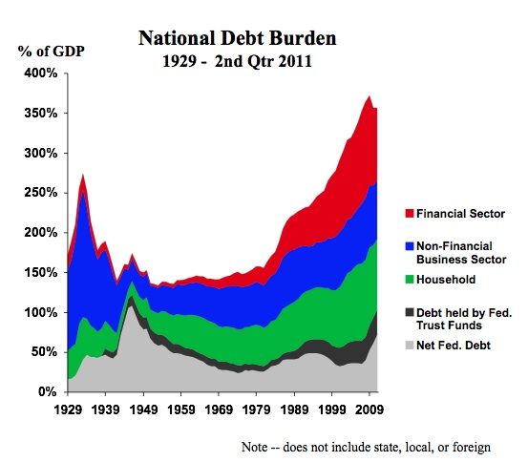
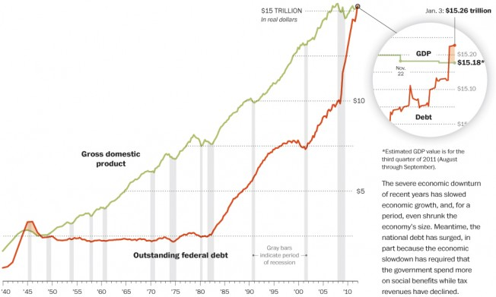
In the mean time we live in hope that US Govt borrow and Fed printing will keep economy going

Slide 16
US Current Account Deficit

Slide 17
Inflation - mild turn for the better, the benefit of a slowing economy

Slide 18
Global Economic Growth Broad Slowdown expected, risks still high
UN – 2.6% GDP Growth forecast in 2012, down from 4% in 2010, and 2.8% in 2011 (Downward revision)
World Bank – 2.5% GDP growth in 2012, down from 4.1% in 2010 and 2.7% in 2011 (Downward Revision)
IMF - “Slowing Growth, Rising Risks”. 4% GDP growth forecast in 2012, but downward revision set to occur, after 4% in 2011 and 5.1% in 2010
IMF - Some slowing in 2011 had been expected due to end in inventory replenishment cycle. Rise in oil prices and Japan Tsunami also negative events in 2011. But concerns have increased due to “lack of global re-balancing”, “increased fiscal and financial uncertainty” (concerns expanded from Europe to Japan and US), and overheating in some emerging economies
SARB – CPI inflation peak in Q2 2012, but thereafter move back to the target range,
2.9% GDP growth forecast in 2012, down from 3.1% in 2011
JL – house price growth to average around 6%, slightly better than average for 2011 due to good start to 2012, but down from where we are currently - based on assumption of reasonable though slower economic growth. Recession expected to equal nominal price decline

Slide 19
Mild improvement recently, but FNB Valuers point to Market Imbalance continuing

Slide 20
Residential Development Activity “settling” at lower levels - development sector battles to compete with existing mkt

Slide 21
Residential market balance shows no improvement

Slide 22
Residential market balance shows no improvement

Slide 23
Financial Pressure-related selling still significant

Slide 24
Debt-to-disposable income Ratio still very high for a bottom turning point

Slide 25
Basics In, Luxuries Out

Slide 26
Basics In, Luxuries Out

Slide 27
Rental Market Ticks Over, but subdued by low interest rates and strong supply

Slide 28
Low buy-to-let buying gradually improves rental market supply-demand balance

Slide 29
Agents not anticipating buy-to-let fireworks any time soon

Slide 30
Housing yields may have risen, but still seem to be low

Slide 31
Renewed 1st Time buyer interest a “drain” on the rental market for now

Slide 32
Household balance sheet still fragile, not allowing major investment in property

Slide 33
Key Focal Points
Affordability is king – market adapting to financial pressure and huge municipal and rates cost increases – Relatively good for the affordable end but bad for the luxury end
Size counts – far smaller is going to be far better
Going Green – How?
(Green building one of the fastest growing economic sector - according to Wackhead at least)
Transport cost increases – looming
Location near to work place, important facilities, open space
Weak market and financial pressure = Need for reliable information and expertise
Gradual rise in yields as rental stock gradually becomes more constrained

Slide 34
Follow our Research on: http://blog.propertyleader.co.za Research mailing list: propertybarometer@fnb.co.za John Loos on Twitter: @john_loos

