Slide 1





Slide 2

What is PayProp?
PayProp merges online banking with traditional property management and accounting software into a single seamless process
PayProp operates within an audited trust environment that offers compliance and peace of mind

Slide 3














Who is using PayProp?
600+ agencies with 1 500 active users
65 000 properties listed, 50 000 active leases
150 000 transactions processed monthly

Slide 4
Trends and Issues in the Rental Market

Slide 5
Broad Trends in the Rental Market
More agencies are starting rental portfolio’s because they offer annuity income
More competition between agencies to stand out of the crowd
The Rental Industry has received a lot of bad press recently
Tenants are becoming more vigilant and want access to information
The EAAB is gearing up for more audits – out of the 262 done so far
73% primary trust account contraventions
40% improper maintenance of accounting records
32% not all agents issued with FFC’s
27% principals not issued with FFC’s
26% agency not issued with FFC and operating illegally
26% insufficient accounting records for trust accounts
25% improper administration of trust accounts
Franchisors are becoming short on patience because of the brand damage done
Some franchisors are instituting criminal charges against errant franchisees
The legal environment is becoming stricter
Increased audit requirements, FICA registration etc.

Slide 6
So……
With all this happening around us, can you still afford to see your rental portfolio as an ‘add-on’ to your business?
The morning coffee with your rental agent might make you feel like you are ‘on top of it all’ but consider the following:
The average rental portfolio generates 400 financial transactions and 700 accounting data entries over a 7 day period every month
How do you ensure that everything is happening the way that it should?

Slide 7
Checks and Balances

Slide 8
Any rental agency’s biggest concern should be misrepresentation of financial data
You are entrusted with other people’s money and it is CRUCIAL that the sum of the transactions that you process adds up to the balance in your sect 32(1) trust account at the end of the month
You are also the custodian of the tenant’s deposit money and it is CRUCIAL that the sum of the deposits handed to you equals the balance in your sect 32(2) trust account at all times
It sounds simple enough – but how does it happen that things go wrong?
Two basic categories of fraud/misrepresentation
Deposit
Transactional
Some of it is intentional and some of it is accidental – the law does not differentiate

Slide 9
Deposit Issues
“Rolling deposits”
If you have R100 000 on deposit for 10 tenants, but only 2 tenants that will call their deposit this month, there is an R80 000 ‘float’ that won’t be immediately missed
Legally the issue is not necessarily what the balance is, but if there have been unauthorised transactions
Fictitious/erroneous record keeping
Records are left off the control spreadsheet so that it matches the bank balance (partial record keeping)
Loan accounts
The owner needs to paid NOW – let’s take it from the deposit and refund it later
32 day notice accounts often cause the reverse
Split deposit accounts
Different deposit accounts means that you have multiple points to control – some that you may not even know of

Slide 10
Transactional Issues
Phantom beneficiaries
Often one account number with multiple descriptions
Debit & Credit notes
Confusion creates opportunity for errors/omissions to go un-noticed
Cash receipts in the office
Written receipts either altered or issued from duplicate receipt book
Pre-emptive commission taking
The tenant still has to pay, but I’m taking the commission so long
Duplicate Rental Book
Using your office infrastructure to run an own rental company on the side
Who is trading under your FFC?

Slide 11
How do I prevent this from happening to me?

Slide 12
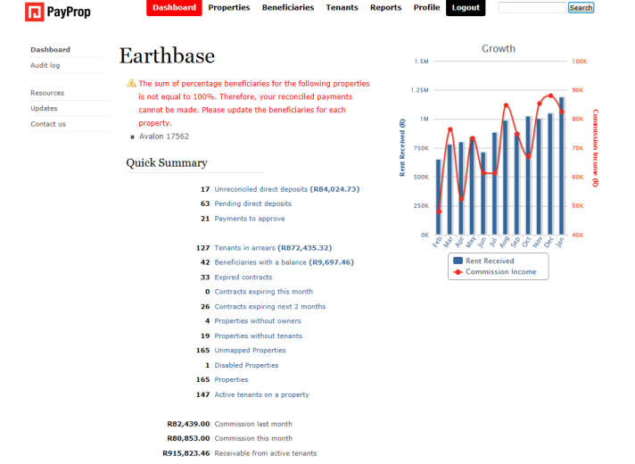
Get a high level view first
At first glance – do the numbers stack up?
You need to set yourself a few key parameters that you are constantly up to date with:
Tenants in arrears
Deposits released
Contracts expiring
Rental invoiced vs. commission collected

Slide 13
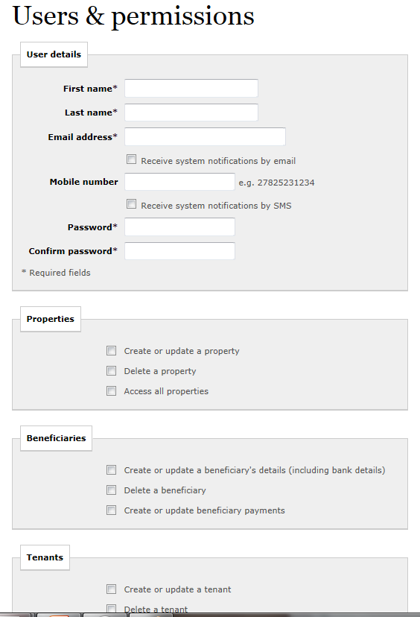
Set up your user permissions correctly
Regularly review who in your office has what level of transactional access (include ex-employees!)
Understand the transactional risk implications of each level of access
Implement a two-stage approval process immediately

Slide 14
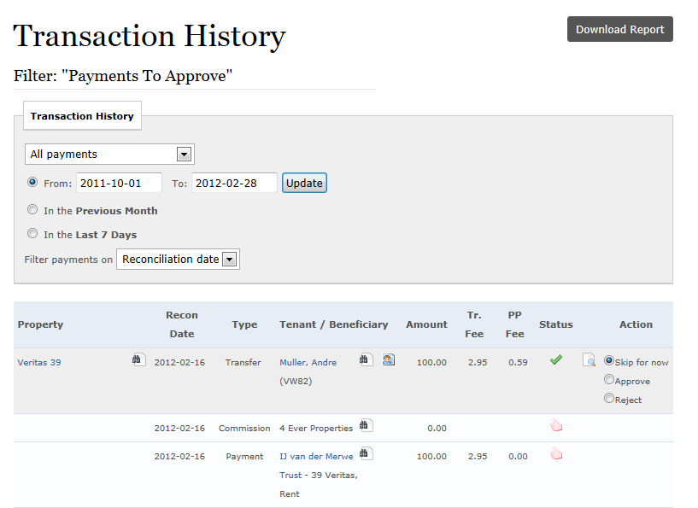
Understand what you are approving
When you are in EFT mode, how much attention do you pay to the full transaction chain?
ALWAYS approve an expense in the context of the full rental transaction
ALWAYS ensure that the corresponding rental income has been received BEFORE you approve the payment

Slide 15
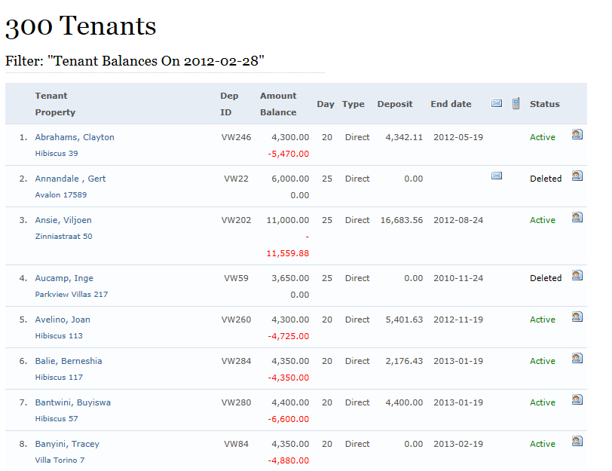
Check Tenant Balances
Basic risk analysis:
What was the last invoice value?
What is the current outstanding balance?
What is the value of deposits held?
You need to see (and manage) possible tenant problems before they get out of hand

Slide 16
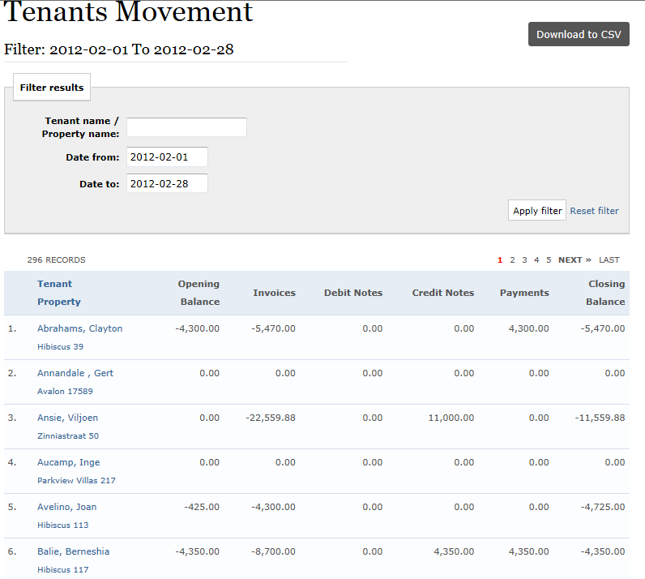
Even better, look at tenant movement
How the tenant gets to a positive balance at the end of the month is often just as important
Use a service such as TPN to reward good tenant payment behaviour and discourage bad behaviour

Slide 17
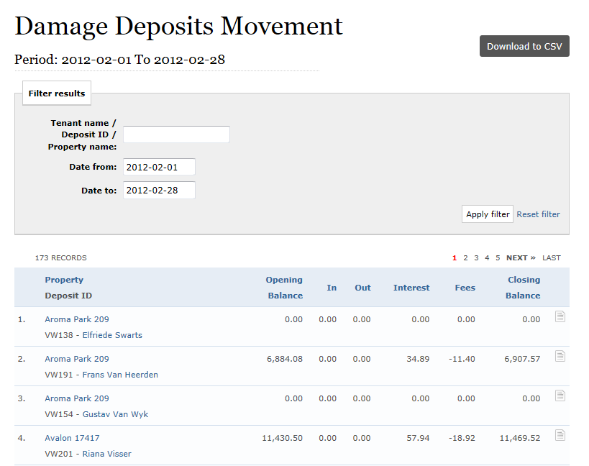
Check damage deposit movement
Matching balances are important, but the devil is in the detail
Ensure that you can easily and quickly spot transactions involving deposit money
Stop any form of ‘deposit borrowing’

Slide 18
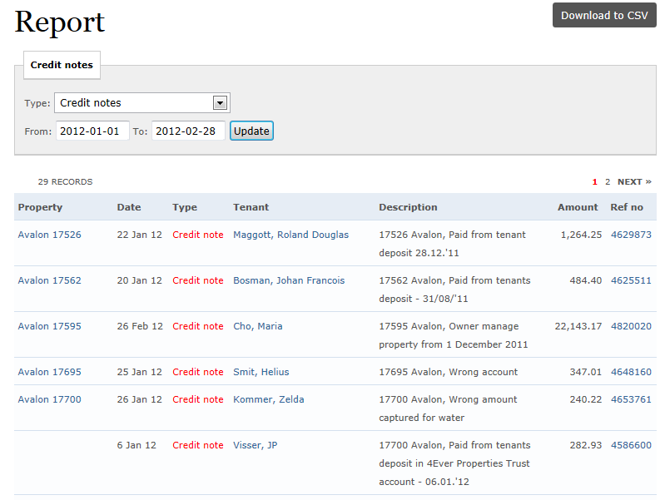
Do you understand why credit notes were issued?
Debit and credit notes alter account balances and should be checked in the same way as any other rental transaction

Slide 19
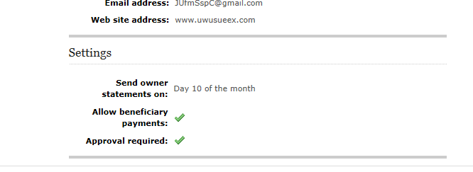
Open communication
You are obliged to provide your tenants with statements of financial transactions
Responsible agents will inform their landlords of the financial standing of the asset they are managing
Ensure that you are able to send accurate and detailed transactional statements to all parties involved

Slide 20
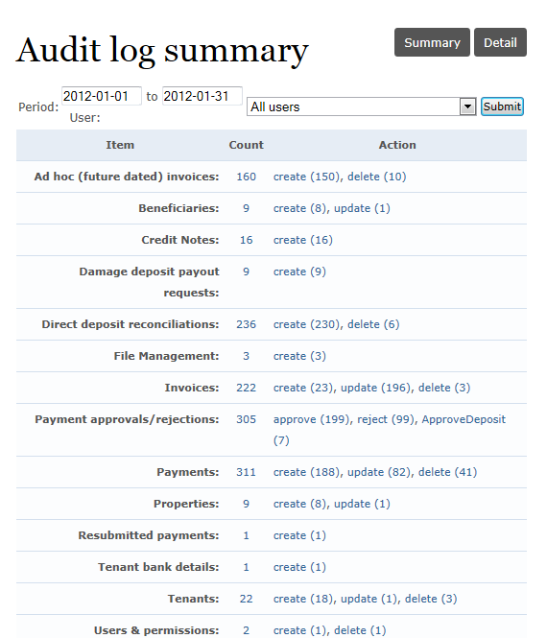
Who has done what recently?
When things do go wrong, how do you know who did what?
Ensure that you only have ONE approver
Ensure that any other transactions/amendments can be traced back to the actual person that did it
Sometimes it takes a while for problems to surface, so make sure that you have data over an extended period of time

Slide 21
Be safe, you are responsible!

